Slide 1
COS 212
Priority Queues
(Heaps)
Chapter 6

Slide 2
Outline
Priority queue definition
Binary heap definition
Min VS max heaps
Heap implementation with arrays
Enqueuing and dequeuing
Converting an arbitrary array to a heap (“heapifying”)

Slide 3

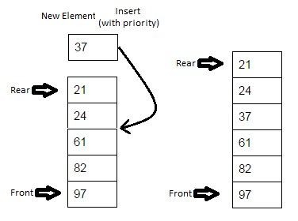
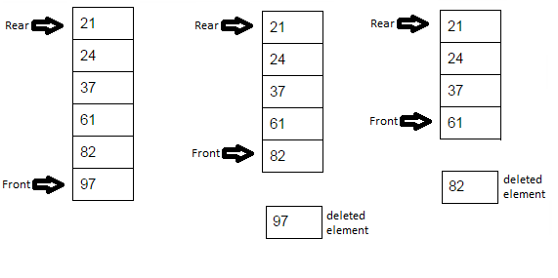
Priority Queue
Priority queues:
  Items are processed on first-in-first-out basis (FIFO)
  Every item in the queue has a priority tag
  Items of higher priority are pushed in front of the items of lower priority
  Items with the highest priority will always be processed first
How would you implement such a structure?
Using linear ADT: O(n) is the best performance we can get

Slide 4
Binary Heaps
Binary Search Tree
Binary Heap
el
el
< el
≥ el
≤ el
≤ el
A binary heap is another kind of binary tree
A binary tree is a max heap if it satisfies the following two properties:
  The value of each node is greater than or equal to the values stored in each of its children
  The tree is complete (perfectly balanced, leaves on a max of two levels, no “gaps”) and the leaves in the last level are all in the leftmost positions.

Slide 5
Binary Heaps
Examples:
Max Heap
Min Heap
20
10 15
7 3 7 9
6 5
4
10 5
17 13 7 9
26 45
20
10 15
7 3 7 8
6 5
20
10 15
7 3 7 18
6 5
Not a heap: violates (1)
Not a heap: violates (2)

Slide 6
Binary Heaps
Heaps make great priority queues!
Access smallest/largest element:
  Max heap provides immediate O(1) access to the largest element
  Min heap provides immediate O(1) access to the smallest element
Root item is the front of the queue
Tree structure – path to every leaf is lg n
So, we should implement binary heaps as binary trees… right?
97
82 61
37 24 21

Slide 7
Binary Heaps: Implementation
Heaps are typically
implemented using arrays
Successive nodes are stored in
breadth-first manner
parent index | left child | right child
0 | 1 | 2
1 | 3 | 4
20
10 15
7 3 7 10
6 5
2 | 5 | 6
3 | 7 | 8
…. | …. | ….
i
2∙i +1
2∙i +2
0 | 1 | 2 | 3 | 4 | 5 | 6 | 7 | 8
20 | 10 | 15 | 7 | 3 | 7 | 10 | 6 | 5

Slide 8
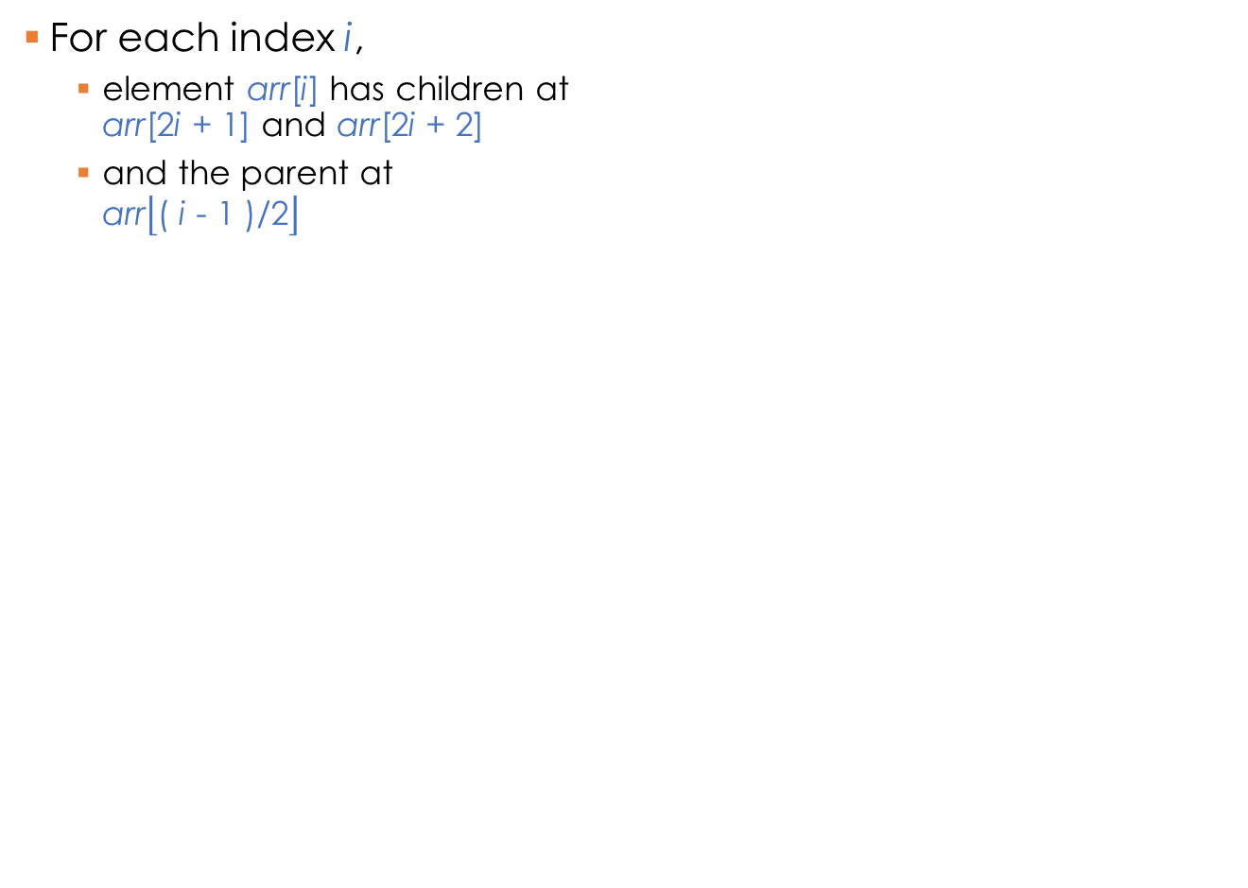
Binary Heaps: Implementation
For each index i,
  element arr[i] has children at
  arr[2i + 1] and arr[2i + 2]
  and the parent at
  arr$\left\lfloor \text{( }\text{i}\text{ − 1 )/2}\right\rfloor$
parent | left child | right child
0 | 1 | 2
1 | 3 | 4
20
10 15
7 3 7 10
6 5
2 | 5 | 6
3 | 7 | 8
…. | …. | ….
i
2∙i +1
2∙i +2
0 | 1 | 2 | 3 | 4 | 5 | 6 | 7 | 8
No need to store links/tree structure!
20 | 10 | 15 | 7 | 3 | 7 | 10 | 6 | 5

Slide 9
Heaps as Priority Queues: Enqueuing
Enqueue:
  Add an element
  Make sure the heap properties are preserved
What’s the best place to add an element?
  Leftmost leaf position
  Why? Because property (2) must be preserved
Enqueue (max heap):
  Add element to the open leftmost leaf position
  Swap the element with its parent while
  element > parent && element != root
20
10 15
7 3 7 9
6 5
heapEnqueue(el)
put el at the end of heap;
while el is not in the root and el > parent(el)
swap el with its parent;
X

Slide 10
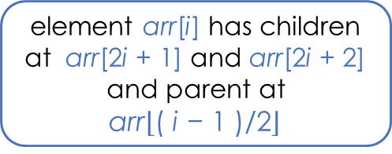
Heaps: Enqueuing
  element arr[i] has children at arr[2i + 1] and arr[2i + 2] and parent at
  arr$\left\lfloor \text{( }\text{i}\text{ − 1 )/2}\right\rfloor$
4
6
3
7
empty
4
4
6
6
4
6
4 3
6
4 3
7
6
7 3
4
4
4 | 6
6 | 4
6 | 4 | 3
6 | 4 | 3 | 7
6 | 7 | 3 | 4
5
4
7
6 3
4
7
6 3
4 5
7
6 3
4 5 4
7
6 4
4 5 3
7 | 6 | 3 | 4
7 | 6 | 3 | 4 | 5
7 | 6 | 3 | 4 | 5 | 4
7 | 6 | 4 | 4 | 5 | 3

Slide 11
Heaps as Priority Queues: Dequeuing
Dequeue:
  Remove root (it has the highest priority!)
  Make sure the heap properties are preserved
How do we put the two resulting heaps
back together?
  Preserve property (2): take the rightmost leaf from the lowest level, and make it the new root
  Preserve property (1): iteratively swap the p=root with its largest child while (p < largest child)
Result:
  Extract root
  Replace root with the rightmost leaf of the
  last level
  Propagate the new root downwards till
  heap properties are satisfied
20
10 15
7 3 7 9
6 5
10 15
7 3 7 9
6 5

Slide 12
Heaps as Priority Queues: Dequeuing
heapDequeue()
extract the element from the root;
put the element from the last leaf in its place;
remove the last leaf;
// both subtrees of the root are heaps
p = the root;
while p is not a leaf and p < any of its children
swap p with the larger child;
20
10 15
7 3 7 9
6 5
5
10 15
7 3 7 9
6

Slide 13
Heaps as Priority Queues: Dequeuing
7
6 4
4 5 3
6 4
4 5 3
3
6 4
4 5
6
3 4
4 5
6
5 4
4 3
7 | 6 | 4 | 4 | 5 | 3
7 | 6 | 4 | 4 | 5 | 3
3 | 6 | 4 | 4 | 5
6 | 3 | 4 | 4 | 5
6 | 5 | 4 | 4 | 3
5 4
4 3
3
5 4
4
5
3 4
4
5
4 4
3
6 | 5 | 4 | 4 | 3
3 | 5 | 4 | 4
5 | 3 | 4 | 4
5 | 4 | 4 | 3

Slide 14
Heaps as Priority Queues: Dequeuing
5
4 4
3
4 4
3
3
4 4
4
3 4
3 4
5 | 4 | 4 | 3
5 | 4 | 4 | 3
3 | 4 | 4
4 | 3 | 4
4 | 3 | 4
4
3
3
3
4 | 3
4 | 3
3

Slide 15
“Heapifying” arrays
Given an array of data, how do you convert it into a heap?
  Create an empty heap
  Insert elements from the array to the heap one by one
Efficiency:
  To insert n elements: n insertions
  To insert a single element: maximum of lg n “percolations”
  Thus: O(n lg n)
Is there a better way?
Floyd’s algorithm:
  Bottom-up: Pretend the given array is already a heap
  Find the last non-leaf node p, set start=p
  Enforce heap property (1) by moving p down as far as necessary
  Go to previous non-leaf node
  Repeat while p >= 0 (move from last non-leaf to root)

Slide 16
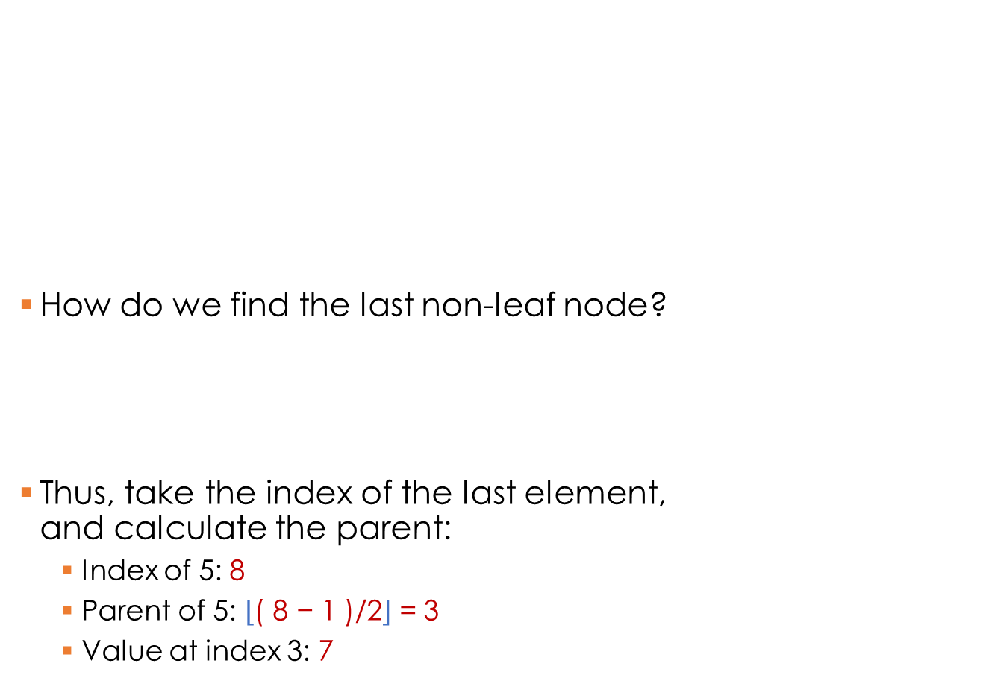
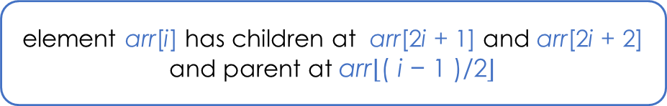
“Heapifying” arrays
How do we find the last non-leaf node?
Thus, take the index of the last element,
and calculate the parent:
  Index of 5: 8
  Parent of 5: $\left\lfloor \text{( 8 − 1 )/2}\right\rfloor$ = 3
  Value at index 3: 7
FloydAlgorithm(data[])
i = index of the last nonleaf
while i >= 0
p = data[i];
while p is not a leaf and p < any of its children
swap p with the larger child;
i = i--; // index of the previous non-leaf
20
10 15
7 3 7 9
6 5
  element arr[i] has children at arr[2i + 1] and arr[2i + 2] and parent at arr$\left\lfloor \text{( }\text{i}\text{ − 1 )/2}\right\rfloor$
20 | 10 | 15 | 7 | 3 | 7 | 9 | 6 | 5
0 | 1 | 2 | 3 | 4 | 5 | 6 | 7 | 8

Slide 17
“Heapifying” arrays: Floyd’s Algorithm
4
6 3
7 5 4
7 5 4
Efficiency:
O(n)
6
3
7 5
4
3
That’s better than
O(n lg n)!
4 | 6 | 3 | 7 | 5 | 4
4 | 6 | 3 | 7 | 5 | 4
4 | 6 | 4 | 7 | 5 | 3
last nonleaf
4
7
4 4
6 5 3
7
6 4
4 5 3
7
6 5
4
3
4 | 7 | 4 | 6 | 5 | 3
7 | 4 | 4 | 6 | 5 | 3
7 | 6 | 4 | 4 | 5 | 3

Slide 18
Summary
Binary Heaps:
  Special case of a binary tree
  Max heap: parent is larger than its children
  Min heap: parent is smaller than its children
Applications:
  Priority queues
  Access to highest priority element is instant
  i.e. O(1)
Implementation:
  Array is used instead of a linked structure
20
10 15
7 3 7 9
6 5
20 | 10 | 15 | 7 | 3 | 7 | 9 | 6 | 5
0 | 1 | 2 | 3 | 4 | 5 | 6 | 7 | 8

