Slide 1
COS 212
Leftist and Skew Heaps

Slide 2
Outline
Problem: merging two heaps
Solution: leftist heaps
Leftist heap definition and properties
Recursive merging algorithm
Enqueue and dequeue algorithms
Skew heaps

Slide 3
Binary Heaps (Recap)
Special case of a binary tree
Max heap: parent is larger than its children
Min heap: parent is smaller than its children
Applications:
  Priority queues
  Access to highest priority element is instant
  i.e. O(1)
Implementation:
  Array is used instead of a linked structure
20
10 15
7 3 7 9
6 5
20 | 10 | 15 | 7 | 3 | 7 | 9 | 6 | 5
0 | 1 | 2 | 3 | 4 | 5 | 6 | 7 | 8

Slide 4
Merging
10 5
17 13 7 9
26 45
What if you needed to merge two existing heaps?
E.g., one processor fails, and two existing operation queues must be combined and sent to the remaining working processor
Merge(H1,H2): Merge two heaps H1 and H2 of size N.
(combine queues from two different sources)
  Can do N insert operations: O(N log N) time
  Better: Append H2 at the end of H1 (assuming array implementation) and use Floyd’s Method to “heapify”.
  Running Time: O(N)
  Can we do even better with a different data structure?
  (i.e. Merge in O(log N) time?)

Slide 5
Leftist Heaps
npl(null) = -1
npl(leaf) = 0
npl(single-child node) = 0
A heap structure that enables efficient merges
Uses a tree structure (rather than an array)
Follows the min heap ordering property (parent is always smaller than the children)
Not necessarily balanced!
Instead, maintains the
null path length (npl) of
a node X
  Length of the shortest path
  from X to a node without
  two children
  (smallest number of nodes
  between X and a null in the
  tree)
2
3
1
7
4
1
0
9
13
1
6
0
8
0
0
0
0
15
19
9
Notes:
What if you had networked printers or CPUs and one of them went down.
Now you want to merge the priority queues!
How can we do that?
Here’s two naïve ways.
1st attempt: If the two trees are the same size: O(n log n)
2nd attempt: O(n) (that’s how long buildHeap takse)

Slide 6
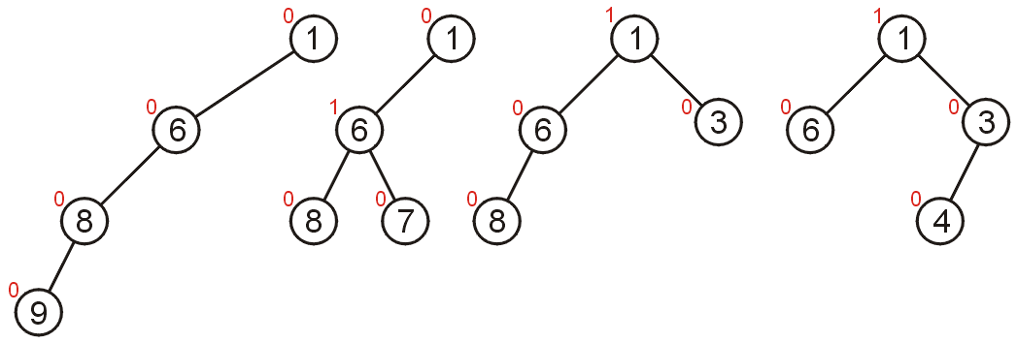
Leftist Heap Properties
Heap-order property
  parent’s priority value ≤ childrens’ priority values
  result: minimum element is at the root (min heap)
Leftist property
  null path length (npl) of left subtree ≥ npl of right subtree
  Result: tree is at least as “heavy” on the left as the right
  Every subtree of a leftist heap is also leftist
Notes:
So, here are the formal properties of a leftist heap.
Heap-order, of course.
And, the leftist property; this means that the npl of the right child is never greater than that of the left child.
Are leftist trees necessarily complete or balanced? NO. In fact, a _great_ leftist tree is a string of nodes all on the left!

Slide 7
Are these heaps leftist?
NOT leftist
leftist
leftist
2
2
0
1
1
1
1
0
0
1
0
0
1
0
0
0
1
0
0
0
0
0
0
0
0
0
(npl values shown inside the nodes)
0
0
Notes:
Here are some training examples to help you learn.
The red nodes break the leftist property for the first tree.
The other two trees are leftist.

Slide 8

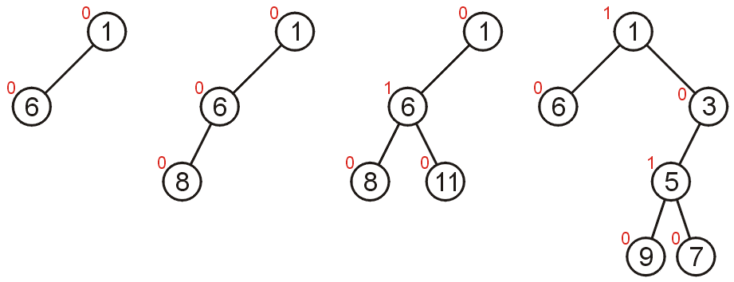
Are these heaps leftist?
Do not trust your eyes, trust the NPL values!

Slide 9
Right Path in a Leftist Tree is Short
2
If the right path has length
at least r, the tree has at
least 2^{r} - 1 nodes
The shortest path must be
to the right.
Thus, if you always take the shortest path, it can’t be longer than log n.
We will use this property to make leftist heaps efficient!
1
1
1
0
0
0
0
0
0
Notes:
Why do we have this leftist property?
Because it guarantees that the right path is really short compared to the number of nodes in the tree without being as stodgy as the heap structure property.
Here’s a proof which boils down to the fact that if the left path is r long, the null path length must be at least r (otherwise somewhere along there, there’s a node with a larger right npl than left).
Since the tree is complete at least to depth r, there are at least 2^{r} - 1 nodes in the tree.

Slide 10
Merging
As there is no relationship between the siblings (left and right children) in the sub-trees of a heap :
  If both the left and right sub-trees are leftist heaps,
  …but the root does not form a leftist heap,
  We only need to swap the two sub-trees to restore leftist heap property!
We can use this idea to merge two leftist heaps
1
1
0
1
1
0
1
0
0
0
0
1
0
0
0
0
0
0

Slide 11
Merging Leftist Heaps
Compare the roots of the two leftist heaps
Smaller root will be the new root;
Recursively merge the right subheap of the new root with the remaining leftist heap
Stop when there is nothing left to merge
As you backtrack, check if each subheap on the upward path is leftist
  If not leftist, swap the right and the left branches!
1
1
5
3
0
0
0
0
10
12
7
8
0
14

Slide 12
Example
merge
1
?
5
3
merge
?
0
0
0
5
10
12
7
1
5
0
merge
1
0
10
0
3
14
0
0
12
10
12
0
0
0
8
7
8
0
8
0
Base case: Root has no right branch. If also no left branch: attach remaining heap on the left. Otherwise, attach remaining heap on the right.
14
0
8
0
12
Notes:
Alright, let’s try an example.
I’m unwinding the recursion here.
I pulled a fast one merging the last two nodes. I could have reduced that to merging a node with null (which is clearly the original node) but I didn’t for convenience.
Don’t _you_ do that on tests!

Slide 13
Putting together the pieces
?
?
1
3
3
3
0
0
0
1
7
?
7
1
7
5
5
5
0
0
0
0
0
14
0
0
14
0
0
14
10
8
10
8
10
8
0
0
0
12
12
12
Leftist
Leftist
Not leftist
Notes:
No, we need to put the example back together, fixing the leftist property as we go.
Are we done here?
NO!
The root’s right child has a higher npl than its left child!

Slide 14
Swap the branches around to make it leftist:
1
1
3
3
0
0
7
5
1
5
1
7
0
0
0
0
0
0
14
10
8
10
8
14
0
0
12
12
Notes:
So, we swap the root’s children.
Is the final tree a leftist heap?

Slide 15
Operations on Leftist Heaps: Everything is a merge!
Merge two trees of total size n: O(log n)
Insert (enqueue) with heap size n: O(log n)
  Treat the new node as a size 1 leftist heap
  Insert by merging original heap with one node heap:
Dequeue with heap size n: O(log n)
  Remove and return root
  Merge left and right subtrees
merge
merge
Notes:
Now that we have that wicked merge op. Let’s just use it to implement all the other ops.
Is one node a size one leftist heap?

Slide 16
Insert (enqueue)
1
0
3
6
0
0
7
6
0
5
1
7
0
14
0
0
0
1
10
8
14
3
0
0
12
5
1
6
0
6
0
0
0
10
8
7
0
7
0
0
12
14
0
14

Slide 17
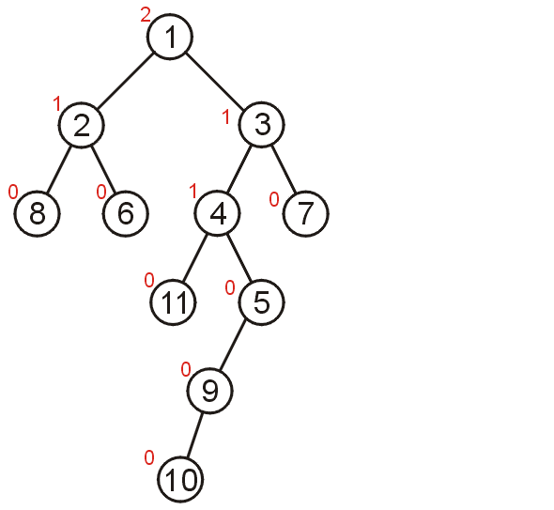
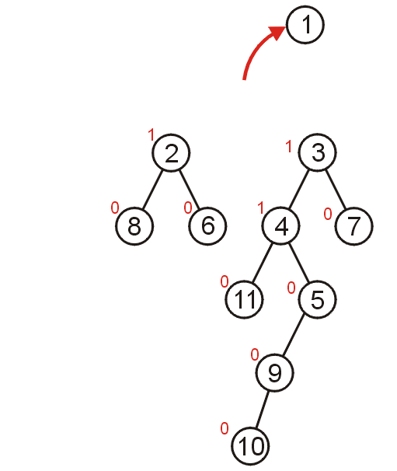
Delete Min (dequeue)

Slide 18
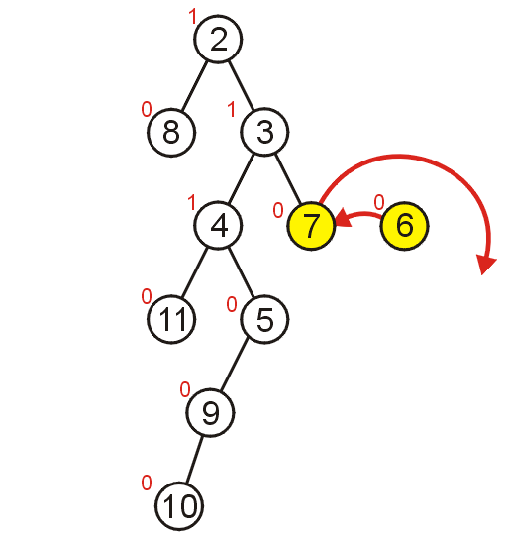
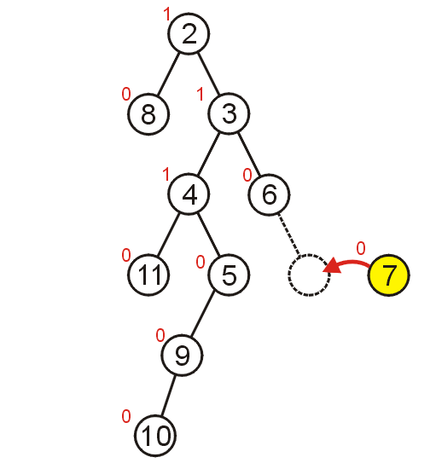
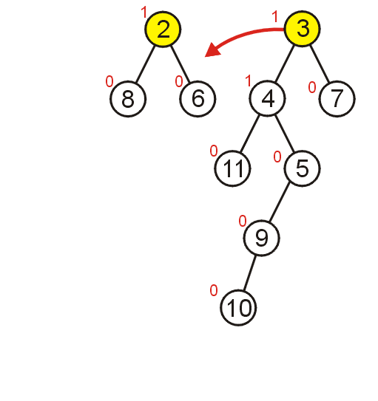
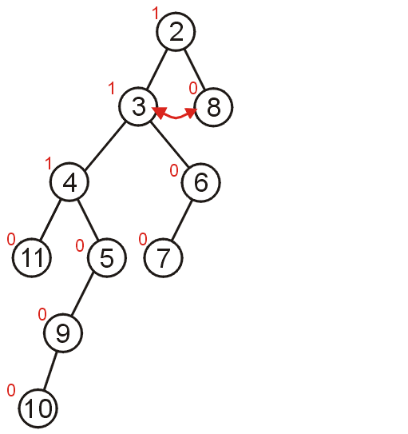
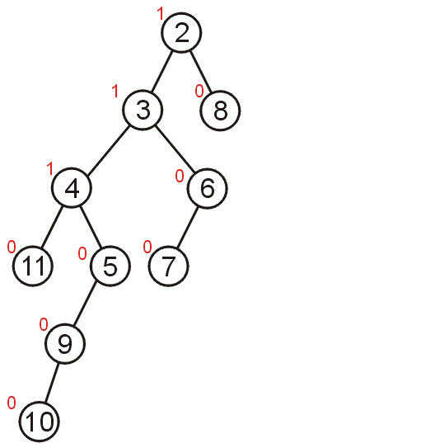
Merge the heaps recursively
Back-track!

Slide 19
Skew Heaps
Problems with leftist heaps:
  Extra storage for npl
  Extra complexity/logic to maintain and check npl
  (Kind of like AVL trees with their balance factors)
Solution: skew heaps
  Blind adjusting version of leftist heaps
  Amortized time for merge, insert, and dequeue is O(log n)
  Worst case time for all three is O(n)
  How:
    Merge always swaps children when fixing right path
Do skew heaps remind you of anything?..
Notes:
There are some problems with leftist heaps.
We’ll use skew heaps to fix those problems.
Motivation? Remember that we “often” get heavy right sides when we merge.
So, why not just assume the right side is heavy and move it over automatically?
Amortized time = average time for huge operations

Slide 20
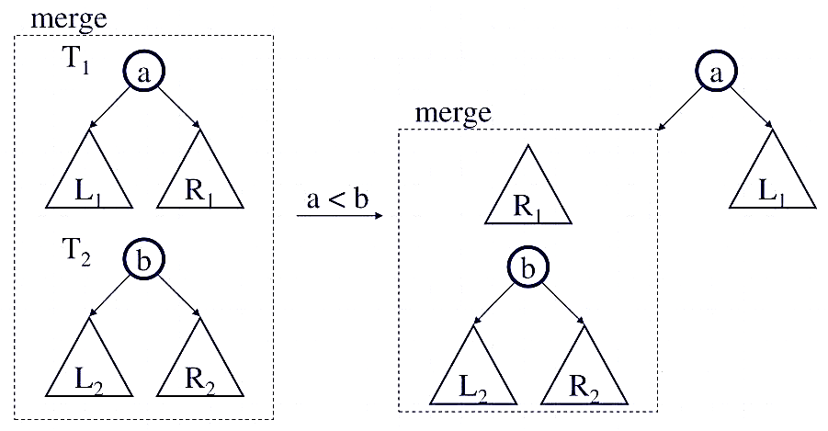
Merging Skew Heaps
Merge always swaps children when fixing right path: swap preemptively (top down), then put the merged subheap on the left
Notes:
There are some problems with leftist heaps.
We’ll use skew heaps to fix those problems.
Motivation? Remember that we “often” get heavy right sides when we merge.
So, why not just assume the right side is heavy and move it over automatically?

Slide 21
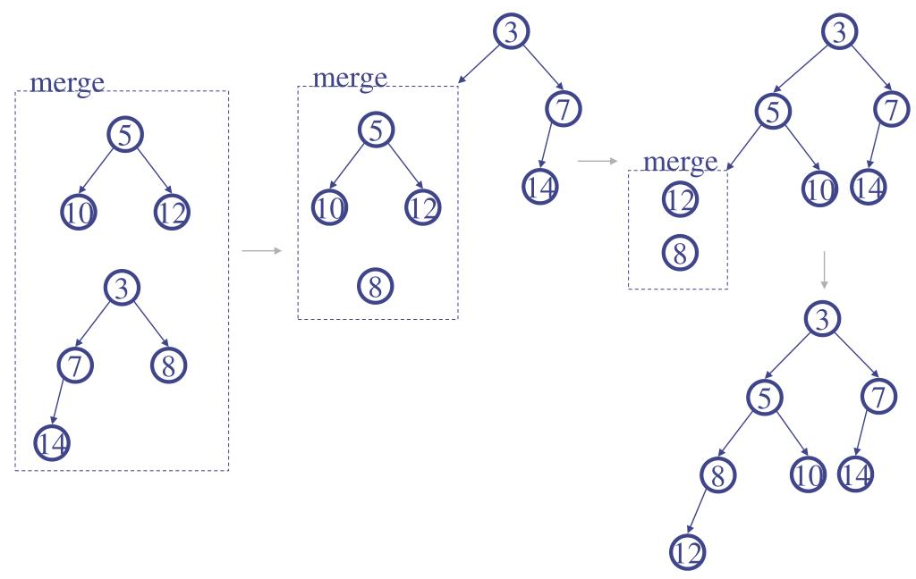
Merging Skew Heaps: Example
swap
swap
We only compare the roots, we do not check if the result is leftist
Can easily be implemented iteratively!
On average, the resulting heap will be leftist!
Notes:
There are some problems with leftist heaps.
We’ll use skew heaps to fix those problems.
Motivation? Remember that we “often” get heavy right sides when we merge.
So, why not just assume the right side is heavy and move it over automatically?

Slide 22
Summary
Leftist heaps
  Designed for efficient merging
  Stored as trees rather than arrays
  Min-heap property maintained
  Null path length of left child >= NPL of right child
  Right branch is shorter!
All operations on the leftist heaps are done via merging
Skew heaps: leftist heaps that do not store NPL and always swap children when merging

