Slide 1
COS 212
Sorting:
Shell Sort and Heap Sort

Slide 2
Intuitive Sorting Algorithms are Slow
Why are the intuitive sorting algorithms so slow?
  Always involves a nested loop, bringing complexity up to O(n²)
  Can we alleviate this quadratic bane?
Let’s look at an example
  This array contains 8 elements
  If sorting has O(n²) complexity, then t(n) = n², and t(8) = 64
What if we split the array in two halves?
  Using the same algorithm to sort the halves separately
    For each half of the array, t(4) = 16
    Therefore, for the entire array, t(4) x 2 = 32
    Much less time complex than sorting the whole array!
6 | 7 | 2 | 1 | 5 | 8 | 3 | 4
6 | 7 | 2 | 1
5 | 8 | 3 | 4

Slide 3
Efficient sorting
However… sorting each half does not sort the entire array!
  But it does bring the array closer to a fully sorted array
Arrays can be subdivided in many ways – not just halved
Let’s consider comb sort again
  Compare elements that are m places apart
  Value of m is called a gap
  The gap shrinks non-linearly for each pass through the array
  In each pass we bubble sort only a subset of elements
This improves performance
  Comb sort improves bubble sort to O(n lg n) in the best case
  Can we improve insertion sort and selection sort in a similar way?
33 98 74 13 55 20 77 45 64 83
m = 7
33 98 74 13 55 20 77 45 64 83
33 64 74 13 55 20 77 45 98 83
33 64 74 13 55 20 77 45 98 83

Slide 4
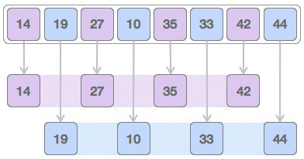
Shell Sort
How do insertion sort and selection sort work?
  Keep an “invisible wall” between the sorted and unsorted part
  Insertion sort removes elements from unsorted, inserting them into the correct location in sorted
  Selection sort swaps the smallest element in unsorted with the element at the head of unsorted, moving it into sorted
The shell sort algorithm
  Uses comb sort’s idea: Use a variable gap to create sub-arrays
  Sort sub-arrays using any algorithm, decrease gap, until sorted
44
45
46
48
43
12
Sorted
Unsorted

Slide 5
Shell Sort
Let’s look at an example
  n = 6
  Choose an initial gap = 3
  Find sub-arrays
  Apply a sorting algorithm
  to every sub-array
    Use any sorting algorithm
    Insertion sort is very commonly
    used, so we’ll do the same
    for this example
  Shrink the gap until gap = 1
3
6
2
8
1
5
3
8
6
1
2
5
3
1
2
8
6
5

Slide 6
Shell Sort
Moving on to the second pass
  We’ll reduce the gap by 1
  for this example
  gap = 2
  Find sub-arrays
  Apply insertion sort to
  sub-arrays
Now for the final pass
  gap = 1
  We’re now working with
  the full array
  Apply insertion sort
We performed a single move on the last iteration!
3
1
2
8
6
5
3
2
6
1
8
5
2
1
3
5
6
8

Slide 7
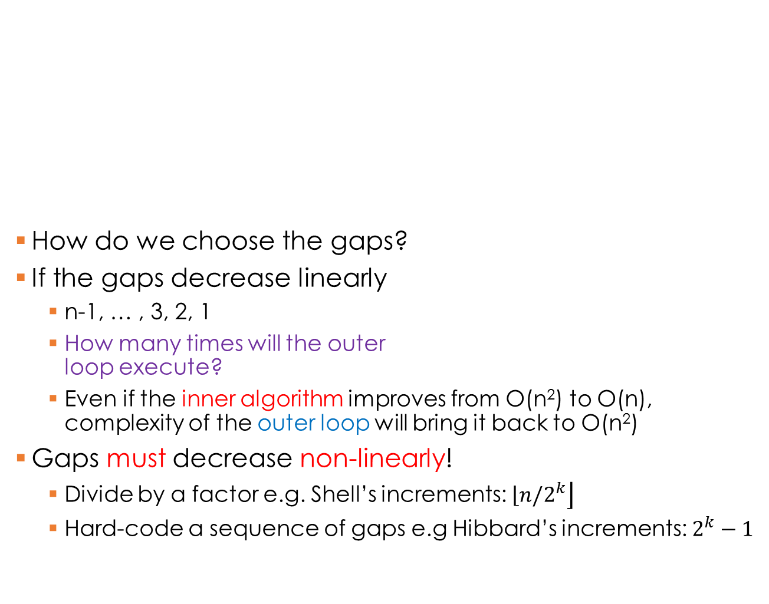
Shell Sort: Efficiency
Iterate through all the gaps
How do we choose the gaps?
If the gaps decrease linearly
  n-1, … , 3, 2, 1
  How many times will the outer
  loop execute?
  Even if the inner algorithm improves from O(n²) to O(n), complexity of the outer loop will bring it back to O(n²)
Gaps must decrease non-linearly!
  Divide by a factor e.g. Shell’s increments: $\left\lfloor n/\right.\left.2^{k}\right\rfloor$
  Hard-code a sequence of gaps e.g Hibbard’s increments: $2^{k}−1$
for (gap = initialValue; gap >= 1; gap = shrinkGap(gap)){
for (p = 0; p < gap; p++) {
// insert your favourite algorithm here to
// sort each sub-array starting at index p
}
}
Generate all the sub-arrays
O(n²), but will improve significantly thanks to sorting of sub-arrays

Slide 8
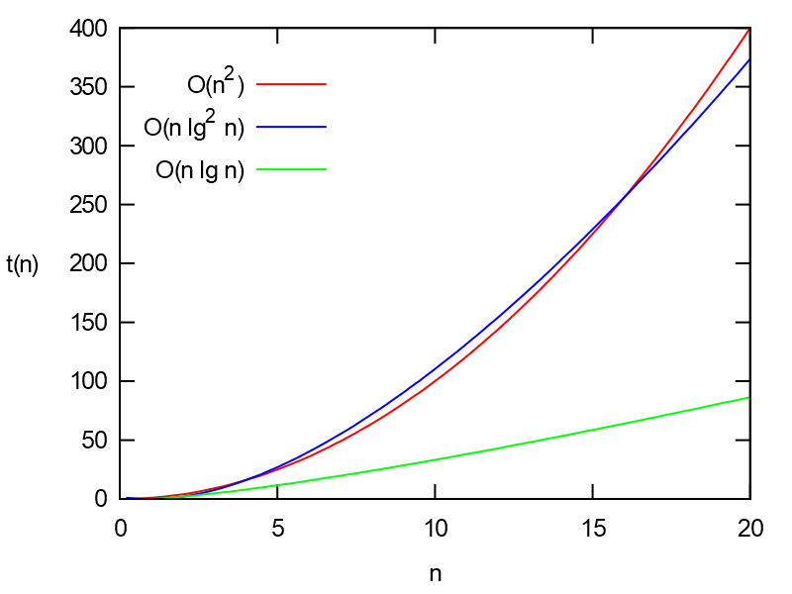
Shell Sort: Efficiency
Best case:
O(n lg n)
Worst case:
O(n lg² n )

Slide 9
Revisiting Selection Sort
selectionSort(AnyType[] data)
for i = 0 to data.length-1
select the smallest element among
data[i], ... , data[data.length-1];
swap it with data[i];
Selection | Best | Average | Worst
Comparisons | O(n²) | O(n²) | O(n²)
Movements | 0 | O(n) | O(n)
Why is selection sort slow?
  We have to search for the
  smallest element at every
  outer loop iteration
  What if we had direct access to the smallest element?
  Do you recall any data structure that allows exactly that?
Yes! Heaps
  Min-heap: The smallest element is always at the top
  Max-heap: The largest element is always at the top
Heaps are especially appropriate for sorting
  They can be stored in arrays

Slide 10
Heap Sort
Phase 1: Transform data into a max-heap
Phase 2: The sorting procedure
  The opposite of classic selection sort (i.e. sorted part is on the right)
  Start with entire array in unsorted part
  Swap root (largest element in the heap) with last value in unsorted
  This removes root from heap, adding it to the left of the sorted part
  Thus the heap shrinks as the sorted part grows
  Finally, restore the heap in the unsorted part, and repeat
The result of this heap sort
  Array in ascending order
  What if you wanted descending order instead?
heapsort(AnyType[] data)
transform data[] into a max-heap; // Floyd’s algorithm
for i = data.length-1 down to 2
swap the root with the element in position i;
restore heap property for the tree data[0], ... , data[i-1];

Slide 11
Heap Sort
Phase 1: Transform data into a max-heap
Floyd’s algorithm
  Start with the last non-leaf node
  While the non-leaf node has a smaller value than any of its children
    Swap the non-leaf node with the largest of these children
    Stop if no larger valued children found, or non-leaf node becomes a leaf
  Continue with the previous non-leaf node
  Efficiency is O(n)
FloydAlgorithm(AnyType[] data)
i = index of the last nonleaf
while i >= 0
p = data[i];
while p is not a leaf and p < any of its children
swap p with the larger child;
i = i--; // index of the previous non-leaf

Slide 12
Heap Sort
Phase 1: Transform data into a max-heap (Floyd’s algorithm)
4
6 3
7 5 4
3
7 5 4
7 5
4
3
6
4 | 6 | 3 | 7 | 5 | 4
4 | 6 | 3 | 7 | 5 | 4
4 | 6 | 4 | 7 | 5 | 3
Last nonleaf
4
7
4 4
6 5 3
7
6 4
4 5 3
7
6 5
4
3
4 | 7 | 4 | 6 | 5 | 3
7 | 4 | 4 | 6 | 5 | 3
7 | 6 | 4 | 4 | 5 | 3

Slide 13
Heap Sort
Phase 2: The sorting procedure
Dequeuing algorithm
  Swap largest element (always at data[0]) with last leaf (at data[i])
    Both are efficient to work with, due to direct access
  Restore the heap property
    Set p to the root of the heap
    While p is less than any of its children, swap p with its largest child
    Efficiency is O(lg n)
for i = data.length-1 down to 2
swap the root with the element in position i;
p = the root;
while p is not a leaf and p < any of its children
swap p with the larger child;

Slide 14
Heap Sort
Phase 2: The sorting procedure
7
6 4
4 5 3
3
6 4
4 5 7
6
3 4
4 5
6
5 4
4 3
7 | 6 | 4 | 4 | 5 | 3
3 | 6 | 4 | 4 | 5 | 7
6 | 3 | 4 | 4 | 5 | 7
6 | 5 | 4 | 4 | 3 | 7
3
5 4
4 6
5
3 4
4
5
4 4
3
3
4 4
5
3 | 5 | 4 | 4 | 6 | 7
5 | 3 | 4 | 4 | 6 | 7
5 | 4 | 4 | 3 | 6 | 7
3 | 4 | 4 | 5 | 6 | 7

Slide 15
Heap Sort
3
4 4
5
4
3 4
4
3 4
4
3
3
4
3 | 4 | 4 | 5 | 6 | 7
4 | 3 | 4 | 5 | 6 | 7
4 | 3 | 4 | 5 | 6 | 7
4 | 3 | 4 | 5 | 6 | 7
3 | 4 | 4 | 5 | 6 | 7

Slide 16
Heap Sort
Efficiency of heap sort?
O(n)
heapsort(AnyType[] data)
transform data[] into a heap; // Floyd’s heapifying algorithm
for i = data.length-1 down to 2
swap the root with the element in position i;
restore the heap property for the tree data[0], …, data[i-1];
O(n)
O(1)
Best case:
O(n lg n)
Worst case:
O(n lg n )
O(lg n)
Average case:
O(n lg n )

