Slide 1
COS 212
Sorting:
Radix Sort & Counting Sort

Slide 2
Bucket Sort
How would you sort a stack of books?
  You could sort the books by the name of the author
  Create 26 separate piles, one for each letter of the alphabet
  Books by authors whose names start with ‘A’ go in 1st pile, books by authors whose names start with ‘B’ go in 2nd pile, and so on…
Now you have your books organised by first letter
  But there are still a lot of books by different authors in each pile…
  Sort each one of the 26 piles in the same way
    Create 26 piles within one of the original piles
    Books by authors whose names have a second letter of ‘A’ go in 1st pile, books by authors whose names have a second letter of ‘B’ go in 2nd pile, and so on…
Do this until only one author’s books are in each pile
This is a legitimate sorting algorithm used in the real world

Slide 3
Radix Sort
Can we do the same thing with numbers?
  We can sort by each digit, creating 10 buckets (for digits 0 to 9)
  Let’s see how this works if we start with the first digit & move right
But we immediately have a problem
  The values starting with 1 are sorted into the incorrect order
  Clearly sorting left to right doesn’t work
12
100
12
23
23
23
2
2
2
17
17
100
12
17
100
data = [12 23 2 17 100]
100
100
17
17
12
12
0 | 1 | 2 | 3 | 4 | 5 | 6 | 7 | 8 | 9
0 | 1 | 2 | 3 | 4 | 5 | 6 | 7 | 8 | 9

Slide 4
Radix Sort
How could we solve this problem?
  Sort right to left, starting with the rightmost digit
  Pad numbers with leading zeros to make them the same length
To store the multiple values that map to a digit
  We’ll use one queue per digit
Our previous example also wastes a lot of memory
  A separate destination array for each digit
  Process repeated as many times as maximum digits in a number
  Leads to a proliferation of arrays
  We’ll move numbers back and forth between the array we’re sorting and a single array of queues
radixSort(data[])
n = number of digits in largest number
add leading zeros to numbers until all have n digits
for d = n down to 1
distribute numbers in data[] among queues 0 to 9 according to digit d
for i = 0 up to 9
dequeue each number in queue i and add to next position in data[]

Slide 5
Radix Sort
Let’s apply radix sort to the array [25 5 20 315 11 77]
data = [025 005 020 315 011 077]
025
025
005
005
020
020
077
025
005
020
315
077
315
011
011
315
011
077
0 | 1 | 2 | 3 | 4 | 5 | 6 | 7 | 8 | 9

Slide 6
Radix Sort
Let’s apply radix sort to the array [25 5 20 315 11 77]
data = [025 005 020 315 011 077]
020
020
011
011
025
025
077
020
011
025
005
077
005
315
315
005
315
077
0 | 1 | 2 | 3 | 4 | 5 | 6 | 7 | 8 | 9

Slide 7
Radix Sort
Let’s apply radix sort to the array [25 5 20 315 11 77]
data = [025 005 020 315 011 077]
005
005
011
011
315
315
077
005
011
315
020
077
020
025
025
020
025
077
= [5 11 20 25 77 315]
0 | 1 | 2 | 3 | 4 | 5 | 6 | 7 | 8 | 9
Do you think it’s possible to implement radix sort recursively?

Slide 8
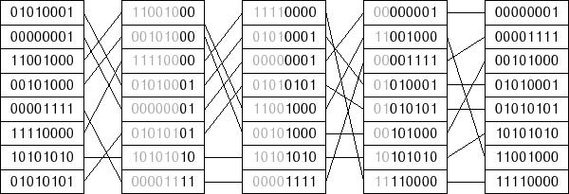
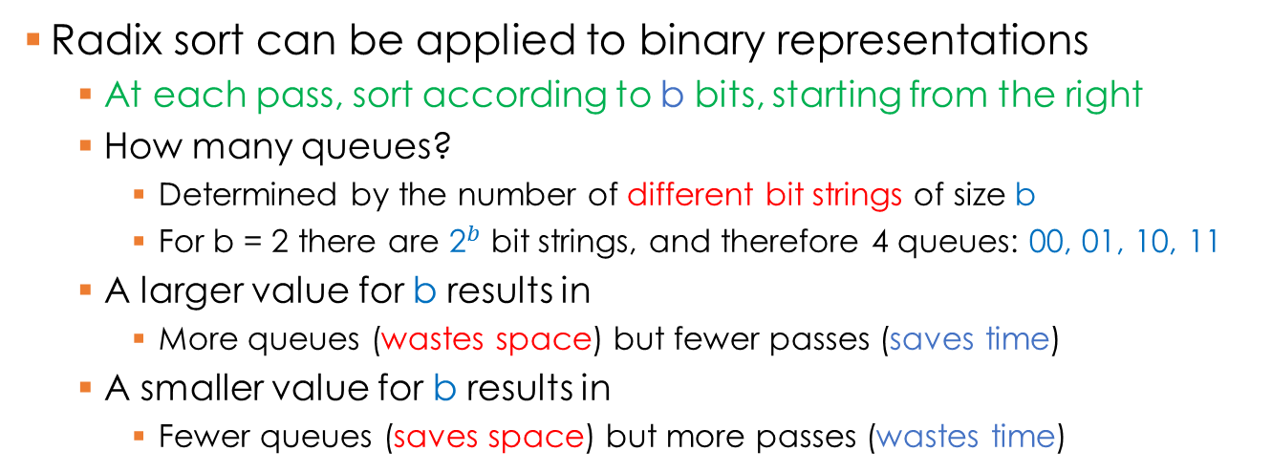
Radix Sort
Radix sort can be applied to binary representations
  At each pass, sort according to b bits, starting from the right
  How many queues?
    Determined by the number of different bit strings of size b
    For b = 2 there are ${\text{2}}^{b}$ bit strings, and therefore 4 queues: 00, 01, 10, 11
  A larger value for b results in
    More queues (wastes space) but fewer passes (saves time)
  A smaller value for b results in
    Fewer queues (saves space) but more passes (wastes time)

Slide 9
Radix Sort: Efficiency
private final int radix = 10; // number of digits and buckets
private final int digits = 10; // max number of digits in a number
public void radixsort(int[] data) {
int d, j, k, factor;
Queue<Integer>[] queues = new Queue[radix];//1 queue per bucket
for (d = 0; d < radix; d++)
queues[d] = new Queue<Integer>();
// run through every digit, starting from the rightmost
for (d = 1, factor = 1; d <= digits; factor *= radix, d++) {
for (j = 0; j < data.length; j++) // enqueue data[j]
queues[(data[j] / factor) % radix].enqueue(data[j]);
for (j = k = 0; j < radix; j++) // rebuild data
while (!queues[j].isEmpty())
data[k++] = queues[j].dequeue();
}
}
O(1)
O(d)
O(n)
O(n)
Total complexity?
O(dn)
What about the complexity of using queues?

Slide 10
Counting Sort
Array indices are always sorted (0 up to size-1)
What if we treat each element as an index?
Create array tmp where last index is the largest data value
Populate tmp array: tmp[array[i]] = array[i]
6 | 7 | 2 | 5 | 1 | 0 | 3 | 4
0 | 1 | 2 | 3 | 4 | 5 | 6 | 7
What if there are duplicate values?
0 | 1 | 2 | 3 | 4 | 5 | 6 | 7
What if there are gaps between numbers?
0
1
2
3
4
5
6
7
0 | 1 | 2 | 3 | 4 | 5 | 6 | 7

Slide 11
Counting Sort
count occurrences of each number in data[];
store occurrences in count[] indexed with numbers in data[];
for i = 1 up to count.length-1
count[i] = the number of elements <= i;
// transfer numbers from data[] to tmp[]
for i = n-1 down to 0
tmp[count[data[i]] - 1] = data[i];
decrement count[data[i]];
transfer numbers from tmp[] to data[];
Last index in count[] is equal to the largest number in data[]
data[]
count[]
0 | 1 | 2 | 3 | 4 | 5 | 6 | 7
7 | 2 | 9 | 3 | 7 | 3 | 4 | 1
0 | 1 | 2 | 3 | 4 | 5 | 6 | 7 | 8 | 9
0 |  |  |  |  | 0 | 0 |  | 0
0
1
1
1
2
0
1
0
1
2
0
1
0
0
0 | 1 | 2 | 3 | 4 | 5 | 6 | 7 | 8 | 9
count[i] = count[i – 1] + count[i]
0
1
1
2
2
4
1
5
5
0
5
0
7
2
7
0
1
8

Slide 12
Counting Sort
for i = n-1 down to 0
tmp[count[data[i]]-1] = data[i];
decrement count[data[i]];
0 | 1 | 2 | 3 | 4 | 5 | 6 | 7
7 | 2 | 9 | 3 | 7 | 3 | 4 | 1
data[]
7
2
9
3
7
3
4
1
0 | 1 | 2 | 3 | 4 | 5 | 6 | 7
0 | 1 | 2 | 3 | 4 | 5 | 6 | 7 | 8 | 9
0 | 1 | 2 | 4 | 5 | 5 | 5 | 7 | 7 | 8
tmp[]
count[]
1
0 | 0 | 2 | 4 | 5 | 5 | 5 | 7 | 7 | 8
1 |  |  |  | 4
0 | 0 | 2 | 4 | 4 | 5 | 5 | 7 | 7 | 8
1 |  |  | 3 | 4
0 | 0 | 2 | 3 | 4 | 5 | 5 | 7 | 7 | 8
1 |  |  | 3 | 4 |  | 7
0 | 0 | 2 | 3 | 4 | 5 | 5 | 6 | 7 | 8
1 |  | 3 | 3 | 4 |  | 7
0 | 0 | 2 | 2 | 4 | 5 | 5 | 6 | 7 | 8
1 |  | 3 | 3 | 4 |  | 7 | 9
0 | 0 | 2 | 2 | 4 | 5 | 5 | 6 | 7 | 7
1 | 2 | 3 | 3 | 4 |  | 7 | 9
0 | 0 | 1 | 2 | 4 | 5 | 5 | 6 | 7 | 7
1 | 2 | 3 | 3 | 4 | 7 | 7 | 9
0 | 0 | 1 | 2 | 4 | 5 | 5 | 5 | 7 | 7

Slide 13
Counting Sort: Complexity
count occurrences of each number in data[];
store occurrences in count[] indexed with numbers in data[];
for i = 1 up to count.length-1
count[i] = the number of elements <= i;
// transfer numbers from data[] to tmp[]
for i = n-1 down to 0
tmp[count[data[i]] - 1] = data[i];
decrement count[data[i]];
transfer numbers from tmp[] to data[];
O(n)
O(n)
How many times will the loop execute?
O(n)
Total complexity?
O(n + max)
O(max)
3 | 5 | 100000000
Imagine data looks like this:
Counting sort is very efficient, but only if
max is not much larger than n
Can counting sort work on non-integers e.g. strings?
This number determines max

Slide 14
Counting Radix Sort
public static void countingRadixSort(String[] data, int stringLen) {
final int BUCKETS = 128; // 7bit ASCII
int N = data.length; // number of strings
String[] tmp = new String[N];
String[] in = data; String[] out = tmp;
for(int pos = stringLen - 1; pos >= 0; pos--) // repeat for each character
{ // in string starting with last
int[] count = new int[BUCKETS]; // bucket for each ASCII character
for(int i = 0; i < N; i++)
count[in[i].charAt(pos)]++; // count ASCII characters per bucket
for(int b = 1; b < BUCKETS; b++)
count[b] += count[b - 1]; // count ASCII characters <= b
for(int i = 0; i < N; i++) {
out[count[in[i].charAt(pos)] - 1] = in[i]; // place strings in correct
count[in[i].charAt(pos)]--; // position in tmp array
}
// swap in and out roles
String[] backup = in; in = out; out = backup;
}
// if odd number of passes, in is tmp, out is data; so copy back
if(stringLen % 2 == 1) for(int i = 0; i < N; i++) out[i] = in[i];
}
Can counting sort work on non-integers e.g. strings?
  Only efficiently in combination with radix sort.

Slide 15
Which Algorithm Should You Use?
 | 20,000 Integers
 | Ascending | Random | Descending
Insertion sort Selection sort Bubble sort Comb sort Shell sort Heap sort Merge sort Quick sort Radix sort Counting sort | .06 3 m 13.5 2 m 58.51 .15 .22 .72 .50 .16 2.31 .05 | 1 m 2.73 3 m 21.31 4 m 47.81 1.05 .49 .88 .66 .44 1.59 .08 | 1 m 40.57 3 m 23.56 5 m 3.90 .67 .33 .72 .49 .22 2.20 .05

Slide 16
Which Algorithm Should You Use?
 | 80,000 Integers
 | Ascending | Random | Descending
Insertion sort Selection sort Bubble sort Comb sort Shell sort Heap sort Merge sort Quick sort Radix sort Counting sort | .11 56 m 8.09 52 m 6.90 .67 1.32 3.63 2.19 .93 10.98 .22 | 29 m 2.73 67 m 21.31 87 m 9.62 6.52 2.75 4.56 3.35 2.04 10.82 .57 | 29 m 36.13 56 m 49.94 83 m 6.68 3.10 1.59 3.35 2.20 .99 10.00 .20
It will always depend on the application
Just be sure to avoid the simple sorting algorithms!

