Slide 1
COS212
Connectivity in Undirected Graphs

Slide 2
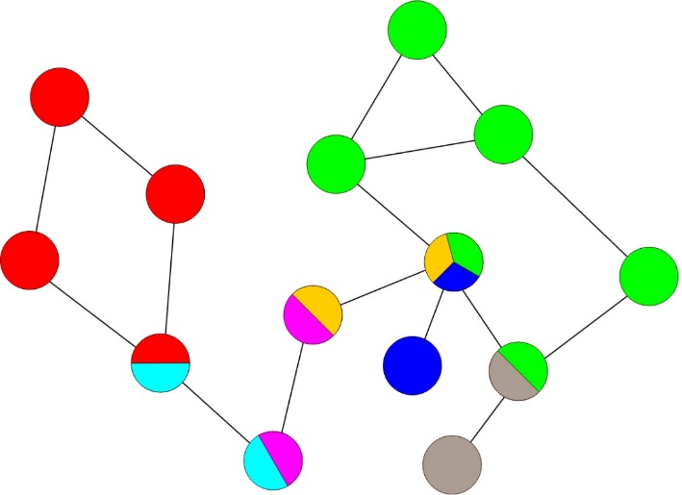
Lecture Outline
Connectivity in Undirected Graphs
What does it mean for an undirected graph to be “connected”?
Articulation points in a graph
What is an articulation point?
N-connected and bi-connected graphs
How do you find articulation points in a graph?

Slide 3
Connectivity in Graphs
Can you remove one vertex to make the graph disconnected?
Is the graph below connected?
Yes: a graph is connected when there exists a path between any two vertices
But how connected is the graph?
I.e., how difficult/easy is it to make the graph disconnected?
N
N
P
L
Z
P
L
Z
J
H
D
J
H
D

Slide 4
Connectivity in Graphs
A graph is called n-connected when there are at least n non-overlapping paths between any two vertices
A 2-connected, or biconnected graph is a graph where at least two non-overlapping paths exist between two vertices
Is the graph on the left biconnected?
What about the graph on the right?
N
N
P
L
Z
P
L
Z
J
H
D
J
H
D

Slide 5

Connectivity in Graphs
A graph is not biconnected if there is a vertex that always has to be included on the path between some u and v
Such vertex is called an articulation point
Articulation point is a “breaking point”: if articulation point is removed, the graph will fall apart into disconnected subgraphs
Biconnected subgraphs are referred to as blocks
How many blocks?
N
P
L
Z
J
H
D

Slide 6
Why do we care about articulation points?
Articulation points are “breaking points”
If an articulation point in your graph fails, you have a problem!
Especially important for various routing tasks
We need an algorithm that will identify articulation points in a graph

Slide 7
Depth First Search
Can we reuse depth first search (DFS)?
DFS visits every vertex once, constructing a spanning tree:
The root of the spanning tree above is P, leaves are D and N
How can we tell that L and Z are articulation points?
  The “H” branch of L does not have back edges leading to nodes preceding L
  Same goes for Z, second articulation point in the graph: D has no back edges
We will devise an algorithm that will keep track of back edges, i.e. edges that lead to visited vertices
Back edge
7
D did not discover back edges that lead to a vertex earlier than Z in the spanning tree;
To find articulation points, find the earliest spanning tree predecessors.
N
Back edge
1
P
3
L
Z
5
2
J
4
H
D
6

Slide 8
DFS: Find Articulation Points
As we go through the vertices recursively, assign to each vertex a DFS number (num) and the number of lowest (earliest) predecessor (low)
Recursive algorithm: start on a vertex v, check each neighbour u
When recursive call backtracks from u to v, compare low(v) to low(u): did vertex u find an alternative path (a back edge)?
  If low(u) < low(v), set low(v) = low(u)
  Else, u can only connect to the rest of the graph through v
  Therefore, v is an articulation point
    In other words, v is an articulation point if low(u) >= low(v)
If an edge (v,u) leads to a visited vertex u (back edge), adjust low(v) = num(u) if num(u) < low(v)
num
low
7,1
N
7,7
1,1
5,5
P
3,3
L
5,3
3,1
Z
2,2
J
H
D
2,1
4,3
4,4
6,6

Slide 9
DFS: Find Articulation Points
Efficiency:
O(|V| + |E|)
articulationPointSearch()
for all vertices v
num(v) = 0; // initialize all vertices as unvisited
i = 1;
while there is a vertex v such that num(v) == 0
assignLow(v);
assignLow(v)
low(v) = num(v) = i++; // intialise num and low to the current i
for all vertices u adjacent to v
if num(u) is 0
assignLow(u); // if unvisited vertex found, visit it recursively
if low(u) ≥ num(v) // if there is no edge from u to an earlier vertex,
print(v + “ is an articulation point”); // report articulation pnt
else low(v) = min(low(v),low(u)); // take an earlier predecessor
else if u is not the parent of v // if the vertex has been visited before
low(v) = min(low(v),num(u)); // update when back edge(vu) is found
7,1
vertex | num | low
P
J
L
H
Z
D
N
N
7,7
0
1
1
2
1,1
0
1
2
5,5
5,3
0
3
3
P
3,1
L
1
3,3
Z
4
0
3
4
5
0
5
3
0
6
6
2,1
J
H
D
2,2
4,3
4,4
6,6
7
0
1
7

Slide 10
What about the starting node?
We have now found all the articulation points… Or have we?
Can the root of the DFS spanning tree be an articulation point?
What if we started the traversal from L or Z?
The root of the spanning tree is an articulation point if and only if it has more than one child (i.e., more than one branch)
  Why? Because the necessity of having more than one branch indicates that the two branches are not connected to each other elsewhere
N
N
P
L
Z
P
L
Z
J
H
D
J
H
D

Slide 11
Summary
N
P
L
Z
J
H
D
Connectivity:
  Connected: a graph G where there is a path between any two vertices u and v
  Biconnected: a graph G where there exist at least two (non-overlapping) paths between any two vertices u and v
Articulation point search:
  Search for “weak” points in the graph that, if removed, make the graph disconnected
  Very important for routing tasks!
  How? Use DFS, keep track of back edges
Next lecture: connectivity in directed graphs

