Slide 1
COS 212
Minimum Spanning Trees

Slide 2
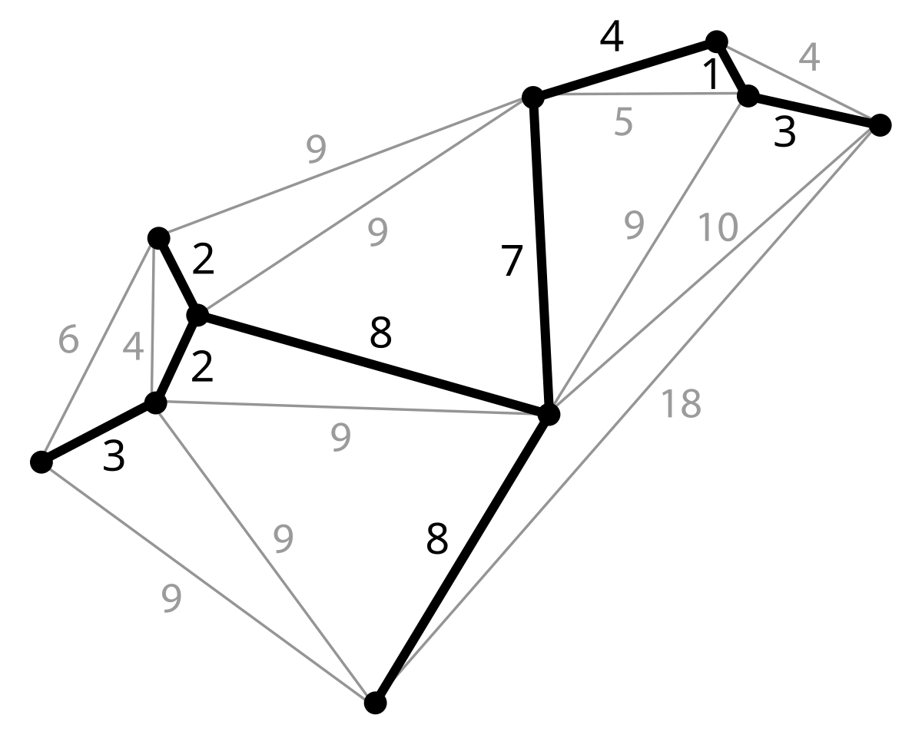
Lecture Outline
Minimum Spanning Tree
Prim’s Algorithm
Kruskal’s Algorithm
Spanning Tree

Slide 3
Spanning Trees
What assumptions are we making about the graph?
What happens when DFS is performed on a graph?
  Every vertex is visited exactly once
  The edges used in DFS form a connected and acyclic structure
  We call this structure a spanning tree
The path will differ depending on the starting point and the order of vertices in the adjacency list
Are all spanning trees equally useful?
A
A
15
23
2
2
D
B
C
D
B
C
8
6
9
7
3
6
3
8
7
E
F
G
E
F
G
15
1
15

Slide 4
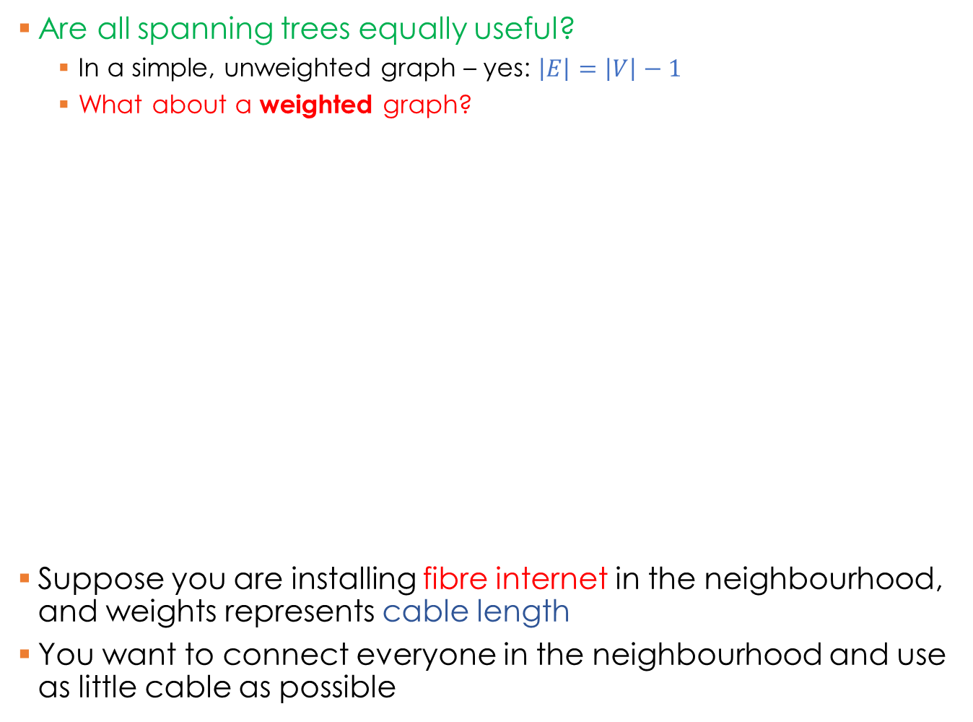
Spanning Trees
Are all spanning trees equally useful?
  In a simple, unweighted graph – yes: $\left|E\right|=\left|V\right|−1$
  What about a weighted graph?
Suppose you are installing fibre internet in the neighbourhood, and weights represents cable length
You want to connect everyone in the neighbourhood and use as little cable as possible
A
A
15
2
2
D
B
C
D
B
C
8
9
3
6
7
3
8
E
F
G
E
F
G
1
15
Total cost: 38
Total cost: 41

Slide 5
Minimum Spanning Tree
A minimum spanning tree is a spanning tree that minimises the sum of edges
Very useful in routing applications!
How is it different from the shortest
path problem?
  Shortest path assumes a specific
  starting point
  All-pairs shortest path algorithm
  finds multiple paths
We are interested in a
single cheapest way to connect
all the dots (vertices)
Many algorithms have been proposed to minimise the spanning tree
We will only look at two:
  Prim’s algorithm
  Kruskal’s algorithm
A
15
2
D
B
C
8
9
3
E
F
G
1

Slide 6
Prim’s algorithm: Minimum Spanning Tree
Works on vertices and associated edges
Add all vertices to an “unknown vertex” pool
Set current = vertex with smallest distance (initially, starting vertex)
For every unknown adjacent vertex n
of current, evaluate distance from current to n
If weight of edge from current to n is less than distance of n
  Update distance of n to edge weight
  Update path of n to current
All neighbours considered, so remove current from “unknown” pool and repeat from step 2
A
15
23
2
D
B
C
8
6
9
7
3
E
F
G
15
1
Similar to Dijkstra’s shortest path!
Search through vertices in a greedy, breadth-first fashion

Slide 7
Prim’s algorithm: Minimum Spanning Tree
while (!unknown.empty()) {
curr = unknown vertex with min dist
curr.known = true;
for (each unknown neighbour w of curr) {
newDist = length(curr, w);
if (newDist < w.dist) {
w.dist = newDist;
w.path = curr;
}
}
}
Iteration: | Init
curr:
A | 0
B | ∞
C | ∞
D | ∞
E | ∞
F | ∞
G | ∞
1
A
2
B
3
E
4
D
5
F
6
G
(null, 0)
A
(null, ∞)
15
23
(A, 15)
(E, 8)
2
(A, 23)
(null, ∞)
(F, 7)
2
(G, 3)
D
B
C
23
23
23
23
7
3
(A, 2)
(null, ∞)
15
15
8
8
6
9
7
3
∞
6
E
F
G
∞
9
9
9
15
1
(null, ∞)
(B, 6)
(B, 9)
(null, ∞)
∞
∞
∞
∞
(null, ∞)
(F, 1)
1

Slide 8
Kruskal’s algorithm: Minimum Spanning Tree
Works on edges rather than vertices
Sort all the edges weight-wise in ascending order
While |spanning tree| < |V| - 1
  if edge(i) does not form a cycle,
  add it to the tree
  i++
|V| = 7
|E| = 6
A
Sorting the edges can be expensive!
15
23
2
D
B
C
Use a heap instead
8
6
9
7
3
E
F
G
15
1
How do we detect cycles?
FG (1), AB (2), CG(3), EB (6), FC (7), DE (8), BF (9), AD (15), EF (15), AC (23)

Slide 9
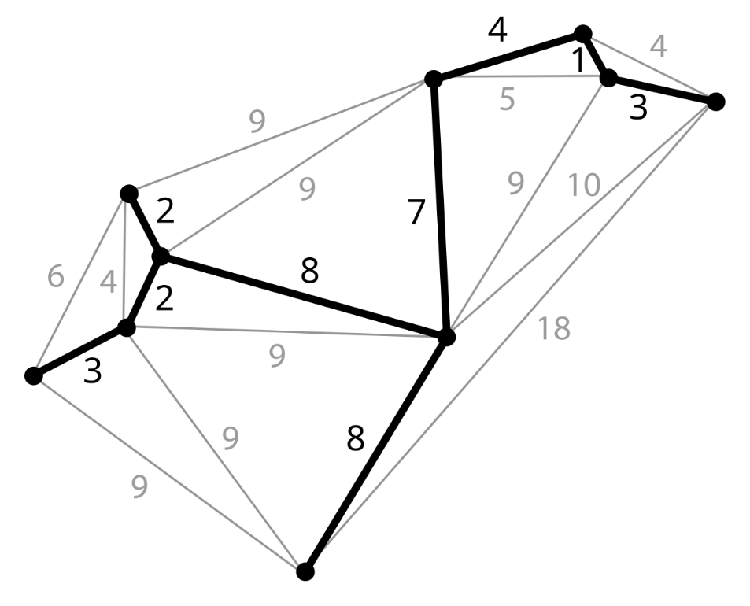
Summary
Minimal Spanning Trees
  Connected acyclic traversals of a graph that minimise the total sum of edges
  Useful for routing applications
Prim’s algorithm
  Iterate over vertices
Kruskal’s algorithm
  Iterate over edges
Next lecture: Connectivity

