Slide 1
COS 212
9.1: Graphs

Slide 2
Lecture Outline
Graph Data Structure
Graph Traversals
Graph Representations
Depth-First
Breadth-First
Terminology
List
Matrix

Slide 3
Limitations of Trees and other ADTs
Linear ADTs such as arrays and linked lists are not efficiently searchable, and encode only one relationship between the elements: order of elements
Trees add the capacity for hierarchical relationship between data elements, and introduce efficient O(lg n) search
What if the data that we want to store is neither linear nor hierarchical?
Suppose you are hired by Google, and you are asked to re-invent Google maps
  How are you going to store the different destinations?
  How are you going to store the distance between different points on the map?
  If a list/tree is used, which point will be the head/root?
When data gets complex, simple structures may fail you

Slide 4
Simple (undirected) graph
edge
deg = 3
vertex
Vertex i is adjacent to vertex j if there is an edge(i,j)
Edge(i,j) is incident with vertices i and j
degree of vertex i, deg(i), is the number of edges incident with i
A set of vertices interconnected by edges
Every vertex represents a data element
Every edge between vertices i and j represents
the relationship between vertices i and j
If the graph is undirected, edge(i, j) == edge(j, i)

Slide 5
Directed graph (Digraph)
directed edge
Every edge between i and j represents the relationship between i and j
In a digraph, every pair of adjacent (connected) vertices is ordered
edge(i, j) != edge(j, i)

Slide 6
Multigraph
Can be directed or undirected
Multiple edges between i and j are allowed

Slide 7
Pseudograph
An edge may connect vertex i to itself
Such a connection is referred to as a loop

Slide 8
Weighted graph
23
5
3
3
15
4
8
9
7
15
5
2
51
5
43
1
A graph where every edge bears a value (weight, or cost)
Based on the application, the value can represent length, cost, distance, etc.

Slide 9
Paths in a graph
If a graph does not contain cycles, it is called an acyclic graph
A
What kind of graph is a binary tree?
N
D
B
C
Binary tree: directed, acyclic, unweighted graph
O
M
Z
E
F
G
Y
H
I
A path from i to j is a set of edges connecting vertices i and j
A path from A to H: (A,C), (C,G), (G,H)
Simple path: a path on which each vertex is unique
Circuit: a path that does a full circle and arrives back at the start (From O to O: [O,N],[N,M],[M,O])
Cycle: a circuit where every vertex is unique

Slide 10
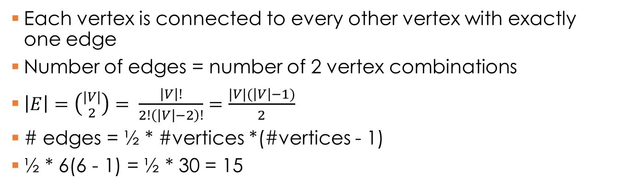
Complete graph
6 vertices,
15 edges
A
D
B
C
E
F
Each vertex is connected to every other vertex with exactly one edge
Number of edges = number of 2 vertex combinations
$\left|E\right|=\left({|V| \atop 2}\right)= \frac{\left|V\right|!}{2!\left(\left|V\right|−2\right)!}=\frac{|V|(\left|V\right|−1)}{2}$
# edges = ½ * #vertices *(#vertices - 1)
½ * 6(6 - 1) = ½ * 30 = 15

Slide 11
Representing graphs
Which representation is better?
a b c
d e f
 | a | b | c | d | e | f
a | 0 | 0 | 0 | 0 | 1 | 0
b | 0 | 0 | 0 | 1 | 0 | 1
c | 0 | 0 | 0 | 0 | 0 | 0
d | 0 | 1 | 0 | 0 | 1 | 1
e | 1 | 0 | 0 | 1 | 0 | 0
f | 0 | 1 | 0 | 1 | 0 | 0
adjacency matrix
a
e
b
d
f
c
 | ae | bd | bf | de | df
a | 1 | 0 | 0 | 0 | 0
b | 0 | 1 | 1 | 0 | 0
c | 0 | 0 | 0 | 0 | 0
d | 0 | 1 | 0 | 1 | 1
e | 1 | 0 | 0 | 1 | 0
f | 0 | 0 | 1 | 0 | 1
d
b
e
f
incidence matrix
e
a
d
f
b
d
adjacency list

Slide 12
Graph VS Tree
A tree is a simple acyclic graph
Tree traversal: visit every node exactly once
Graph traversal: visit every vertex exactly once
Can we use tree traversal algorithms to traverse a graph?
NO, because graphs may have cycles, and unmodified tree traversal algorithms will result in infinite recursion
We have to keep track of the vertices that have already been visited
Depth-first search graph traversal algorithm
  Formalised by J Hopcroft and R Tarjan (1974)
  Visit each vertex v
  For each vertex v, visit its unvisited adjacent vertices
  If a vertex v has no unvisited adjacent vertices, backtrack to v’s predecessor
  Every visited vertex must be labelled as visited for the method to work

Slide 13
Depth-first Traversal: Simple Graph
depthFirst()
for all vertices v
num(v) = 0;
edges = null;
i = 1;//visit order count
while there is a vertex v such that num(v) is 0
DFS(v); // initiate recursion
output edges;
DFS(v) // recursive function
num(v) = i++; // visit
for all vertices u adjacent to v
if num(u) is 0 //unvisited
attach edge(uv) to edges;
DFS(u); // recursion
For every vertex, store the order of visiting; 0 = unvisited.
Store the path
Why do we need the while loop?
a b c
d e f
g h
(1)
(2)
(7)
(4)
(3)
(8)
(5)
(6)
edges: ab, be, ed, dg, gh, ac, cf

Slide 14
Depth-first Traversal: Digraph (directed graph)
depthFirst()
for all vertices v
num(v) = 0;
edges = null;
i = 1;
while there is a vertex v such that num(v) is 0
DFS(v);
output edges;
DFS(v)
num(v) = i++; // visit
for all vertices u adjacent to v
if num(u) is 0
attach edge(uv) to edges;
DFS(u);
The while loop ensures that the entire graph is traversed, even if the graph is not fully connected
a b c
d e f
g h
(1)
(2)
(6)
(5)
(3)
(7)
(4)
(8)

Slide 15
Breadth-first Traversal
(2)
a b c
d e f
g h
(1)
(3)
Depth-first: use a stack
Breadth-first: use a queue
(7)
(5)
(4)
breadthFirst()
for all vertices u
num(u) = 0; // visited #
edges = null; // path
i = 1;
while there is a vertex v such that num(v) is 0
num(v) = i++;
enqueue(v); // add to queue
while queue is not empty
v = dequeue(); // visit
for all vertices u adjacent to v
if num(u) is 0 // unvisited
num(u) = i++;
enqueue(u);
attach edge(vu) to edges;
output edges;
(6)
(8)
iteration | v | queue
init
a
a
b
c
f
1
2
b
c f
e
g
3
c
f e g
4
f
e g
d
5
e
g
6
g
d
7
d
h
8
h

Slide 16
Summary
A
Graphs:
  ADT consisting of vertices connected
  by edges
  Directed VS undirected
  Weighted VS unweighted
  Cyclic VS acyclic
Implementation:
  Adjacency list VS Adjacency matrix
Graph traversals:
  Depth-first: recursive
  Breadth-first: iterative, uses a queue
Next lecture: Topological Sort
D
B
C
E
F
 | a | b | c | d | e | f
a | 0 | 0 | 0 | 0 | 1 | 0
b | 0 | 0 | 0 | 1 | 0 | 1
c | 0 | 0 | 0 | 0 | 0 | 0
d | 0 | 1 | 0 | 0 | 1 | 1
e | 1 | 0 | 0 | 1 | 0 | 0
f | 0 | 1 | 0 | 1 | 0 | 0

