Slide 1
COS 212
Weighted Shortest Paths

Slide 2
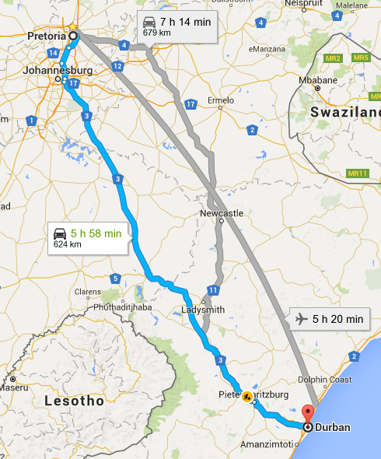
Weighted Shortest Path
Suppose you are travelling
from Pretoria to Durban
What route is the best?
Let’s find the shortest path!
N
13
9
L
10
P
Z
2
3
3
11
J
H
D
15

Slide 3
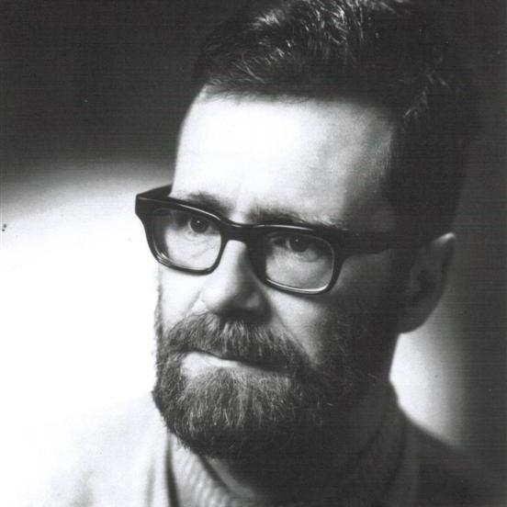
Weighted Shortest Path
The shortest path will have a starting point: P (for Pretoria)
We will also have an endpoint: D (for Durban)
We’ll use Dijkstra’s algorithm to find shortest path from P to D
  Invented by computer scientist Edsger W. Dijkstra in 1956
  One of the best-known shortest path algorithms out there!
N
13
9
L
10
P
Z
2
3
3
11
J
H
D
15

Slide 4
Dijkstra’s Algorithm
For the shortest path, every vertex
will maintain a number variable
to store its distance from the
start vertex
At the beginning of the
algorithm
  Set start.dist = 0;
  For the rest of the vertices,
  dist = Infinity (i.e. unknown)
Remembering the distance
is not enough!
  To be able to reconstruct the
  shortest path, every vertex must also
  remember its “shortest path” predecessor
(null, ∞)
N
13
9
(null, ∞)
L
10
P
Z
(null, 0)
(null, ∞)
3
2
3
11
J
H
D
15
(null, ∞)
(null, ∞)
(null, ∞)

Slide 5
Dijkstra’s Algorithm
Add all vertices to an “unknown vertex” pool
Set current = vertex with smallest distance (initially, start vertex)
For every unknown adjacent vertex n
of current, calculate its distance
from the start, through current
  newdist(n) = current.dist +
  newdist(n) = edge(current, n)
  “If we travel to n through
  current, how long will it take?”
  For current = P
    newdist(J) = dist(P) + edge(P,J) = 0 + 2 = 2
    newdist(N) = dist(P) + edge(P,N) = 0 + 13 = 13
We are looking for the shortest path: If current makes distance to n smaller, current is on the shortest path to n found so far
  if newdist(n) < n.dist, set n.dist = newdist(n), n.path = current
All neighbours considered, so remove current from “unknown” pool, set current = vertex with min dist, repeat from step 2!
(P, 13)
(null, ∞)
N
13
9
(null, ∞)
L
10
P
Z
(null, 0)
(null, ∞)
3
2
3
11
J
H
D
15
(null, ∞)
(P, 2)
(null, ∞)
(null, ∞)

Slide 6
Dijkstra’s
Algorithm
while (!unknown.empty()) {
curr = unknown vertex with min dist
curr.known = true;
for (each unknown neighbour w of curr) {
newDist = curr.dist + length(curr, w);
if (newDist < w.dist) {
w.dist = newDist;
w.path = curr;
}
}
}
Iteration: | Init
curr:
P | 0
J | ∞
N | ∞
L | ∞
H | ∞
Z | ∞
D | ∞
1
P
2
J
3
N
4
H
5
L
6
Z
(P, 13)
(null, ∞)
N
13
9
(null, ∞)
10
(H, 28)
2
P
L
Z
13
13
(null, ∞)
(N, 22)
(null, 0)
(H, 20)
3
∞
∞
22
20
2
3
11
∞
17
17
J
H
D
15
∞
∞
∞
(null, ∞)
28
(P, 2)
(Z, 31)
(null, ∞)
(null, ∞)
28
(J, 17)
∞
∞
∞
∞
∞
31

Slide 7
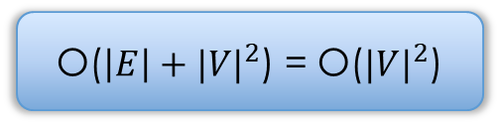
Dijkstra’s Algorithm
(P, 13)
N
13
9
(H, 28)
L
10
P
Z
(null, 0)
(H, 20)
3
2
3
11
J
H
D
15
(P, 2)
(J, 17)
(Z, 31)
So… What is the shortest path?
The predecessor vertices can tell us!
Two ways to use Dijkstra’s algorithm
  To find the shortest path between A and B
  Given A, to determine the shortest paths to every vertex in the graph
  The latter is referred to as shortest-path tree
Complexity?
O($\left|E\right|+{|V|}^{2}$) = O(${|V|}^{2}$)

Slide 8
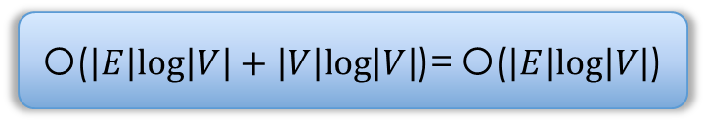
Shortest Paths: Dijkstra’s Algorithm
Dijkstra(Graph, start){
for (each vertex v in Graph) { // Initialization
v.dist = INFINITY; // Unknown distance from start to v
v.path = null; // Previous node in shortest path
v.known = false; // All vertices initially unvisited
}
start.dist = 0 // Distance from start to start (0)
while (vertex with known = false exists in Graph) {
curr = unknown vertex with min dist // will be start
curr.known = true;
for (each unknown neighbour w of curr) {
newDist = curr.dist + length(curr, w)
if (newDist < w.dist) {
w.dist = newDist;
w.path = curr;
}
}
}
What data structure would you use for “unknown”?
Heap Complexity?
Using a min heap can significantly improve the performance
O($\left|E\right|log\left|V\right|+\left|V\right|log\left|V\right|$)= O($\left|E\right|log\left|V\right|$)
Notes:
Section 8.3.

Slide 9
How Reliable is Dijkstra’s Algorithm?
6
6
(null, 0)
(A, 2)
(null, 0)
(A, 2)
(B, 5)
(B, 5)
(A, 6)
(A, 6)
A
2
B
3
C
A
2
B
3
C
100
1
100
-100
D
D
(A, 100)
(A, 100)
Iteration: | Init
curr:
A | 0
B | ∞
C | ∞
D | ∞
1
A
2
6
100
2
B
5
100
3
C
100
4
D
100
Iteration: | Init
curr:
A | 0
B | ∞
C | ∞
D | ∞
1
A
2
6
100
2
B
5
100
3
C
100
4
D
100
0
3
Dijkstra’s algorithm will never realise that D offers a shorter path!

Slide 10
Fixing Dijkstra’s Algorithm
Can’t we fix Dijkstra’s algorithm?
while !unknown.empty() {
curr = unknown vertex with min dist
curr.known = true;
for (each unknown neighbour w of curr) {
newDist = curr.dist + length(curr, w)
if (newDist < w.dist) {
w.dist = newDist;
w.path = curr;
}
}
}
Should we really remove it?
Visit all neighbours?
Add vertex back to the heap if dist changes?

Slide 11
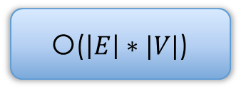
Shortest Paths: Label Correcting Algorithm
labelCorrecting(Graph, start){
create vertex pool toBeChecked
for (each vertex v in Graph) { // Initialization
v.dist = INFINITY; // Unknown distance
v.path = null; // Previous node in shortest path
}
start.dist = 0
toBeChecked.enqueue(start);
while (!toBeChecked.empty()) {
curr = toBeChecked.dequeue();
for (each neighbour w of curr) { // even the visited ones
newDist = curr.dist + length(curr, w);
if (newDist < w.dist) {
w.dist = newDist;
w.path = curr;
if (!toBeChecked.contains(w))
toBeChecked.enqueue(w);
}
}
}
}
Use a queue for the “toBeChecked” pool!
Put w in the queue if w gets updated!
Complexity?
O($\left|E\right|∗|V|$)
Notes:
Section 8.3.

Slide 12
Label Correcting Algorithm with Queue
2
(a,2)
5
(b,7)
Works on negative weights, but not if cycles are present!
a
b
c
2
2
-3
9
(e,4)
4
5
(e,3)
d
(a,2)
e
f
(a,2)
(b,-1)
(g,-2)
Iter:
curr:
Queue: | a
a | 0
b | ∞
c | ∞
d | ∞
e | ∞
f | ∞
g | ∞
1
2
3
4
5
6
7
8
9
Init
1
-5
b
d
e
g
f
f
g
a
b
c
e
f
(d,3)
d
e
c
c
g
f
d
e
g
f
e
e
create vertex set toBeChecked
for (each vertex v in Graph) {
v.dist = INFINITY;
v.path = null;
}
start.dist = 0;
toBeChecked.enqueue(start);
while (!toBeChecked.empty()) {
curr = toBeChecked.dequeue()
for (each neighbour w of curr) {
newDist = curr.dist + length(curr,w);
if (newDist < w.dist) {
w.dist = newDist;
w.path = curr;
if (!toBeChecked.contains(w))
toBeChecked.enqueue(w);
}
}
}
e
c
g
f
2
7
2
2
-1
-2
4
3
3
Notes:
Cf. Figure 8.8.

Slide 13
Shortest Paths: All-Pairs
All the algorithms discussed so far discover the shortest paths from vertex i to any other vertex in the graph
Can we find all the shortest paths from any vertex to any other vertex?
We can calculate the adjacency matrix of shortest paths using the Floyd–Warshall algorithm (named after R. Floyd and S. Warshall)
let dist be a |V| × |V| array of minimum distances initialized to infinity
for each vertex v
dist[v][v] = 0
for each edge(u,v)
dist[u][v] = weight(u,v) // the weight of the edge(u,v)
FWalgorithm(Matrix dist)
for i = 1 to |V|
for j = 1 to |V|
for k = 1 to |V|
if dist[j][k] > dist[j][i] + dist[i][k]
dist[j][k] = dist[j][i] + dist[i][k]
6
 | A | B | C | D
A | 0 | 0 | 3 | 1
B | ∞ | 0 | 3 | ∞
C | ∞ | ∞ | 0 | ∞
D | ∞ | -1 | 2 | 0
A
2
B
3
C
distance
adjacency
matrix
1
-1
D

Slide 14
All-Pairs: Adjacency Matrix
let dist be a |V| × |V| array of minimum distances initialized to infinity
for each vertex v
dist[v][v] = 0
for each edge(u,v)
dist[u][v] = weight(u,v) // the weight of the edge (u,v)
6
 | A | B | C | D
A | 0 | ∞ | ∞ | ∞
B | ∞ | 0 | ∞ | ∞
C | ∞ | ∞ | 0 | ∞
D | ∞ | ∞ | ∞ | 0
 | A | B | C | D
A | 0 | 2 | 6 | 1
B | ∞ | 0 | 3 | ∞
C | ∞ | ∞ | 0 | ∞
D | ∞ | -1 | ∞ | 0
A
2
B
3
C
1
-1
D
Initialise intersections to
existing edge weights

Slide 15
All-Pairs: Distance Matrix
6
A
2
B
3
C
for i = 1 to |V|
for j = 1 to |V|
for k = 1 to |V|
if dist[j][k] > dist[j][i] + dist[i][k]
dist[j][k] = dist[j][i] + dist[i][k]
1
-1
D
At every iteration, determine: Given i, j, k, will the path
from j to k be cheaper if it goes through i ?
 | A | B | C | D
A | 0 | 2 | 6 | 1
B | ∞ | 0 | 3 | ∞
C | ∞ | ∞ | 0 | ∞
D | ∞ | -1 | ∞ | 0
 | A | B | C | D
A | 0 | 2 | 5 | 1
B | ∞ | 0 | 3 | ∞
C | ∞ | ∞ | 0 | ∞
D | ∞ | -1 | 2 | 0
i = 1: A
i = 2: B
 | A | B | C | D
A | 0 | 2 | 5 | 1
B | ∞ | 0 | 3 | ∞
C | ∞ | ∞ | 0 | ∞
D | ∞ | -1 | 2 | 0
 | A | B | C | D
A | 0 | 0 | 3 | 1
B | ∞ | 0 | 3 | ∞
C | ∞ | ∞ | 0 | ∞
D | ∞ | -1 | 2 | 0
i = 3: C
i = 4: D

Slide 16

All-Pairs: Modified FW Algorithm
public static void allPairs(int [ ][ ] a, int [ ][ ] dist, int [ ][ ] path)
{
int n = a.length;
// Initialize distance and path matrices
for (int i = 0; i < n; i++)
for (int j = 0; j < n; j++)
{
dist[i][j] = a[i][j];
path[i][j] = NOT_A_VERTEX;
}
for (int k = 0; k < n; k++)
// Consider each vertex as an intermediate
for (int i = 0; i < n; i++)
for (int j = 0; j < n; j++)
if(dist[i][k] + dist[k][j] < dist[i][j])
{
// Update shortest path and distance
dist[i][j] = dist[i][k] + dist[k][j];
path[i][j] = k;
}
}
Complexity?
O(${|V|}^{3}$)
Also allows for reconstruction of all shortest paths
Notes:
Section 8.3.

Slide 17
All-Pairs: Path Matrix
6
A
2
B
3
C
for i = 1 to |V|
for j = 1 to |V|
for k = 1 to |V|
if dist[j][k] > dist[j][i] + dist[i][k]
dist[j][k] = dist[j][i] + dist[i][k]
path[j][k] = i
1
-1
D
path adjacency
matrix
distance adjacency
matrix
 | A | B | C | D
A | -1 | -1 | 2 | -1
B | -1 | -1 | -1 | -1
C | -1 | -1 | -1 | -1
D | -1 | -1 | 2 | -1
 | A | B | C | D
A | 0 | 2 | 5 | 1
B | ∞ | 0 | 3 | ∞
C | ∞ | ∞ | 0 | ∞
D | ∞ | -1 | 2 | 0
B = 2
i = 2: B
 | A | B | C | D
A | -1 | 4 | 4 | -1
B | -1 | -1 | -1 | -1
C | -1 | -1 | -1 | -1
D | -1 | -1 | 2 | -1
 | A | B | C | D
A | 0 | 0 | 3 | 1
B | ∞ | 0 | 3 | ∞
C | ∞ | ∞ | 0 | ∞
D | ∞ | -1 | 2 | 0
D = 4
i = 4: D

