Slide 1
COS 212
Unweighted Shortest Path

Slide 2
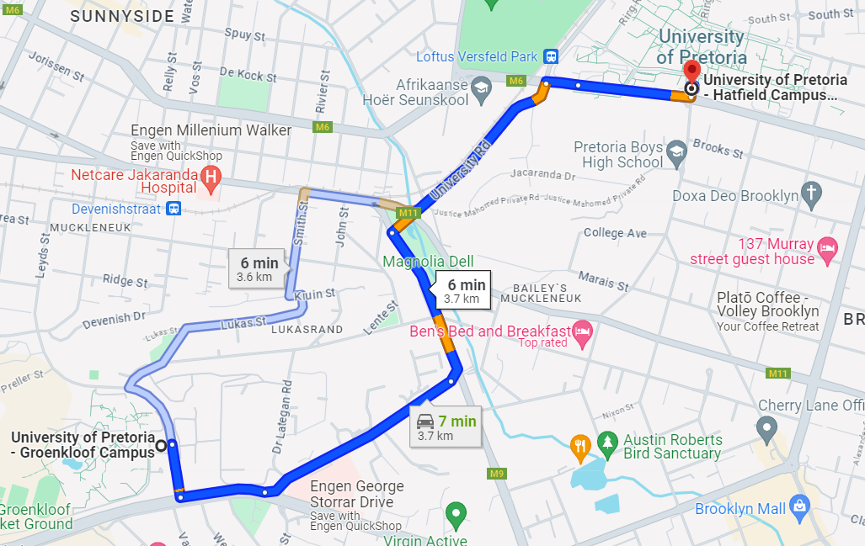
Shortest Paths
How do Google Maps figure out the fastest way between any two selected points?

Slide 3
Representing Maps as Graphs
How do we represent a map as a graph? What are the vertices and edges?

Slide 4
Representing Maps as Graphs
Task: given all possible paths, pick the shortest/cheapest
H
3
I
4
F
2
3
G
3
E
3
2
D
C
K
1
4
B
1
2
A
J

Slide 5
Shortest Paths
The length of a path is the sum of the edge weights on that path.
Shortest Path Problem:
  Given: a graph G and vertices s and t
  Find: the shortest path from s to t
1
y
4
w
3
s
5
t
6
2
4
5
u
1
v
x

Slide 6
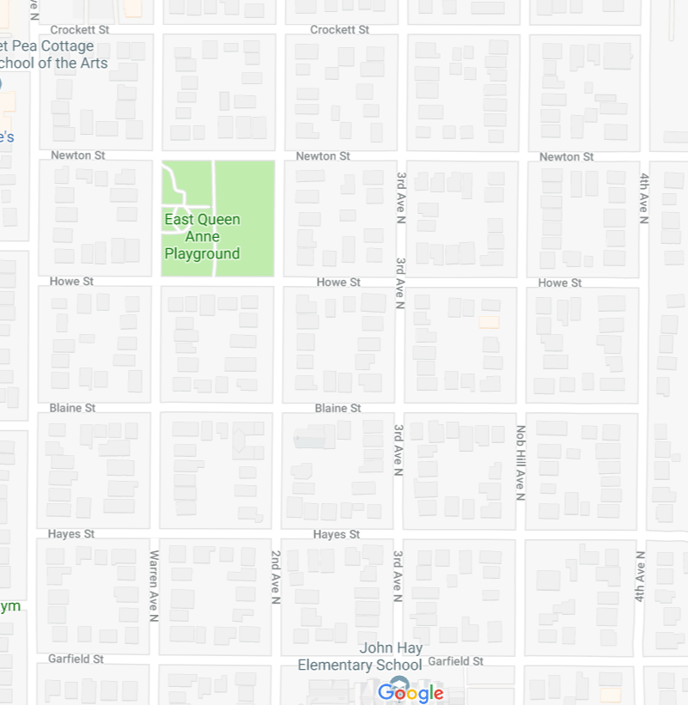
Unweighted Graphs
Let’s start with a simpler version: the edges are all the same weight
If all weights are the same, they carry no information and can be discarded: the graph becomes unweighted
If the graph is unweighted, how do we find a shortest path?
Since the edges have no weight, all we can do is count the number of edges.
Unweighted shortest path: find the path from s to t with the least number of edges
Notes:
9:38:30

Slide 7
Unweighted Graphs
If the graph is unweighted, how do we find a shortest path?
What’s the shortest path from s to s?
  Well….we’re already there.
What’s the shortest path from s to u or v?
  Just follow a single edge from s
What’s the shortest path from s to w, x, or y?
  Can’t get there directly from s!
  We have to go through u or v.
1
2
u
w
0
2
s
y
t
v
x
1
2
Let’s design an algorithm!

Slide 8

Naïve Unweighted Shortest Path
currDist = 1
Complexity?
currDist = 2
unweighted(s)
for all vertices v
dist(v) = INF;
known(v) = False;
dist(s) = 0;
for (currDist = 0; currDist < |V|; currDist++)
for all vertices v
if !known(v) and dist(v) is currDist
known(v) = True;
for all vertices u adjacent to v
if dist(u) is INF
dist(u) = currDist + 1;
path(u) = v;
O(${|V|}^{2}$)
currDist = 3
currDist = 4
…
currDist = |V|-1
vertex | known | dist | path
s
u
v
w
x
y
z
∞
T
0
F
∞
s
T
1
F
∞
s
F
1
T
∞
∞
2
1
∞
T
2
u
F
∞
u
w
∞
0
3
∞
u
∞
F
2
2
T
s
y
z
∞
v
F
2
T
v
x
3
w
∞
∞
F
∞
1
2
T

Slide 9
Optimising the Unweighted Shortest Path
How does the naïve algorithm work?
For each vertex, assign a path length to all neighbours that don’t know their path length
Move on to the next node only after all neighbours have been considered
What does this remind you of?
Breadth first search / traversal!
1
2
u
w
0
2
s
y
t
v
x
1
2

Slide 10
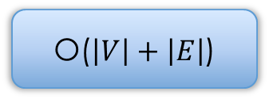
Unweighted Shortest Path
s
u
v
w
x
y
z
unweighted(s)
for all vertices v
dist(v) = INF;
dist(s) = 0;
enqueue(s); // use a queue – Breadth-First!
while queue is not empty
v = dequeue();
for all vertices u adjacent to v
if dist(u) is INF
dist(u) = dist(v) + 1;
path(u) = v;
enqueue(u);
Complexity?
O($\left|V\right|+\left|E\right|$)
vertex | dist | path
s
u
v
w
x
y
z
∞
0
1
s
∞
∞
s
1
∞
1
2
∞
∞
u
2
0
u
w
∞
∞
3
∞
u
∞
2
2
s
y
z
2
∞
v
v
x
w
∞
∞
∞
3
1
2

Slide 11
What about the target vertex?
Shortest Path Problem:
  Given: a graph G and vertices s and t
  Find: the shortest path from s to t
BFS finds the shortest path from s to every other vertex.
If a target is known: stop the search when the target is found
Note: this only works for unweighted graphs
In weighted graphs, we never know if future edges will be cheaper than the ones already considered!
More on this next week ☺
1
2
u
w
2
3
s
y
t
v
x
1
2

Slide 12
Summary
1
2
u
w
2
3
s
y
t
v
x
1
2
Shortest Path Problem:
  Given: a graph G and vertices s and t
  Find: the shortest path from s to t
Unweighted shortest path
  Assume each weight is 1
  Shortest path = path with fewest edges
  Use a BFS + queue!
Next week: weighted shortest paths

