Slide 1
Danju Zhihan
Tangerine Knows the Drought — a climate decision assistant for citrus growers
Danjiangkou Reservoir Area · South-North Water Transfer Middle Route
One Place · One Climate Problem · One AI Solution
AI4Climate Global Youth Climate Solutions Challenge · Team Canglangzhou
Open track / Climate adaptation & resilience

Slide 2
01
The Real Problem: Citrus Under Extreme Drought-Flood Swings
Danjiangkou Reservoir — the core water source of the South-North Water Transfer (Middle Route);
300,000 mu of citrus and ~100,000 growers along its banks. Weather-driven losses are now routine:
● 2022: the Yangtze basin's worst heat-drought since 1961 — 44.6℃ in Zhushan, Shiyan set a Hubei record;
weather authorities flew cloud-seeding aircraft over the Danjiangkou basin for the first time
● Reference orchard (Liangshuihe town): 30 days at ≥35℃ that summer, extreme high 40.9℃ (ERA5-Land recomputed)
● Literature (study area is Wuxue, Hubei — not Danjiangkou): 38 weather disasters in 2008–2023;
flowering water deficit raised flower drop by 32–45% (DOI 10.12238/as.v8i8.3240)
— used only as problem motivation, never as evidence of this tool's effect
● 2025: the Hanjiang river's densest autumn flood season in 64 years, 7 numbered floods — drought-flood swings are the new normal
Pain point: growers improvise from experience, with no decision hint of "my orchard × current phenophase × next few days" — remediation after the fact costs far more than preparation before it.

Slide 3
02
The Solution: From Open Weather Data to Actionable Advice
Open weather data
Open-Meteo
ERA5-Land reanalysis
+ ECMWF forecast
(no key, browser-direct)
Phenophase ID
budbreak / bloom /
fruit set / swell /
harvest / dormancy
Four-risk engine
heat · drought
low-temp bloom · winter
levels + trigger evidence
Farm advice
risk × phenophase
action list
rules sourced
Live demo: https://pawnnwap.github.io/danju-zhihan/ Open source: https://github.com/Pawnnwap/danju-zhihan
Works in any phone browser: pick an orchard block (or enter custom coordinates) → phenophase & four-risk dashboard → 90-day risk calendar → farm advice → historical replay → Q&A.

Slide 4
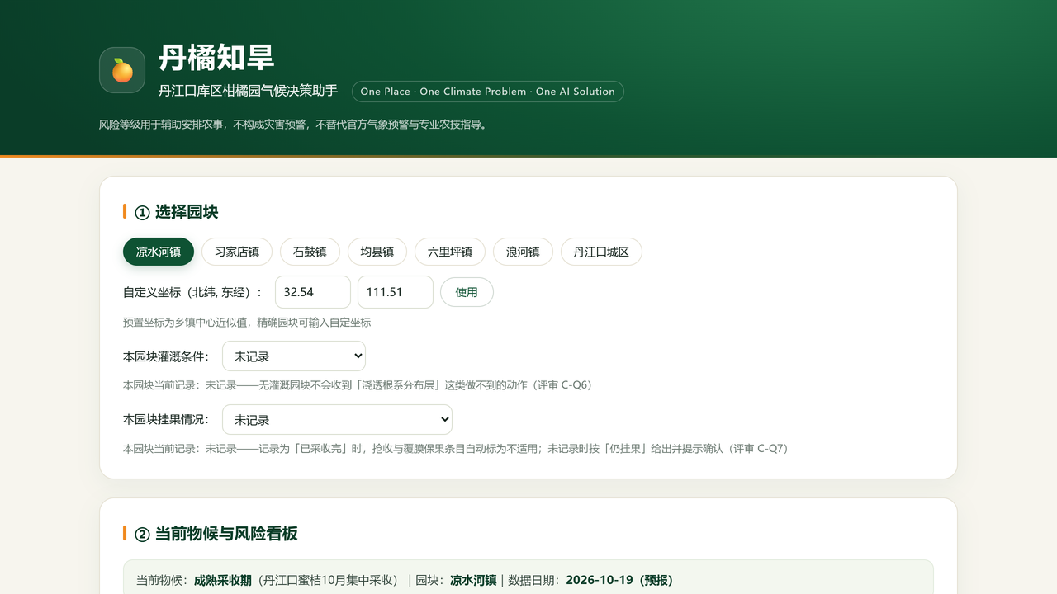
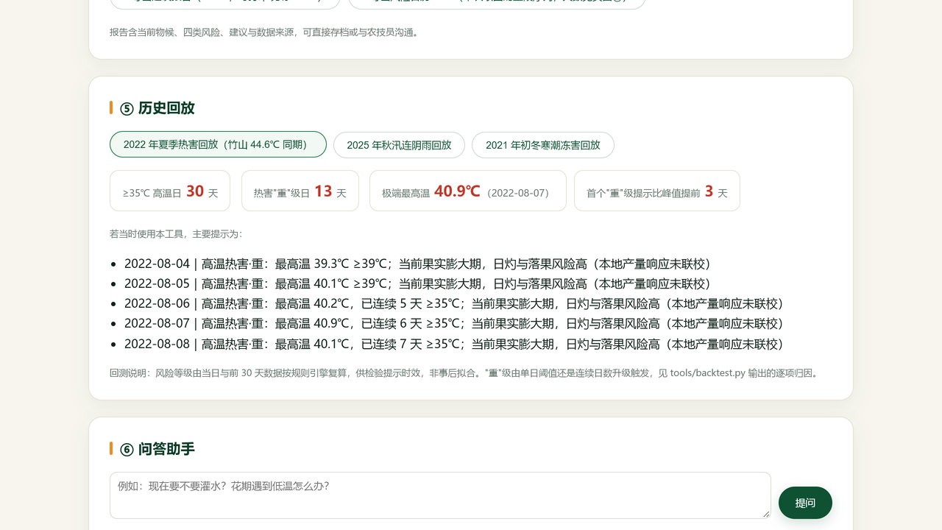
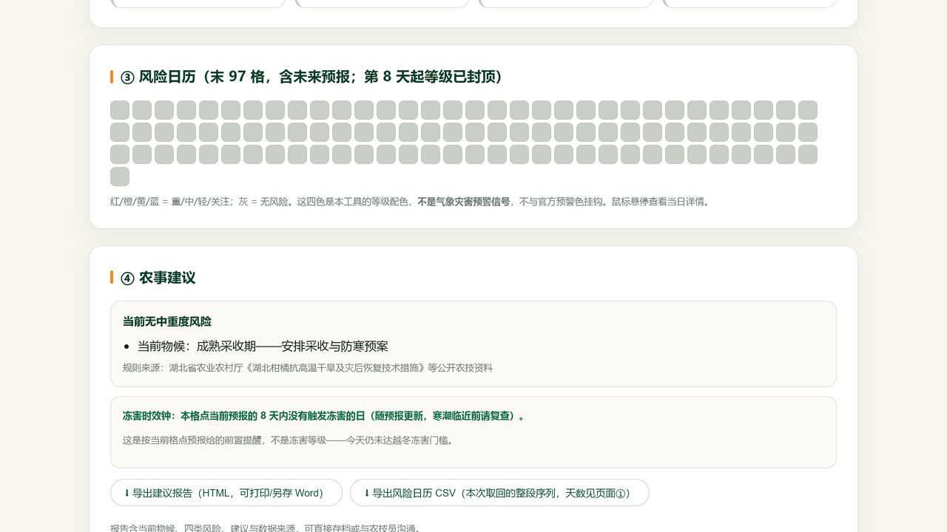
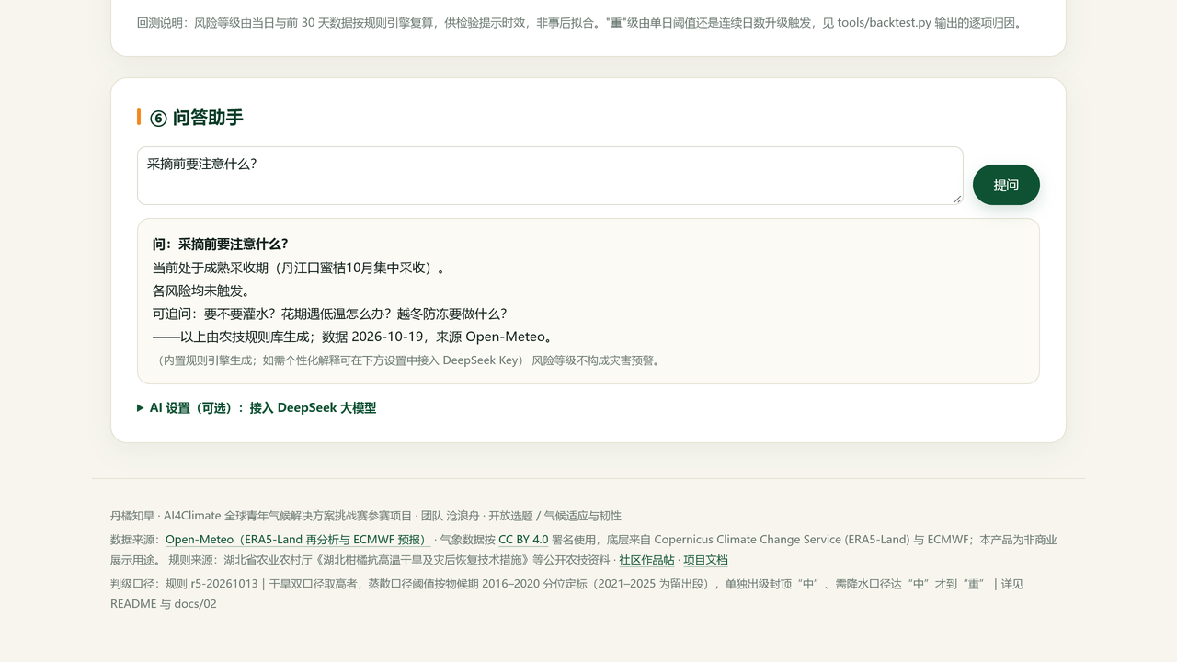
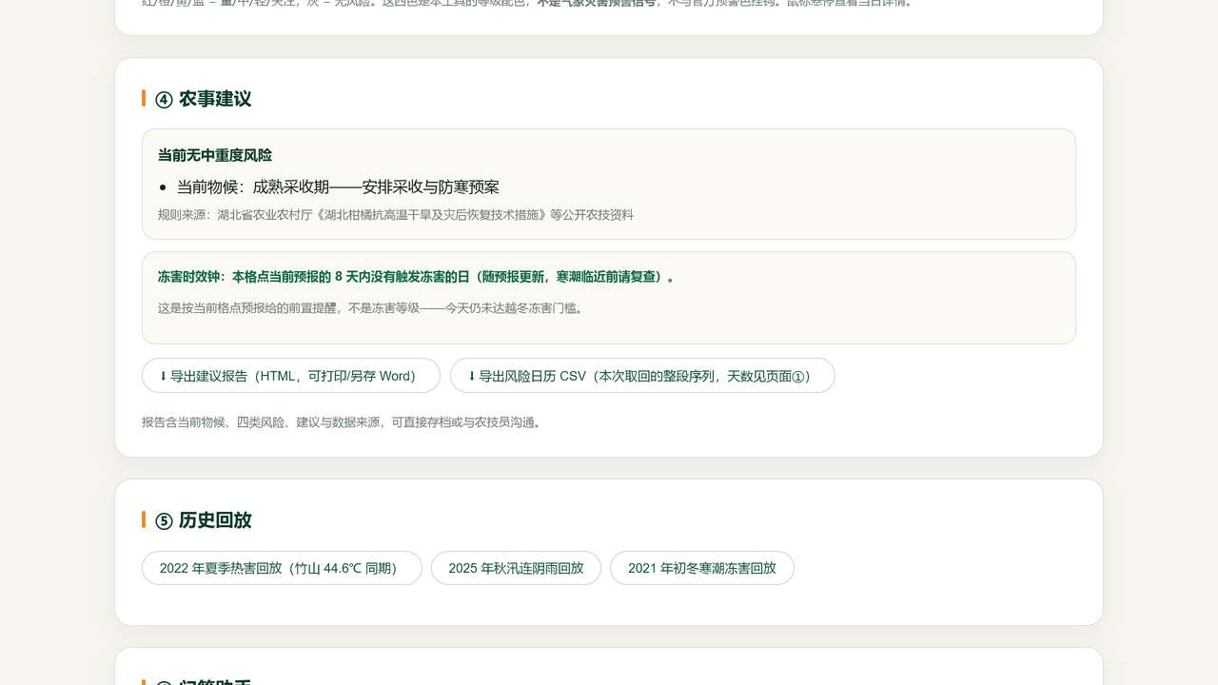
02
Product UI: Real Screenshots (same build as the live demo)
① Dashboard: current phenophase + four risk levels & trigger evidence
② Historical replay: day-by-day of the 2022 summer heat event
③ 90-day risk calendar (CSV export, BOM, opens in Excel)
Runs in any phone browser
· No install, no account, no backend
· Orchard conditions stay on-device
· 175-second demo video, 1080p, VO + subtitles
· UI shown is Chinese; rules are open & auditable
④ Q&A: built-in rule-based answers when no LLM key is set
⑤ Advice & exportable report (printable for technicians)

Slide 5
03
AI's Specific Task: Rules Compute, LLM Explains
① Deterministic risk engine (core)
② DeepSeek LLM explanation layer (optional)
● Thresholds + consecutive days + phenophase, daily
level & trigger evidence
● All thresholds explicit — auditable, reproducible, testable
● Drought: dual criteria take the higher — rainfall type +
ET0 type (calibrated on 2016–2020 by phenophase;
ET0 alone caps at mid, severe needs rainfall corroboration)
● Day-by-day parity vs the Python implementation: 442 days +
37 boundary cases + threshold binding + verbatim text match;
44 injected mutations all caught by the gates
● Risk data + rule library as context → personalized
advice & natural-language follow-ups
● Answers must cite data dates — hallucination suppressed
● LLM only translates & explains; it never predicts numbers
● No key? Falls back to built-in rule Q&A —
the product stays complete without the LLM
Not "AI for AI's sake": the product works fully without the LLM; the model solves one concrete burden — the same data needs different wording for different users, plus follow-up questions.

Slide 6
04
Verification: Backtest Passed; 90-Day Pilot Designed
Historical backtest (2022 heat event · Liangshuihe town · real data)
● 30 days at ≥35℃ 13 days at heat-severe extreme high 40.9℃ (Aug 7)
● First severe-level alert Aug 4 (39.2℃) — 3 days ahead of the peak; timing attributed to the single-day ≥39℃ threshold, not the streak upgrade
● Drought dual-criteria same period: 1 severe / 55 mid (severe needs rainfall corroboration); first alert Jun 1 (35-day warm-up, same as the product)
● Where the ET0 criterion adds value (recomputable day-by-day): four days in Aug 2022 exceeded the swelling-phase p99 (123–138mm); Aug 26 scored severe (rain30=29.9 lifted rainfall to mid, corroboration holds), other three recorded mid
● Offline-recomputable: input series frozen in repo; parity + boundary + mutation + doc-consistency gates all green
90-day pilot plan:
● Who: 1–2 citrus cooperatives / township technicians (30–100 mu), two on-site visits + weekly check-ins (cash cap ¥3,400; drops to ¥2,200 if compensation cannot be legitimately paid)
● Metrics (n=2 households, 13 weeks, counts only): weekly-active ≥19/26 household-weeks | winter-readiness ≥6/8
adoption ≥5/10 (fewer than 5 mid/severe alerts → report cases only) | satisfaction 2/2 households avg ≥4 | continued use 2/2
● Failure (pre-registered): weekly-active ≤14/26, or readiness <3/8, or any household never opens → core target missed
● Precondition: one-page pilot & responsibility agreement with the cooperative (internal arrangement); unconfirmed external actions are never pushed

Slide 7
05
Sustainability · Openness · Safety Boundaries
Sustainability (next 12 months, honest choice)
Scaling & single-point risks
● A public-good product: permanently free, no paywall,
self-hostable, no commercialization ever (including long term)
● Positioning: open, recomputable work + handover kit
(we do not claim "public infrastructure")
● Funding: no external funds beyond one-off prize money;
public-good stance is permanently consistent with the
Open-Meteo non-commercial license
● Cost model: zero-server static site; pilot cash capped at ¥3,400,
labor 85–95 h — overspending triggers & exit triggers pre-written
● Same-climate citrus areas = weak transfer (still needs
local calibration)
● Cross-crop (e.g. tea) = strong calibration, 5–15 person-days/area
● Only Danjiangkou in the next 12 months
● Bus factor = 1: no successor committed yet, so we do not
call this " dependable public infrastructure"
Safety boundary: risk levels assist farm planning only — not disaster warnings, and no substitute for official meteorological warnings or professional guidance; reanalysis/forecast data carry uncertainty — combine with local weather authorities for major decisions.
Ethics: no personal identity collected; pilot evidence (screenshots/photos) is de-identified and stored locally; only aggregates published; participants may withdraw at any time.

Slide 8
06
Uncertainty Stated Upfront (Grid Sensitivity Measured)
Same coordinates, four distinct grid cells: in 2022, 54 of 122 days (44.3%) disagreed on the highest of the four risk levels. A ~9km grid reanalysis is not an orchard measurement — this test ships in the repo, recomputable by anyone.
Known uncertainties & how we handle them
● ERA5-Land is a ~9km grid — biases vs on-orchard reality
→ per-orchard calibration in the pilot; levels labeled with grid scope
● 7-day forecast error grows with lead time
→ beyond day 8, levels are capped at "watch"
● Drought thresholds not yet checked against local soil moisture
→ field soil-moisture cross-check is a mandatory pilot record
● Forecast skill never backtested
→ we claim no forecast skill, only risk-window hints
Honestly stated, never claimed:
● The 2022 backtest is one event at one grid point —
not a general accuracy rate
● Drought "severe" discrimination is the weakest named claim
● No user interviews yet; no loss-reduction data (pilot answers)
● Every level prints rule version + calibration/holdout years —
screenshots trace to a specific rule version
Principle: external actions fail closed (never pushed without confirmation); no on-site commands; levels assist farm planning only.

Slide 9
07
Communication: Turning Expert Levels Into Wall-Ready Advice
① Dashboard: four risks on one screen
② 97-day calendar: one color-coded cell per day
③ Report: printable for the cooperative board
Communication chain (already live)
● Complex climate info → four color levels + one-line trigger
● Report/CSV generated locally in the page — no server
● Portrait phone layout, shareable in technician WeChat groups
● Smallholders benefit via nodes: print & post the report
Public verifiability:
● Three historical replay scenes, openable on the spot
● Frozen inputs + open code — anyone recomputes offline
● 175-second video + open repo + community post
● Page footer prints the rule string — traceable to rule version

Slide 10
08
90-Day Pilot: Weekly Rhythm & Pre-Registered Criteria
Weekly rhythm (by citrus season)
Evidence rules (anti-self-confirmation)
● Weeks 1–2 (Nov): sign agreement · set blocks · record baseline
● Weeks 3–10: usage · weekly reports · biweekly threshold calibration
● Weeks 11–13 (Jan): revisit · review · final report
● Covers two risk processes: winter freeze (Nov–Dec) and
cold-snap window (Mar–Apr, tracked after the review)
● Every Friday: LLM usage screenshot logged (cap ¥100;
at ¥50 cumulative the kill-switch disables the key)
● Adoption needs evidence: whitewash photos / purchase receipts /
irrigation records; timing from two specific dates
● n<10 → counts only, never percentage claims
● Replay-scene evaluation labeled "intent/rehearsal",
never merged with real adoption
● 6 weeks zero activity or zero confirmation responses
→ exit triggers: 90-day sunset banner + archive
● "Request sent with delivery proof, still unsigned" is the only
demand-side evidence that counts
Pilot cash cap ¥3,400 (drops to ¥2,200 if compensation cannot be legitimately paid) + 85–95 project labor hours — all with pre-written overspending triggers and exit triggers; weekly ledger in docs/04, published at the review.

Slide 11
Canglangzhou
Solo entry · October 2026
Bring a real problem; let AI actually solve it.
One place. One climate problem. One AI solution.
ai4climate.world ｜ pawnnwap.github.io/danju-zhihan ｜ deepseek.club/topic/5043

