Slide 1

Session 1: Use The Source
Notes:
<Feel free to replace these initial slides with your own “intro to Allinea” slides or any background you want to cover before the story starts at slide 4/5>

Slide 2
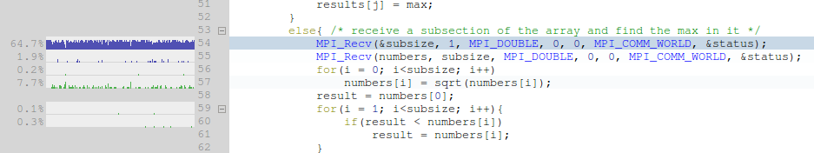
Session 1: Use The Source
-> Measure the performance of an MPI program
-> Explore the code with Allinea MAP's viewer
-> Identify a bottleneck and deduce its cause
-> Change the code and measure the improvement
Notes:
<Feel free to replace these initial slides with your own “intro to Allinea” slides or any background you want to cover before the story starts at slide 4/5>

Slide 3
Review: Use The Source
-> Introduced to Allinea MAP
-> Used code folding to explore an unfamiliar file
-> Saw high MPI usage and high MPI imbalance
-> Deduced cause – rand() is slow!
-> Fixed by distributing rand() work to nodes for >2x speedup
Notes:
<Feel free to replace these initial slides with your own “intro to Allinea” slides or any background you want to cover before the story starts at slide 4/5>

Slide 4
Session 2: CPU Optimization
Notes:
<Feel free to replace these initial slides with your own “intro to Allinea” slides or any background you want to cover before the story starts at slide 4/5>

Slide 5
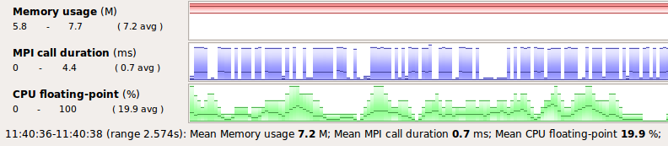
Session 2: CPU Optimization
-> Interpret Allinea MAP's metric graphs
-> Explore compiler loop vectorization
-> Recognize cache-related problems
-> Improve loop cache performance
-> Experiment with conflicting optimizations
Notes:
<Feel free to replace these initial slides with your own “intro to Allinea” slides or any background you want to cover before the story starts at slide 4/5>

Slide 6


Review: CPU Optimization
-> Introduced to single-core optimization with Allinea MAP
-> Saw zero vectorization and corrected with compiler flags
-> Recognized poor cache performance and its solutions:
  In this case improved temporal locality with loop fusion
-> Looked at conflicting optimizations – vectorization and loop fusion
-> Found further benefits by swapping library functions
Notes:
<Feel free to replace these initial slides with your own “intro to Allinea” slides or any background you want to cover before the story starts at slide 4/5>

Slide 7
Review: Profiling with Allinea MAP
Compile with both -O3 and -g
  -ffast-math and friends are also recommended!
Remember that “time mpirun” includes system overheads
Run interactively with: map program-name
Run in batch mode with: map -n #procs -profile program-name
Use View->Fold All to explore unfamiliar files
Use metric views to spot imbalance and cause of bottlenecks
In this course we improved performance by 4x – let me know how you get on with your own codes!
Notes:
<Feel free to replace these initial slides with your own “intro to Allinea” slides or any background you want to cover before the story starts at slide 4/5>

