Slide 1
Introduction to IT
IT – Information Technology

Slide 2

IT - Definition
Everyone knows what information is…
A bit formalized:
Data: a set of specific values, e.g. 0010010011
Information: what we interpret data as repre-senting, given a specific context
A sequence of 0 and 1 might be interpreted as text, an image, music, video etc..
A computer only works with binary data: 0’s and 1’s.

Slide 3
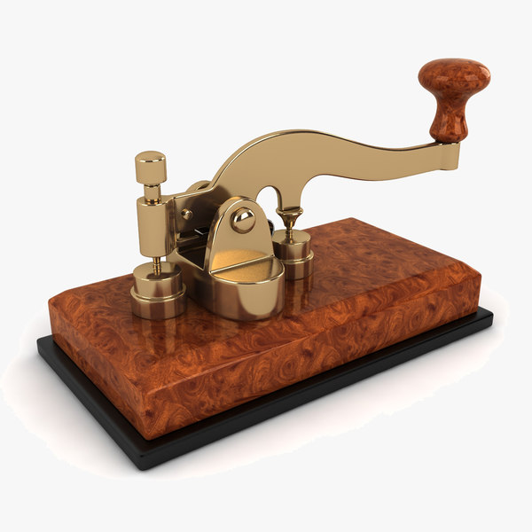
Information
We produce information in order to communicate
We want to communicate
With our (future) selves
With other humans
With computer systems
Across space and time

Slide 4
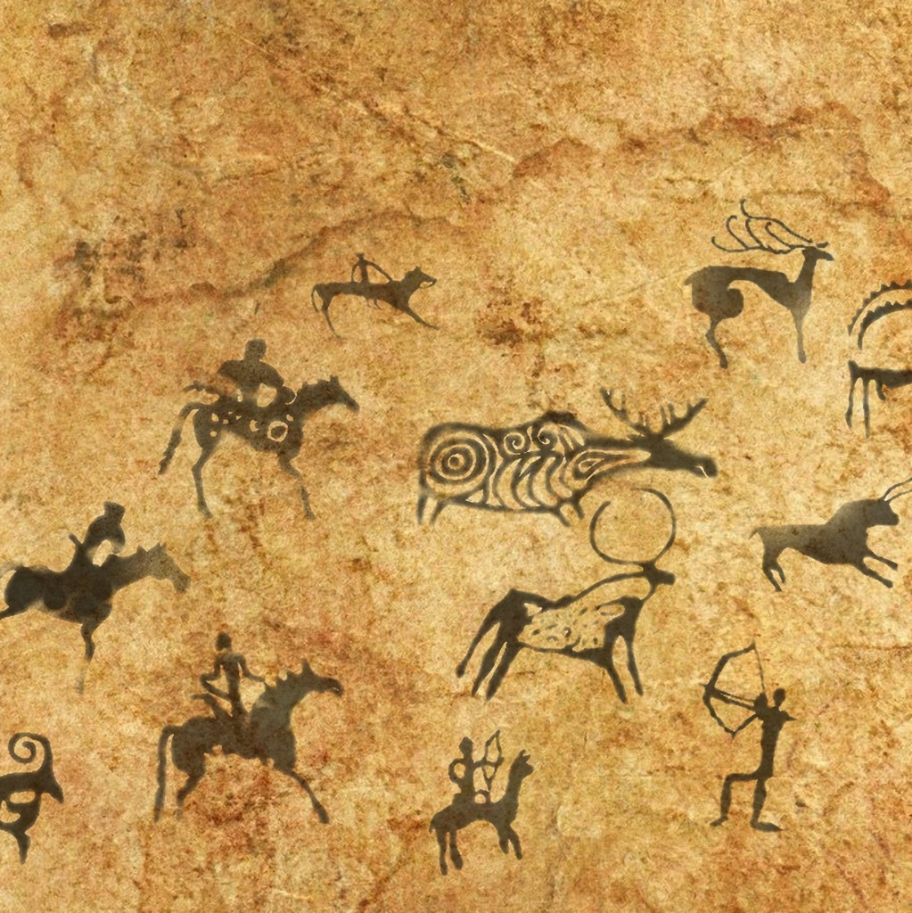
Information
Our ability to communicate complex information enables us to create culture, and preserve knowledge across generations

Slide 5
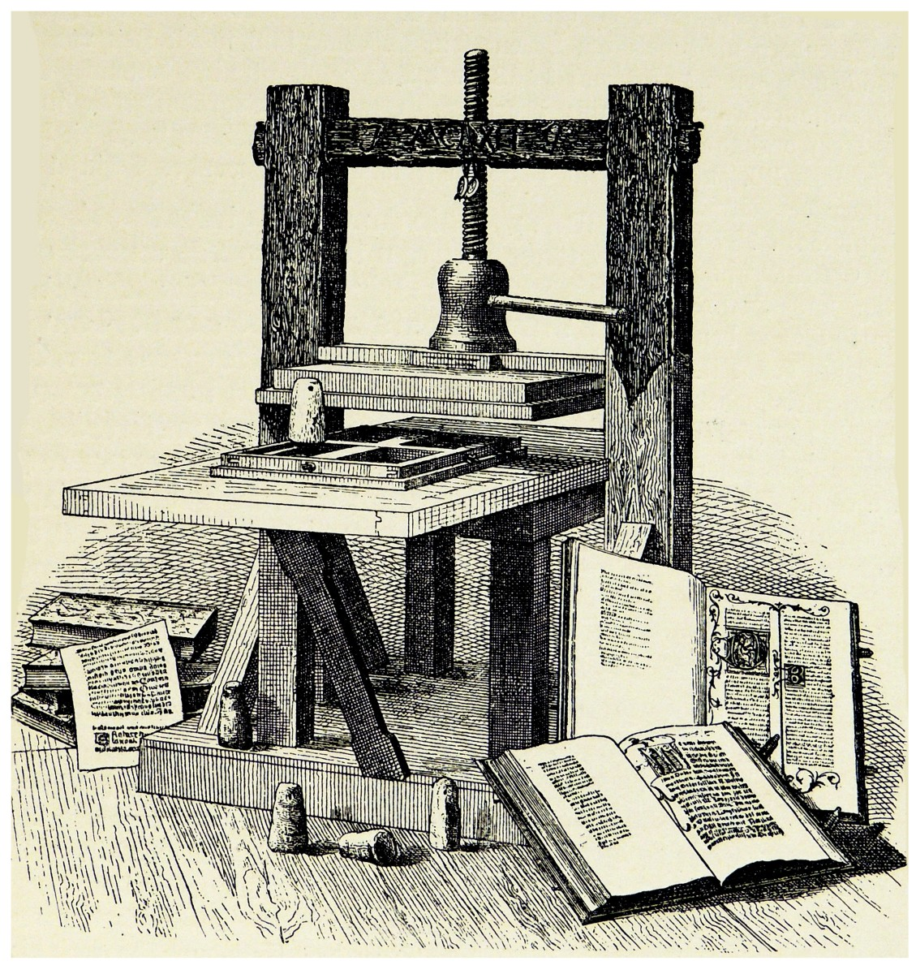
Technology
Information and technology are (of course) strongly connected
More advanced technology enables more complex and voluminous communication

Slide 6
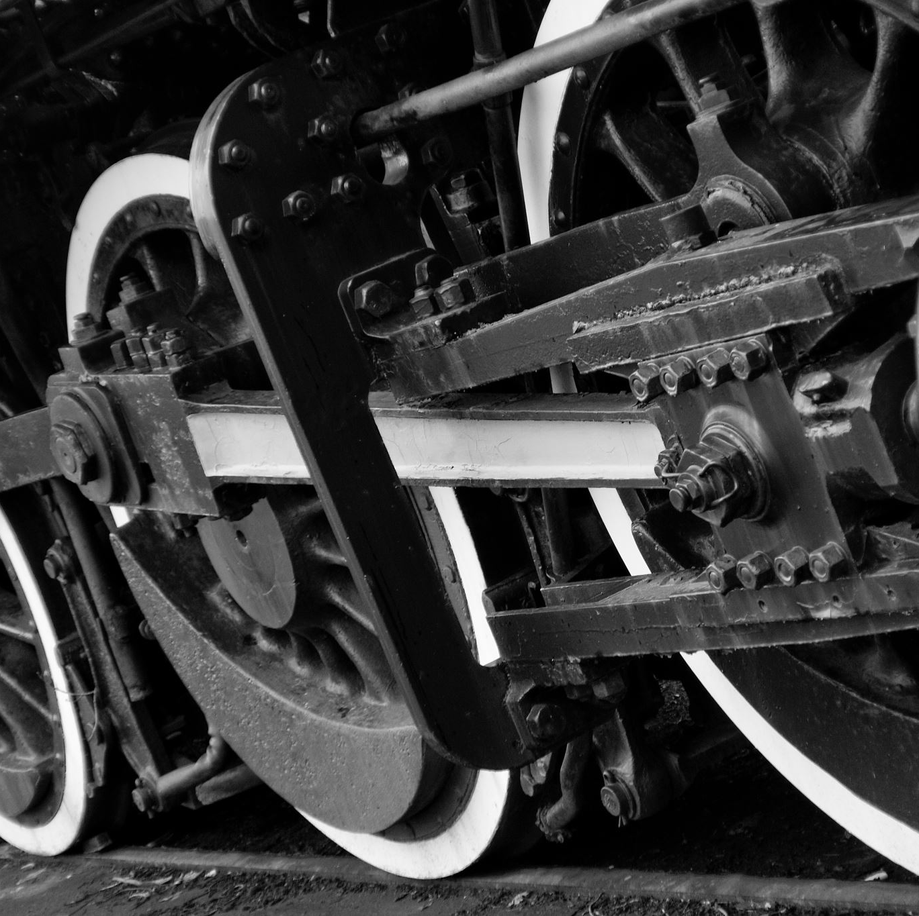
Eras (years are not accurate)
Pre-mechanical ( – 1200)
Mechanical (1200 – 1840)
Elektro-mechanical (1840 – 1940)
Electronic (1940 - )

Slide 7
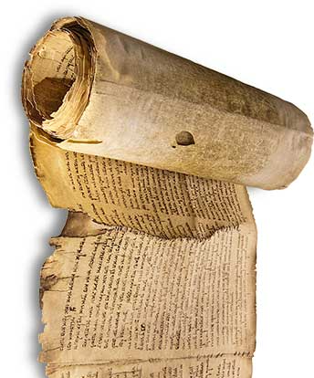
Pre-mechanical
Languages, alphabets
Writing tools
Hand-written permanent media (books, scrolls, stone tablets, etc.)
Number systems
First major cultures
Producing (permanent) information is slow…

Slide 8
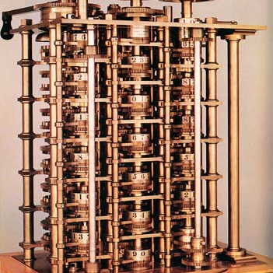
Mechanical
Book-printing (Gutenberg and others, not just Europe!)
Books become accessible
Mechanical calculators
First examples of ”program-mable” units (looms)
Long-distance communication is slow and high-latency…

Slide 9
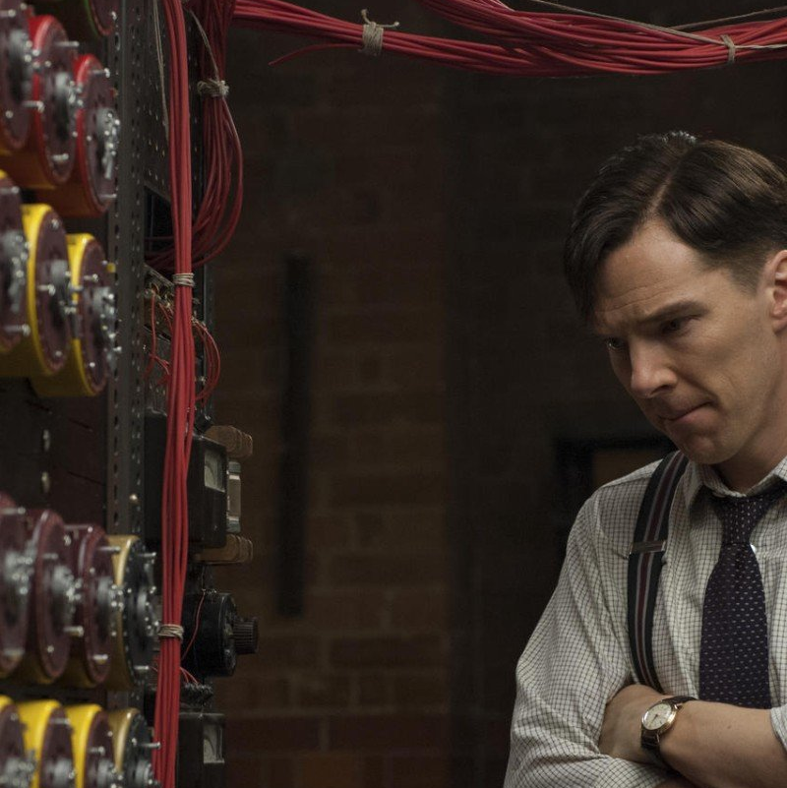
Electro-mechanical
Taming of electrical current
Telegraph, radio, phone systems
Instant round-the-globe communication (almost…)
IBM

Slide 10
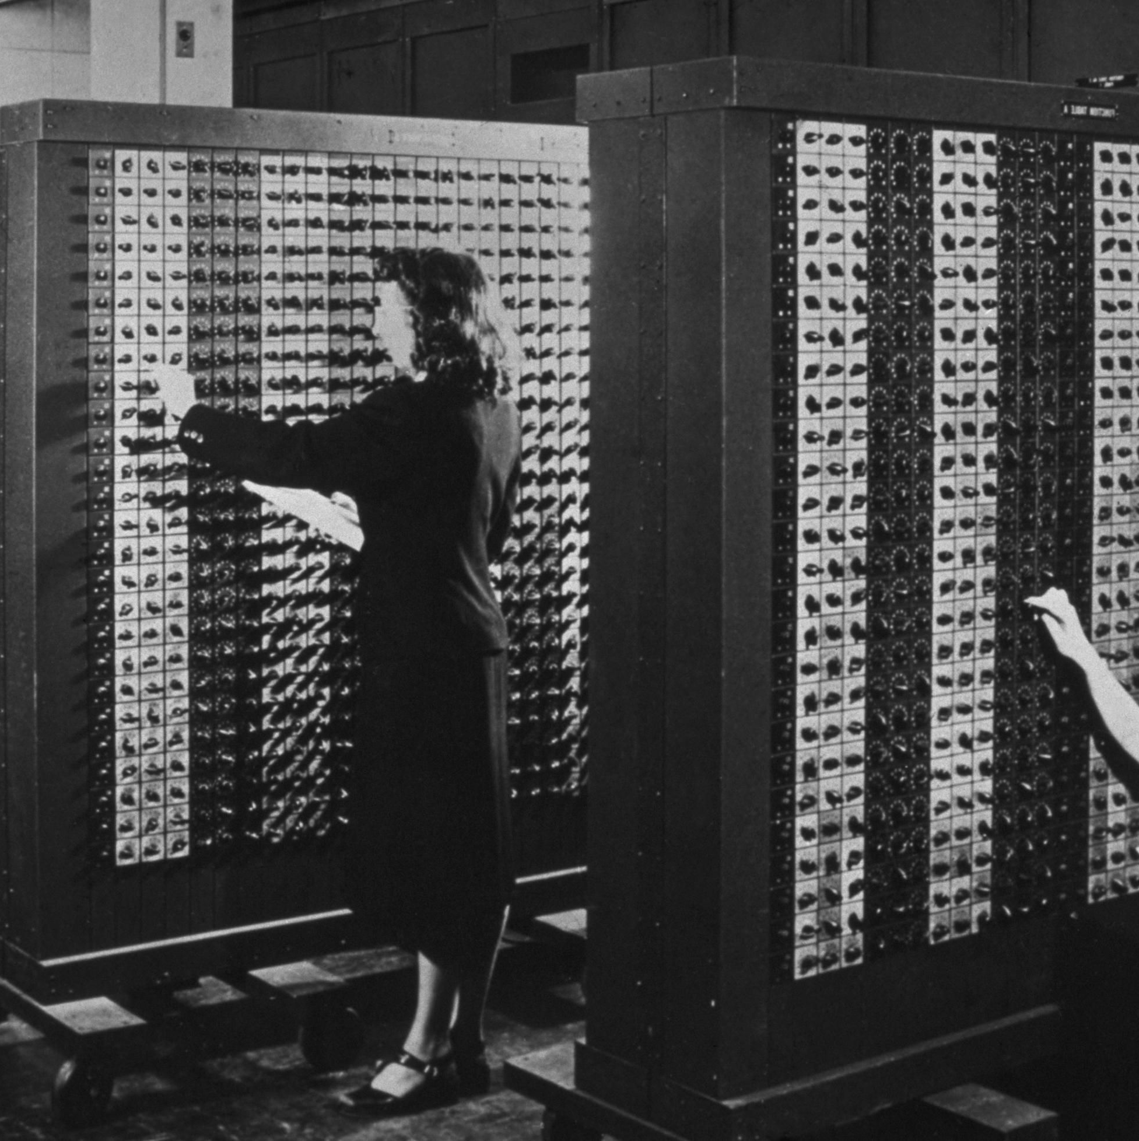
1940 - 1950
First purely electronic computers, based on radio tubes
Definition of general computer architecture (von Neumann)
Very expensive, slow and error-prone…
Only military and universities

Slide 11
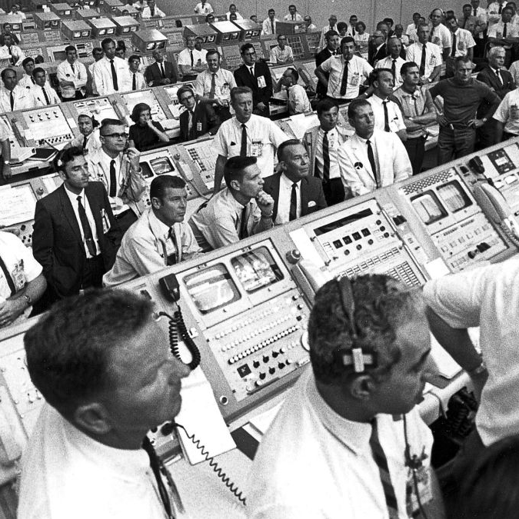
1950 - 1975
Transistors, later microchips
Punch cards, later magnetic tape
Programming languages
Operating systems
Prices drop, capacity and speed increase
Commercial use (banks, insurance,…)
Space industry
Pocket calculators…

Slide 12
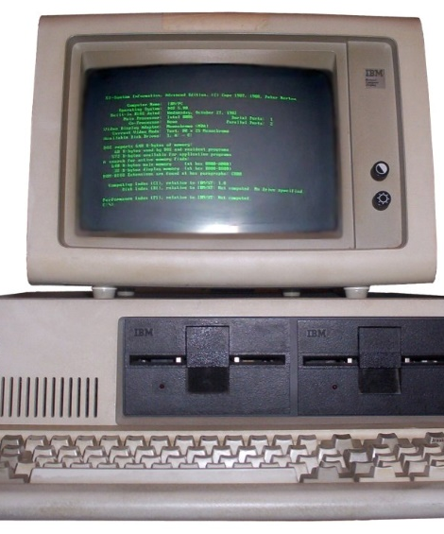
1975 - 1990
Prices still drop (fast), and capacity/speed still increases (fast)
First products aimed at private consumers and small businesses
IBM Personal Computer (about 50.000 kr.)
ZX Spectrum, Commodore 64
PC down to 15.000 kr. in late 80’s
1989: Tim-Berners Lee and others at CERN lay the foundation for WWW (World Wide Web)

Slide 13
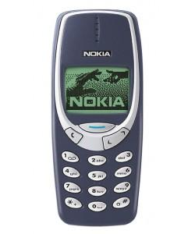
1990 - 2000
PCs for the masses…
Windows, browsers
Proliferation of digitalisation in public and private sector
Mobile phones (Nokia)
Internet Bubble 1995-2000

Slide 14
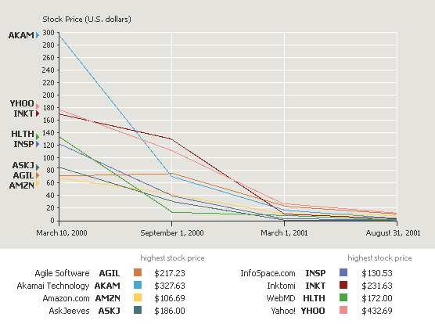

Slide 15

2000 - 2010
Rapid increase in homes with PC and internet access
Web 2.0: Users create content (Facebook, YouTube,…)
Internet access through other devices (access more important than device)
iPhone

Slide 16
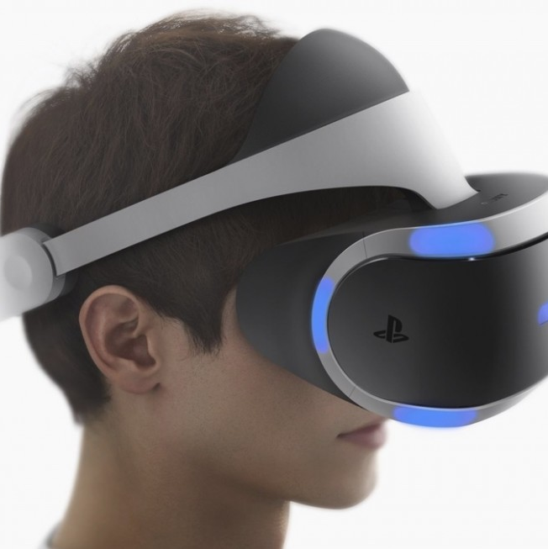
2010 -
Everyone is online (almost…)
Everything is online (well…)
Digitalisation continues
Renewed interest in AI and VR
Robotics
IT permeates out lives – for better or worse…

Slide 17

AI to-do list
Beat humans at
Chess (1997)
Jeopardy (2011)
Go (2016)
Protein Folding (2021)
…?

Slide 18
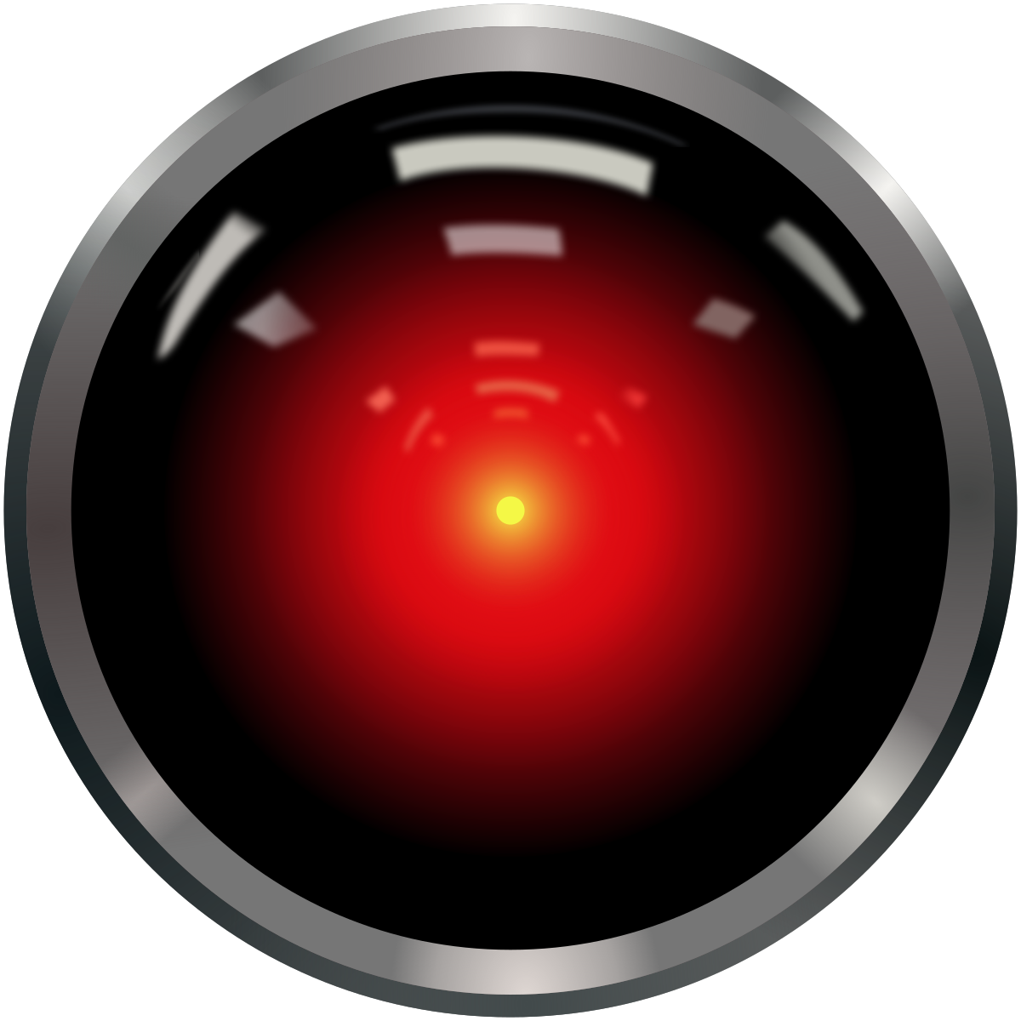
AI to-do list
Beat humans at
Chess (1997)
Jeopardy (2011)
Go (2016)
Protein Folding (2021)
…?

Slide 19

The rise of LLMs…
LLM (Large Language Model)
ChatGPT, Claude, Grok, Open Source…
Are – in principle – just ”token predictors”
Outperform humans for a very large spectrum of tasks
A very large topic on its own…

