Slide 1
The Programming Process

Slide 2



Slide 3
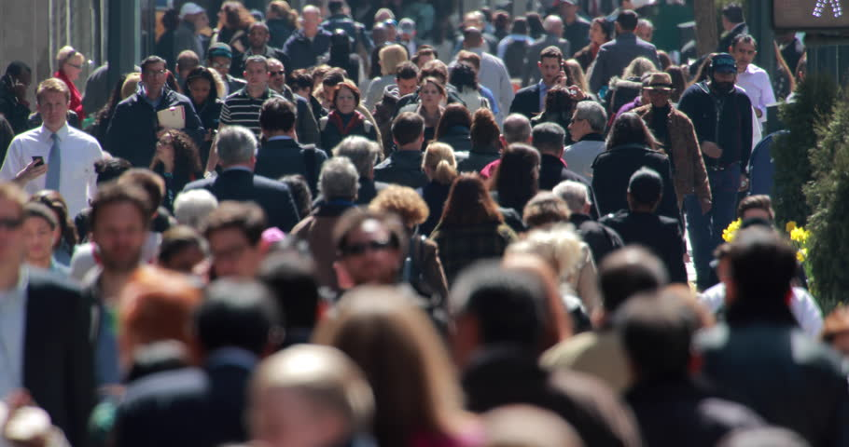
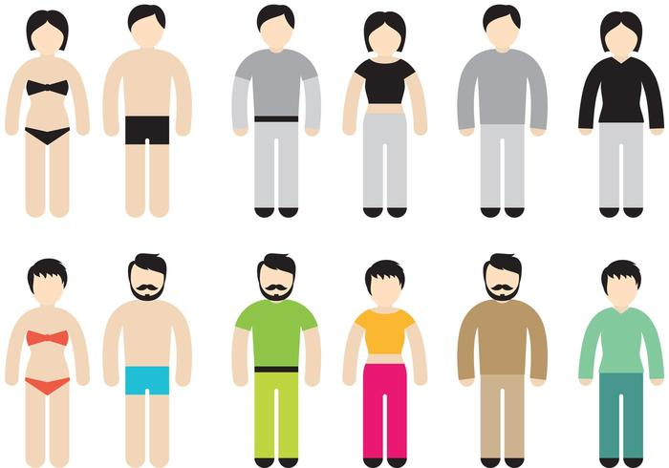

Slide 4


Slide 5
Gender
Height
Weight
Hair Color
Eye Color
…

Slide 6
if (hungry AND foodAvailable)
{
Eat(food);
}
if (happy OR drunk)
{
Dance();
}

Slide 7
Idea…
App
Ideas,
concepts,
rules,
…
Program-
ming
language
(e.g. C#)
Machine-
code
(CPU)
Micro-
code
0/1
Human
Software
Hardware

Slide 8
Ideas,
concepts,
rules,
…
Program-
ming
language
(e.g. C#)

Slide 9
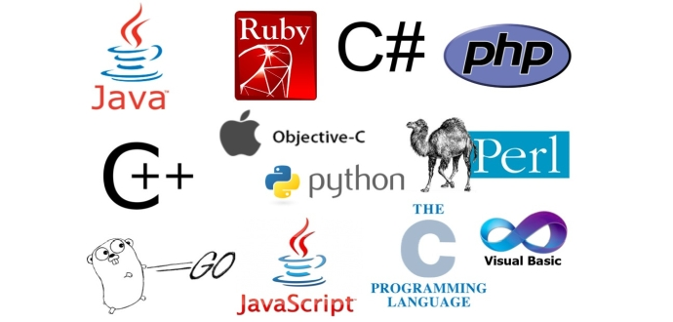

Slide 11
Object-Oriented Programming

Slide 12
Statement

Slide 13
a = b + 10;

Slide 14
Method
Statement
Statement
Statement
Statement

Slide 15
int Average(int a, int b)
{
int average = (a + b)/2;
return average;
}

Slide 16
Class
Method
Method
Method
Method

Slide 17
Student
GetScores
IsActive
CalculateSU
PhoneNo

Slide 18
App
Class
Class
Class
Class

Slide 19
SchoolAdmin
Student
Teacher
Course
Classroom

