Slide 1
Introduction to SW
SW - Software

Slide 2
Definition
Software is instructions to the computer about how to perform a certain calculation (in a very broad sense)
Given the ”state” of the computer, how should it react to certain data
Data could be many very different things; a mouse-click, HTML code, the state of another device, etc..

Slide 3
Definition
Borderline between hardware and software can appear a bit fuzzy…
Certain very fundamental software can be an integral part of the computer itself, like BIOS (Basic Input/Output System)
This is sometimes referred to as firmware
Our usual definition: a program we supply to the computer from an external source

Slide 4
Software Development
Someone has a bright idea for a new App
Someone tries to specifiy the requirements for the App
Someone tries to specifiy rules and logic for realising these requirements
Sounds easy, doesn’t it…?

Slide 5

Multiplication
Rules are very clear
Easy to implement
Hard for humans (at least for large numbers)
Computers much better than humans

Slide 6
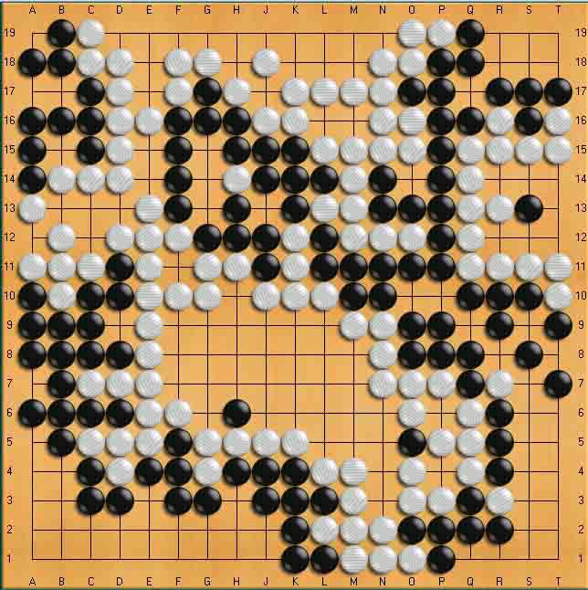
Go
Rules are clear, logic (like a good strategy) is hard to implement
Hard for humans
Also hard for computers
Computers only beat best humans fairly recently (2016)
Best Go-software does not explicitly implement strategies (uses Deep Learning, e.g. AI)

Slide 7
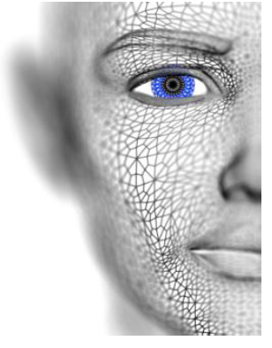
Facial recognition
Very easy for humans
Rules are fuzzy…
Hard problem to solve by software (until recently)

Slide 8
Software Development
If we can describe rules and logic for the behavior of our software…
…what language should we then use for describing these rules and logic?
Humans use words, diagrams, etc..
Computers use bits…
How do we bridge the gap from human concepts to bits?
Translation!

Slide 9
Idea
SW
Ideas,
words,
concepts,
etc.
Program-
ming
language
(e.g. C#)
Machine
code
(CPU)
Micro
code
0s and 1s
(bits)
Humans
Software
Hardware

Slide 10
Rules and Logic
Ordinary human language is often implicit and imprecise
”Go buy 2 liters of milk. If they have eggs, buy 12…”
”Let’s eat, my friend”
”Let’s eat my friend”

Slide 11
Rules and Logic
A programming language should
Be close enough to human language to enable humans to (fairly) easily express themselves
Be translatable to a language the computer understand (or other layers of software understands)
First programming ”languages” did not fulfill first criterion…
Modern languages are definitely closer, still not easy
AI is beginning to write code for us…

Slide 12
if (myPieces.King.Status == Check) then
{
if (board.noCheck(myPieces.King).exists == true)
then (myPieces.King.move())
else
if (myPieces.avoidCheck().exists == true)
then (myPieces.avoidCheck().move())
else
myGame.status = lost;
}

Slide 13
Rules and Logic
If we can define such a language AND construct software that can translate it to computer-compatible code, we are done!
Steps in translation (roughly)
Programming language => Assembler code
Assembler code => Micro code
Micro code => bits

Slide 14
C#
The programming language named C# (C-Sharp) is such a language
Many other programming languages exist, some similar to C#, some very different
We use C# during first year (and beyond), also other languages
Software to write and translate code: Visual Studio
All we need to learn is to translate requirements, designs, etc. to C# code ☺.

