Slide 1
Databases and Visual Studio Executing Queries

Slide 2
Executing queries on a database
Same procedure as executing a given script
Open a Query Window
Type in your query
Execute the query

Slide 3
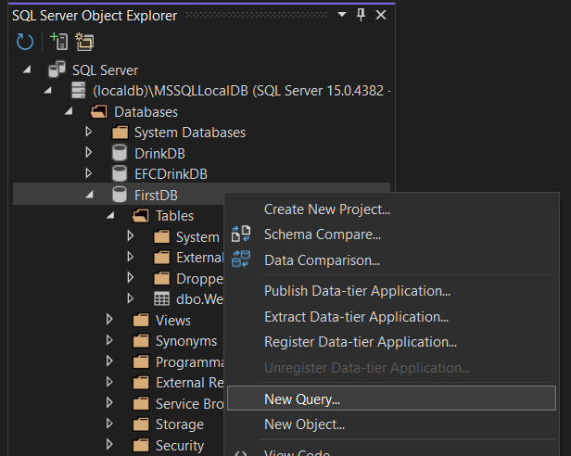
Right-click on FirstDB, and choose New Ouery…

Slide 4
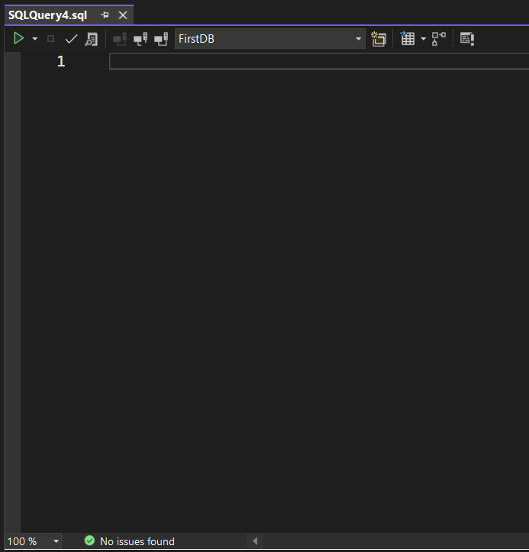
This opens a Query window

Slide 5
Here you can write SQL directly, or copy SQL from a given script

Slide 6
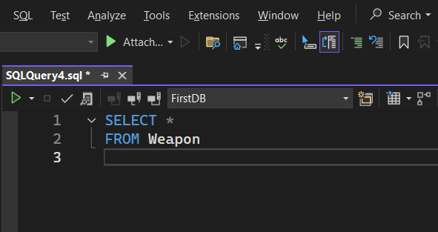
NOT THIS ONE!!! ☺
Run query by clicking the small green triangle

Slide 7
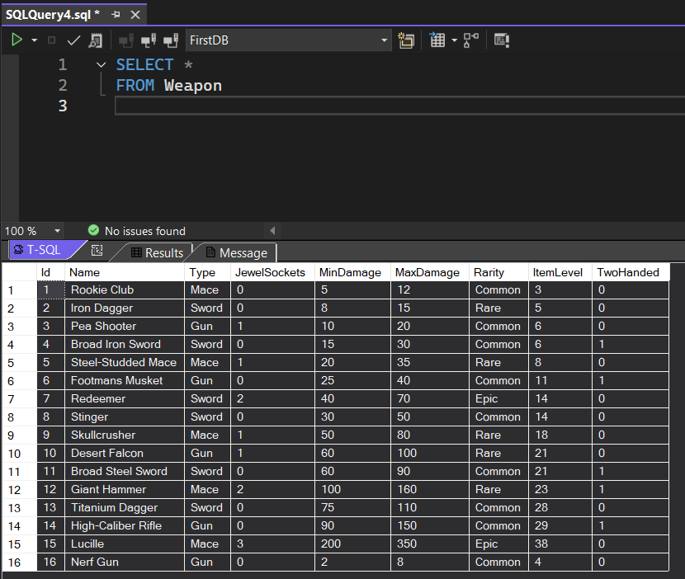

Slide 8
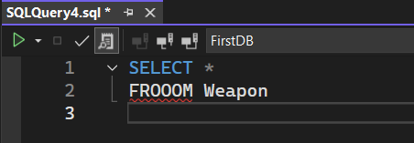
Main SQL keywords in blue
Syntax errors are indicated

Slide 9
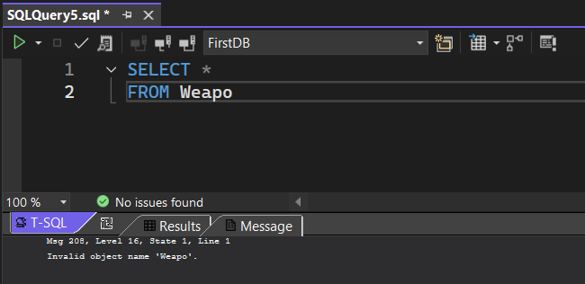
NB: Logical errors not discovered before running the query!

Slide 10
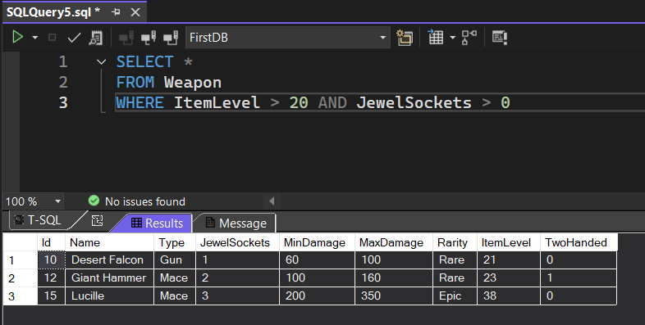

Slide 11
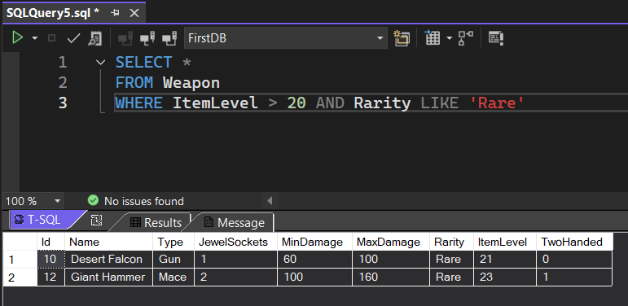

Slide 12
