Slide 1
GitHub Essentials (simplified version)
With Visual Studio 2022

Slide 2
Best advice…
KEEP IT SIMPLE!!
Define a simple protocol for using GitHub, and stick to it.
Be very careful about multiple persons working on same files.
GitHub doesn’t replace communication and common sense…

Slide 3
Main concepts
Git. Source code version control software.
GitHub. Website for storing source code repositories (a UI for Git).
Repository. A single named source code storage unit.
Origin: The instance of the repository on GitHub
Local repository: The instance of the repository on your own local PC

Slide 4
Main concepts
In Visual Studio, the Git menu and the Git Changes view are your main tools for managing source code control with GitHub.

Slide 5
GitHub (person A)
Repository
(person A,
invites person B)
Master
Creates
Clones
Person A local PC
Person B local PC
Repository
Repository
Master
Master

Slide 6
Single person
Person A creates new VS solution
Person A adds solution to Source Control (local + GitHub repo created)
Person A can update code, commit and push
Remember: getting code from local PC to GitHub repository is a two-step procedure:
Commit changes (to local repository)
Push commit to Origin (i.e. to GitHub repository)

Slide 7
Single person
Save: Local files are updated, local repository is not updated.
Commit: Local repository is updated, GitHub repository is not updated.
Push: GitHub repository is updated.

Slide 8
GitHub (person A)
Repository
Master
Push
Person A local PC
Source code
Repository
Master
Commit

Slide 9
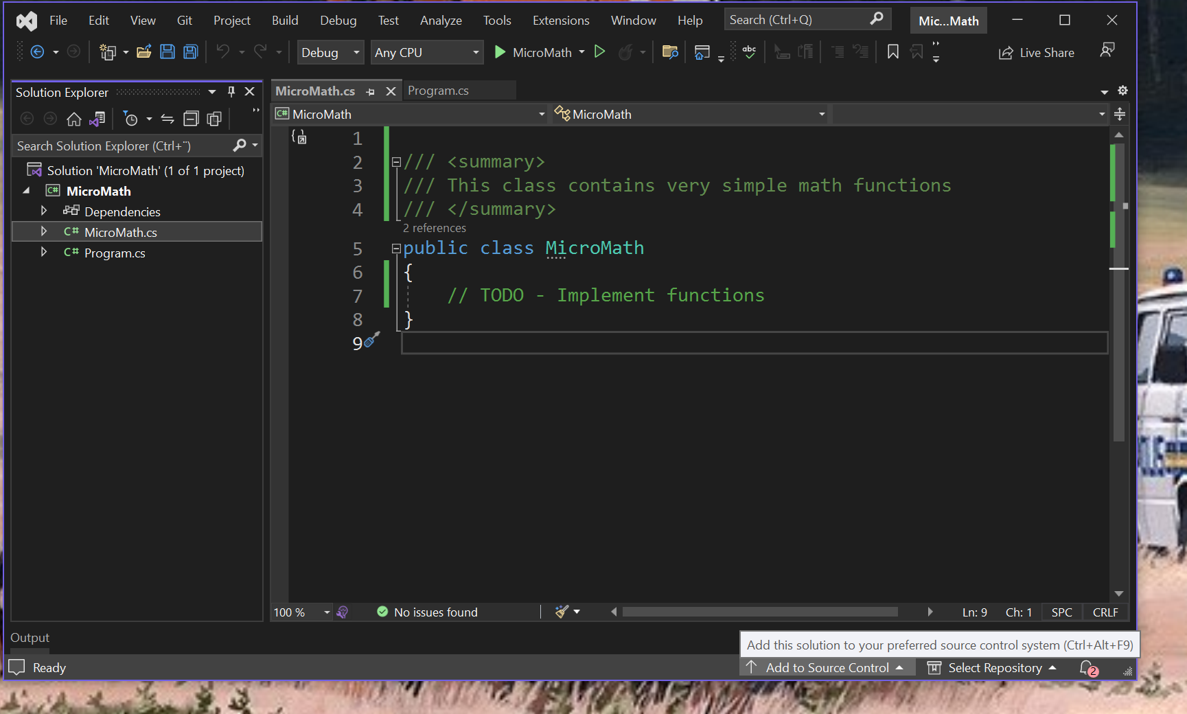

Slide 10
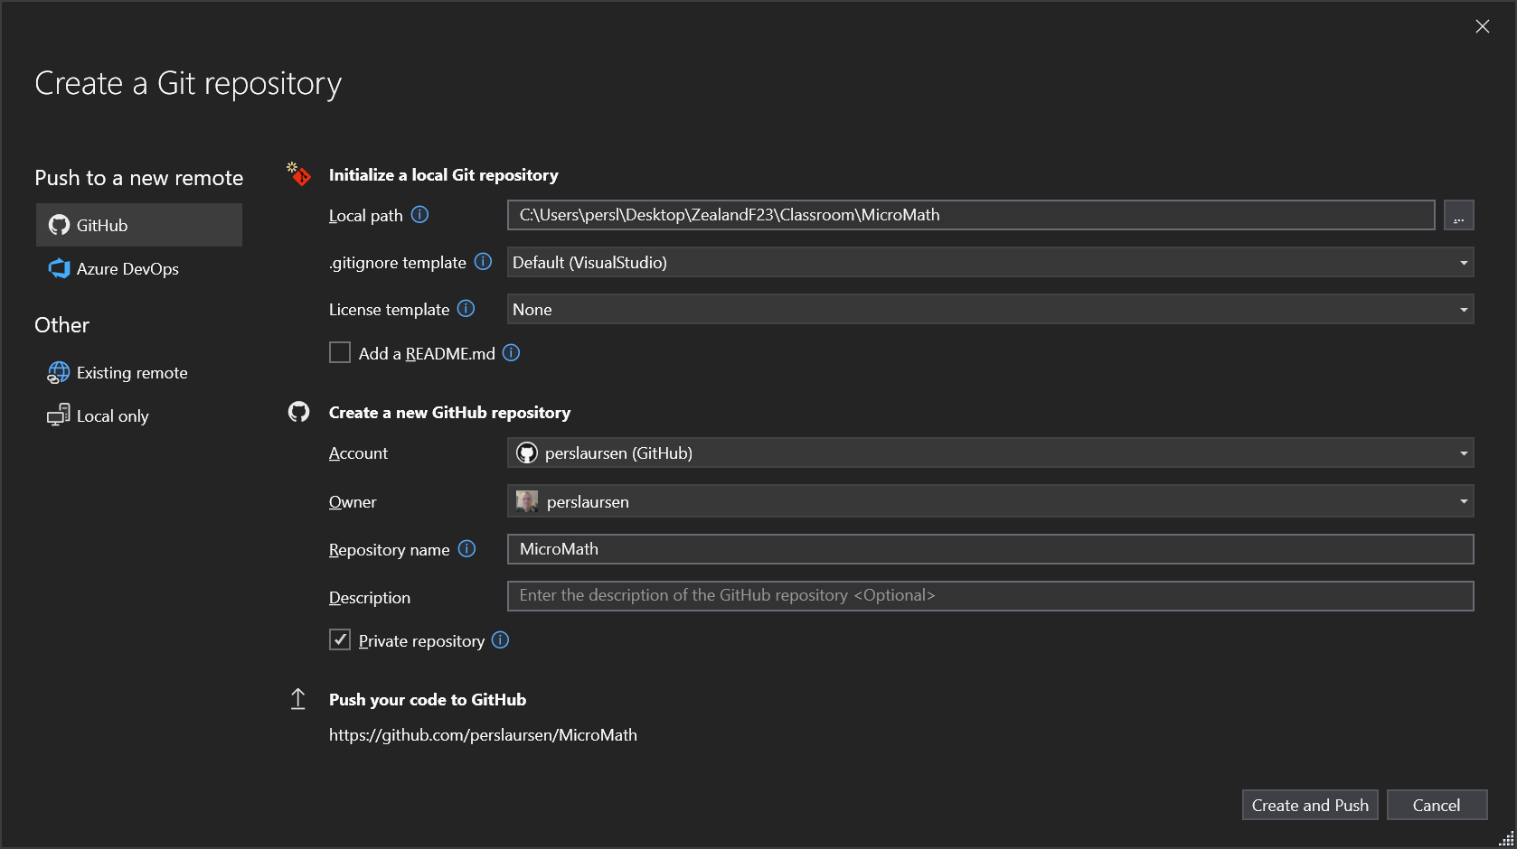

Slide 11
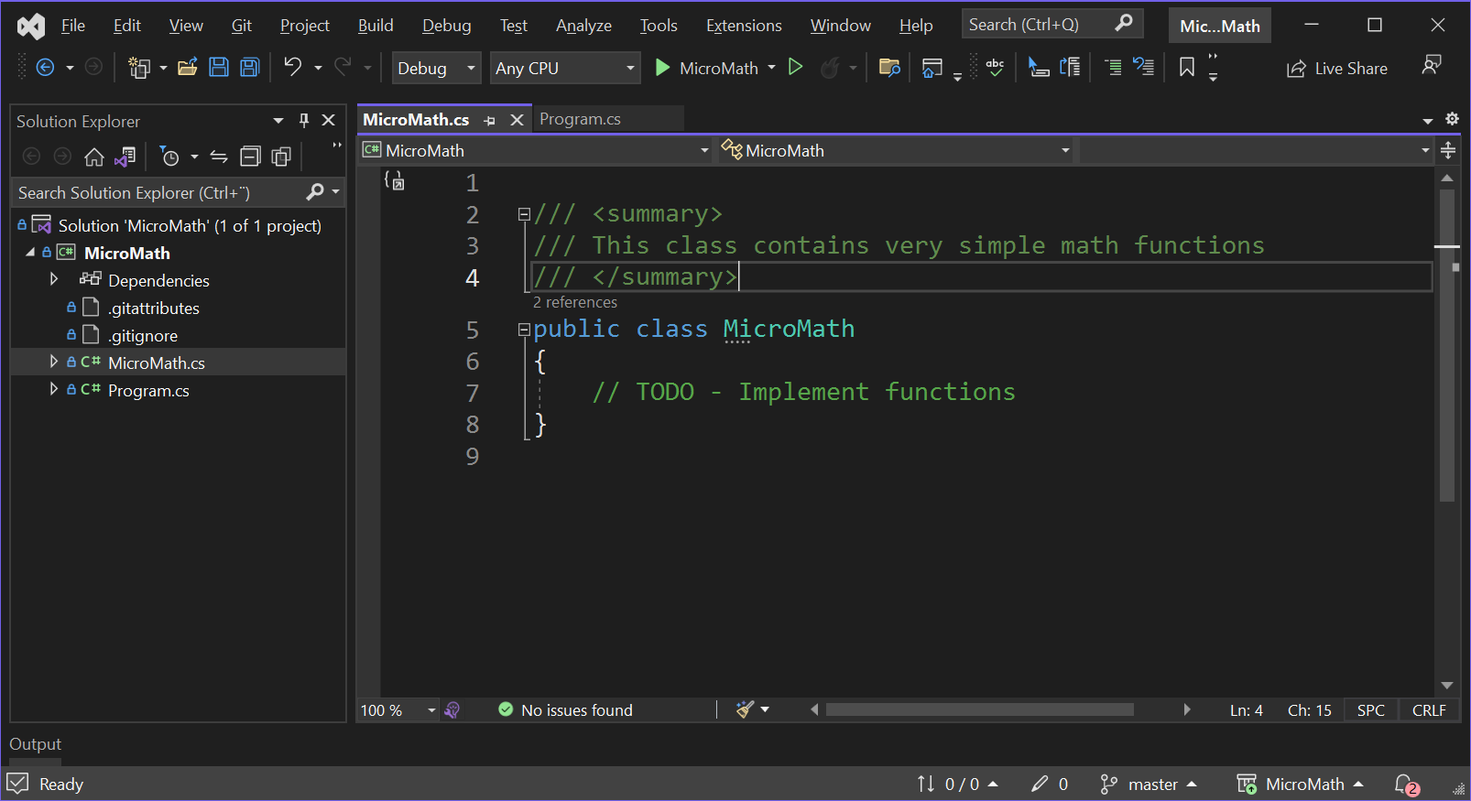

Slide 12
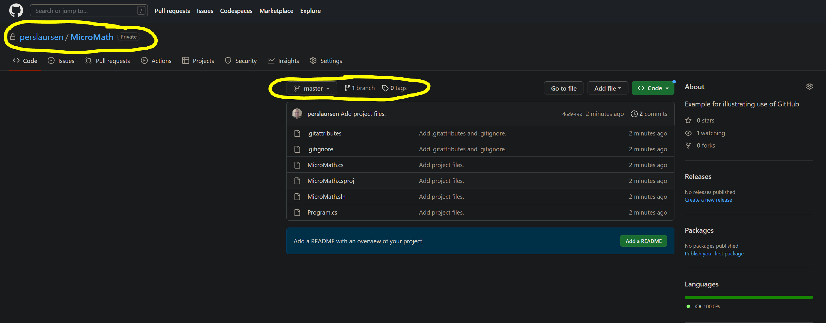

Slide 13
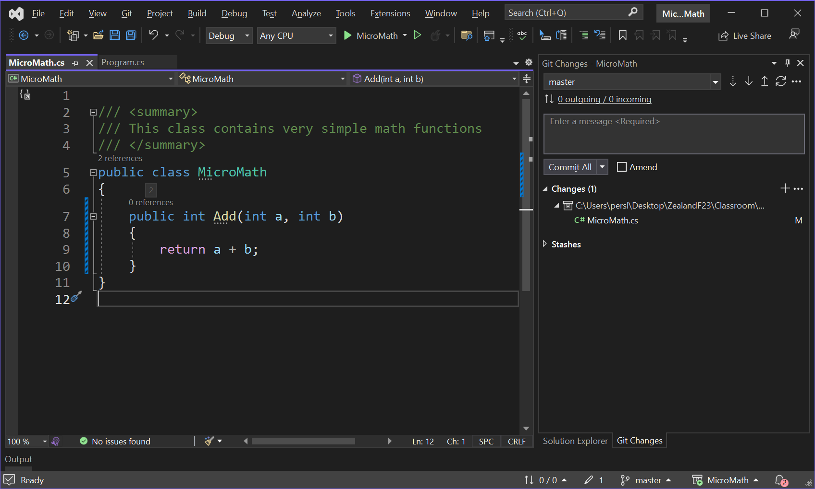

Slide 14
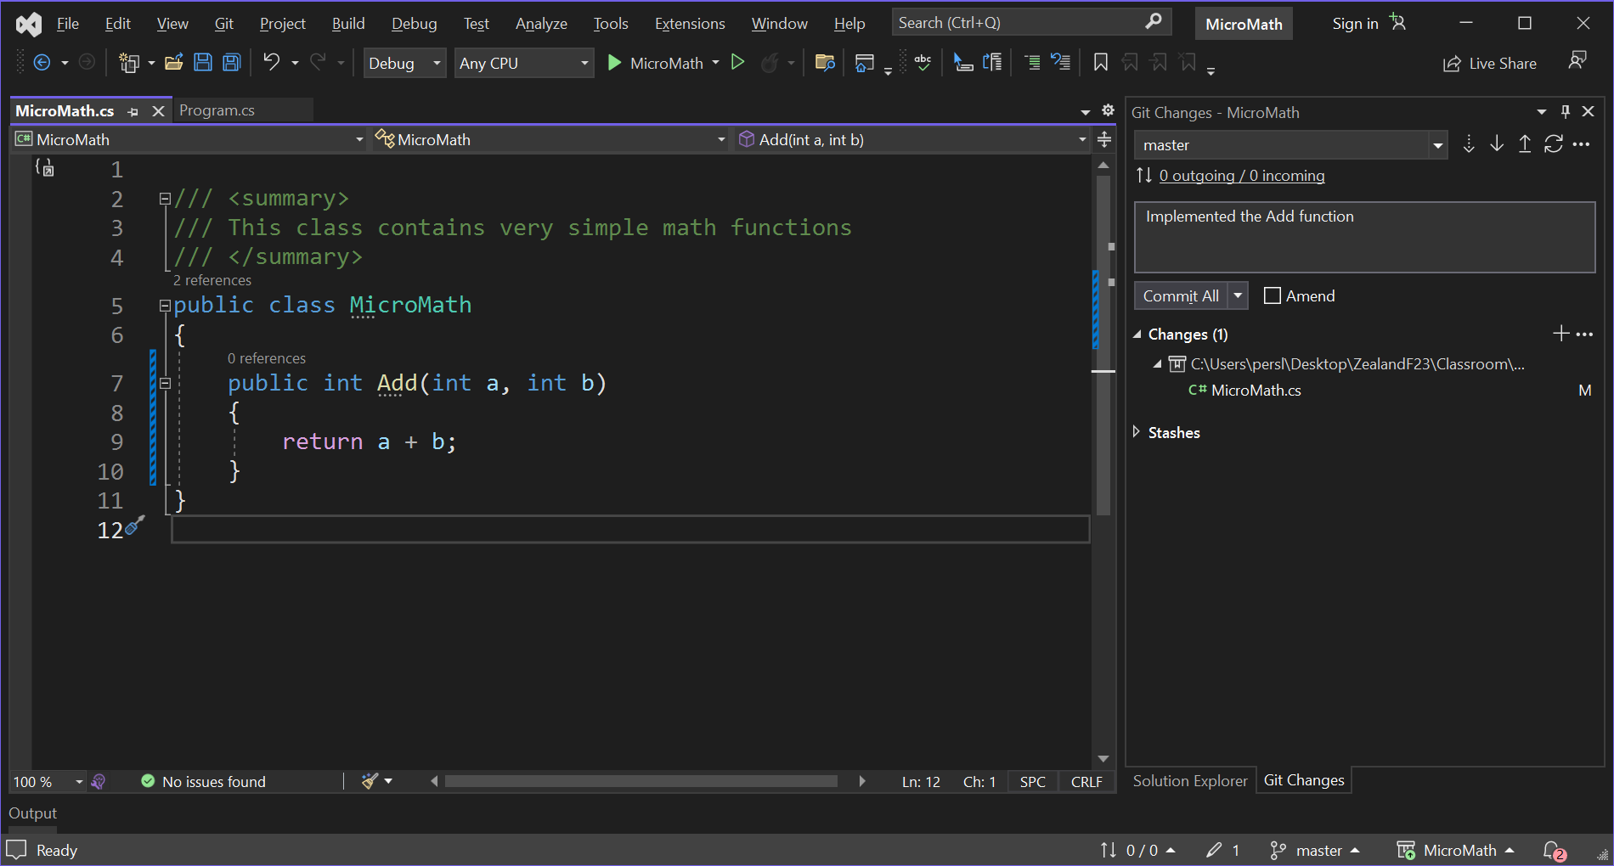

Slide 15
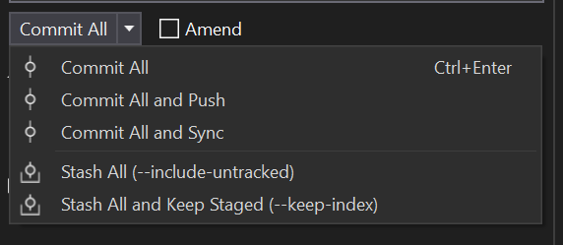

Slide 16
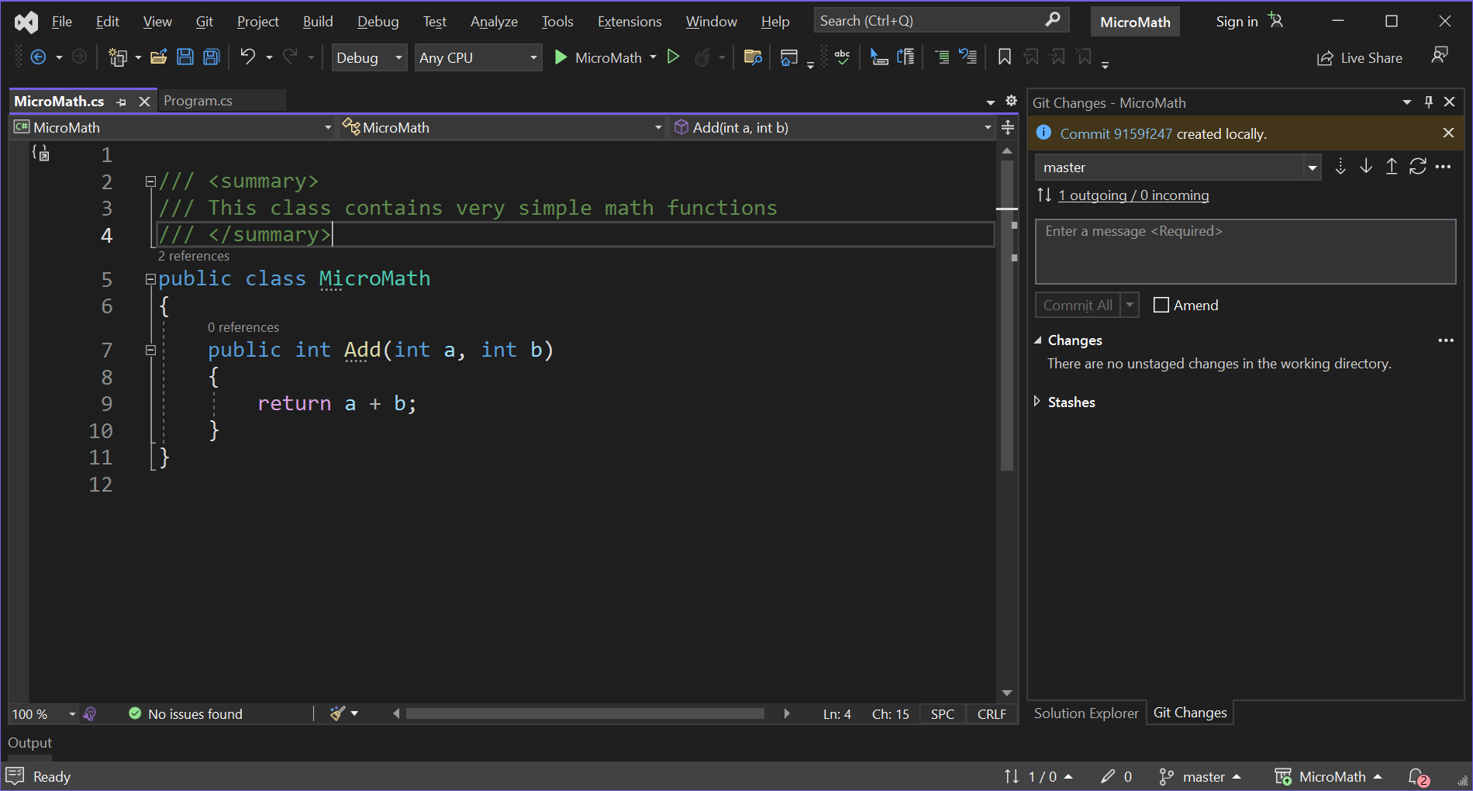


Slide 17
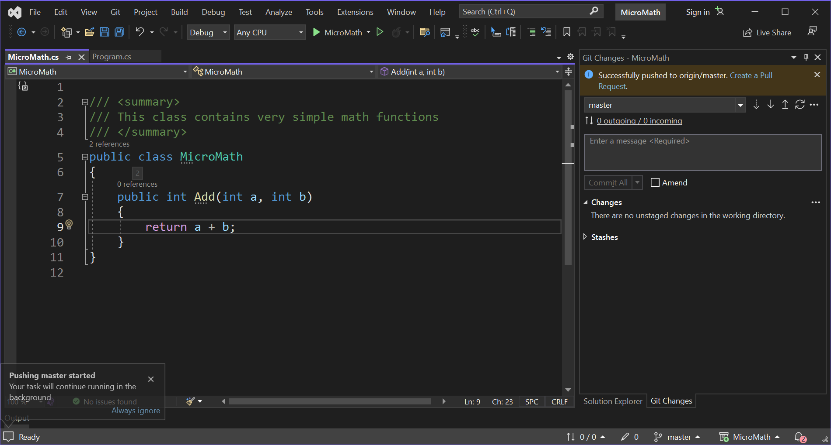

Slide 18
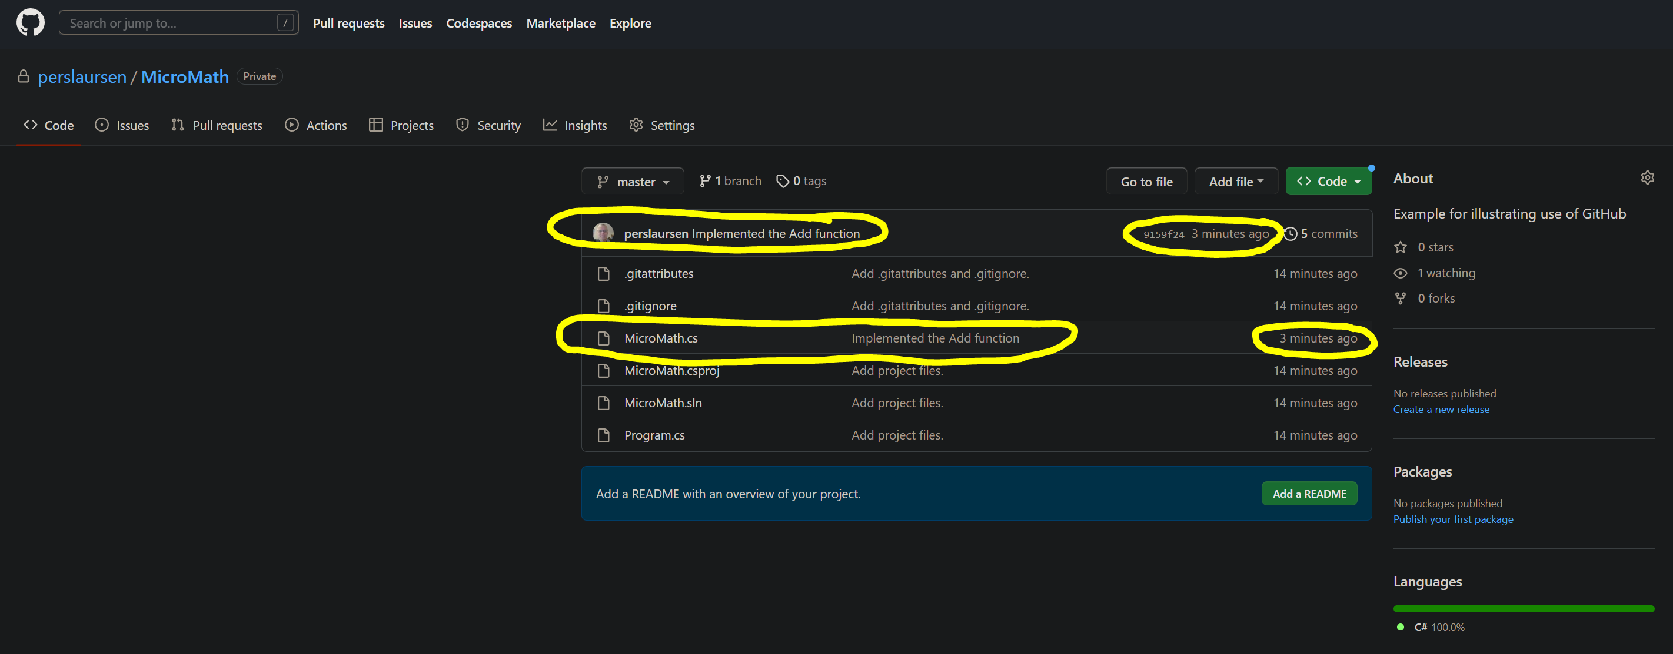

Slide 19
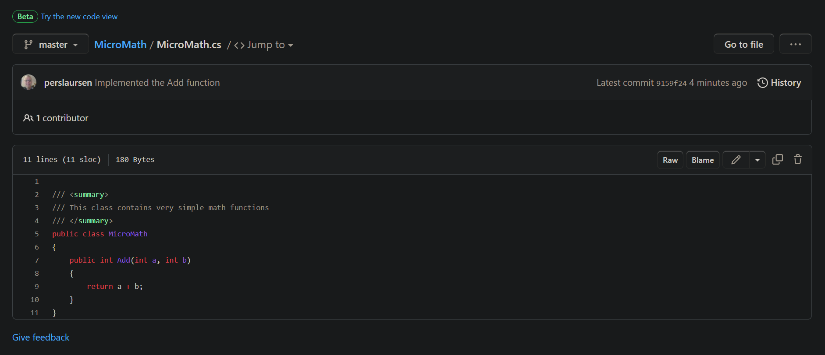

Slide 20
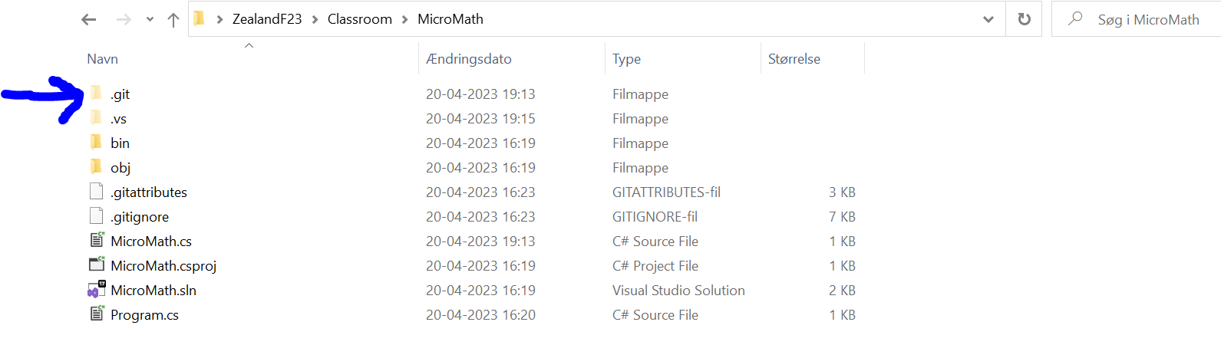
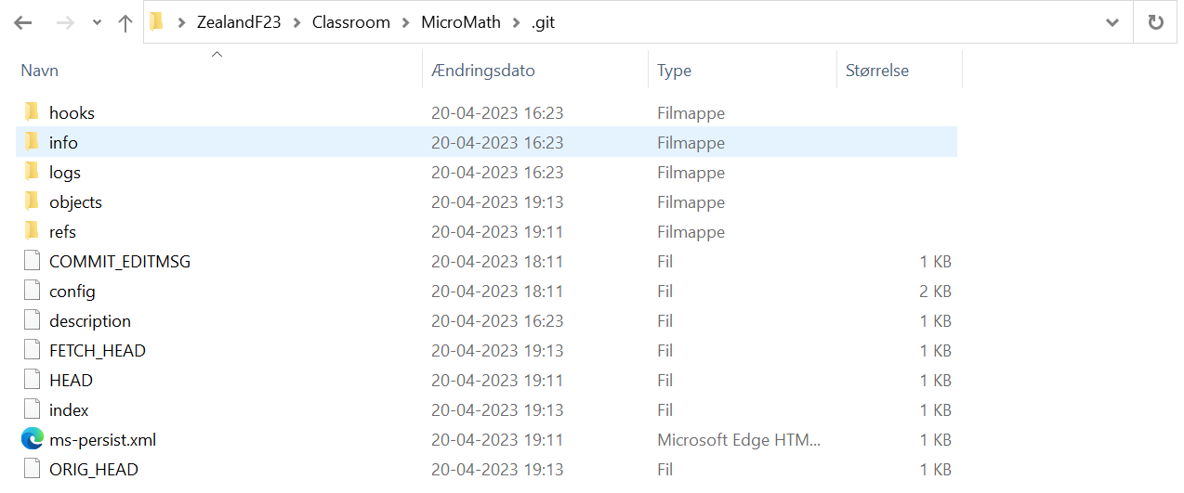
Where is my (local) repository…!?
On your local PC, you have two logical entities
Your source code
Your repository
The repository is physically represented by a hidden folder named .git in your source code folder

Slide 21
Two+ persons
Person A invites Person B/C/… to be a collaborator on repository
Person B/C/… accepts invitation
Person B/C/… can now (in VS) clone repository (cloning is done once)
Person B/C/… can now also update code, commit and push

Slide 22
GitHub (person A)
Repository
Master
Clone
Person B local PC
Repository
Master

Slide 23
GitHub (person A)
Repository
Master
Push
Person B local PC
Source code
Repository
Master
Commit

Slide 24
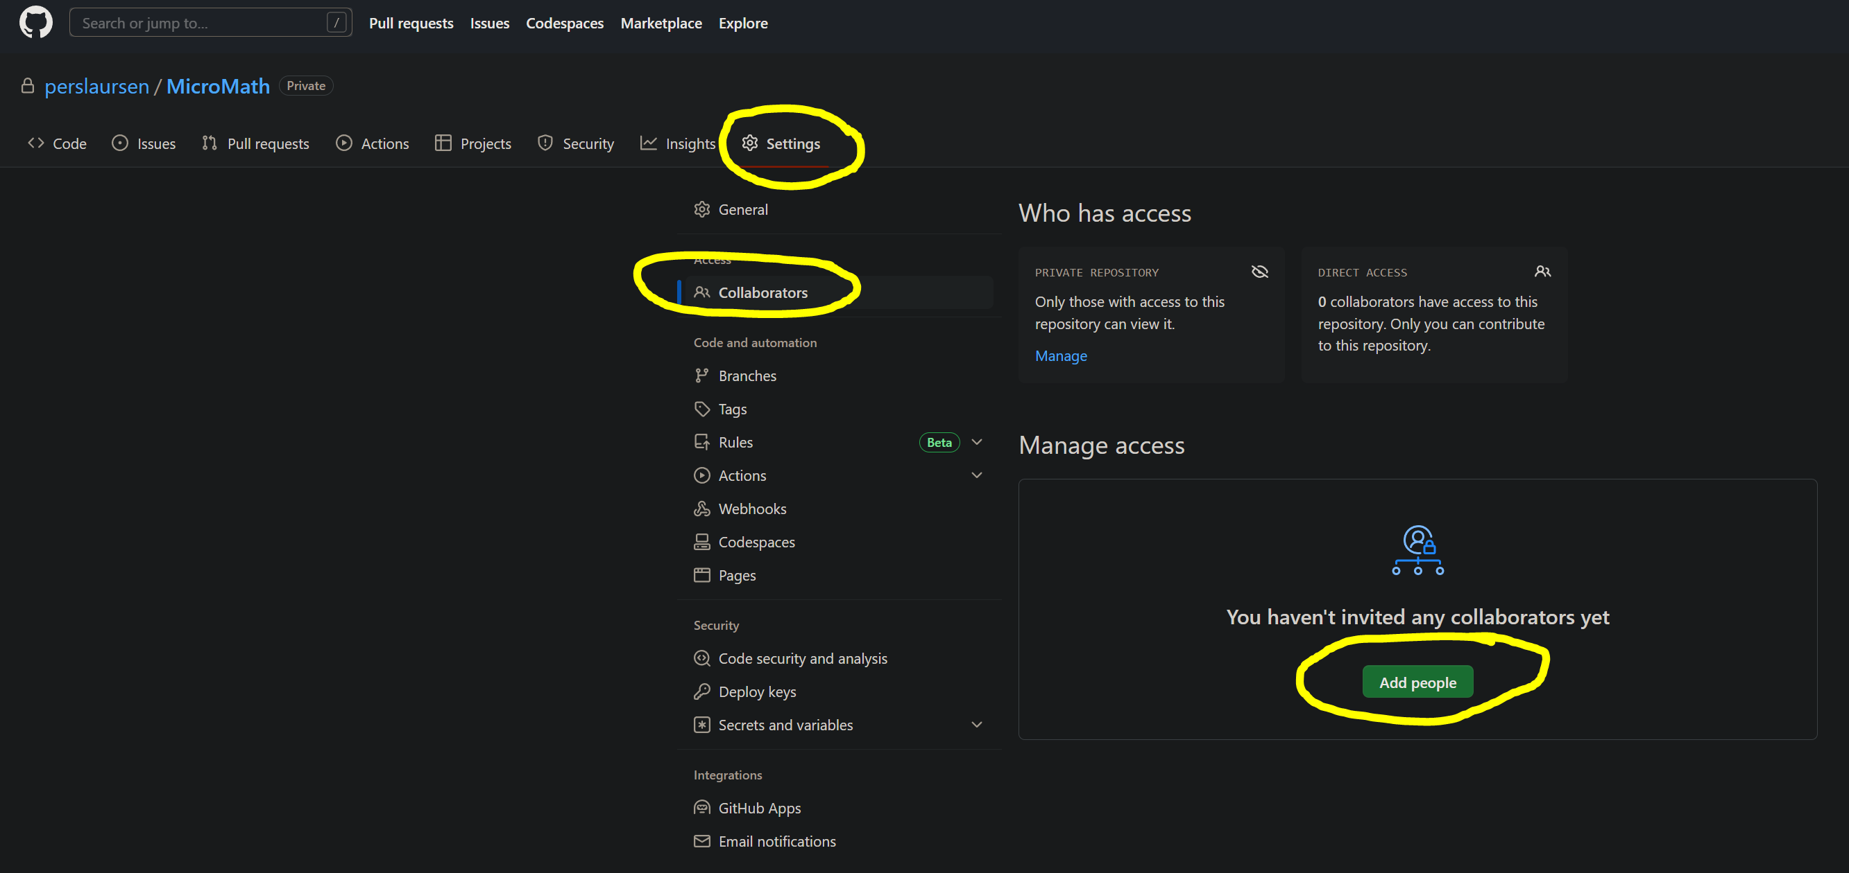

Slide 25
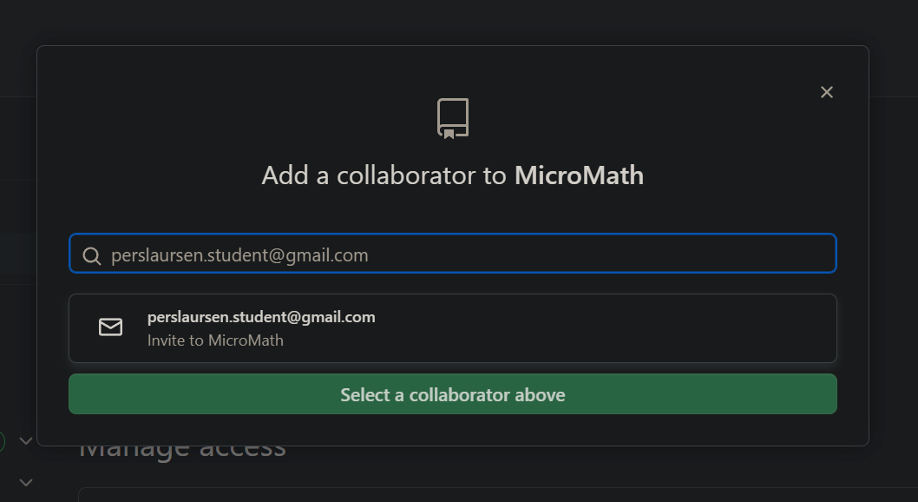

Slide 26
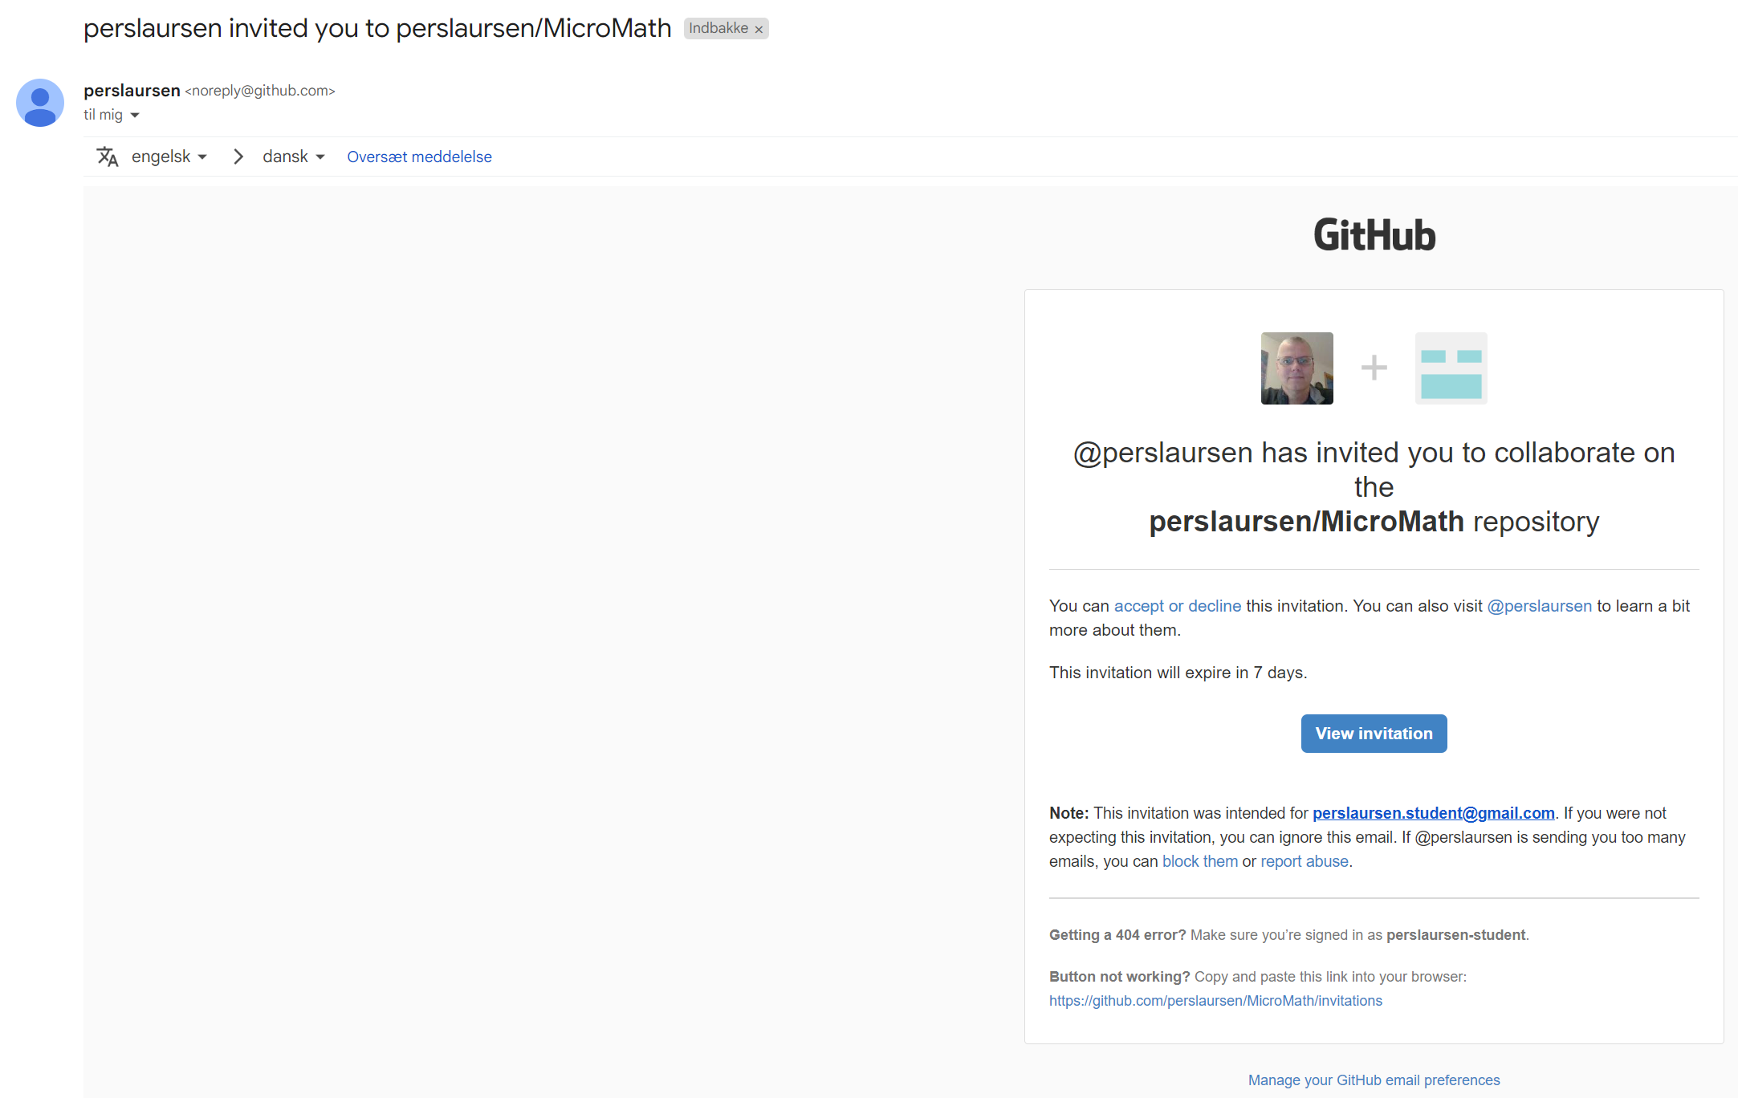
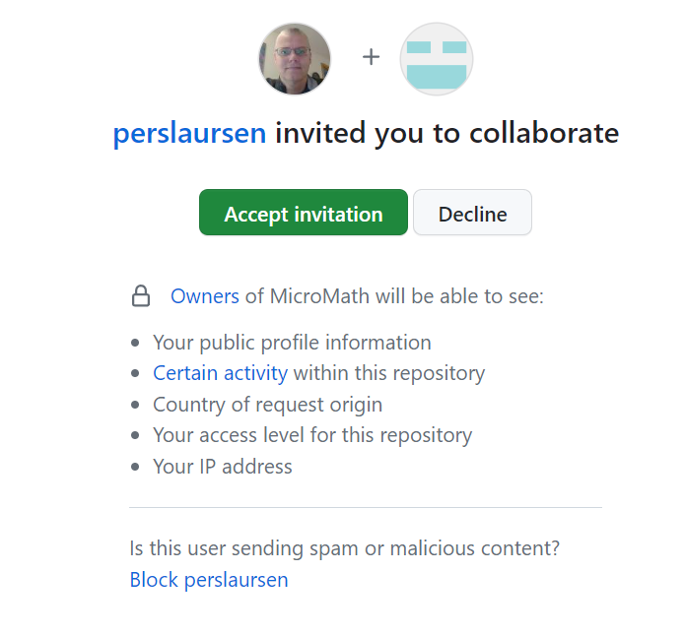

Slide 27
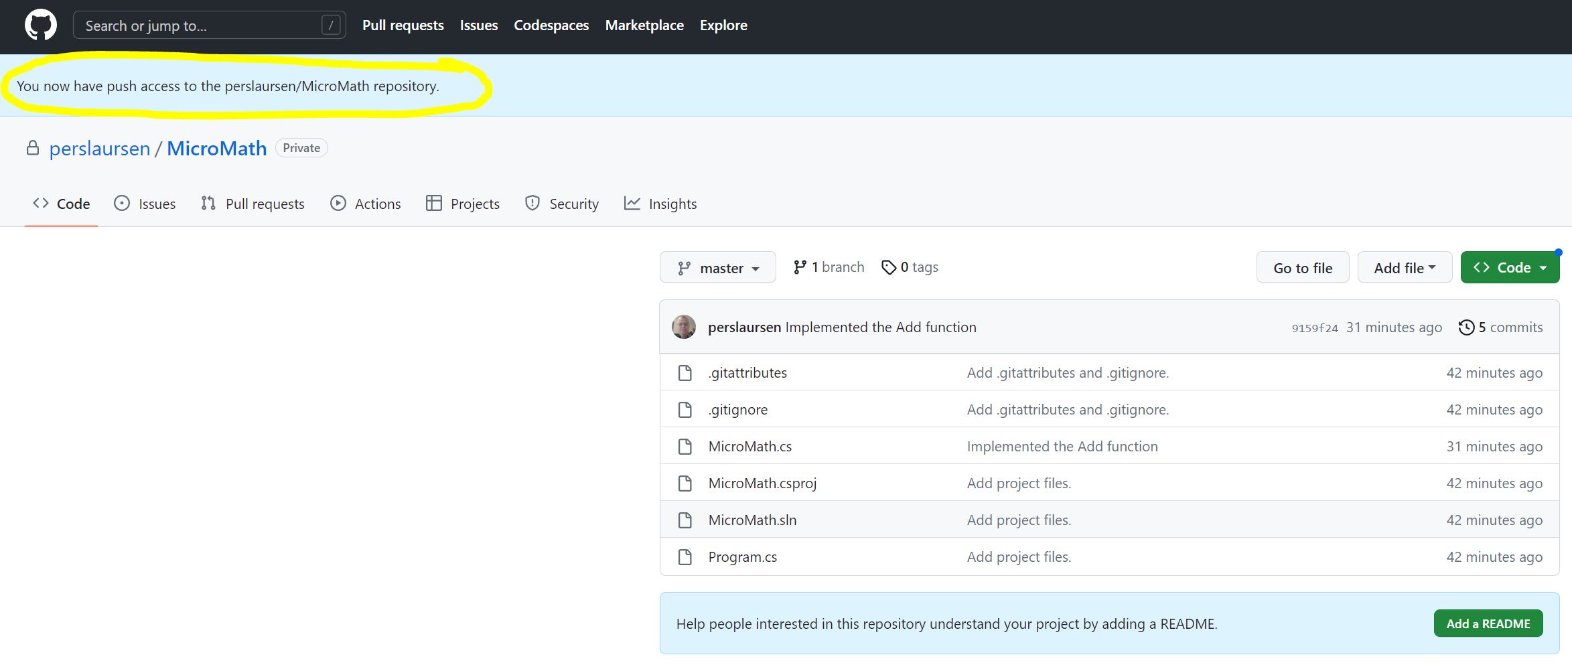

Slide 28
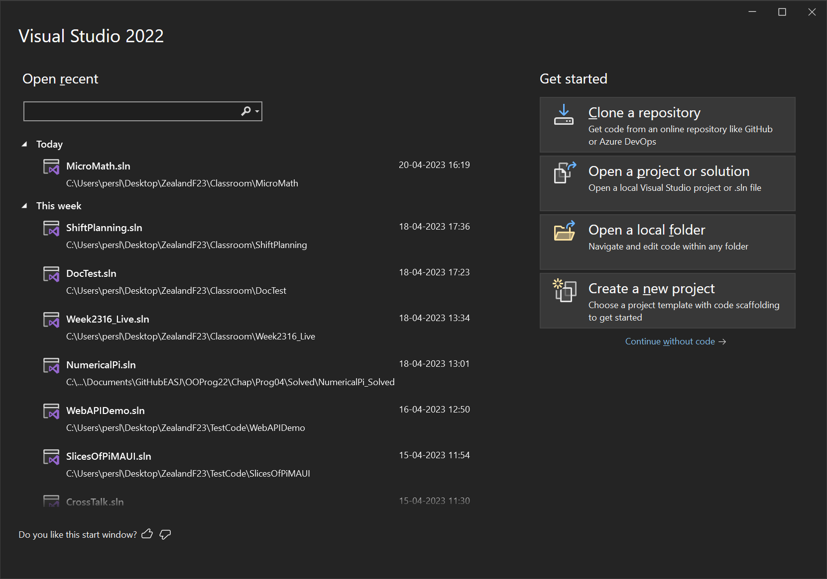

Slide 29
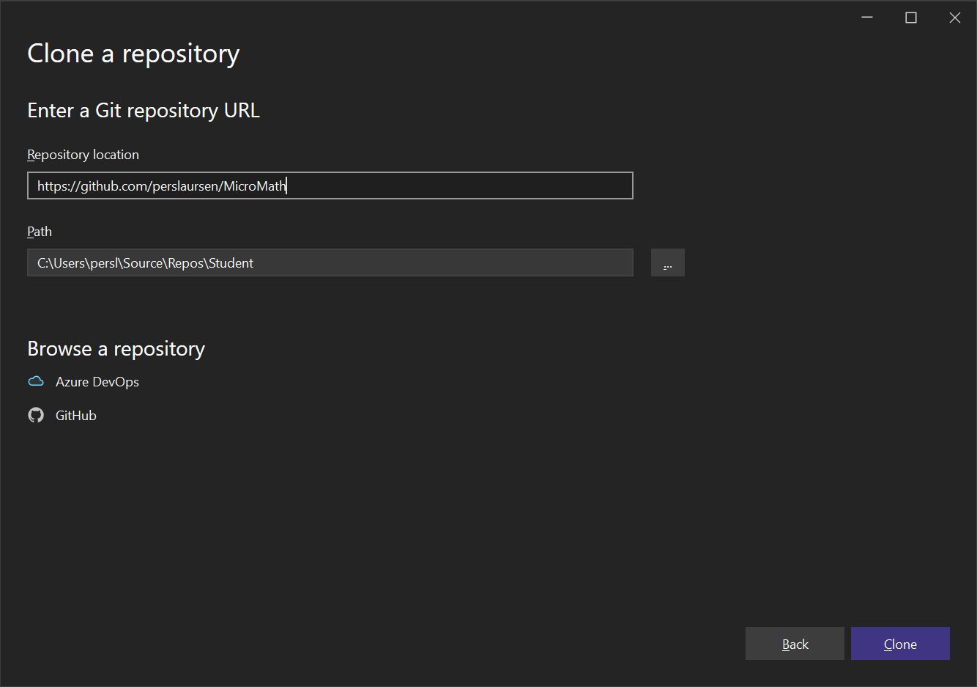

Slide 30
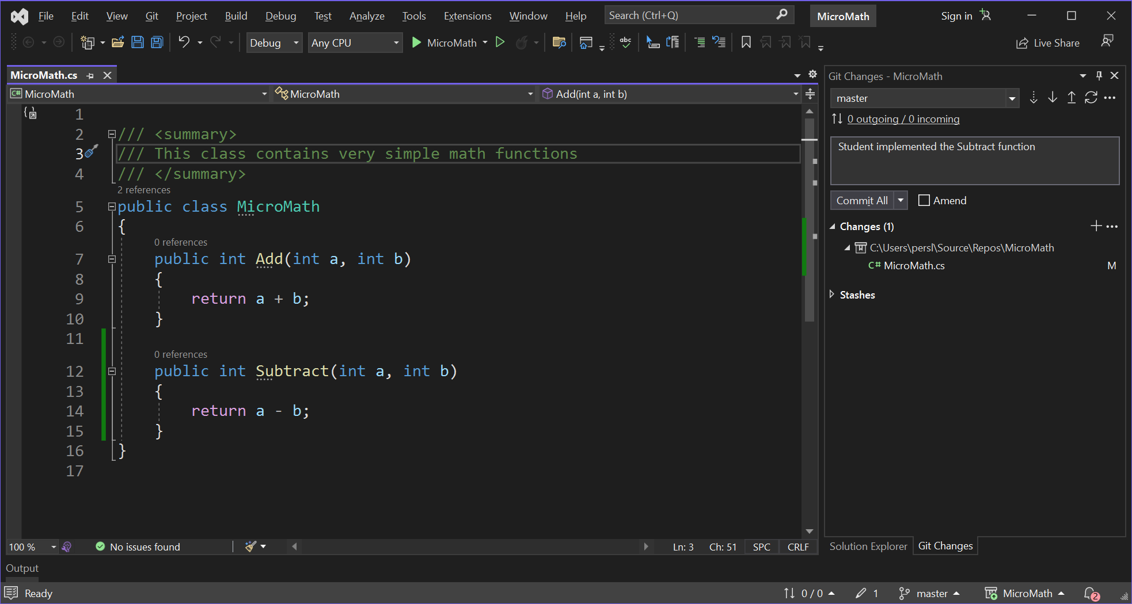

Slide 31
Two+ persons – getting changes
One person has made changes and has committed+pushed to GitHub
How do other persons get these changes onto their local PC…?
These operations are available:
Fetch: Get changes from GitHub to your local repository. NB: This does not update your actual source code files!
Merge: Merge changes in your local repository into your source code files.
Pull: Does Fetch and Merge in a single operation
Sync: Does Pull and Push in a single operation

Slide 32
Two+ persons – getting changes
My advice: use Pull (in the Git Changes view) to get changes.
Talk to each other!
Inform each other as soon as changes are made.
Do not build up ”backlogs” of uncommitted/unpulled changes

Slide 33
Best advice (once more)…
KEEP IT SIMPLE!!
Figure out a simple scheme for using GitHub, and stick to it.
Be very careful about multiple persons working on same files.
In particular, be aware of changes that changes the .csproj file!
GitHub doesn’t replace communication and common sense…

Slide 34
GitHub playbook
Agree upfront on a simple and realistic protocol
All group members have a GitHub account
One member creates the solution in VS, and creates repository
Creator invites all group members to be collaborators
Never accumulate large sets of unmerged changes!

