Slide 1
Adapter Design Pattern

Slide 2
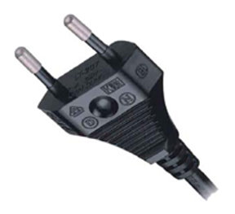

The Problem
A certain functionality is available
We want to use the functionality through interface IX
The functionality is available through an interface IY

Slide 3
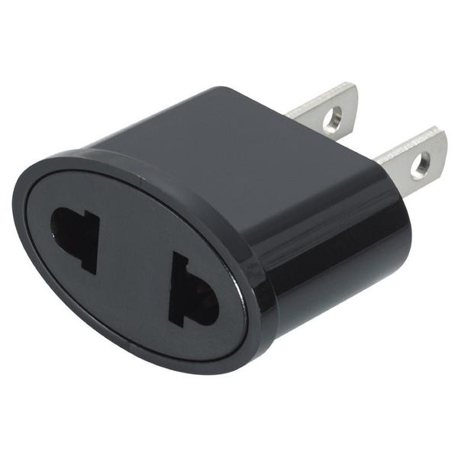
The Problem
A certain functionality is available
We want to use the functionality through interface IX
The functionality is available through an interface IY
How to implement the functionality of interface IX by means of interface IY

Slide 4
Interface
Client
Base Class
Class

Slide 5
public class ArrayCollection<T>
{
public int GetSize() {…}
public T[] GetArray() {…}
public void Insert(T obj, int pos) {…}
public void Delete(int pos) {…}
public T ElementAt(int pos) {…}
}

Slide 6
public interface IArrayCollection<T>
{
int GetSize();
T[] GetArray();
void Insert(T obj, int pos);
void Delete(int pos);
T ElementAt(int pos);
}

Slide 7
Client
IArrayCollection<T>
ArrayCollection<T>

Slide 8
public interface IIndexedCollection<T>
{
int Count { get; }
List<T> All { get; }
void Add(T obj);
void Remove();
void InsertAt(T obj, int pos);
void DeleteAt(int pos);
T At(int pos);
}

Slide 9
Client
IIndexedCollection<T>
IArrayCollection<T>
ArrayCollection<T>

Slide 10
Client
IIndexedCollection<T>
AdapterICAC<T>
IArrayCollection<T>
ArrayCollection<T>

Slide 11

IDesired
IExisting

Slide 12
IDesired
Adapter
IExisting

Slide 13
public class AdapterICAC<T> : IIndexedCollection<T>
{
private IArrayCollection<T> _adaptee;
public AdapterICAC(IArrayCollection<T> adaptee)
{
_adaptee = adaptee;
}
// Rest of class implementation
}

Slide 14
public List<T> All
{
get { return _adaptee.GetArray().ToList(); }
}
public void Add(T obj)
{
_adaptee.Insert(obj, _adaptee.GetSize());
}
public T At(int pos)
{
return _adaptee.ElementAt(pos);
}

Slide 15
IArrayCollection<Car> carArray = new ArrayCollection<Car>();
carArray.Insert(new Car(…), 0);
carArray.Insert(new Car(…), 1);
// …and so on
IIndexedCollection<Car> carIC = new AdapterICAC<Car>(carArray);
// Access Car collection through new interface
carIC.DeleteAt(2);
carIC.InsertAt(new Car(…), 1);
carIC.Remove();
carIC.Add(new Car(…));
Car aCar = carIC.At(3);

Slide 16
private void PrintContent<T>(IIndexedCollection<T> ic)
{
for (int i = 0; i < ic.Count; i++)
{
Console.WriteLine($"[{i}] {ic.At(i)}");
}
Console.WriteLine();
}

Slide 17
Client
IX
IY
Yv1

Slide 18
Client
IX
AdapterXY
IY
Yv1

Slide 19
Client
IX
AdapterXZ
AdapterXY
IZ
IY
Zv1
Yv1

Slide 20
Client
IX
X
AdapterXZ
AdapterXY
IZ
IY
Zv1
Yv1

Slide 21
Client
IX

Slide 22
IX adapter = new AdapterXY(…);
Client c = new Client(adapter);

Slide 23
Configurator
Client
Adapter
XY

