Slide 1
Data Structures LinkedList, Queue and Stack

Slide 2
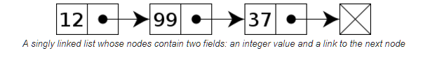

Slide 3
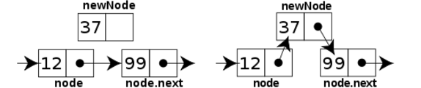

Slide 4
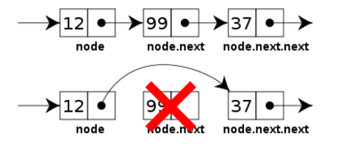

Slide 5
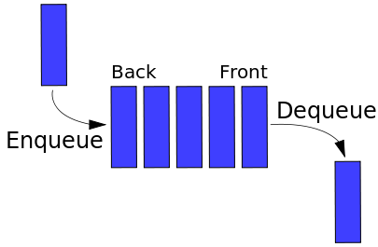

Slide 6
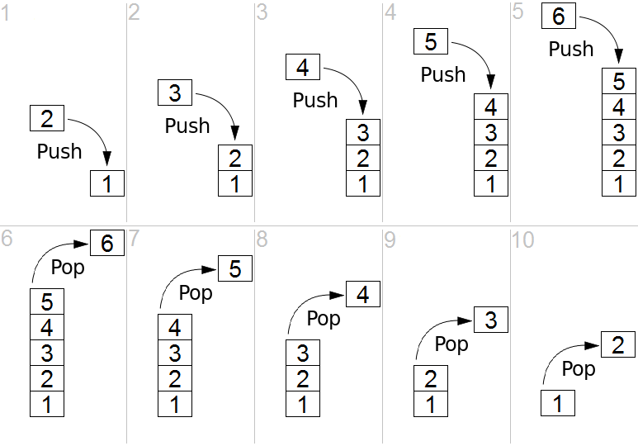

Slide 7
Union | Given two sets A and B, the union of A and B is the set containing all elements that are a member of A or B (or both)
Intersection | Given two sets A and B, the intersection of A and B is the set containing all elements that are a member of A and B
Complement | Given two sets A and B, the complement of B is the set containing all elements that are a member of B and not a member of A
Subset | Given two sets A and B, A is a subset of B if all elements that are a member of A are also a member of B
Superset | Given two sets A and B, A is a superset of B if all elements that are a member of B are also a member of A

