Slide 1
Run-time complexity The O-notation

Slide 2
n
n
n
n
T
T
T
T

Slide 3
n
n
n
n
T
T
T
T
n
n
n
n
T
T
T
T
O(n)

Slide 4
n
n
n
n
T
T
T
T
n
n
n
n
T
T
T
T
n
n
n
n
T
T
T
T
O(n)
n
n
n
n
T
T
T
T

Slide 5
n
n
n
n
T
T
T
T

Slide 6
n
n
n
n
T
T
T
T
n
n
n
n
T
T
T
T
T
T
T
T
T
T
T
T
O(n²)

Slide 7
n
n
n
n
T
T
T
T
T
T
T
T
T
T
T
T
T
T
T
T
n
n
n
n
T
T
T
T
T
T
T
T
T
T
T
T
T
T
T
T
n
n
n
n
T
T
T
T
T
T
T
T
T
T
T
T
T
T
T
T
n
n
n
n
O(n²)
T
T
T
T
T
T
T
T
T
T
T
T
T
T
T
T

Slide 8
n
n
n
n
T
T
T
T

Slide 9
n
n
n
n
T
T
T
T
n
T
T
T
T
O(2^{n})

Slide 10
n
n
n
n
T
T
T
T
n
n
T
T
T
T
T
T
T
T
T
T
T
T
O(2^{n})

Slide 11
n
n
n
n
T
T
T
T
T
T
T
T
T
T
T
T
T
T
T
T
n
n
n
T
T
T
T
T
T
T
T
T
T
T
T
T
T
T
T
O(2^{n})

Slide 12
n
n
n
n
T
T
T
T
T
T
T
T
T
T
T
T
T
T
T
T
n
n
n
n
T
T
T
T
T
T
T
T
T
T
T
T
T
T
T
T
T
T
T
T
T
T
T
T
T
T
T
T
T
T
T
T
O(2^{n})
T
T
T
T
T
T
T
T
T
T
T
T
T
T
T
T

Slide 13
n
n
n
n
T
T
T
T

Slide 14
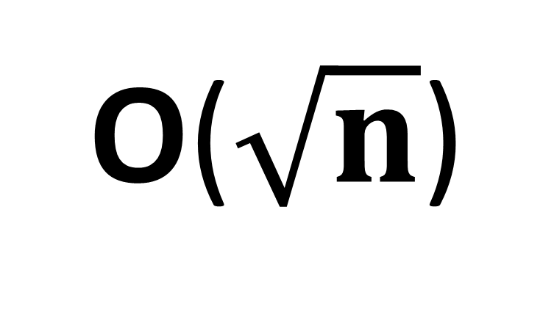
n
n
n
n
T
T
T
T
n
n
n
n
T
T
T
T
n
n
n
n
O($\sqrt{n}$)
n
n
n
n

Slide 15
n
n
n
n
n
n
n
n
T
T
T
T
n
n
n
n
n
n
n
n
n
n
n
n
n
n
n
n
T
T
T
T
n
n
n
n
n
n
n
n
T
T
T
T
n
n
n
n
n
n
n
n
n
n
n
n
n
n
n
n
O($\sqrt{n}$)
T
T
T
T
n
n
n
n
n
n
n
n
n
n
n
n
n
n
n
n

Slide 16
n
n
n
n
T
T
T
T

Slide 17
n
n
n
n
T
T
T
T
n
n
n
n
T
O(log(n))

Slide 18
n
n
n
n
T
T
T
T
n
n
n
n
T
T
n
n
n
n
n
n
n
n
O(log(n))

Slide 19
n
n
n
n
n
n
n
n
T
T
T
T
n
n
n
n
n
n
n
n
n
n
n
n
n
n
n
n
T
T
T
n
n
n
n
n
n
n
n
O(log(n))

Slide 20
n
n
n
n
n
n
n
n
T
T
T
T
n
n
n
n
n
n
n
n
n
n
n
n
n
n
n
n
T
T
T
T
n
n
n
n
n
n
n
n
n
n
n
n
n
n
n
n
n
n
n
n
n
n
n
n
n
n
n
n
n
n
n
O(log(n))
n
n
n
n
n
n
n
n
n

Slide 21
n
n
n
n
T
T
T
T

Slide 22
n
n
n
n
T
T
T
T
n
n
n
n
O(1)

Slide 23
n
n
n
n
T
T
T
T
n
n
n
n
n
n
n
n
n
n
n
n
O(1)

Slide 24
n
n
n
n
n
n
n
n
T
T
T
T
n
n
n
n
n
n
n
n
n
n
n
n
n
n
n
n
n
n
n
n
n
n
n
n
n
n
n
n
n
n
n
n
n
n
n
n
n
n
n
n
n
n
n
n
n
n
n
O(1)
n
n
n
n
n
n
n
n
n

Slide 25
