Slide 1
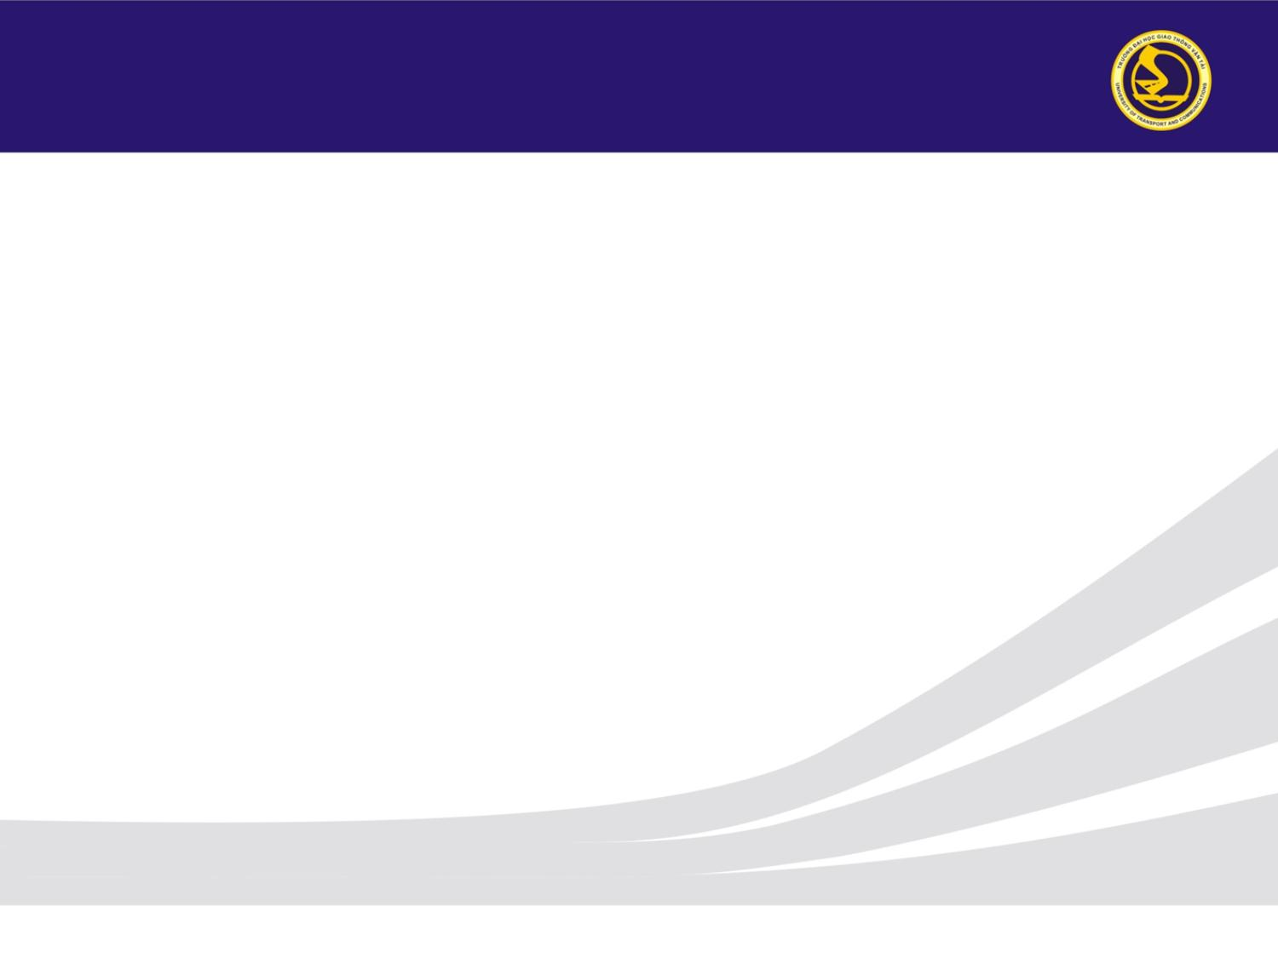
UNIVERSITY OF TRANSPORT AND COMMUNICATIONS
UNIVERSITY OF TRANSPORT AND COMMUNICATION
Object Detection on FishEye8K Camera Images
Using YOLO11
Supervisor: Dr. Nguyen Duc Du
2024

Slide 2
Outline
Table of Contents
01
AI City Challenge 2024 & FishEye8K Problem
06
Model Training (2-Stage)
02
Our Research — Problem Introduction
07
Experimental Results
03
Dataset (FishEye8K + VisDrone)
08
Comparison with Competition Winners
04
YOLO11 Model Architecture
09
Conclusion & Future Directions
05
Data Pipeline & Preprocessing

Slide 3
Section 1: AI City Challenge 2024
AI City Challenge 2024 — Overview
About the Competition
Top 3 Competition Results
Organizers:
NVIDIA + IEEE @ CVPR 2024
🥇 1st
F1: 0.6406
Focus:
AI for Intelligent Transportation Systems
VNPT AI (Team 9)
Track 4:
Road Object Detection in Fish-Eye Cameras
🥈 2nd
F1: 0.6196
Teams:
50+ teams worldwide
Nota/NetsPresso (Team 40)
Dataset:
FishEye8K — by HCMIU-VisionLab
🥉 3rd
F1: 0.6194
Metric:
F1-score (Precision × Recall harmonic mean)
SKKU-AutoLab (Team 5)

Slide 4
Section 1: AI City Challenge 2024
Track 4 — FishEye8K Dataset & Techniques
FishEye8K Dataset Stats
Key Techniques of Top Teams
Parameter | Value
Total Images | 8,000 (5,288 train + 2,712 test)
Total Annotations | ~157,000 bounding boxes
Fisheye Cameras | 18 cameras
Object Classes | 5: Bus, Bike, Car, Pedestrian, Truck
Annotation Format | COCO JSON
Model Ensemble
WBF fusion of YOLO + Transformer models
Strong Augmentation
Barrel distortion, mosaic, mixup, copy-paste
Pseudo-labeling
Generate labels for unannotated data
Extra Datasets
VisDrone, MIO-TCD, UAV datasets
SAHI
Slicing for small object detection
Multi-scale
Train/test at multiple resolutions

Slide 5
Section 2: Our Research
Our Research — Motivation & Objectives
Research Context
Key Challenges
Inspired by: AI City Challenge 2024 Track 4 Model: YOLO11l (Ultralytics, Sep 2024) Approach: Single-model pipeline (vs ensemble) Data: FishEye8K + VisDrone combined Goal: Establish a strong baseline for fisheye detection
Barrel Distortion
Edge objects severely deformed
Multi-scale
Extreme size variation center→edge
Limited Data
Only ~5,288 training images
Class Imbalance
Car ~90% vs few Bus/Pedestrian
Domain Gap
FishEye8K vs converted VisDrone

Slide 6
Section 3: Dataset
Datasets — FishEye8K & VisDrone
FishEye8K
VisDrone (Supplementary)
Split | Images | Labels
Train | 5,288 | 112,213
Test | 2,712 | —
Cameras | 15 | —
Classes | 5 | Car/Bus/Truck/Pedestrian/Motorbike
Subset | Images | Labels
train | 6,471 | 343,205
val | 548 | 38,759
test-dev | 1,610 | 75,102
Total | 8,629 | 457,066
Class Mapping: VisDrone → FishEye8K
VisDrone Classes | → | FishEye8K Class
pedestrian, people (1,2) | → | Pedestrian (3)
bicycle, tricycle, motor (3,7,8,10) | → | Motorbike (4)
car, van (4,5) | → | Car (0)
truck (6) | → | Truck (2)
bus (9) | → | Bus (1)

Slide 7
Section 4: Model
YOLO11 — Architecture Overview
YOLO11l Specifications
Key Improvements over YOLOv8
Parameter | Value
Version | YOLO11l (Large)
Pretrained On | COCO (80 classes)
Fine-tuned Classes | 5 (FishEye8K)
Total Layers | 358
Parameters | 25.3M
GFLOPs | 87.3
File Size (fused) | ~51.2 MB
Replaces C2f
C3k2
Higher efficiency, faster inference
C2PSA
New module
Spatial attention — better small objects
SPPF
Enhanced
Expanded receptive field at deep layers
BACKBONE
Layers 0-10
→
NECK (FPN)
Layers 11-22
→
HEAD
Layer 23
→
5 Classes
+ Confidence

Slide 8
Section 4: Model
Multi-scale Detection — Fisheye Context
Fisheye Characteristic | YOLO11 Solution | Benefit
Small objects at edges (distant pedestrians) | P3 (80×80) high resolution | Detects distorted edge objects
Medium objects (Car, Motorbike) | P4 (40×40) balanced scale | Accurate detection of common objects
Large objects near center (Bus, Truck) | P5 (20×20) large receptive field | Captures full large objects + context
Barrel distortion | C2PSA spatial attention | Focus on important regions
Extreme scale variation | FPN combining 3 scales | Handles very small to very large
P3
80×80
P4
40×40
P5
20×20
Small Objects
Pedestrian · Motorbike
Medium Objects
Car · Motorbike
Large Objects
Bus · Truck

Slide 9
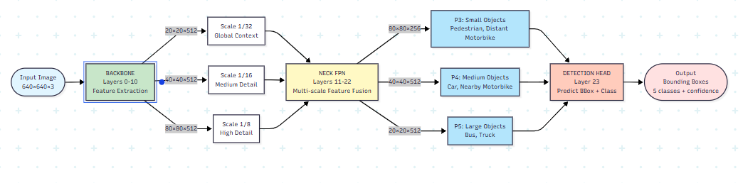
Section 4: Model
Multi-scale Detection — Fisheye Context

Slide 10
Section 5: Data Pipeline
Data Pipeline — 5-Phase Processing
1
2
3
4
5
→
→
→
→
EDA + Split
+ Export Labels
Convert VisDrone
→ Fisheye + Merge
Train
YOLO11l
Validation
+ Per-class AP
Checkpoint
+ Export
FishEye8K → YOLO format
Barrel distortion transform
2-stage training
mAP, F1, precision/recall
Save best.pt + fuse
Fisheye Barrel Distortion Transform
① Compute center (cx, cy) and R = min(w,h)/2
④ Remap image via cv2.remap() with Lanczos4 interpolation
② Normalize pixel coords to polar (r, θ)
⑤ FISHEYE_STRENGTH = 0.5 (range: 0.4–0.6)
③ Apply: r_src = tan(r_dst × s × π/2) / tan(s × π/2)
Merged Dataset: Train: 11,296 images | Val: 1,768 | Test: 853 | Train Annotations: 406,355 bboxes

Slide 11
Section 6: Model Training
2-Stage Training Configuration
Stage 1 — Initial Training (50 epochs)
Stage 2 — Resume Training (80 more epochs)
Parameter | Value
GPU | 1× Tesla P100-PCIE-16GB
Batch Size | 16
Epochs | 50
Optimizer | AdamW | lr0: 0.0005
Patience | 30 epochs (early stop)
Best Result | mAP 0.5 = 0.427 @ epoch 31
Parameter | Value
GPU | 2× Tesla T4 (32 eff. batch)
Batch Size | 16/card → 32 effective
Epochs | 80 (130 total)
Optimizer | AdamW | lr0: 0.001
Patience | 40 epochs (early stop)
Best Result | mAP 0.5 = 0.617 @ epoch 79
Loss Function Weights
Box Loss
Classification Loss
DFL Loss
Weight: 7.5
Weight: 0.5
Weight: 1.5

Slide 12
Section 6: Model Training
Training Progress — Stage 2 (v5, 80 Epochs)
Validation mAP Progress (Stage 2)
Final Model Summary
Epoch | Box Loss | Cls Loss | mAP 0.5 | mAP 0.5:0.95
1/80 | 1.409 | 0.921 | 0.418 | 0.219
20/80 | 1.324 | 0.842 | 0.476 | 0.259
40/80 | 1.240 | 0.758 | 0.541 | 0.310
60/80 | 1.182 | 0.692 | 0.594 | 0.350
70/80 | 1.152 | 0.659 | 0.609 | 0.362
79/80 ⭐ | 1.054 | 0.581 | 0.617 | 0.368
mAP 0.5
0.617
mAP 0.5:0.95
0.368
Total Epochs
130
Improvement
+44.3%
✓ Resume training improved mAP 0.5 from 0.427 → 0.617 (+44.3%) | Total training time: ~9.64h (Stage 1) + ~5.21h (Stage 2)

Slide 13
Section 7: Experimental Results
Experimental Results — Per-class Performance
mAP 0.5
mAP 0.5:0.95
Precision
Recall
Inference
0.616
0.368
0.654
0.582
~181 FPS
Per-class Results (Validation: 862 images, 27,193 instances)
Class | Instances | Precision | Recall | AP 0.5 | AP 0.5:0.95
Car | 3,894 | 0.718 | 0.719 | 0.776 | 0.534
Bus | 2,469 | 0.623 | 0.569 | 0.565 | 0.267
Truck | 286 | 0.519 | 0.486 | 0.515 | 0.304
Pedestrian | 4,232 | 0.603 | 0.276 | 0.339 | 0.129
Motorbike | 16,312 | 0.805 | 0.858 | 0.887 | 0.607
✓ Motorbike AP 0.5 = 0.887 | Car AP 0.5 = 0.776 | ~181 FPS real-time
⚠ Pedestrian Recall = 0.276 (low) | Class imbalance: Motorbike ~60% vs Pedestrian ~15%

Slide 14
Section 8: Comparison with Winners
Comparison with AI City Challenge 2024 Top Teams
Criterion | VNPT AI (1st) | Nota (2nd) | SKKU (3rd) | Ours
F1-score | 0.6406 | 0.6196 | 0.6194 | ~0.616
Models | 4 (Ensemble) | Multi-model | Multi-model | 1 (YOLO11l)
Fusion | WBF | WBF | WBF | None
Pseudo-labels | Yes | Yes | Yes | No
SAHI | Yes | Yes | Yes | No
Extra Data | FE8K+VisDrone+Syn | FE8K+External | FE8K+External | FE8K+VisDrone
Inference Speed | Slow (multi-model) | Slow | Slow | ~181 FPS ✓
Our single-model approach achieves F1 ≈ 0.616 — only ~4% behind the winner — while delivering 181 FPS real-time inference vs 5-15 FPS for ensemble methods. This makes it practical for edge deployment.

Slide 15
Section 9: Conclusion
Conclusion & Future Directions
Key Achievements
Future Directions
✓
End-to-end fisheye detection pipeline built successfully
🔬 Model Ensemble
Combine YOLO11 + Co-DETR via WBF
✓
FishEye8K + VisDrone merged: ~5,300 → ~11,300 training images
📊 SAHI Integration
Slicing for small object detection
✓
YOLO11l: 25.3M params, advanced C3k2, C2PSA, SPPF modules
✓
2-stage training: 130 epochs total (P100 + 2×T4)
🔄 Pseudo-labeling
Expand training set with auto-labels
✓
mAP 0.5 = 0.616, mAP 0.5:0.95 = 0.368 on validation
🏗 Domain Adaptation
Reduce FishEye8K ↔ VisDrone gap
✓
mAP 0.5 improved +44.3% via resume training (0.427 → 0.616)
⚡ TTA & Multi-scale
Test-time augmentation strategies
✓
Competitive: F1 ≈ 0.616 vs winner 0.6406 (~4% gap)
✓
Real-time inference: ~181 FPS on single GPU
🎯 Pedestrian Focus
Address low Recall (0.276) issue

Slide 16
Thank You!
Questions & Discussion
Supervisor: Dr. Nguyen Duc Du
Object Detection on FishEye8K Using YOLO11 — 2024

