Slide 1




HOW TO HOST YOUR MASTERNODE
(LightNode version)
HostNodes

Slide 2
🚨All FLUX Transaction / Payment must be made from Zelcore🚨
If you use an exchange wallet :
⛔ Will cause a delay in the deployment of your node ⛔
⛔ Can lead to the loss of FLUX ⛔

Slide 3
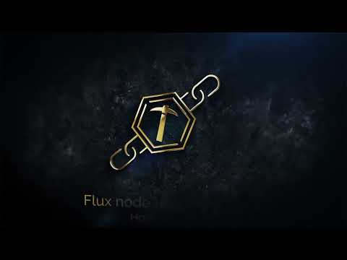

Slide 4
Create your MasterNode
Manage your MasterNode
STEP 1 – Your reward address
STEP 2 – Sending the collateral
STEP 3 – Retrieving some information
STEP 4 – Node reservation
STEP 5 – Node configuration
STEP 6 – Add IP address
STEP 7 – Start your rocket !
TIPS 1 – Subscription extension
TIPS 2 – Change alias of node
TIPS 3 – Change KDA address
TIPS 4 – Activate the “Watchdog” function

Slide 5
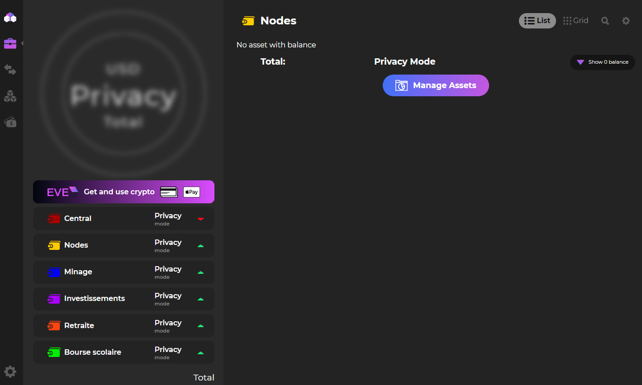
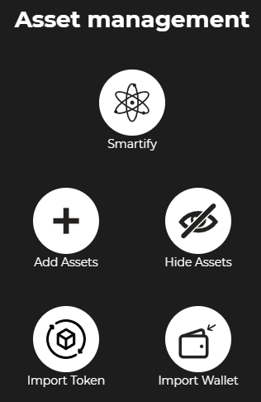
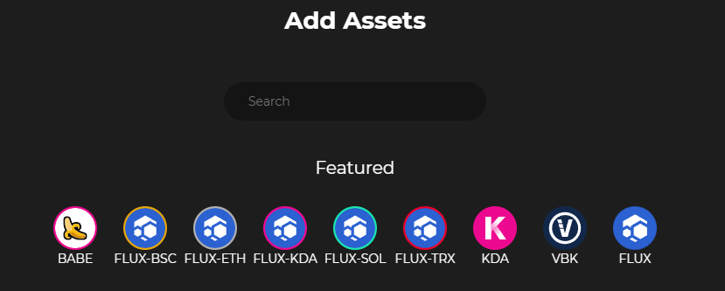
STEP 1 – Your reward address
On your wallet, go to Portfolio and select the wallet you want to use to receive your rewards.
Once on the portfolio, click on Manage Assets
Click on Add Assets
Then select the FLUX and KDA tokens
3
1
2
4

Slide 6
STEP 2 – Sending the collateral
It is very important to only send the necessary collateral No more / No less
Example: you want an Nimbus MasterNode (12500 FLUX). It is therefore necessary to send ONLY 12500 FLUX
Otherwise, your transaction will not be recognized as the necessary collateral for your MasterNode and you will therefore have to redo the manipulation

Slide 7
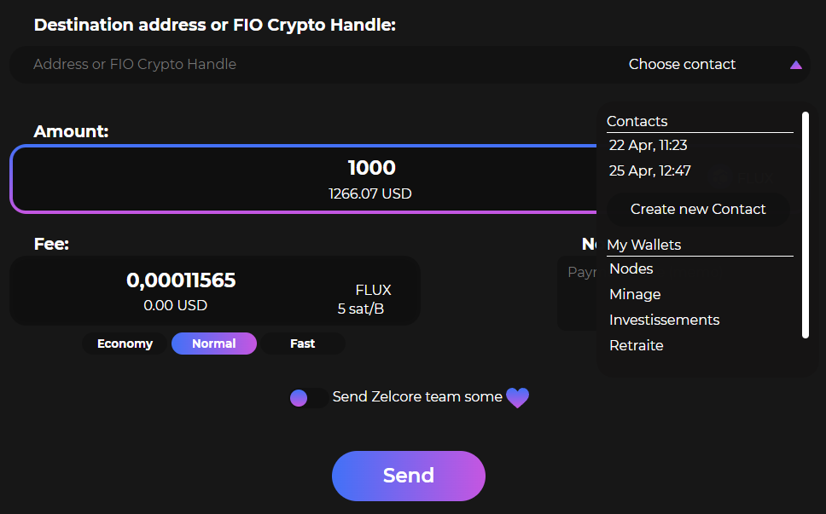
Reminder on Flux collateral
Cumulus = 1000 Flux / Nimbus = 12500 Flux / Stratus = 40000 Flux
Go to your main wallet then send the necessary collateral for your MasterNode
To send the collateral, click on the Flux token of your main wallet then click on “Send”
Fill in the exact amount of the collateral
Click on “Choose a contact”
Select the wallet where you want to send the collateral
Then click “Send”
2
3
1
4

Slide 8
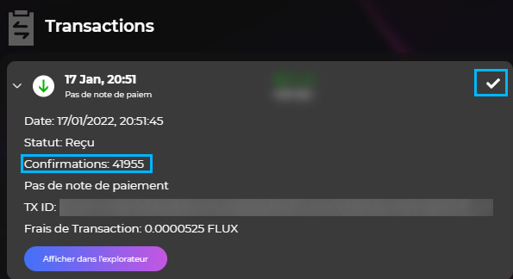
You can check the status of the transaction directly on the wallet, in the Transactions section
You will be able to see the ✅ as well as the number of confirmations.
Expect a waiting time of around 2 to 3.5 hours. The transaction must have 100 confirmations before being validated like a Node Collateral.

Slide 9
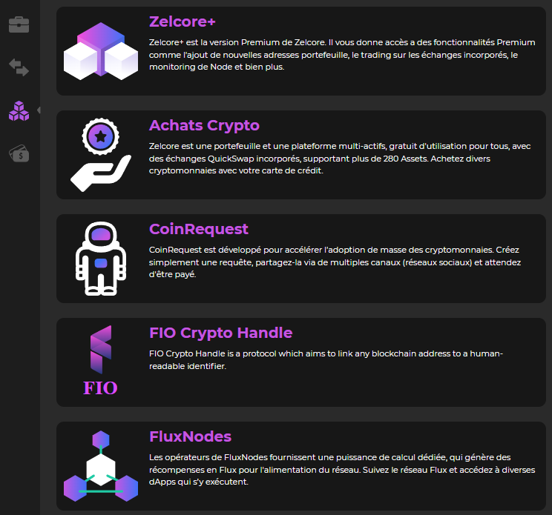
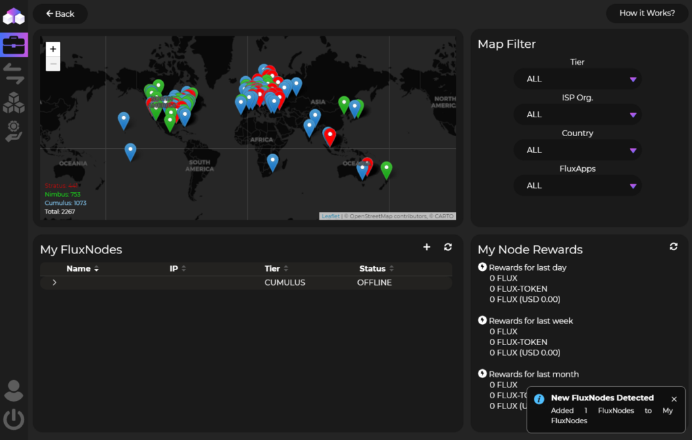
STEP 3 – Retrieving some information
Go to “Dapps” then click on “FluxNodes” The type of node will be automatically recognized
Node not recognized
If nothing is displayed, two possibilities:
Either the transaction is not yet confirmed, and therefore you have to wait
Either you did not make the transaction correctly, in this case, you will have to repeat STEP 2

Slide 10
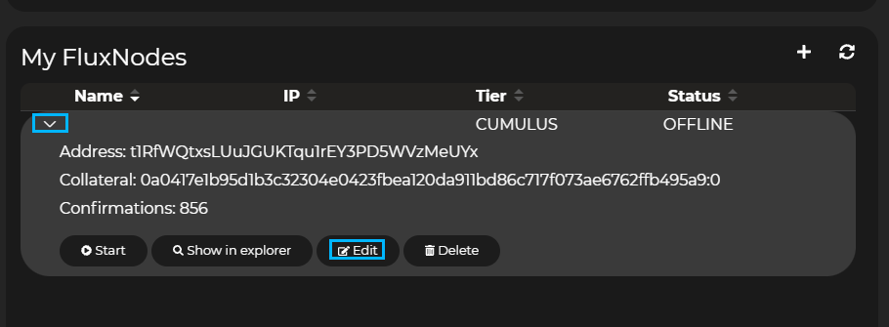
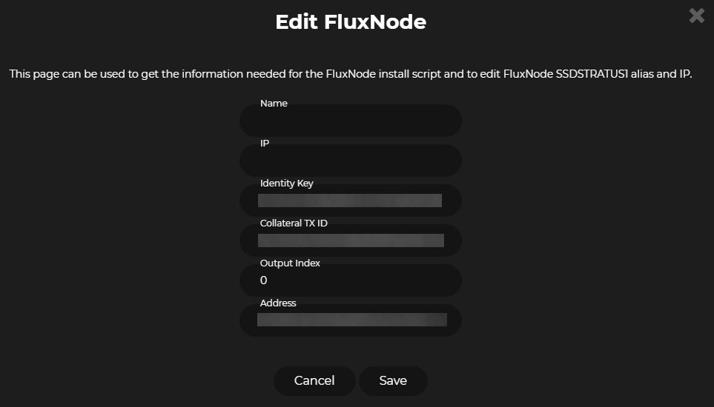
Click on the arrow to see the detail of the node then click on “Modify”
On this new window, record the following information:
Identity Key
Collateral TX ID
Output Index
Zelcore ID (in Dapps – Zel ID) Click at QR code and copy that
KDA address (for Nimbus/Stratus nodes) (Example: k:59e9cc6ede8…)
1
2

Slide 11
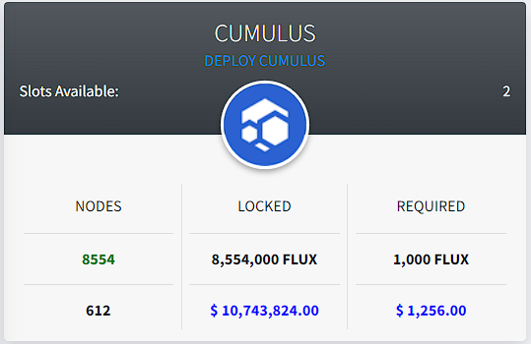
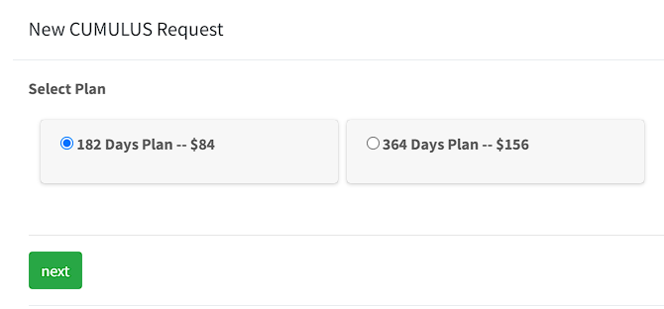
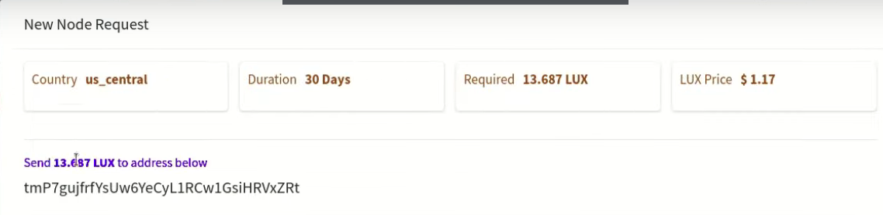
STEP 4 – Node reservation
Please create your HostNode account and verify it via the email received before any manipulation
Go to https://hostnodes.online/
Click on “DEPLOY“
Select “Plan” you want Click on “Next”
Send amount required to subscribe at Flux address which is given to you
Do NOT send from an exchange address, only from Zelcore
Only when it’s done, click on “Submit”
A page is displayed, do not leave it and do not use it. You will be redirected to the Node configuration page once the transaction has been confirmed.
1
2
3

Slide 12

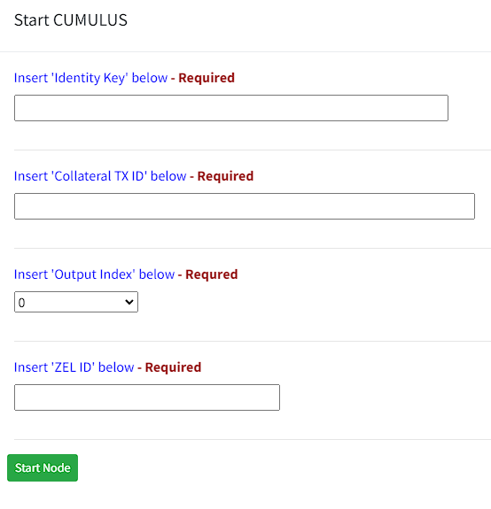
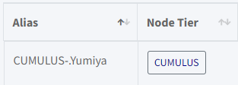

STEP 5 – Node configuration
On your HostNodes dashboard click on “Start” icon
Enter information of Step 3
Click on “Start Node” (Your node goes into "Benchmarks Checking“)
Click on tiers name of your node and copy IP
1
Expect a wait time of around 2-5 minutes.
If it takes longer click on "Cancel" redo this step
2
3

Slide 13

STEP 6 – Add IP address
Return to Zelcore and “FluxNode” as in Step 3
Paste the IP address and give a name to your Node
Click on “Save”
4
5

Slide 14
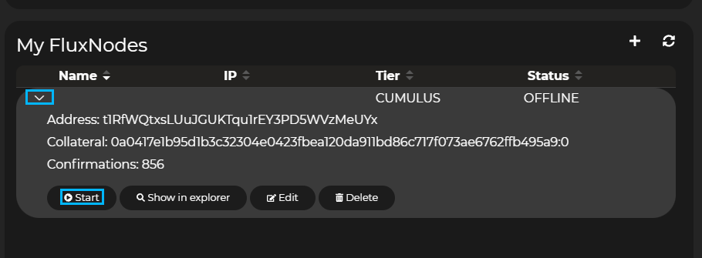

STEP 7 – Start your rocket !
To launch your MasterNode, nothing could be simpler.
Go back to the details of your FluxNodes (in Dapps – FluxNodes)
Go to the details of your node then click on “Start”
Write your HostNodes username in #hosters-role on our Discord
The @HOSTERS role gives :
Access to the Nodes alert
Access to the Rewards alert
Participate in the events and competitions offered
Must have 100 confirmations before

Slide 15
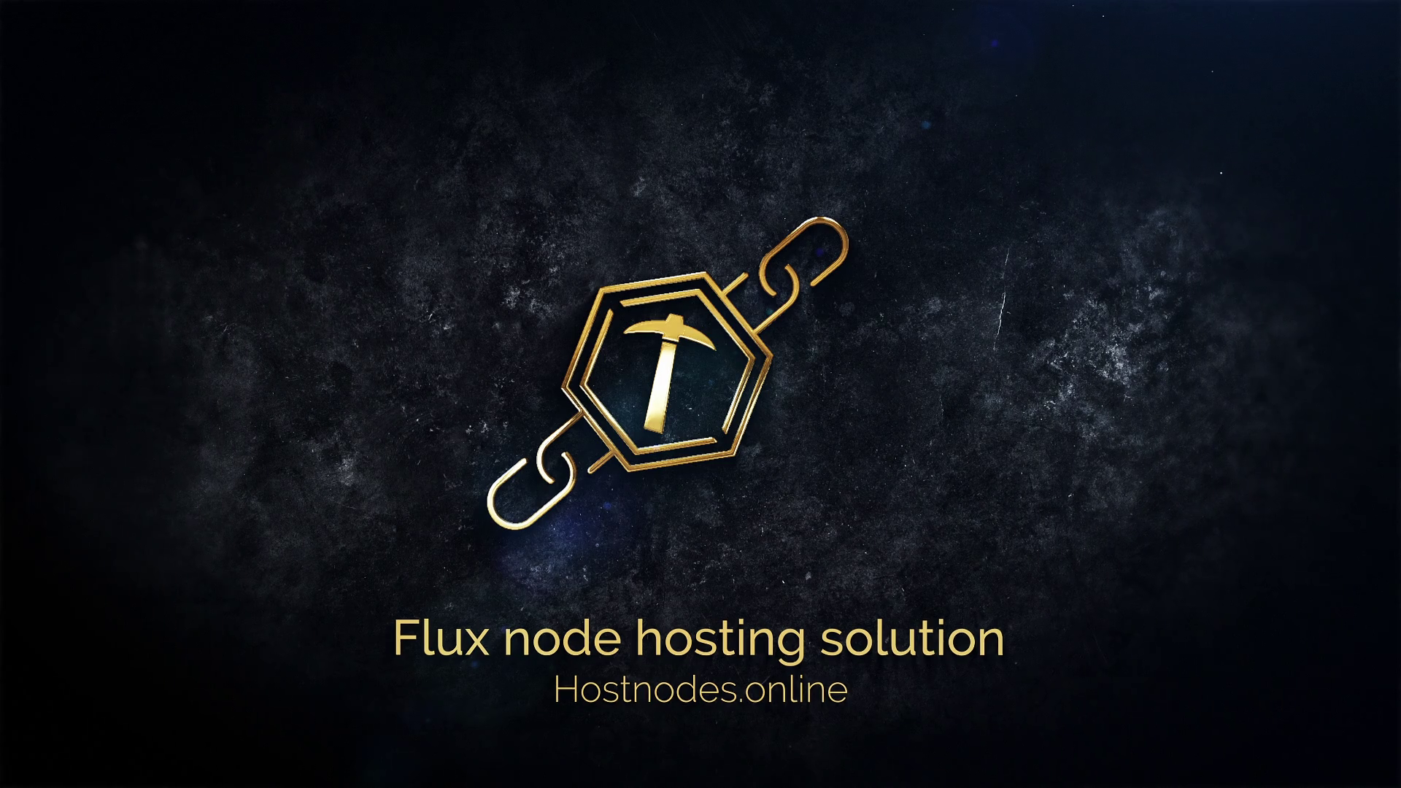


Slide 16
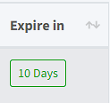
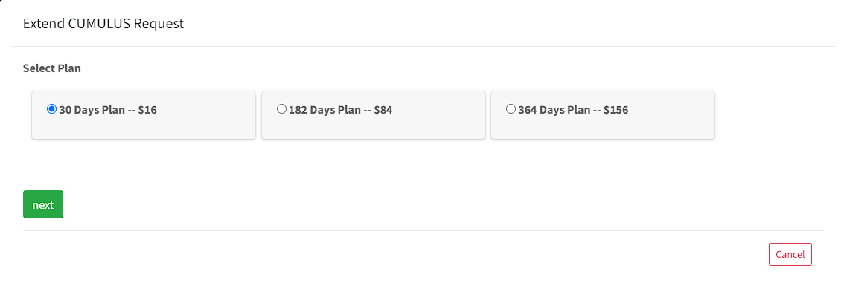
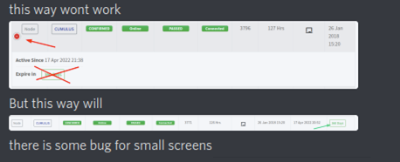
TIPS 1 - Subscription extension
Click on number days left of your node
Choose your “Extension Plan”
The payment system is the same as for the purchase of a node
If u click on number days left and nothing happen:
Zoom out to get this website layout
1
2

Slide 17
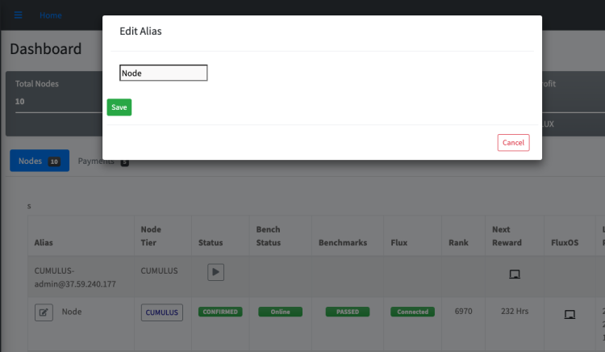
TIPS 2 – Change alias of node
Click in « Edit » icon (pop up will appear)
Edit Alias and click on “Save”
To modify the “Alias" again: Click on the name of your node
1
2

Slide 18
TIPS 3 – Change KDA address
Click the "Apps" section (left side of the Zelcore wallet)
Click on "FluxNodes“
Click the down arrow next to your Nimbus/Stratus node name
Scroll down and click "FluxOS" button
Click on "Please log in using ZelID" (pop up will appear to open Zelcore)
Click on "Open Zelcore"
Enter your d2FA pin and click the "sign and Send" button

Slide 19
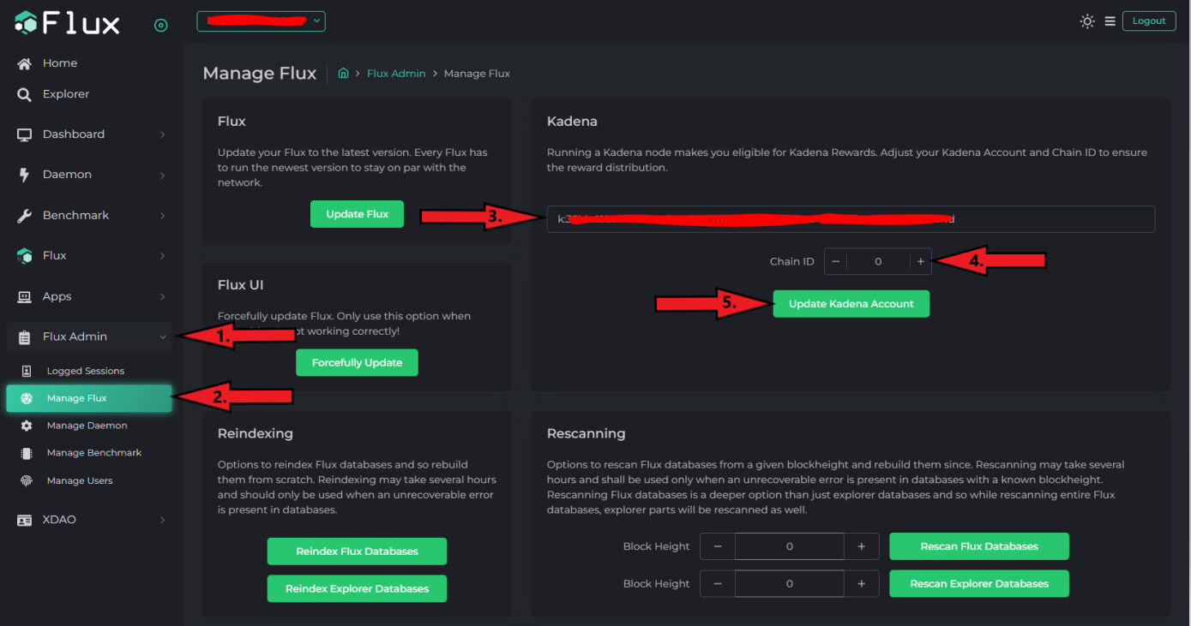
Go back to your FluxOS screen and do the following:
Click "Flux Admin“
Click "Manage Flux“
KDA address (check/add/change)
Chain ID number (check/change)
Click on "Update Kadana Account"

Slide 20

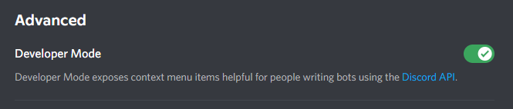
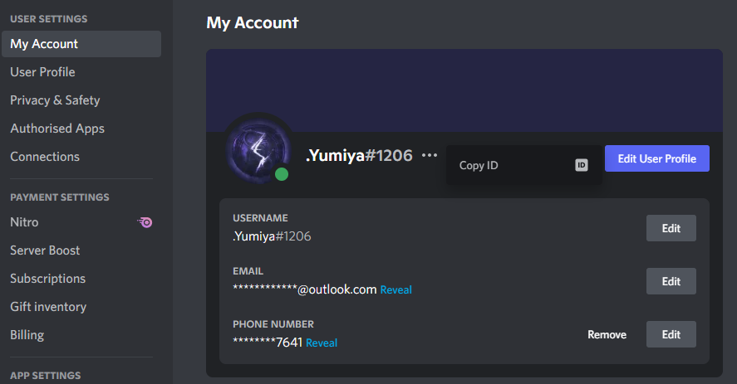
TIPS 4 – Activate the “Watchdog” function
Retrieve your Discord ID (Desktop version)
Click on the parameter wheel
Go to “Advanced” section and enable “Developer Mode”
Go to “My Account” section
Click on “…” between your Discord name
Click on “Copy ID” (it’s a 18 digits code)
1
2
3

Slide 21
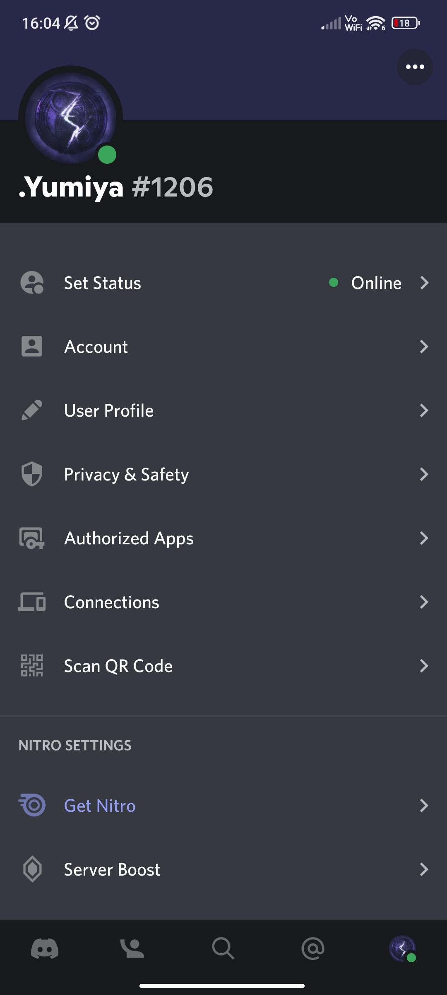
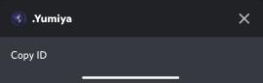
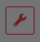
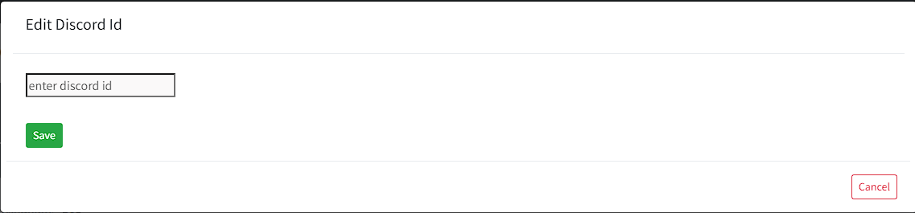
Retrieve your Discord ID (Android/IOS app version)
Click on your profile picture
Click on “…” on top right of your screen
Click on “Copy ID” (it’s a 18 digits code) on bottom of your screen
1
2
3
Go back to your HostNodes dashboard and do the following:
Click on in the line of your node (a pop-up appears)*
Enter your Discord ID
Click on “Save”
Need to have “Hosters” role on HostNodes Discord
* If pop-up don’t appears, zoom out like for “TIPS 1 - Subscription extension”
Your “Watchdog” function is enable for your node, you can redo this for all your nodes

