Slide 1
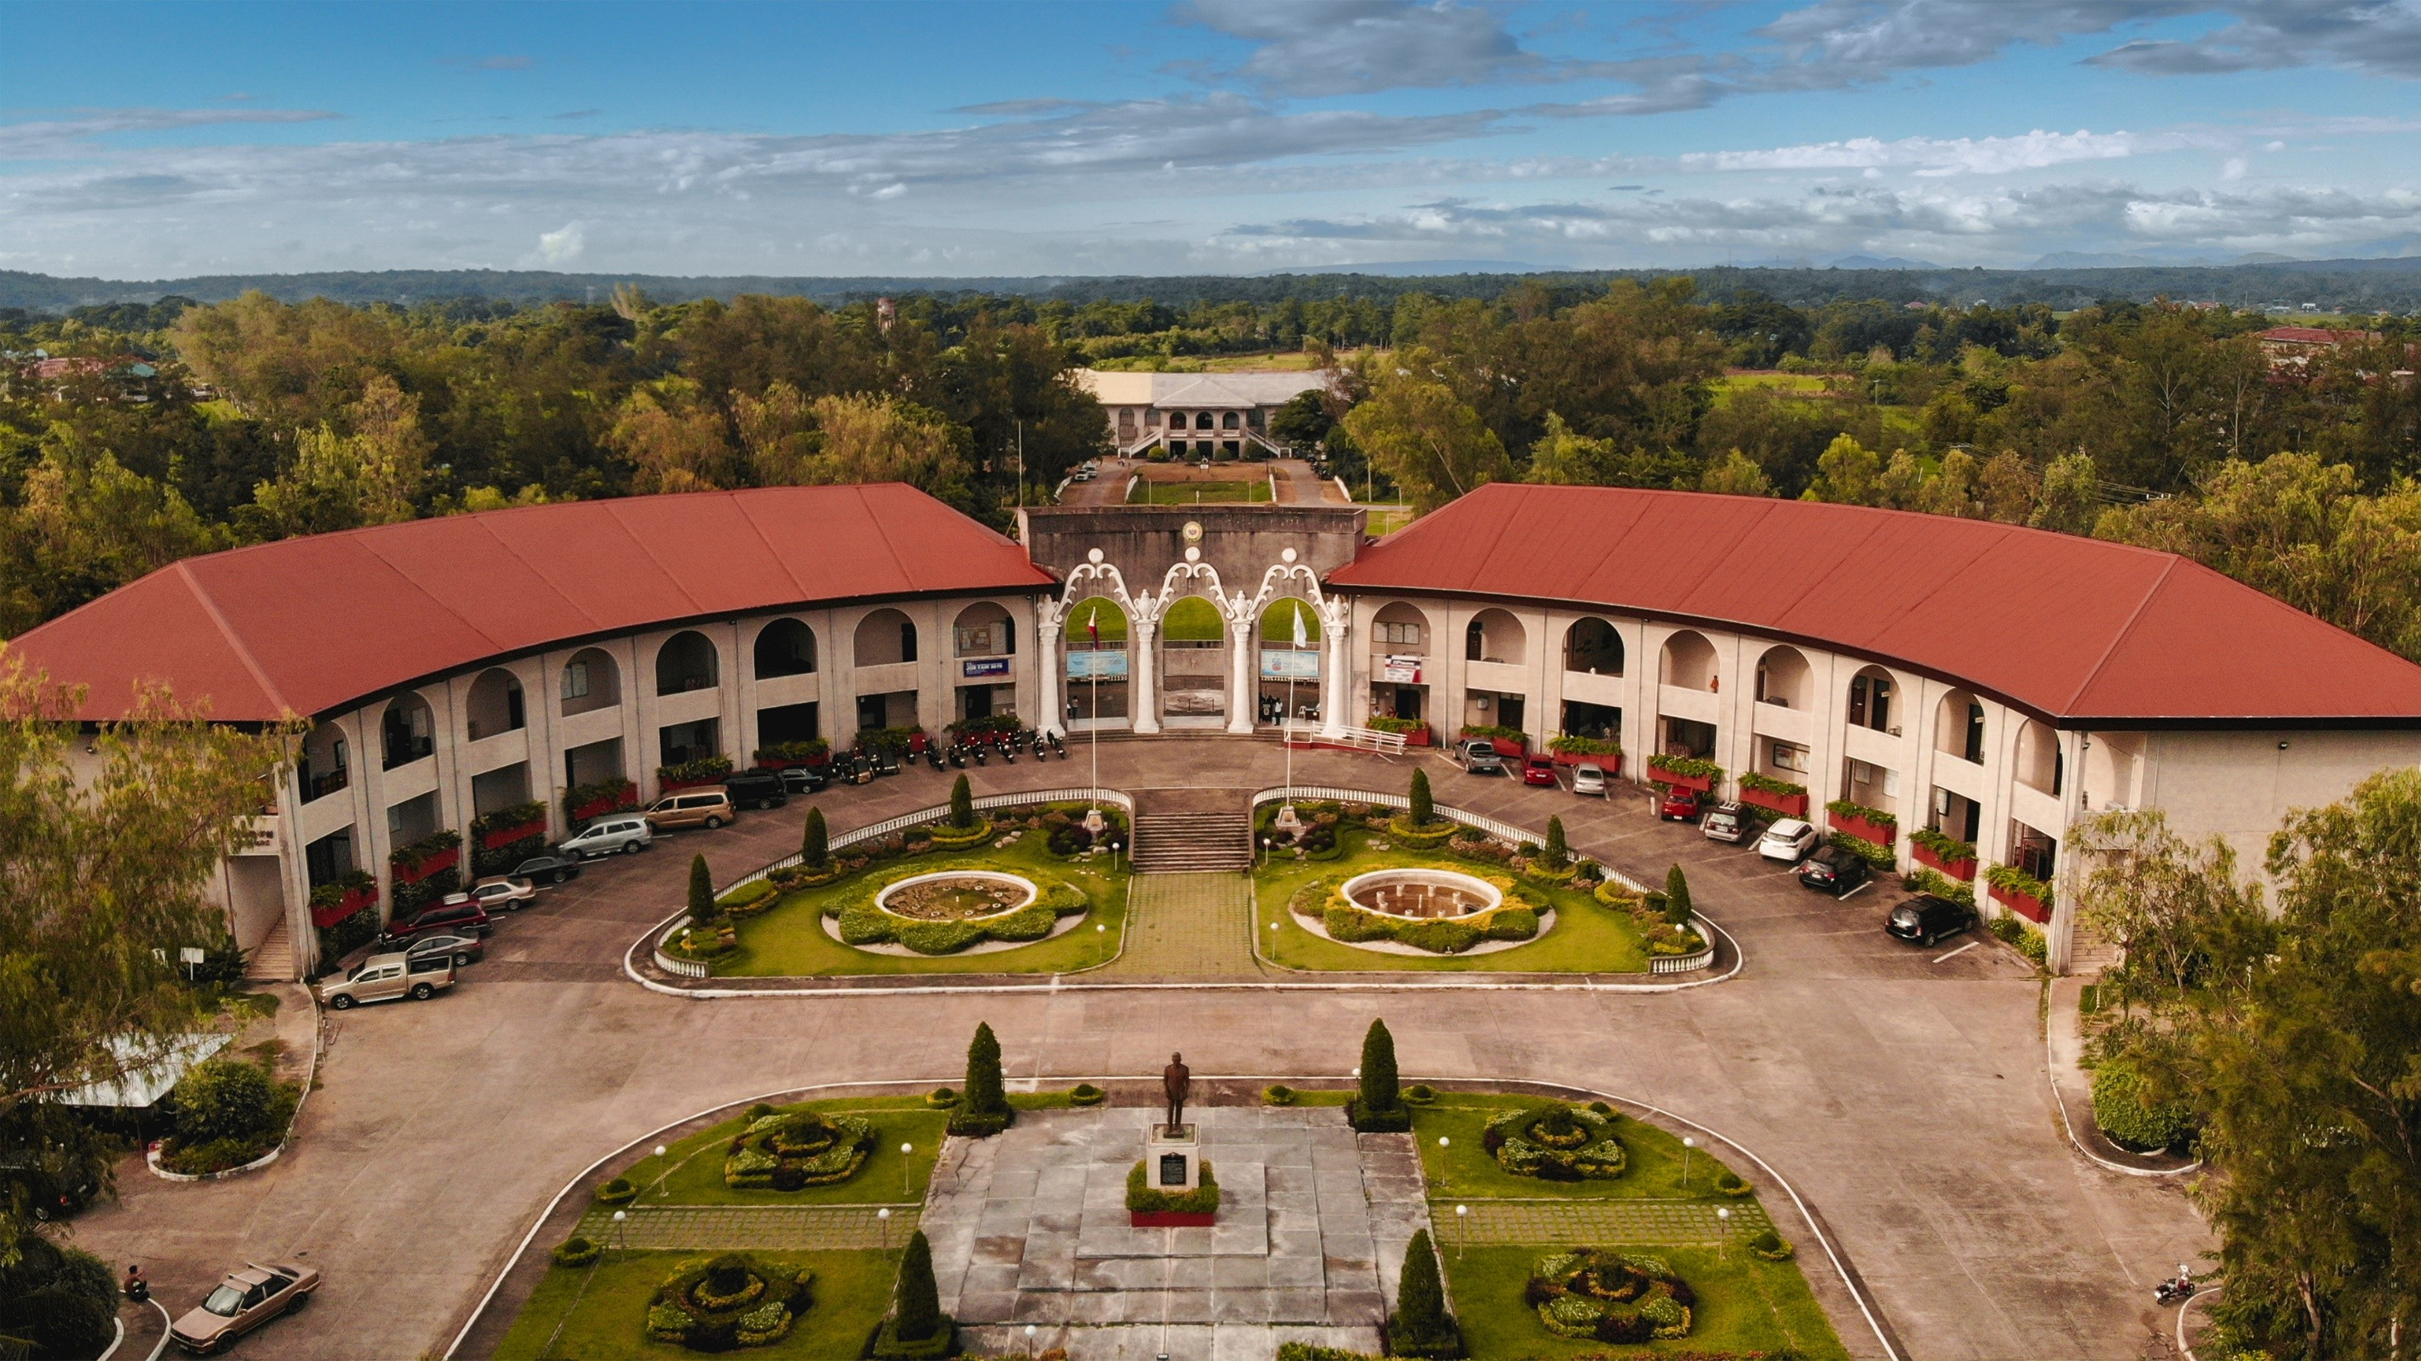

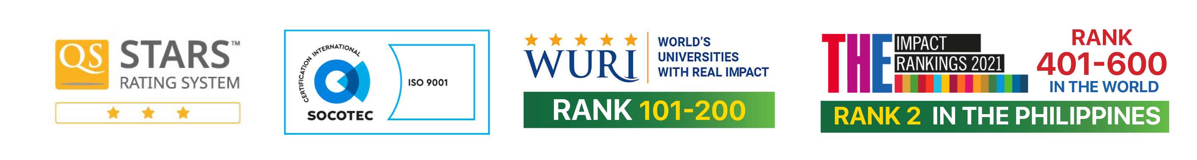

Slide 2


PayTrack: A mobile application system for MMSU-CIT Organizations
BALINO, JASMINE P.
REAL, JOHN PAUL T.
REYES, MARK KENNETH D.
SAOIT, JUSTIN MHEL D.
VALENZUELA, KEES LEIGH ANN G.
BSinTech CT-3B
Notes:
Kenneth Good day to everyone. Today, we will present our research entitled ‘PayTrack: A mobile application system for MMSU-CIT Organizations.' This project was conceptualized and developed by our group: Jasmine P. Balino, John Paul T. Real, Mark Kenneth D. Reyes, Justin Mhel D. Saoit, and Kees Leigh Ann G. Valenzuela, from BSinTech CT-3B.
Recognizing the challenges faced by student organizations in managing payments manually, we will develop PayTrack — a mobile solution aimed at modernizing the financial operations of these organizations. Throughout this presentation, we will discuss our objectives, processes, design, and evaluation of the application we will build.

Slide 3



Purpose and Description of the study
Mobile App
Development
Streamlining Payment Processes
Improving Financial
Oversight
Create a mobile app to improve payment tracking efficiency.
The app aims to enhance accuracy and transparency in financial transactions.
Eliminate inefficiencies in manual payment methods by automating the process.
This will simplify the payment experience for users.
Enhance financial management for students and organization leaders.
Provide tools for effective tracking and reporting of financial activities.
Notes:
Kenneth - presentation
Jasmine - the primary
Kees – pay track
The primary objective of our study is to address inefficiencies in the manual payment processes utilized by student organizations at MMSU-CIT. Manual collection methods have resulted in delayed transactions, human errors, disorganized record-keeping, and a general lack of transparency.
Our study aims to overcome these challenges by designing and developing a mobile application that provides automated tracking of payments, real-time financial reporting, and secure transactions. PayTrack serves not only as a platform for processing payments but also as a tool to promote financial accountability, ease the administrative burden on officers, and enhance the overall experience for students making contributions or paying dues.
Our goal is to create a platform that brings convenience, improves financial management efficiency, and instills a culture of responsible financial practices among student organizations.

Slide 4
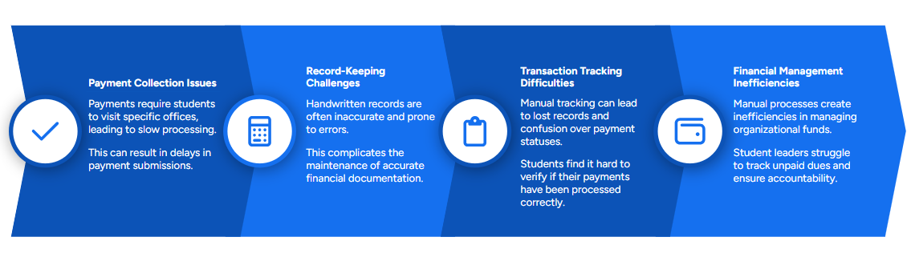
Statement of the Problem: Existing Payment Processes
Notes:
REAL
Read all until next slide.

Slide 5
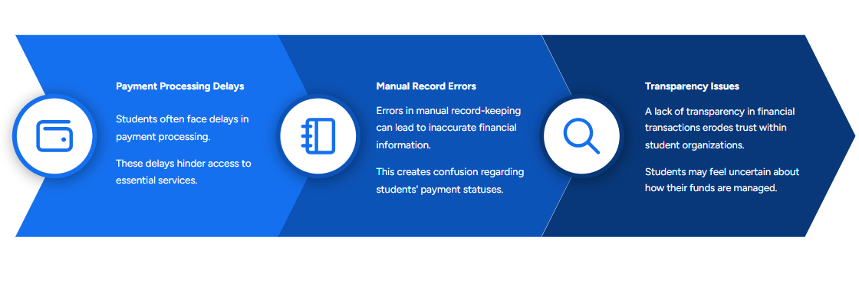
Statement of the Problem: Existing Payment Processes
Notes:
Saoit – presentation
Kenneth – notes
Our study began by identifying the key problems associated with the current payment methods in student organizations.
First, we examined the traditional processes used, which mostly involve manual collection and handwritten records. We found these methods to be highly inefficient, prone to inaccuracies, and vulnerable to data loss or misinterpretation.
Second, students reported difficulties in making timely payments, primarily because of the inconvenience of having to meet officers physically or wait for specific collection schedules.
Third, organizational officers themselves faced issues in tracking pending payments, reconciling financial records, and maintaining transparency.

Slide 6





Scope and Limitation of the study
App Development Process
Core Features
The app will undergo design, development, and implementation phases.
The goal is to develop a mobile application that is intuitive and easy to use for financial management.
Key functionalities include digital payment processing and automated tracking.
Additional features include user notifications, financial reporting, and secure access to protect user data.
Target Features
System Limitations
The application is designed exclusively for MMSU-CIT student organizations.
The app is intended to improve financial management for students and organization officers at MMSU-CIT.
The app is currently developed for Android devices only.
It does not support integration with external banking systems, limiting its functionality.
Notes:
Jasmine presentation
Kees notes
Our study focuses exclusively on the financial management needs of MMSU-CIT student organizations.
The scope includes:
Enabling students to pay their dues, event fees, and other financial obligations using the mobile app through integration with PayMongo as the third-party payment gateway.
Providing organization officers with a tool to manage collections, generate financial reports, and communicate financial updates to members.
Implementing user authentication to secure access to financial data.
The limitations are:
The app will be developed only for Android devices, limiting accessibility for iOS users.
An active internet connection is required for real-time payment processing, tracking, and updates, meaning offline functionality is limited.
Integration will be limited to PayMongo only; other external banks or third-party payment gateways beyond PayMongo’s supported methods are not included.
Students without access to supported online payment options will still have to process payments manually through organization officers.
Despite these limitations, the app aims to create a significant improvement over the existing manual methods.

Slide 7




Conceptual Framework: Input-Process-Output Model
Enhanced Efficiency and Transparency
The goal is to enhance financial management efficiency and transparency
Improved Financial Management
The outcome is improved financial management for student organizations
MMSU-CIT PayTrack Application
The output is the MMSU-CIT PayTrack application.
Development of Mobile App
The process involves developing the mobile application
Existing Payment Processes
The input includes existing payment processes and their problems.
Notes:
John Paul Real presentation umuna bago notes.
Our study follows the Input-Process-Output Model, a simple yet powerful framework for system design.
Input: The initial stage captures the current manual payment processes and the specific problems faced by users, such as transaction delays and record inaccuracies.
Process: Based on the output, we will design and developed a mobile application that streamlines financial transactions, offers real-time updates, and automates reporting.
Output: The tangible result of this process is the PayTrack mobile application — a secure, efficient, and user-friendly financial management system tailored for MMSU-CIT organizations.
This model ensures that the final product directly responds to the identified needs and challenges.

Slide 8
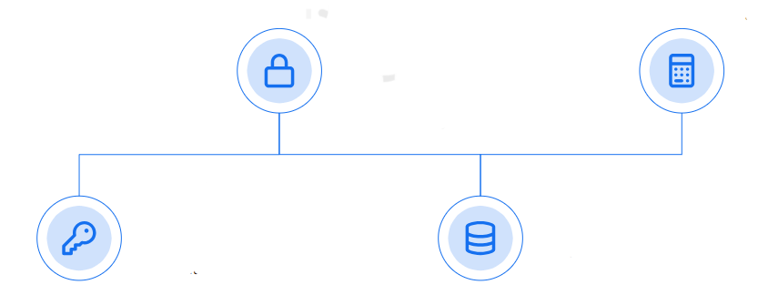
System Architecture
Secure Payment Gateway
A secure payment gateway ensures safe transactions for users.
Automated Reporting
Automated reporting generates financial summaries for organization officers.
User Authentication
Real-time Financial Tracking
User authentication restricts access to authorized individuals, protecting sensitive financial data.
Real-time tracking provides immediate updates on payment statuses.
Notes:
Saoit notes dagus ti basaemon.
The PayTrack system architecture is designed around four major components:
User Authentication: Guarantees that only verified students and officers can access and manage financial data.
Secure Payment Gateway: Ensures all transactions are encrypted and protected against unauthorized access.
Real-time Financial Tracking: Provides immediate visibility into payment status for both members and officers.
Automated Reporting: Enables officers to generate financial summaries and reports instantly.
These components work in harmony to deliver a seamless, secure, and efficient financial system for student organizations.

Slide 9


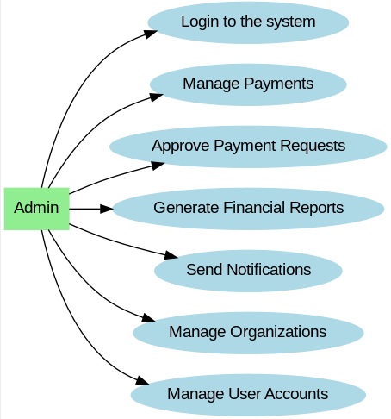
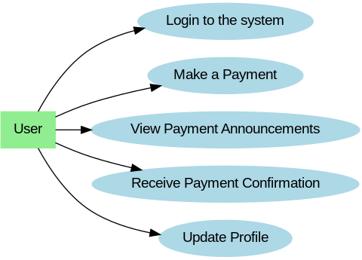
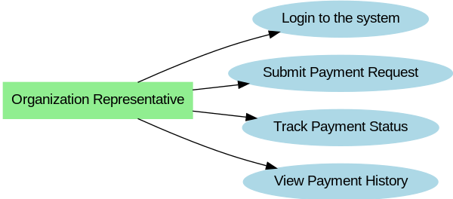
Use Case Diagram
Functions of the Admin Role
Responsibilities of the Organization Representative
User Payment Capabilities
Effectively manages payments and user accounts.
Sends notifications to keep users informed about updates.
Submits payment requests and tracks their status.
Ensures prompt and accurate processing of all transactions.
Makes payments for dues and fees through the app.
Receives confirmations and can update their profile information.
Notes:
Jasmien
Our Use Case Diagram details the interaction between different types of users and the system.
Admin Role: Admins have full control over the system operations. They manage user accounts, oversee payment processing, approve payment requests, generate financial reports, and send notifications.
Organization Representative: They are responsible for submitting payment requests for their organizations, tracking payment statuses, and ensuring that all organization dues are properly recorded and updated.
User: The primary users are students who can make payments, receive payment confirmations, view announcements, and manage their profiles.
This division of responsibilities ensures that users interact only with the features relevant to their role, improving efficiency and user experience.

Slide 10
System Feature Matrix
Organization
Representative Functions
Admin Functions
VS
VS
Functions of the User Role
v
Admins oversee system operations and ensure efficient payment processing.
They manage user accounts, including adding and deactivating users.
Admins generate financial reports to assess performance.
They send notifications to keep users informed of updates.
Allows the organization representative to initiate a payment process by providing necessary details and supporting documents.
To monitor the progress and outcome of their submitted requests.
Access to a record of completed transactions, allowing them to track payments and maintain accurate financial documentation.
Users can make personal payments through the app for convenience.
They receive confirmations to verify successful transactions.
Users can view payment announcements for financial updates.
Additionally, they can update their profile information.
Notes:
kees
The system feature matrix provides a detailed comparison of functionalities available to each user role.
Admin Functions:
Admins oversee system operations and ensure efficient payment processing.
They manage user accounts, including adding and deactivating users.
Admins generate financial reports to assess performance.
They send notifications to keep users informed of updates.
Organization Representative Functions:
Allows the organization representative to initiate a payment process by providing necessary details and supporting documents.
To monitor the progress and outcome of their submitted requests.
Access to a record of completed transactions, allowing them to track payments and maintain accurate financial documentation.
User Functions:
Users can make personal payments through the app for convenience.
They receive confirmations to verify successful transactions.
Users can view payment announcements for financial updates.
Additionally, they can update their profile information.
Clearly delineating these functions will ensures a structured, efficient, and secure system where users perform specific roles without overlap or confusion.

Slide 11



Research Instruments
Researcher-Made Questionnaire
The questionnaire identifies issues in payment tracking.
It serves as a foundational tool for data collection in the study.
ISO/IEC 25010 Standards
ISO/IEC 25010 standards evaluate the acceptability and quality attributes of the mobile application.
They provide a framework for assessing software performance.
Random Sampling of 50 Participants
The study uses random sampling of 50 participants, including students and organization advisers.
This approach ensures diverse representation in the research.
Notes:
Kenneth
We will utilize a researcher-made questionnaire guided by the ISO/IEC 25010 international standards for software quality evaluation.
ISO/IEC - International Organization for Standardization (ISO) and the International Electrotechnical Commission (IEC).
The ISO/IEC 25010 standards assess eight critical attributes:
Functionality,
Performance Efficiency,
Usability,
Reliability,
Security,
Maintainability,
Portability,
Compatibility.
These standards provided a comprehensive framework for objectively measuring the acceptability and effectiveness of the PayTrack application.

Slide 12

Population and Sampling Procedure
Sample Size
Sampling Method
Data Collection Methods
The study will include 50 students along with all organization advisers and officers.
A random sampling method will be employed.
Data will be collected through surveys and face-to-face interviews.
Notes:
Saoit – presentation
Real - notes
Our study will employ random sampling to select 50 student respondents, along with organization advisers and officers from MMSU-CIT.
The use of random sampling ensured that the feedback was representative and unbiased. Data collection was conducted through structured surveys and face-to-face interviews. This method enabled us to gather both quantitative data for statistical analysis and qualitative insights to refine our application further.

Slide 13
Statistical Analysis
Data Collection & Analysis
A researcher-made, panel-validated survey will be used.
Data will be analyzed using weighted mean to assess the project’s acceptability.
Weighted Mean Interpretation
4.50–5.00 – Excellent
3.50–4.49 – Very Acceptable (VA)
2.50–3.49 – Moderately Acceptable (MA)
1.50–2.49 – Slightly Acceptable (SA)
1.00–1.49 – Not Acceptable (NA)
Ethical Considerations
Ethical clearance will be secured from URERB.
Permission to conduct the study will be obtained from MMSU-CIT.
Informed consent will be provided; participation is voluntary.
Respondents will assess the mobile app based on 8 quality attributes.
Confidentiality and data privacy will be strictly maintained.
All sources will be properly cited.
Completed questionnaires will be destroyed after 1 year.
A copy of the study will be available in the library.
Notes:
Kenneth da collection and analysis
Kees ethical considerations
To analyze the collected data, we will employ weighted mean computation.
The weighted mean will allow us to determine the level of acceptability of the application based on participant feedback, interpreted using the following range:
4.50–5.00: Excellent,
3.50–4.49: Very Acceptable,
2.50–3.49: Moderately Acceptable,
1.50–2.49: Slightly Acceptable,
1.00–1.49: Not Acceptable.
We also strictly adhered to ethical standards by obtaining ethical clearance from the URERB, ensuring informed consent, maintaining participant confidentiality, and properly disposing of data after one year.

Slide 14
THANK YOU!
Notes:
Bye bye hak hak graduation cutie. 🤞😀

Slide 15


Get in Touch With Us
Send us a message or visit us
City of Batac, Ilocos Norte,
Philippines
(63) 77-600-0459
op@mmsu.edu.ph
Follow us for updates
facebook.com/MMSUofficial www.mmsu.edu.ph

