Slide 1



Introduction to Accident Sensor Gadgets
Accident sensor gadgets are innovative devices designed to detect and respond to various types of accidents or emergencies. These smart tools use advanced technologies to monitor critical situations and alert users or emergency services, helping to save lives and minimize property damage.
by Seema Kumari

Slide 2

Importance of Accident Detection
1
Rapid Response
2
Improved Safety
Accident sensor gadgets can quickly detect incidents and notify authorities, enabling fast emergency response and potentially reducing the severity of injuries or damages.
These devices provide an extra layer of protection, giving users peace of mind and helping to prevent or mitigate the consequences of accidents.
3
Data Tracking
Accident sensor gadgets can collect valuable data about incident patterns and trends, informing safety improvements and preventive measures.

Slide 3
Types of Accident Sensor Gadgets
Vehicle Sensors
Personal Devices
Home Monitoring
Gadgets that detect collisions, rollovers, or sudden deceleration in vehicles, triggering emergency alerts.
Wearable sensors that monitor user activity and can detect falls or other accidents, notifying emergency contacts.
Sensors placed in homes to detect fires, gas leaks, or other hazardous events, providing early warning and response.

Slide 4
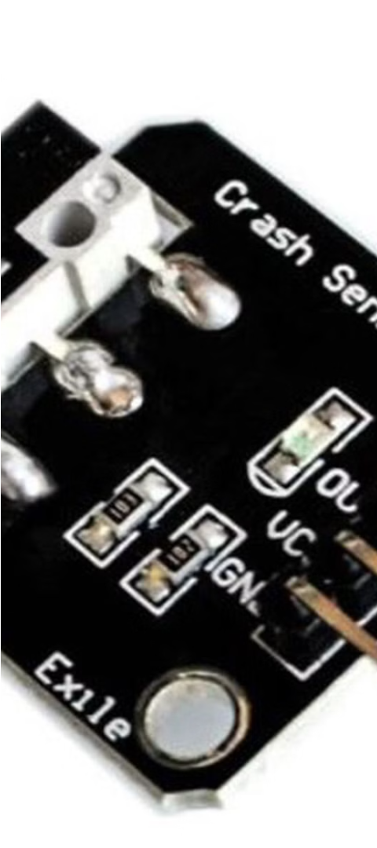
How Accident Sensor Gadgets Work
1
Sensor Activation
Accident sensor gadgets use a variety of technologies, such as accelerometers, pressure sensors, or thermal detectors, to monitor for specific accident-related events.
2
Data Analysis
The gadgets analyze the sensor data in real-time, applying algorithms to distinguish between normal and emergency situations.
3
Alert Notification
When an accident is detected, the gadget immediately triggers an alert, sending notifications to the user, emergency contacts, or authorities.

Slide 5
Key Features of Accident Sensor Gadgets
Connectivity
Customization
Advanced connectivity options, such as Wi-Fi, Bluetooth, or cellular, enable remote monitoring and instant emergency notifications.
Many accident sensor gadgets offer customizable settings, allowing users to tailor the device to their specific needs and preferences.
Durability
Battery Life
Rugged, water-resistant, and shock-proof designs ensure accident sensor gadgets can withstand harsh environments and unexpected incidents.
Long-lasting battery life ensures accident sensor gadgets can operate reliably, even during extended periods without a power source.

Slide 6




Benefits of Using Accident Sensor Gadgets
Life-Saving
Property Protection
Peace of Mind
Data Insights
Accident sensor gadgets can quickly alert emergency services, potentially saving lives in critical situations.
Accident sensor gadgets provide a sense of security and reassurance for users and their loved ones.
The data collected by accident sensor gadgets can inform safety improvements and preventive measures.
These devices can help minimize property damage by triggering rapid emergency response.

Slide 7




Choosing the Right Accident Sensor Gadget
Identify Needs
Research Features
Consider Compatibility
Prioritize Reliability
Determine the specific accident risks or scenarios you need to address, such as vehicle collisions, falls, or home emergencies.
Evaluate the available accident sensor gadgets and their key features, such as connectivity, customization, and durability.
Ensure the accident sensor gadget is compatible with your existing devices, smart home systems, or emergency response services.
Choose a reputable brand and model with a proven track record of accurate detection and reliable performance.

Slide 8
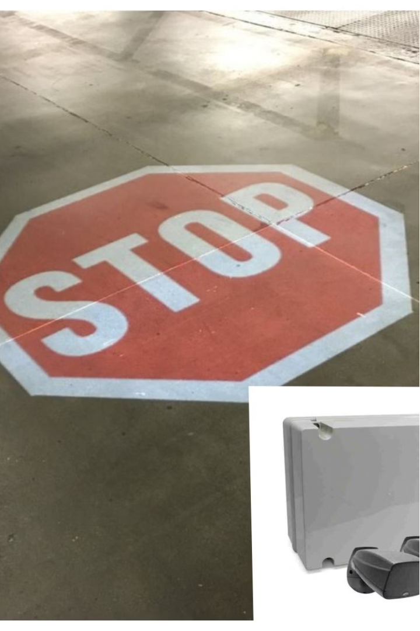
Conclusion and Call to Action
Accident sensor gadgets are innovative tools that can significantly enhance safety and emergency response, providing users with peace of mind and potentially saving lives. By understanding the importance of accident detection, the different types of gadgets available, and the key features to consider, you can choose the right accident sensor gadget to meet your specific needs and enjoy the many benefits these remarkable devices offer.
Explore the world of accident sensor gadgets today and take the first step towards a safer, more secure future.

