Slide 1

Advancing Fraud Detection through CTGAN - Based Synthetic Transactions
Organization : Global Next Consulting India Private Limited
Mentor: Abhipsa Guha
Team Members: Rekha Kumari Bheel, Sajrudin Aalam, Payal Dhokane, Riya Rawat

Slide 2
Project Flow
Abstract
Introduction
Objectives
Problem Statement
Scope of Work
6. Tools and Technologies
7. Methodology
8. Outcomes
9. Team Details
10. Conclusion

Slide 3
Abstract
This project aims to develop a fraud detection system for bank transactions using machine learning. The workflow includes:
Preprocessing: Data cleaning, encoding, scaling, and feature engineering.
Exploratory Data Analysis (EDA): Identifying patterns, anomalies, and key feature relationships.
Imbalance Handling: Leveraging Adversarial Variational Autoencoder (CTGAN) to generate realistic synthetic samples for the minority (fraud) class.
Modeling & Visualization: Training classification models, evaluating performance with robust metrics, and visualizing results.
The ultimate goal is to build a balanced, accurate, and reliable fraud detection system that enables financial institutions to detect and prevent fraudulent transactions effectively.

Slide 4
Introduction
Financial fraud detection is a critical challenge for banking and digital payment systems.
Fraudulent transactions make up only a small portion of total data, causing class imbalance that can bias machine learning models.
The project tackles this issue by creating high-quality, balanced datasets using preprocessing and CTGAN-based synthetic data generation.
The enhanced dataset is then used to train and support machine learning models for accurate fraud detection.
The project integrates data preparation, visualization, and predictive modeling into an end-to-end pipeline for reliable and efficient fraud detection.

Slide 5
Problem Statement
Fraudulent transactions in banking data are rare, leading to imbalanced datasets where traditional models tend to misclassify minority (fraud) cases. Additionally, raw transaction data often contain missing values, mixed data types, and redundant information. The project aims to create a clean, balanced, and informative dataset using CTGAN and preprocessing techniques, followed by model training and visualization to accurately predict fraudulent behavior.
“This project balances and cleans banking data using AVAE and preprocessing techniques. It then trains models to accurately detect and visualize fraudulent transactions..”

Slide 6
Objectives
To load, clean, and preprocess the bank transaction dataset for modeling.
To perform EDA to understand data patterns and correlations.
To balance the dataset using CTGAN for synthetic data generation.
To train and evaluate machine learning models for fraud detection.
To visualize performance metrics (accuracy, precision, recall, ROC curve).
To prepare a complete, optimized dataset ready for deployment in fraud detection systems.

Slide 7
Workflow
Environment setup Database initialization Synthetic data generation
Model evaluation Model implementation Comparative analysis Recommendation model Model artifact storage UI

Slide 8
Scope of Work
The project will cover:
Data Preprocessing: Cleaning, feature extraction, encoding, and scaling
Exploratory Data Analysis (EDA): Statistical and graphical analysis to detect patterns and anomalies
Synthetic Data Generation: Using CTGAN to balance fraud and non-fraud data
Model Training: Building and evaluating machine learning models for fraud detection
Visualization: Feature importance plots, confusion matrices, and fraud pattern charts

Slide 9
Tools and Technologies
Programming Language: Python
Libraries: pandas, numpy, scikit-learn, matplotlib, seaborn, CTGAN
Environment: Google Colab /Jupyter Notebook
Techniques:
  Data Cleaning and Feature Engineering
  Encoding and Scaling
  Dimensionality Reduction
  Synthetic Data Generation (CTGAN)
  Fraud Detection (ML Models – upcoming)
Dataset: Bank_Transaction.csv

Slide 10
Methodology
Phase 1 : Data Preprocessing
Handle missing values using SimpleImputer.
Scale numeric columns with StandardScaler.
Encode categorical data with OneHotEncoder.
Extract new datetime features (year, month, hour).
Phase 2 : EDA
Analyze data distributions, correlations, and transaction trends.
Identify imbalance in fraud vs. non-fraud records.

Slide 11
Phase 3 : Synthetic Data Generation (CTGAN)
Train AVAE on minority fraud data.
Generate realistic synthetic fraud transactions.
Combine synthetic and real data for balance.
Phase 4: Model Training
Evaluate models using Accuracy, Precision, Recall, F1-score.
Phase 5: Visualization
Plot feature importance, confusion matrix, ROC curve.
Visualize real vs. synthetic data distributions.

Slide 12
Outcome
Cleaned and preprocessed dataset ready for modeling.
Balanced dataset with realistic fraud samples using CTGAN.
Fraud detection model capable of distinguishing fraudulent and legitimate transactions.
Visual insights showcasing model performance and fraud detection trends.

Slide 13
Implemented Algorithms
CatBoost - gradient boosting algorithm that handles categorical features efficiently and delivers high-accuracy predictions with minimal preprocessing
XGBoost - a powerful gradient boosting algorithm known for speed, performance, and handling large-scale structured data efficiently
LightGBM - fast, efficient gradient boosting framework that uses leaf-wise tree growth and is optimized for large datasets.
Logistic Regression - statistical model used for binary classification, predicting the probability of an outcome based on input features.
SGD Classifier - linear classifier optimized using Stochastic Gradient Descent, suitable for large-scale and sparse datasets.
Balanced Random Forest - ensemble learning method that builds multiple decision trees while handling imbalanced datasets by balancing class distributions.

Slide 14
EDA & Visualization
.
.
Class Distribution (Slide- 15)
Transaction amount Distribution by Fraud (Slide- 16)
Fraud by state (Slide- 17)
Transaction amount Distribution : Fraud VS Non-Fraud (Slide- 18)
Compare Class Distribution (Slide- 19)
Feature Distribution Comparison -1 (Slide- 20)
Feature Distribution Comparison -2 (Slide- 21)
Dimensionality Visualization using PCA (Slide- 22)

Slide 15
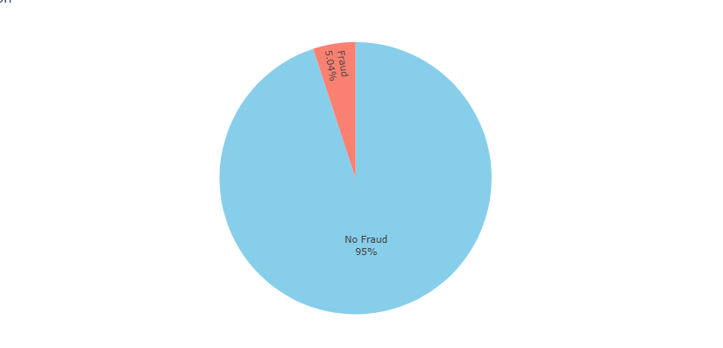
Class Distribution

Slide 16
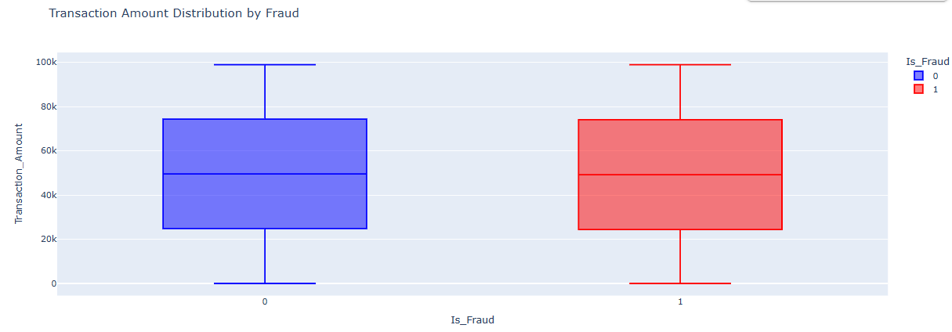
Transaction amount Distribution

Slide 17
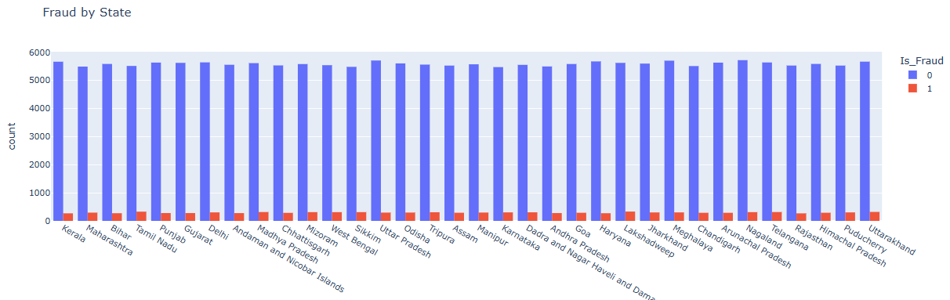
Fraud by state

Slide 18
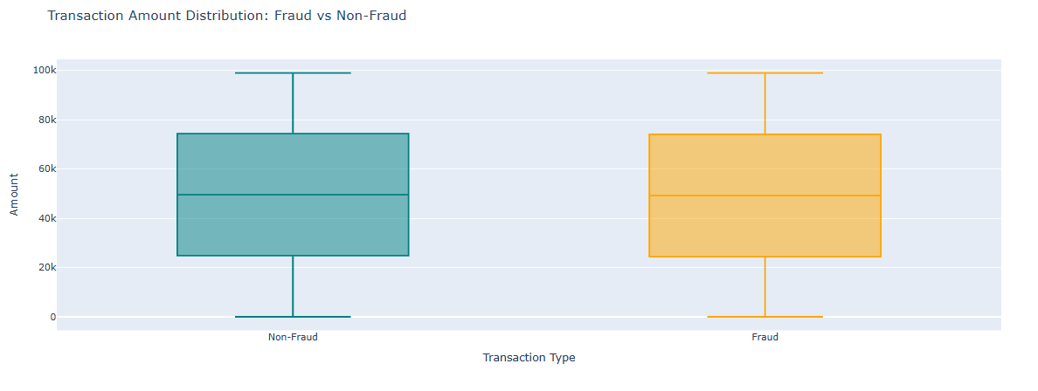
Transaction Amount Distribution

Slide 19
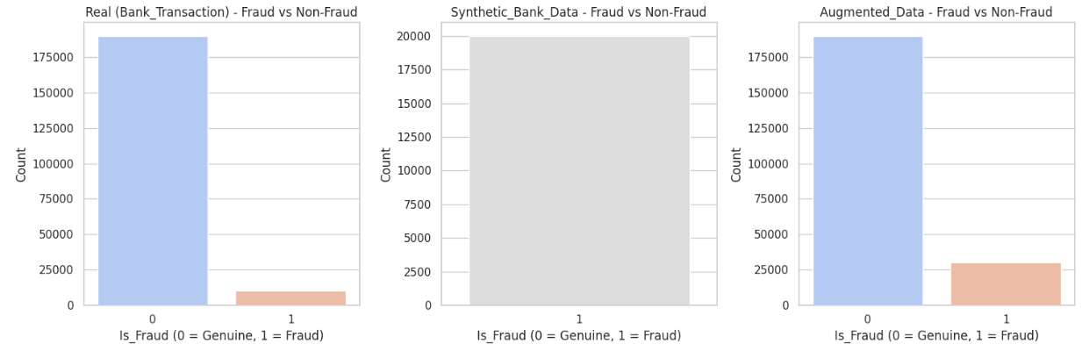
Compare Class Distribution

Slide 20
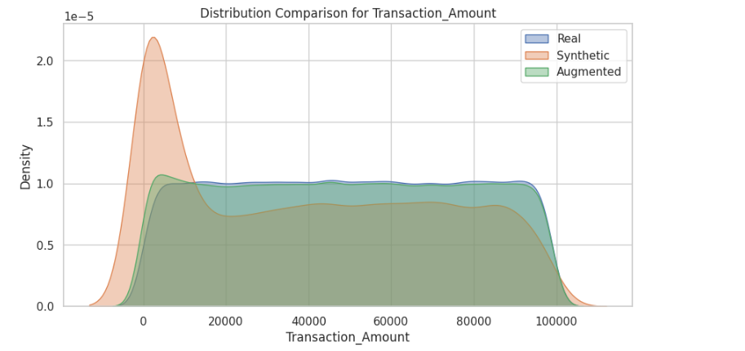
Feature Distribution Comparison -1

Slide 21
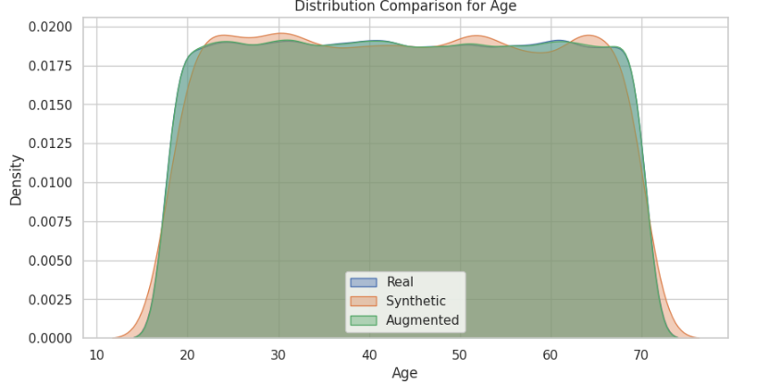
Feature Distribution Comparison -2

Slide 22
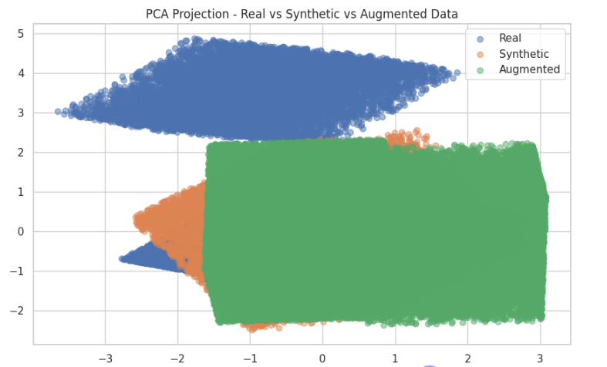
Dimensionality Visualization using PCA

Slide 23
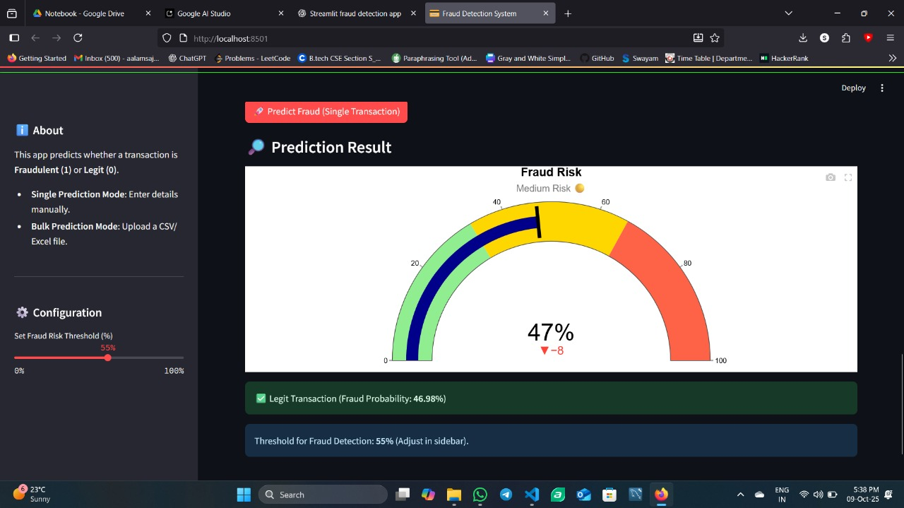
Project UI

Slide 24
Performance
.
.
CatBoost and XGBoost achieved the highest F1-scores (~0.286), driven by very high recall (≈0.88 and 0.83).
These models are highly sensitive to fraudulent cases — ideal when catching fraud is more important than reducing false alarms.
LightGBM provides a better trade-off between accuracy (45%) and F1 (0.26), indicating stronger overall balance in classification.
Logistic Regression (LR) and Decision Tree (DT) perform moderately well, maintaining stable recall around 0.47–0.49, but still suffer from low precision.
SGD Classifier delivers results similar to LR and DT, showing that linear models with class balancing can remain competitive when data is augmented.
Balanced Random Forest (BRF), despite its high accuracy (75%), fails to detect minority (fraud) cases effectively — indicating it’s biased toward non-fraud transactions.

Slide 25
Result
.
.
Best model: CatBoost (F1 = 0.2868)
precision recall f1-score support
0 0.8528 0.0101 0.0200 38896
1 0.1727 0.9916 0.2941 8104

Slide 26
Conclusion
.
.
This project focuses on analyzing banking transactions to identify fraudulent activities. Through comprehensive data exploration and synthetic data augmentation, we uncovered significant patterns and high-risk transaction indicators. The insights derived from this study empower financial institutions to detect fraud proactively, minimize financial losses, and strengthen customer trust.

Slide 27
Reference
.
.
Scikit-learn Documentation – https://scikit-learn.org/stable/
SDV (CTGAN) Documentation – https://docs.sdv.dev/
Kaggle: Bank Transaction Fraud Detection Dataset
Python Official Documentation – https://www.python.org/doc/

Slide 28
Thank You

