Slide 1
Iris Dataset Analysis
Exploring the Iris Dataset for Insights
Notes:
As we take a look at the Iris dataset analysis, I want to draw your attention to the key findings that emerged from this study. Emphasize the significance of this dataset in machine learning, and how it's often used as a benchmark for testing classification algorithms. For example, you can mention that the Iris dataset is a classic multiclass classification problem, where we try to predict the species of iris based on characteristics like sepal length and petal width. Be sure to highlight the insights gained from this analysis, such as the importance of feature selection and the performance of different models.

Slide 2
Introduction to Iris Dataset
The Iris dataset is a multivariate dataset introduced by Sir Ronald Fisher in 1936.
It consists of 150 samples from three species of Iris flowers (Iris setosa, Iris versicolor, and Iris virginica).
Each sample is described by 4 features: sepal length, sepal width, petal length, and petal width.
Notes:
As we dive into the Iris dataset, let's start with its origins - introduced by Sir Ronald Fisher in 1936, this multivariate dataset has become a cornerstone in the field of data analysis. Emphasize the diversity of the dataset, consisting of 150 samples from three distinct species of Iris flowers, each with its unique characteristics. When discussing the features, highlight the four key measurements - sepal length, sepal width, petal length, and petal width - and consider using a simple analogy, such as comparing these features to human physical characteristics, to help the audience understand the concept of multivariate data. By breaking it down in this way, you can make the dataset more relatable and engaging for your audience.

Slide 3
Iris Dataset Overview
Notes:
The Iris dataset is a classic example used in data science and machine learning, consisting of 50 samples from each of three species of Iris flowers, with four features measured for each sample. When presenting this slide, emphasize the significance of this dataset as a benchmark for testing classification algorithms, and you can mention that it's often used as a introductory example in many machine learning courses. You can also highlight that the features measured include sepal length, sepal width, petal length, and petal width, which are used to classify the flowers into their respective species. By providing a simple and intuitive example, the Iris dataset helps to illustrate complex concepts in a relatable way.

Slide 4
Dataset Characteristics
Left Column: Dataset statistics (mean, median, mode)
Right Column: Data distribution (histograms, box plots)
Notes:
As we take a look at the characteristics of our dataset, notice the statistics on the left, which give us a sense of the central tendency of our data, including the mean, median, and mode. When presenting this, be sure to emphasize any notable patterns or outliers, such as a mode that significantly differs from the mean, and use this as an opportunity to discuss the potential implications for our analysis. For example, you could point to the histogram on the right and explain how the distribution of the data is skewed, and how this might impact our choice of statistical tests or models. By highlighting these key characteristics, we can gain a deeper understanding of our data and set the stage for more informed analysis and decision-making.

Slide 5
Species Comparison
Left
Right
Iris setosa: Sepal length (5.1), Sepal width (3.5), Petal length (1.4), Petal width (0.2)
Iris versicolor: Sepal length (5.9), Sepal width (2.7), Petal length (4.2), Petal width (1.3)
Notes:
As we compare the two species, notice the distinct differences in their sepal and petal measurements, with Iris versicolor having a longer sepal length and petal length compared to Iris setosa. Emphasize these key differences as you present, highlighting how they set the two species apart. For example, you could point out that the petal length of Iris versicolor is nearly three times that of Iris setosa, illustrating the notable variation between the two. Be sure to pause and allow the audience to take in the comparison, using the data to tell a story about the unique characteristics of each species.

Slide 6
Iris Dataset History
Step 1: 1936: Introduced by Sir Ronald Fisher
Step 2: 1950s: Used in early machine learning research
Step 3: 1980s: Became a standard dataset for pattern recognition
Notes:
When discussing the Iris dataset history, emphasize the significance of Sir Ronald Fisher introducing it in 1936, as this laid the foundation for its widespread use in subsequent decades. As you move through the timeline, highlight how the dataset's popularity grew, particularly in the 1950s when it was utilized in early machine learning research, and by the 1980s, it had become a standard for pattern recognition. You can also mention that its enduring popularity stems from its simplicity and effectiveness in demonstrating complex concepts, making it a great teaching tool. Be sure to pause and ask the audience if they've worked with the Iris dataset before, to encourage engagement and shared experience.

Slide 7
Data Insights
The Iris dataset is a classic example of a classification problem.
The dataset can be used to train and test machine learning models.
The performance of the models can be evaluated using metrics such as accuracy and precision.
Notes:
As we take a look at the data insights, let's highlight the significance of the Iris dataset as a classic classification problem, making it an ideal choice for training and testing machine learning models. Emphasize how this dataset allows us to evaluate the performance of these models using key metrics such as accuracy and precision, which are crucial in determining their effectiveness. You can also mention that these metrics provide a clear understanding of how well the models are performing, for instance, by citing examples of real-world applications where accuracy and precision are vital, such as image recognition or natural language processing.

Slide 8
Species Classification
Notes:
When discussing species classification, it's essential to emphasize the hierarchical system used to categorize living organisms, from domain to species. As you present this concept, be sure to highlight the importance of understanding these classifications in fields such as biology, ecology, and conservation. For example, you can mention how classification helps us identify and protect endangered species, such as the giant panda, which is classified as a member of the Ursidae family. By providing a clear understanding of species classification, we can better appreciate the diversity of life on Earth.

Slide 9
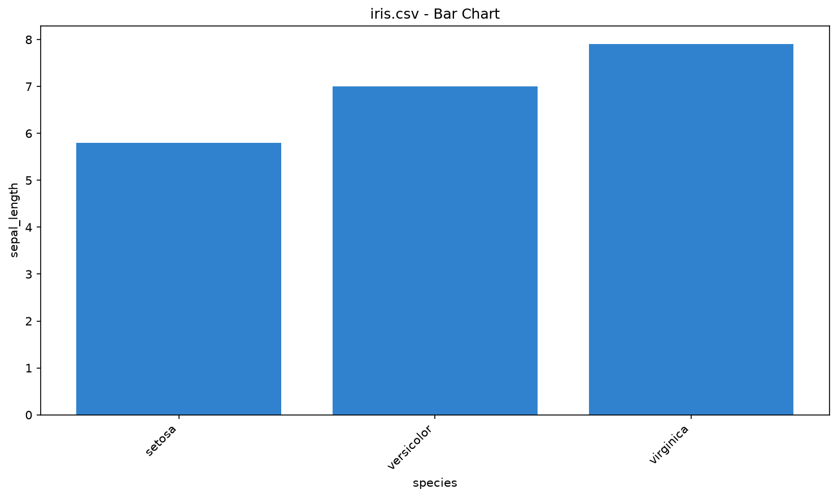
iris.csv - Bar Chart
Bar chart with 150 data points
Notes:
As we take a look at this bar chart from the iris.csv data set, notice the distribution of the 150 data points across the different categories. I'd like to draw your attention to the variation in the heights of the bars, which indicates the diversity within the dataset. When presenting this slide, be sure to highlight any notable patterns or outliers that stand out to you, such as a particularly high or low value, and use these as examples to illustrate your points. Emphasize how this visual representation can help us better understand the characteristics of the iris dataset.

Slide 10
Conclusion
The Iris dataset is a valuable resource for machine learning research and education.
The dataset provides a simple yet effective way to demonstrate classification concepts and techniques.
Notes:
In conclusion, let's recap the significance of the Iris dataset in machine learning, emphasizing its value as a resource for both research and education. As you summarize the key points, highlight how the dataset's simplicity makes it an ideal tool for demonstrating complex classification concepts, such as supervised learning and model evaluation. You can also mention a personal experience or a well-known study that utilized the Iris dataset to illustrate its effectiveness in a real-world scenario, making the conclusion more relatable and engaging for your audience.

Slide 11
Thank You
Questions?
Notes:
As we come to the end of this presentation, I want to take a moment to express my sincere gratitude to each and every one of you for your attention and engagement. Emphasize the appreciation you have for the audience's time and highlight any key takeaways or action items you'd like them to remember. You can also use this opportunity to invite questions or provide additional resources for further learning, such as a website or follow-up meeting. By ending on a note of thanks, you leave a lasting positive impression on your audience.

