Slide 1
Introduction to Regression
Understanding the Basics of Regression Analysis

Slide 2
What is Regression?
Regression is a statistical method for establishing a relationship between two or more variables.
It helps in understanding how the value of a dependent variable changes when any one of the independent variables is changed.

Slide 3
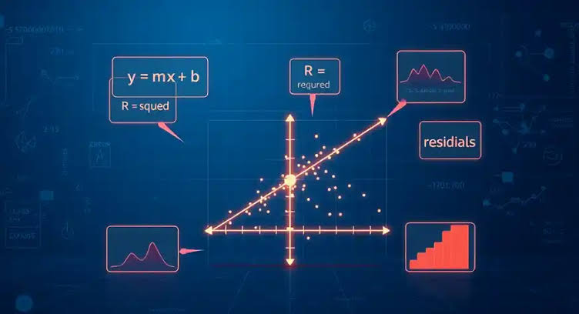
Types of Regression
Simple Regression
Multiple Regression

Slide 4
Linear Regression
Linear regression is a linear method to model the relationship between a dependent variable and one or more independent variables.

Slide 5
Parametric vs Non-Parametric Regression
Left
Right
Parametric Regression
Assumes a specific distribution for the data
Non-Parametric Regression
Does not assume a specific distribution for the data

Slide 6
History of Regression
Step 1: 1800s: The concept of regression was first introduced by Francis Galton
Step 2: 1900s: The development of modern regression analysis began
Step 3: 2000s: The use of regression analysis became widespread in various fields

Slide 7
Logistic Regression
Logistic regression is a type of regression analysis used for predicting the outcome of a categorical dependent variable.
It is commonly used in medical and social sciences research.

Slide 8
Applications of Regression
Finance: Predicting stock prices and portfolio returns
Marketing: Analyzing customer behavior and response to advertising

Slide 9
Conclusion
Regression analysis is a powerful tool for understanding the relationships between variables.
It has numerous applications in various fields and is a fundamental concept in statistics and machine learning.

Slide 10
Thank You
Questions?

