Slide 1

Cancer: A Comprehensive Overview
Introduction to Cancer and Its Implications

Slide 2
What is Cancer?
Cancer is a group of diseases characterized by the uncontrolled growth and spread of abnormal cells.
It can affect any part of the body and is a leading cause of death worldwide.

Slide 3
Types of Cancer
Carcinomas: breast, lung, colon, and skin cancers
Leukemias: blood cancers
Lymphomas: cancers of the immune system
Sarcomas: bone and soft tissue cancers

Slide 4
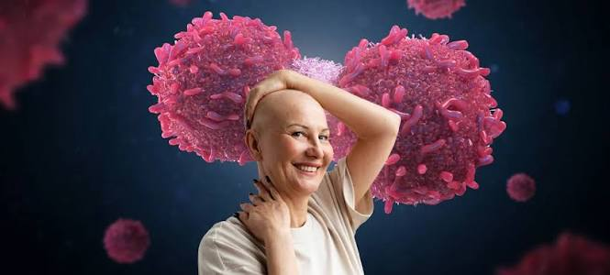
Cancer Cells

Slide 5
Causes and Risk Factors
Genetic mutations
Environmental factors: tobacco, radiation, and pollution
Lifestyle factors: diet, physical activity, and stress

Slide 6
Cancer Treatment Options
Left
Right
Surgery: removal of tumors and affected tissues
Radiation therapy: high-energy rays to kill cancer cells
Chemotherapy: drugs to kill cancer cells
Immunotherapy: boosting the immune system to fight cancer

Slide 7
Cancer Prevention
Healthy diet and exercise
Avoiding tobacco and limiting alcohol consumption
Protecting against UV radiation and pollution

Slide 8
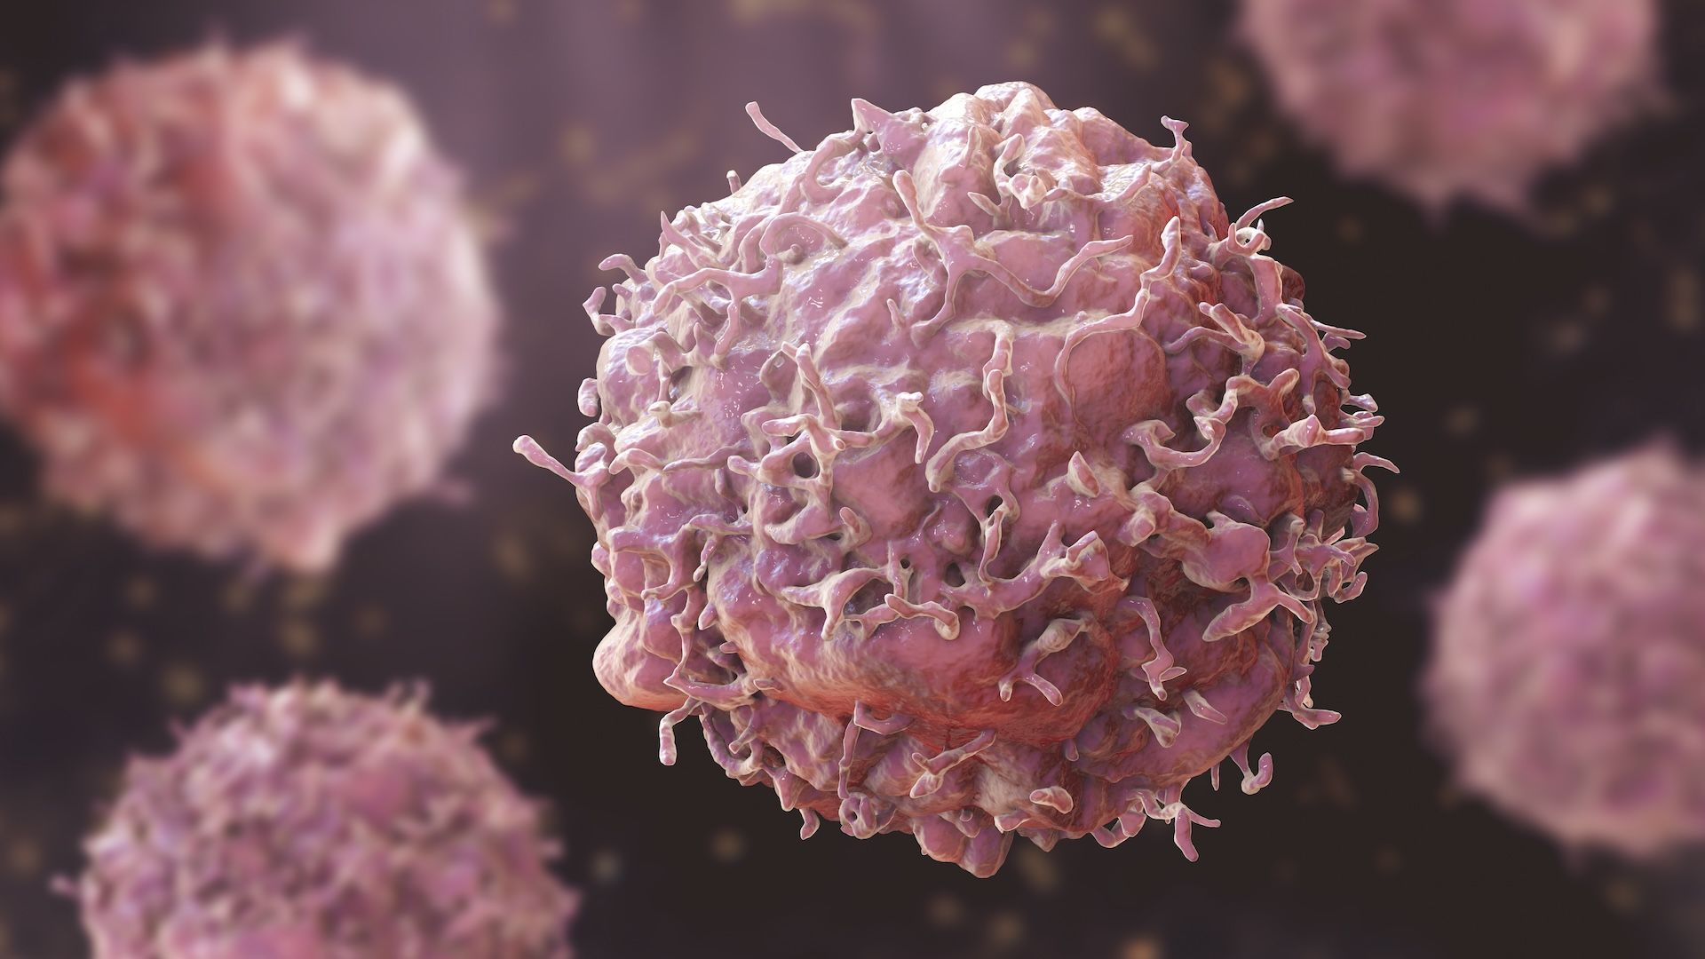
Cancer Screening and Diagnosis
Regular check-ups and screenings
Biopsies and imaging tests: X-rays, CT scans, and MRIs

Slide 9
Cancer Research and Progress
Step 1: 1950s: discovery of the first cancer-causing virus
Step 2: 1970s: development of chemotherapy and radiation therapy
Step 3: 2000s: introduction of targeted therapies and immunotherapies

Slide 10
Challenges in Cancer Treatment
Resistance to therapies
Side effects and toxicity
Limited access to healthcare and treatments

Slide 11
Cancer Support and Care

Slide 12
Solutions to Cancer
Advances in medical research and technology
Increased awareness and education
Support for cancer patients and families

Slide 13
Current and Future Cancer Treatments
Left
Right
Conventional therapies: surgery, radiation, and chemotherapy
Targeted therapies: precision medicine and personalized treatment
Immunotherapies: boosting the immune system
Gene therapies: editing and repairing genes

Slide 14
Conclusion
Cancer is a complex and multifaceted disease
Understanding cancer and its implications is crucial for prevention, diagnosis, and treatment
Continued research and support are necessary to overcome the challenges of cancer

Slide 15
Thank You
Questions?

