Slide 1
Cancer: A Comprehensive Overview
Introduction to Cancer and Its Implications

Slide 2
What is Cancer?
Cancer is a group of diseases characterized by the uncontrolled growth and spread of abnormal cells.
It can affect any part of the body and is a leading cause of death worldwide.

Slide 3
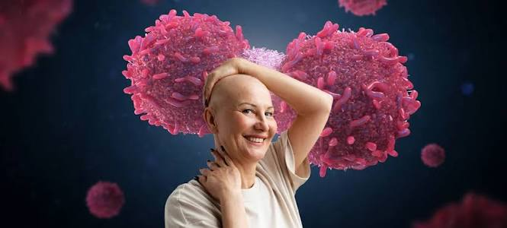
Types of Cancer
Carcinomas: Originating in the skin or lining of organs
Sarcomas: Originating in bones, cartilage, or connective tissue

Slide 4
More Types of Cancer
Leukemias: Originating in the blood or bone marrow
Lymphomas: Originating in the immune system

Slide 5
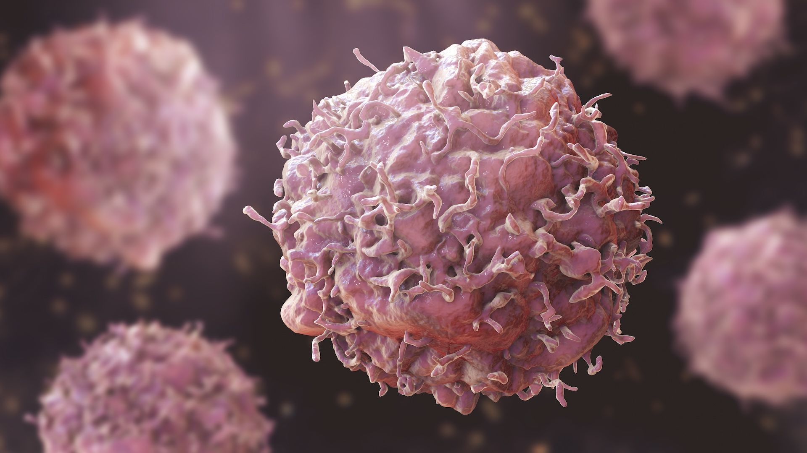
Understanding Cancer Cells

Slide 6
Comparison of Cancer Types
Left
Right
Carcinomas
Most common type of cancer
Sarcomas
Less common, but aggressive type of cancer

Slide 7
Causes and Risk Factors
Genetic mutations
Environmental factors
Lifestyle choices

Slide 8
Solutions to Cancer
Surgery
Chemotherapy
Radiation therapy

Slide 9
More Solutions to Cancer
Immunotherapy
Targeted therapy
Hormone therapy

Slide 10
Cancer Research Timeline
Step 1: 1900s: Discovery of cancer cells
Step 2: 1950s: Development of chemotherapy
Step 3: 2000s: Advances in targeted therapy

Slide 11
Challenges in Cancer Treatment
Resistance to therapy
Side effects
Limited access to care

Slide 12
Challenges vs. Opportunities
Left
Right
Challenges
Limited funding for research
Opportunities
Advances in technology and medicine

Slide 13
Hope for the Future

Slide 14
Conclusion
Cancer is a complex and multifaceted disease
Understanding its causes, types, and solutions is crucial for progress

Slide 15
Thank You
Questions?

