Slide 1
Cancer Awareness Seminar
Understanding the Disease and Finding Solutions

Slide 2
What is Cancer?
Cancer is a group of diseases characterized by the uncontrolled growth and spread of abnormal cells.
It can affect any part of the body and is caused by genetic mutations.
Cancer can be caused by a combination of genetic and environmental factors.

Slide 3
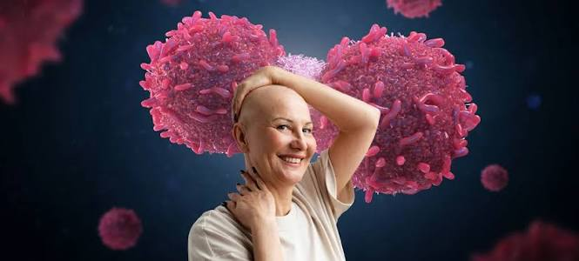
Types of Cancer
Carcinomas: breast, lung, colon, and skin cancers
Sarcomas: bone and soft tissue cancers
Leukemias: blood cancers
Lymphomas: immune system cancers

Slide 4
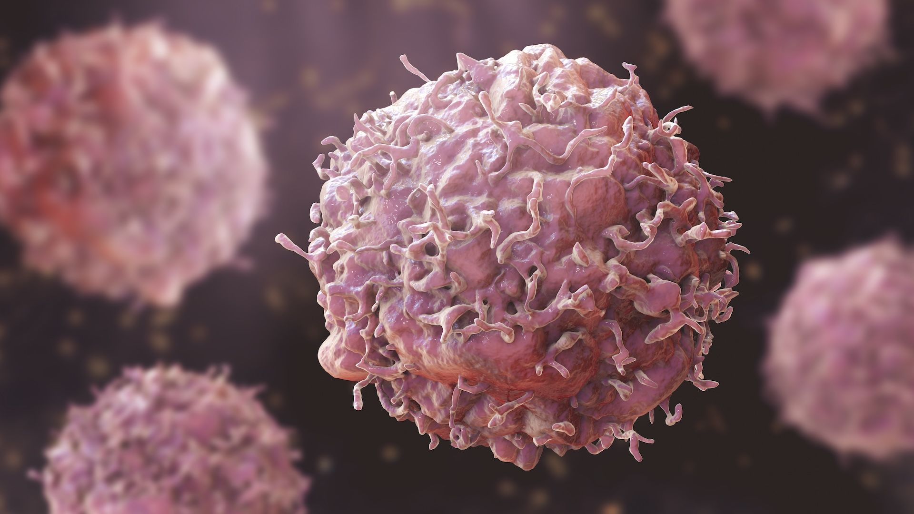
Cancer Cells

Slide 5
Causes of Cancer
Genetic mutations
Environmental factors: tobacco, radiation, and chemicals
Viral and bacterial infections
Poor diet and lack of exercise

Slide 6
Cancer Risk Factors
Left
Right
Genetic predisposition
Family history
Environmental factors
Lifestyle choices

Slide 7
Cancer Research Timeline
Step 1: 1900s: discovery of cancer cells
Step 2: 1950s: development of chemotherapy
Step 3: 1980s: introduction of targeted therapies
Step 4: 2000s: advancements in immunotherapy

Slide 8
Cancer Diagnosis
Biopsy
Imaging tests: MRI, CT, and PET scans
Blood tests
Genetic testing

Slide 9
Cancer Treatment Options
Surgery
Chemotherapy
Radiation therapy
Targeted therapy
Immunotherapy

Slide 10
Cancer Support

Slide 11
Cancer Prevention
Healthy diet
Regular exercise
Not smoking
Limiting sun exposure

Slide 12
Cancer Screening Methods
Left
Right
Mammography
Pap smear
Colonoscopy
Prostate-specific antigen (PSA) test

Slide 13
Challenges in Cancer Research
Funding
Complexity of cancer biology
Limited understanding of cancer causes
Need for more effective treatments

Slide 14
Conclusion
Cancer is a complex and multifaceted disease.
Understanding its causes, types, and treatment options is crucial for prevention and management.
Continued research and support are necessary to overcome the challenges in cancer research.

Slide 15
Thank You
Questions?

