Slide 1
JENKINS
An automation server

Slide 2
Agenda
What is Jenkins ?
Why Jenkins ?
How to Create Jenkins job ?
Jenkins pipeline
How to get Jenkinsfile from Git SCM
How to clone a git repo using Jenkinsfile

Slide 3
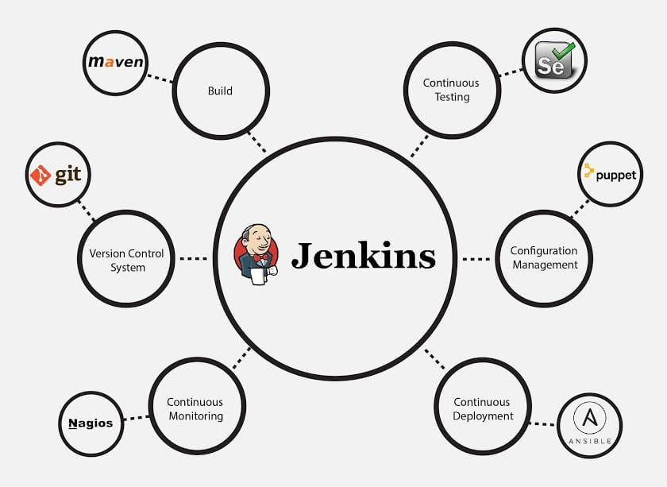
What is Jenkins ?

Slide 4
Why Jenkins ?
Jenkins is used to build and test your software projects continuously making it easier for developers to integrate changes to the project, and making it easier for users to obtain a fresh build.
It also allows you to continuously deliver your software by integrating with a large number of testing and deployment technologies.

Slide 5
How to Create Jenkins job ?
Step 1 : Jenkins - New Item - add details
Step 2 : How to trigger the job remotely
Step 3 : How to chain job executions

Slide 6
Build periodically
you can create a schedule (or multiple schedules) for Jenkins to build periodically or on a specific date/time.
It might be tests that should be run periodically (every morning for example) or a DB clean up Jenkins job or any other Jenkins job.

Slide 7
Jenkins pipeline
Step 1 : Start Jenkins
Step 2 : Install Pipeline Plugin
Step 3 : Create a new job
Step4 : Create or get Jenkinsfile in Pipeline section
Step 5 : Run and check the output

Slide 8
How to get Jenkinsfile from Git SCM
Step 1 : Create a new job or use existing job (type : Pipeline)
Step 2 : Create a repository or GitHub
Step 3 : Add Jenkinsfile in the repo
Step 4 : Under Jenkins job ＞ Pipeline section ＞ Select Definition Pipeline script from SCM
Step 5 : Add repo and jenkinsfile location in the job under Pipeline section
Step 6 : Save & Run

Slide 9
How to clone a git repo using Jenkinsfile

