Slide 1

Task B: Designing a Fountain
By payal patel

Slide 2
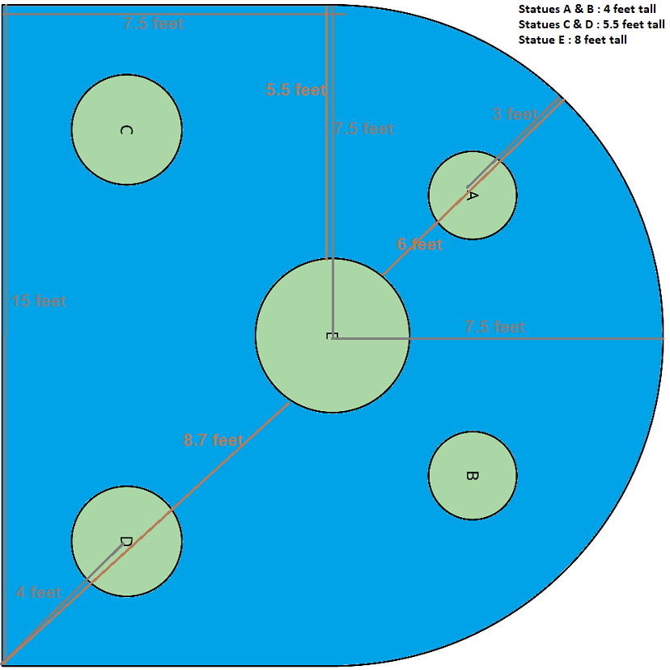
Problem statement and requirements
Jets can only be placed on the edge of the pool
There must be at least two jets
The water cannot hit any of the statues
Some water must go into the vase
The water cannot go higher than 10 feet

Slide 3

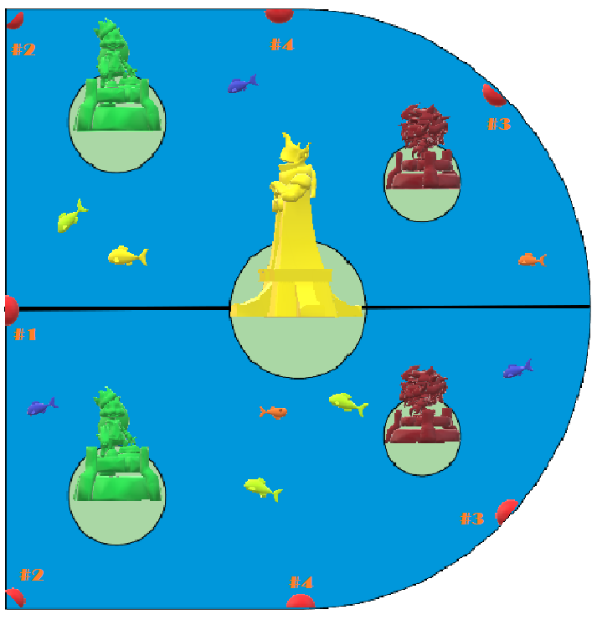
SOLUTION

Slide 4
Fountain # 1 to Statue E
Goal is to install a Jet at ground height [origin (0,0)]. At a horizontal distance of 7.5 feet, the water needs to be exactly at a height of 8 feet so that it will collect into the vase. Also, the Maximum height of the Water (at the vertex) is no greater then 10 feet.
4 Possible Quadratic Equation that will allow collection of the water into the vase at Statue E without falling on the statue itself (center of pool)
Y = - 0.3(X - 5.5)² + 9.2
Y = - 0.366(X - 5.2)² + 9.94
Y = - 0.36(X - 5.2)² + 9.9
Y = - 0.37(X - 5.2)² + 10

Slide 5
Quadratic vertex form #1:
2 Known Values: Vertex = (5.5,9.2) and X,Y values (7.5, 8) where the Curve passes through so water falls into vase.
Equation: Y = a(X - 5.5)² + 9.2
Now substitute the values of 7.5 and 8 for X and Y in order to find the value of dilation (a)
8 = a (7.5 - 5.5)² + 9.2
8 - 9.2 = a (2)²
-1.2 = 4a
a = -1.2/4
a= - 0.3
Quadratic Vertex Form #1 equation will be:
Y = - 0.3 (X - 5.5)² + 9.2

Slide 6
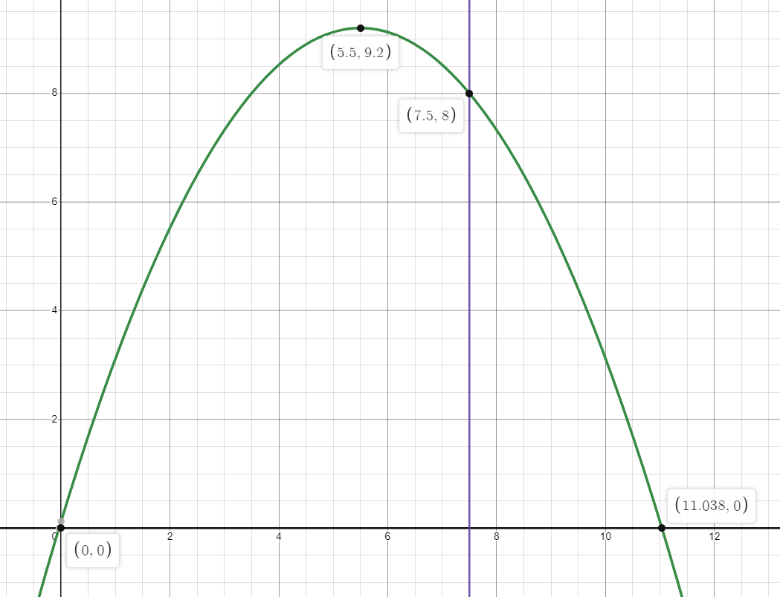

Slide 7
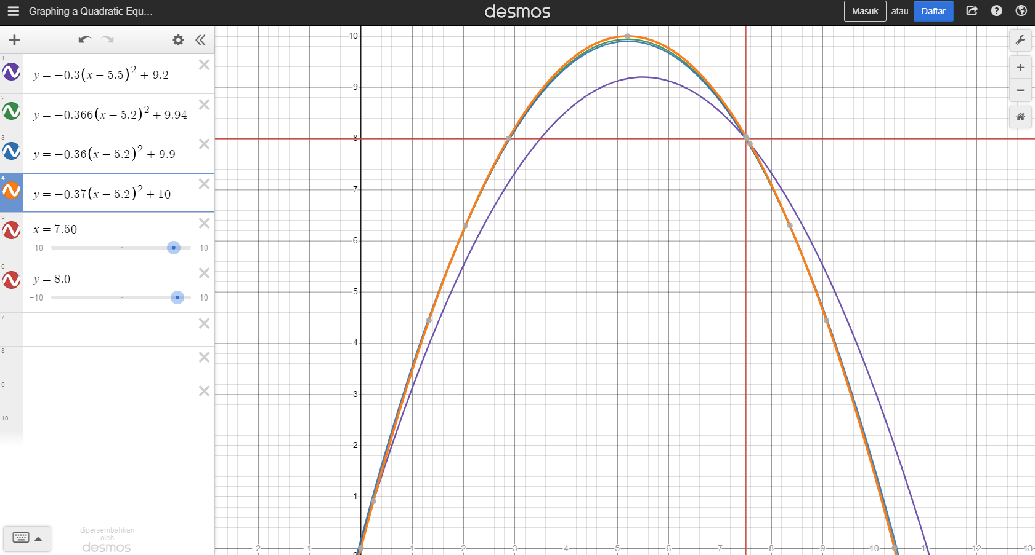

Slide 8
Fountain # 2 to Statues C and D
Goal is to install a Jet at ground height [origin (0,0)]. At a horizontal maximum projectile distance of less than 8.7 feet AND at a vertex horizontal distance around 4 feet, the water needs to be at a height above 5.5 feet in order to avoid the jet water from hitting statues C and D. For this example, a vertex of (4,6) is used.
Possible Quadratic Equation using a Vertex with a horizontal distance of 4 feet and a vertical distance (height) of 6 feet at Statues C & D (Front of the pool - green) that will allow the jet water to fall into the pool without touching any of the statues.
Y = - 0.375(X - 4)² + 6

Slide 9
Quadratic vertex form #2:
2 Known Values: Vertex = (4,6) and X,Y values (0,0) where the jet is installed at the ground level
Equation: Y = a(X - 4)² + 6
Now substitute the values of 0 and 0 for X and Y in order to find the value of dilation (a)
0 = a (0 - 4)² + 6
0 - 6 = a (-4)²
-6 = 16 a
a = -6/16
a = - 0.375
Quadratic Vertex Form #2 equation will be:
Y = - 0.375 (X – 4)² + 6

Slide 10
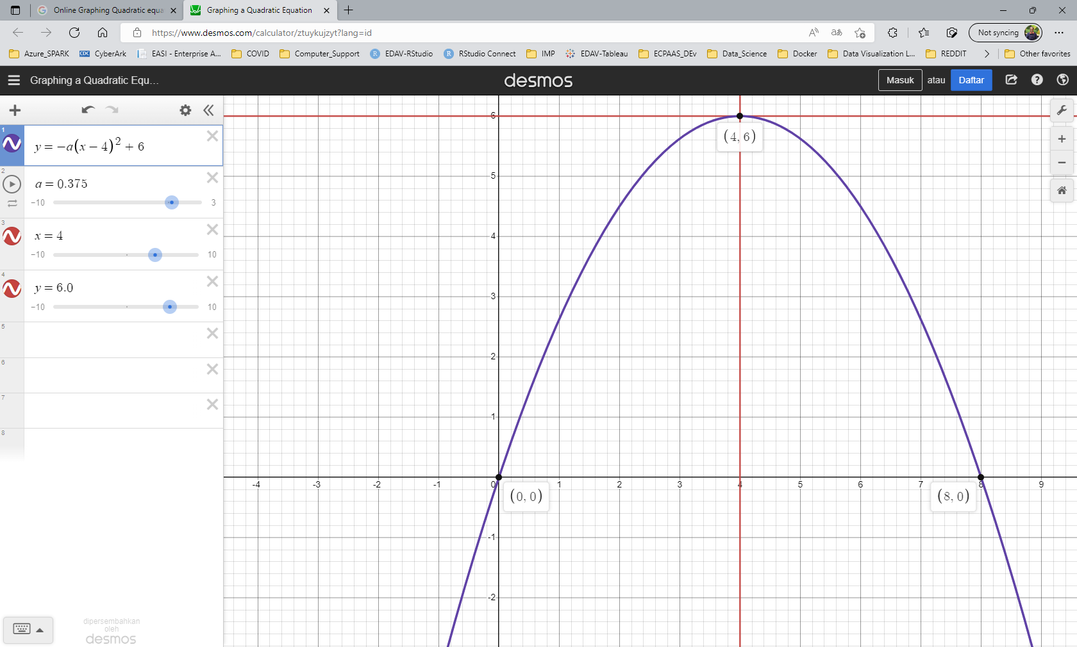

Slide 11
Fountain # 3 to Statues A and B
Goal is to install a Jet at ground height [origin (0,0)]. At the horizontal maximum projectile distance of less then 6 feet AND at a vertex horizontal distance of less than 3 feet, the water needs to be at a height of above 4 feet in order to avoid the jet water from hitting statues A and B. For this example, a vertex of (2.75,9.8) is used.
Possible Quadratic Equation using a Vertex with a horizontal distance of 2.75 feet and a vertical distance (height) of 9.8 feet at Statues A & B (Back of the pool - red) that will allow the jet water to fall into the pool without touching any of the statues.
Y = - 1.295(X – 2.75)² + 9.8

Slide 12
Quadratic vertex form #3:
2 Known Values: Vertex = (2.75,9.8) and X,Y values (0,0) where the jet is installed at the ground level
Equation: Y = a(X – 2.75)² + 9.8
Now substitute the values of 0 and 0 for X and Y in order to find the value of dilation (a)
0 = a (0 – 2.75)² + 9.8
0 – 9.8 = a (- 2.75)²
- 9.8 = 7.5625 a
a = - 9.8/7.5625
a = - 1.295
Quadratic Vertex Form #3 equation will be:
Y = - 1.295(X – 2.75)² + 9.8

Slide 13
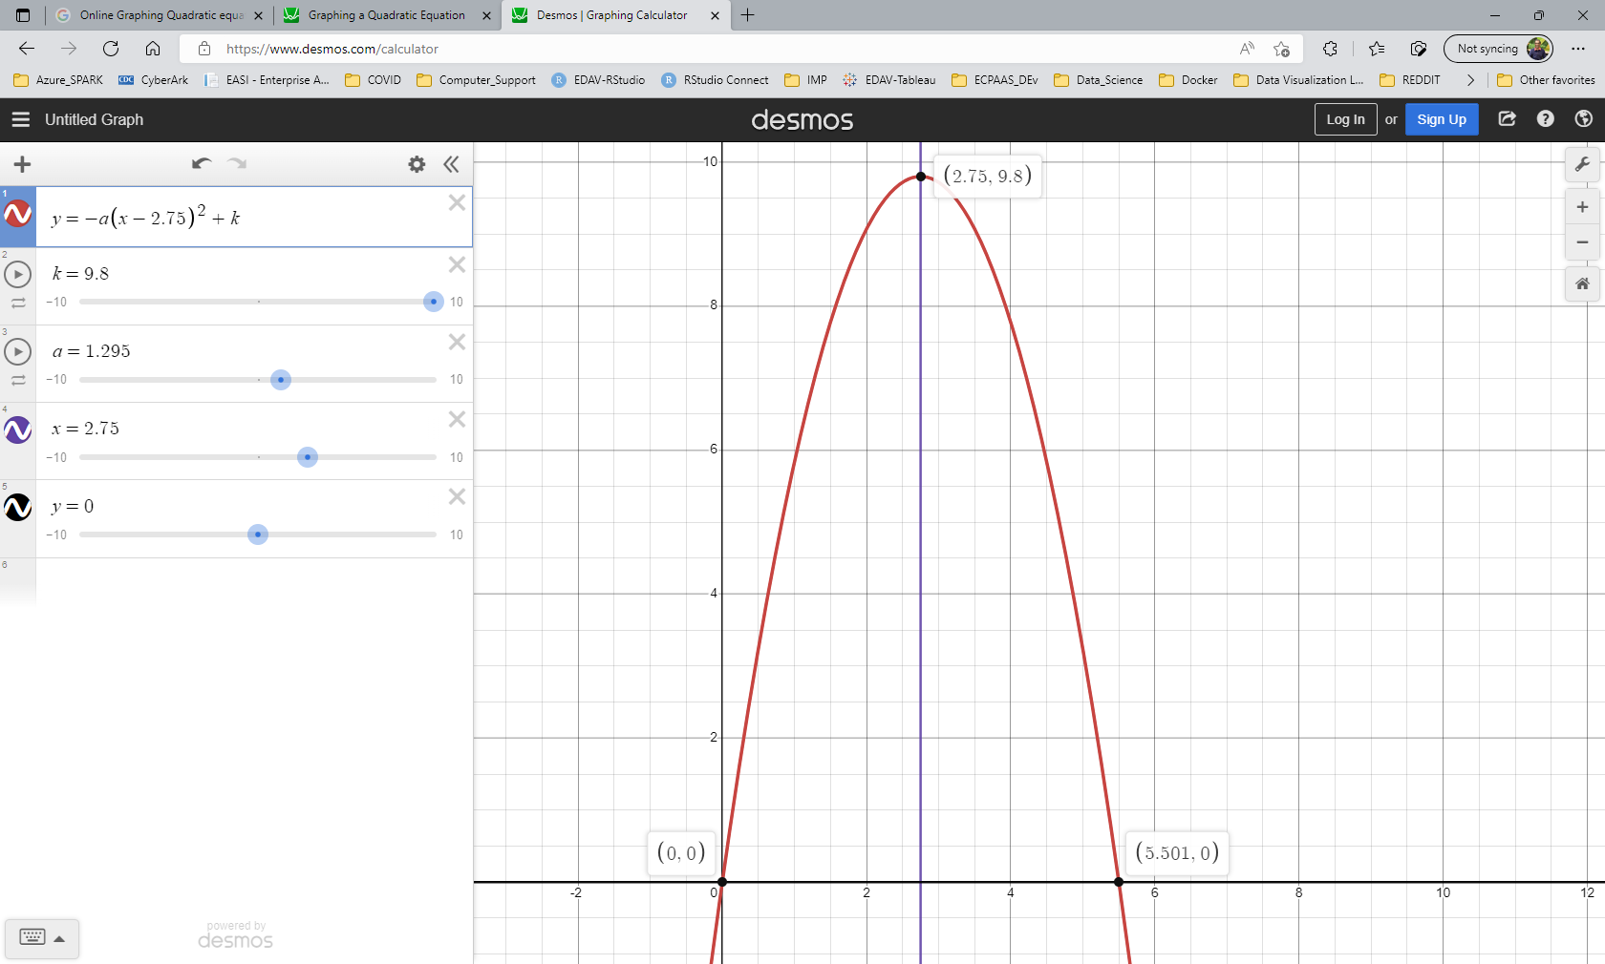

Slide 14
Fountain # 4 around the Statue E (Extra Jets)
Goal is to install a Jet at ground height [origin (0,0)]. At the horizontal maximum projectile distance of less then 5.5 feet AND at a vertex horizontal distance of less than 2.75 feet in order to avoid the jet water from hitting statue E. The vertex height cannot be greater than 10 feet.
Possible Quadratic Equation using a Vertex with a horizontal distance of 2.5 feet and a vertical distance (height) of 7 feet that will allow the jet water to fall into the pool without touching statue E.
Y = - 1.12(X – 2.5)² + 7

Slide 15
Quadratic vertex form #4:
2 Known Values: Vertex = (2.5,7) and X,Y values (0,0) where the jet is installed at the ground level
Equation: Y = a(X – 2.5)² + 7
Now substitute the values of 0 and 0 for X and Y in order to find the value of dilation (a)
0 = a (0 – 2.5)² + 7
0 – 7 = a (- 2.5)²
- 7 = 6.25 a
a = - 7/6.25
a = - 1.12
Quadratic Vertex Form #4 equation will be:
Y = - 1.12(X – 2.5)² + 7

Slide 16
