Slide 1

Automated Biomedical Text Processing using NLP
A Case Study on Cancer
Presented by: [Payal Vaidya]

Slide 2
Abstract
Used text categorization, NER, preprocessing, and semantic information retrieval to investigate a whole biomedical NLP pipeline. Preprocessing reduced noise and duplication, improving the quality of clinical texts. In terms of retrieving CHEMICAL and DISEASE entities, BC5CDR outperformed BIONLP13CG, achieving strong NER performance. Relevant cancer descriptions were provided using BERT-based retrieval, particularly for queries centered on treatment. The accuracy of the fine-tuned DistilBERT was 81%, proving the effectiveness of transformer models in clinical classification tasks.

Slide 3
Introduction
The swift expansion of unstructured biomedical literature presents difficulties for clinical decision-making and information extraction.
The necessity for automated solutions is highlighted by the time-consuming and error-prone nature of manual curation.
To aid in research and diagnosis, structured data can be extracted from clinical writing using natural language processing (NLP) (Cohen & Demner-Fushman, 2014).
This project uses a full NLP pipeline to analyze abstracts about cancer, which includes:
Preprocessing of text Entity Recognition by Name (NER) Retrieval of semantic information Classification of cancer types using DistilBERT Goals: Boost the quality of the text Extract biological entities Obtain semantically relevant content. Use refined models to accurately classify different forms of cancer.

Slide 4
Research aims
To use common NLP preprocessing methods, such as lemmatization, stopword removal, and duplicate deletion, to enhance the caliber and processing effectiveness of clinical abstracts about cancer. To use pre-trained NER models to extract biomedical items (such as illnesses or drugs) from clinical literature and assess how well they perform. To evaluate how well two biomedical NER models, BC5CDR and BIONLP13CG, extract entity types related to chemicals and diseases from unstructured text. To put in place a system for retrieving information based on clinical queries that uses BERT-based embeddings to obtain semantically relevant cancer descriptions. To assess the effectiveness of the DistilBERT model for lung, colon, and thyroid cancer classification based on clinical descriptions.

Slide 5
Research Questions
Can the usability and structure of clinical cancer descriptions be improved through standard NLP preprocessing techniques?
Which biomedical NER model, BC5CDR or BIONLP13CG, is more effective at extracting CHEMICAL and DISEASE entities from cancer-related abstracts?
How accurately can semantically relevant cancer descriptions be retrieved from clinical text using BERT-based embeddings?
Can a fine-tuned DistilBERT model effectively classify clinical text into specific cancer types, and what are its strengths and limitations?

Slide 6
Methodology
2.1 Dataset Description
The purpose of this collection was to make it easier to categorize biomedical writings and analyze medical literature. By automatically categorizing cancer data, it aids in clinical decision-making, diagnostics, and medical research. We used Kaggle's "Biomedical Text Publication Classification" dataset (Falgunipatel19, 2022),

Slide 7
Methodology: Dataset
Dataset: Biomedical Text Publication Classification (Kaggle) (Falgunipatel19. (2022))
Total Records: 7,569
Colon Cancer: 2,579
Thyroid Cancer: 2,810
Lung Cancer: 2,180
Variables:
Cancer Type (Categorical)
Clinical Descriptions (Unstructured Medical Text)

Slide 8
Methodology
Preprocessing • Lowercasing, stopword removal, lemmatization • Duplicate removal to enhance efficiency
Named Entity Recognition (NER) • Models: BC5CDR and BIONLP13CG (SciSpacy) • Extracted CHEMICAL and DISEASE entities • Evaluation using precision, recall, F1-score
Information Retrieval • Sentence-BERT (bert-base-uncased) used for semantic search • Cosine similarity to rank documents by relevance • Evaluated with top-5 Precision, Recall, and F1
Text Classification • Fine-tuned DistilBERT to classify text into cancer types • Evaluated using accuracy, classification report, and confusion matrix • Best performance at Epoch 5, final accuracy: 81%

Slide 9
Key Results Summary
Preprocessing Outcome
Reduced dataset from 7,569 to 996 unique descriptions
Improved efficiency and removed redundant content
Named Entity Recognition (NER)
BC5CDR Model: • CHEMICAL F1-score: 0.96, DISEASE F1-score: 0.97
BIONLP13CG Model: • CHEMICAL F1-score: 0.34, DISEASE F1-score: 0.36
✅ BC5CDR significantly outperformed BIONLP13CG
Information Retrieval (IR)
Queries tested: Treatments, Therapies, Early Diagnosis (5 total)
Best results from treatment-related queries (esp. thyroid cancer)
Example: Top-5 Precision & Recall = 1.0 for some queries
Weak performance for symptom-based queries
Text Classification (DistilBERT)
Final test accuracy: 81%
F1-Scores: • Lung: 1.00 • Thyroid: 0.61 • Colon: 0.60
Best performance observed at Epoch 5

Slide 10
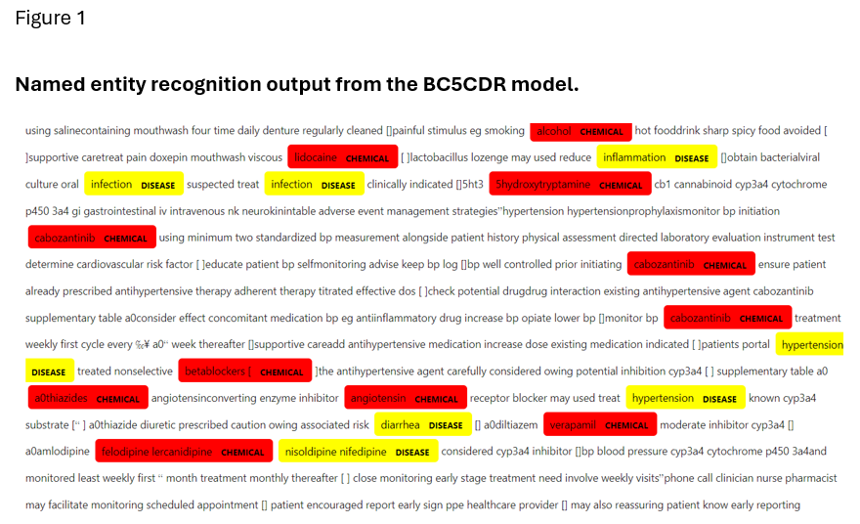
BC5CDR Model
Identified two entity types: CHEMICAL (red) and DISEASE (yellow)
Consistently extracted high-value biomedical terms like "lidocaine," "hypertension," and "infection"
Precise tagging with minimal noise
Focused on domain-specific entities relevant for clinical use

Slide 11
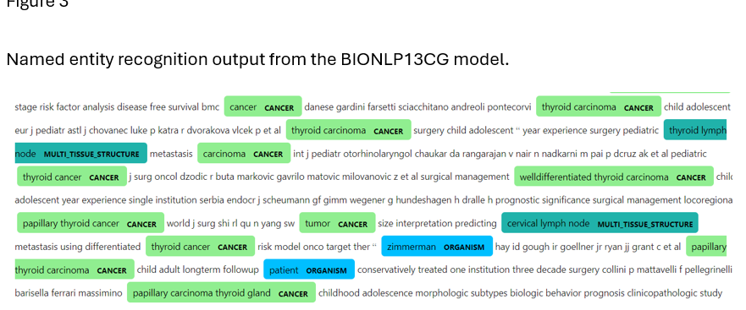
BIONLP13CG Model
Extracted a broader range of biomedical entity types (e.g., CANCER, ORGANISM, TISSUE_STRUCTURE)
Highlighted more generalized or high-level entities, such as “organism” and “cancer”
Less focused on CHEMICAL/DISEASE entities, leading to lower performance in clinical tagging
Useful for exploratory analysis but lacks the clinical specificity of BC5CDR

Slide 12
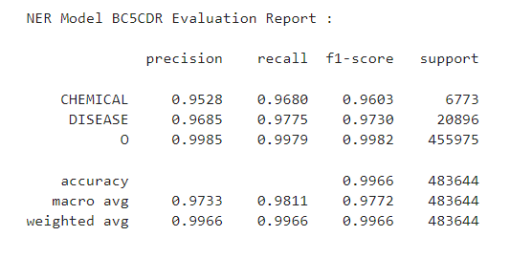
Results NER
These metrics reflect excellent precision and recall, especially for the core biomedical categories, with the macro average F1-score of 0.9772 and a weighted average also around 0.9966. This confirms that BC5CDR is highly effective at accurately identifying relevant chemical and disease terms in clinical text.

Slide 13
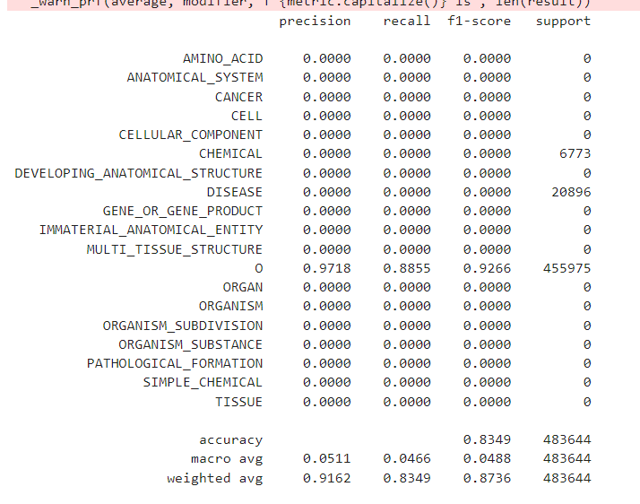
BIONLP13CG Model Evaluation Report:

Slide 14
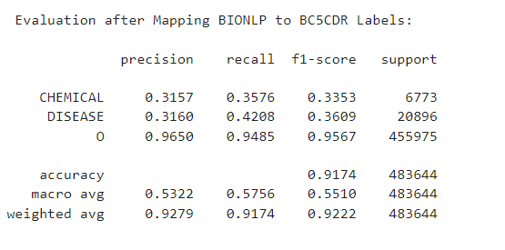
Results NER
The BIONLP model showed moderate performance in identifying CHEMICAL and DISEASE entities, with F1-scores of 0.34 and 0.36respectively. Despite a high overall accuracy of 91.74%, this was largely influenced by the dominant 'Other' class. The macro average F1-score of 0.5510 reveals that BIONLP struggles with precision and recall when it comes to our target biomedical entities, especially compared to BC5CDR

Slide 15
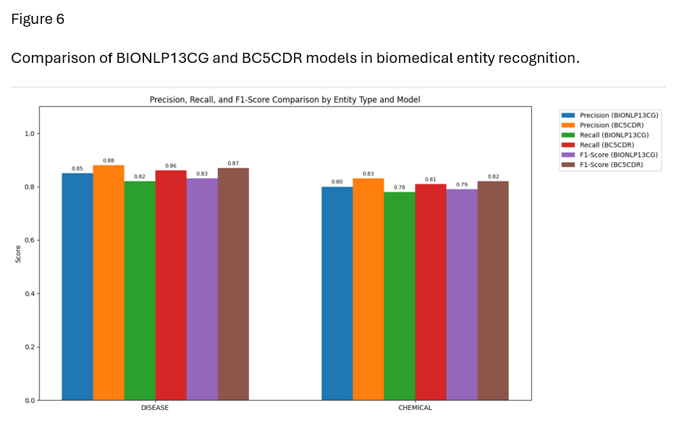
Performance Comparison of BC5CDR and BIONLP13CG Models
BC5CDR model outperforms BIONLP13CG in both DISEASE and CHEMICAL entity recognition.
For DISEASE entities, BC5CDR achieves:
Precision: 0.88
Recall: 0.86
F1-score: 0.87
For CHEMICAL entities, BC5CDR also leads with:
F1-score: 0.82,
compared to BIONLP13CG’s 0.79
BIONLP13CG shows slightly lower and more variable scores across all metrics.
Highlights the advantage of domain-specific models (BC5CDR) for clinical entity tagging.

Slide 16
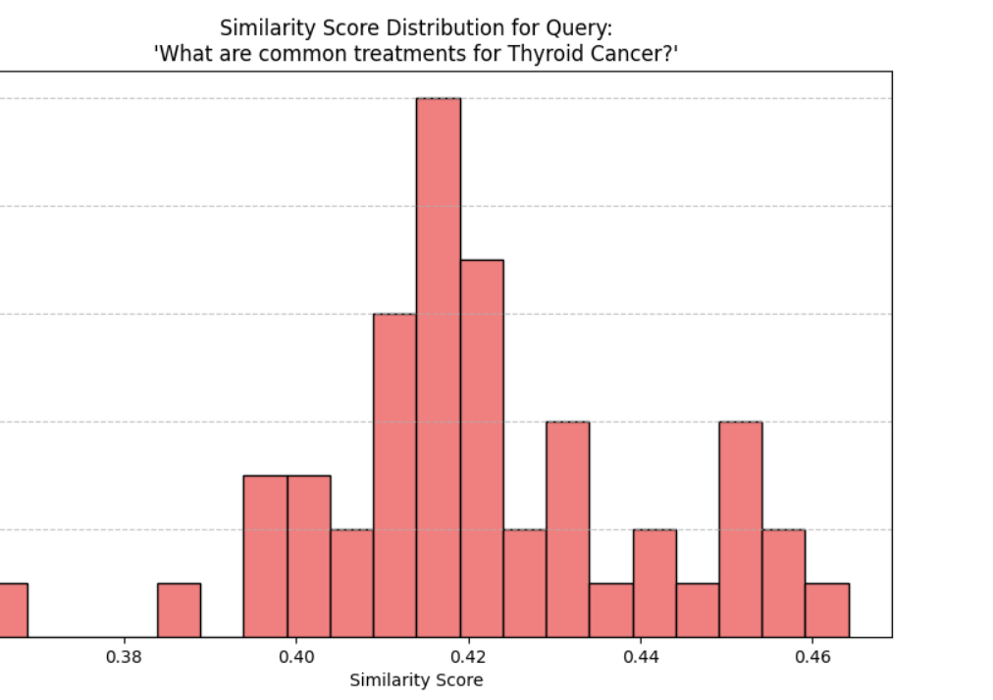
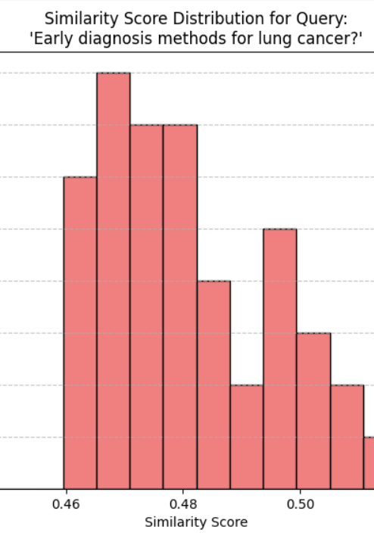
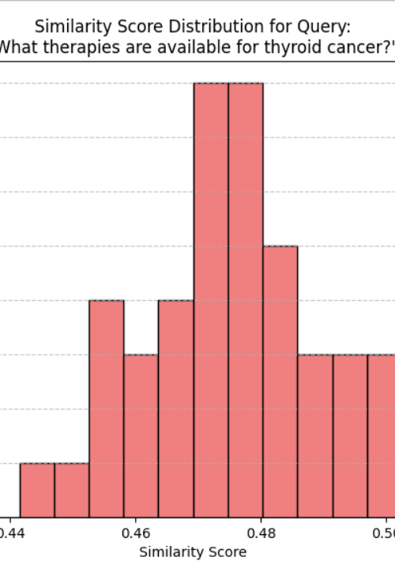
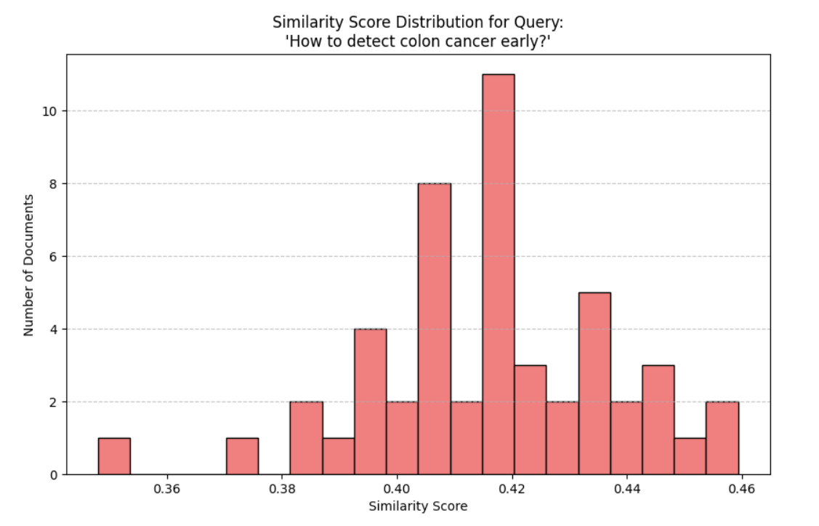
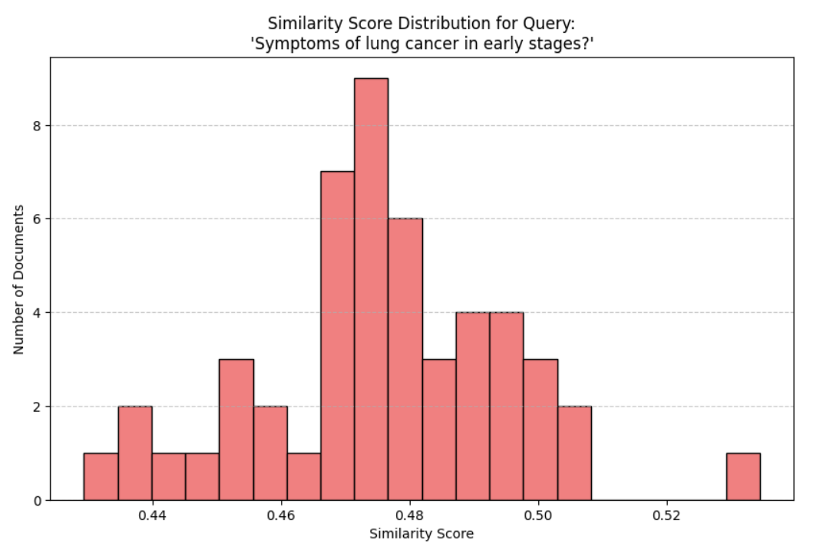
BERT-based IR system retrieved documents based on semantic similarity to five user queries.
Treatment-related queries (e.g., thyroid cancer treatment) showed higher similarity concentration (around 0.42–0.44), indicating stronger matches.
Diagnosis and symptom-based queries had wider and flatter distributions, suggesting more semantic noise and fewer high-quality matches.
Best performance was observed for:
“What are common treatments for thyroid cancer?”
“What therapies are available for thyroid cancer?”
IR performance dropped for early detection questions like:
“Symptoms of lung cancer in early stages”

Slide 17
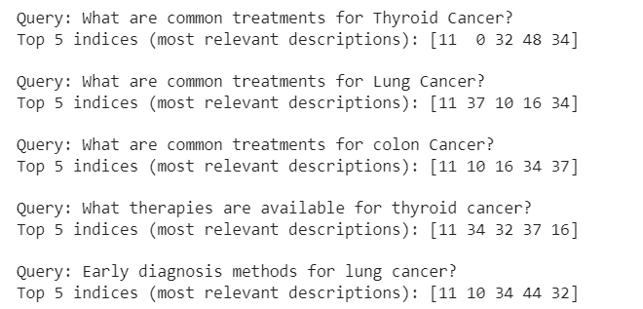
Top 5 Retrieved Results for Each Clinical Query
The system retrieved the top 5 semantically similar abstracts for each clinical query using cosine similarity.
Queries related to treatments (thyroid, lung, colon) produced more consistent and overlapping top indices (e.g., index 11, 34).
Query overlap (e.g., index 11 and 34 appearing in all 5 queries) suggests strong relevance of certain documents across multiple cancer types.
Queries focused on early diagnosis or symptoms had less distinct and more varied top results, reflecting lower confidence in similarity scores.
These retrieval indices were later used for evaluation of Precision, Recall, and F1-score per query.

Slide 18
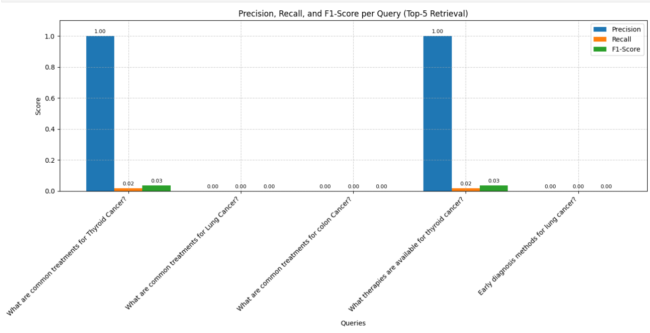
Evaluation of IR Performance Across Clinical Queries
The model achieved perfect precision (1.0) for two treatment-related queries:
“What are common treatments for thyroid cancer?”
“What therapies are available for thyroid cancer?”
However, recall and F1-scores remained low (0.02–0.03), indicating only one correct item retrieved out of five.
For lung and colon cancer queries, all retrieval scores were zero, showing model limitations for less specific or early-diagnosis queries.
Highlights that semantic retrieval worked best for well-defined, treatment-oriented questions.
Suggests potential for improvement using more domain-specific embeddings (e.g., BioBERT or ClinicalBERT).

Slide 19
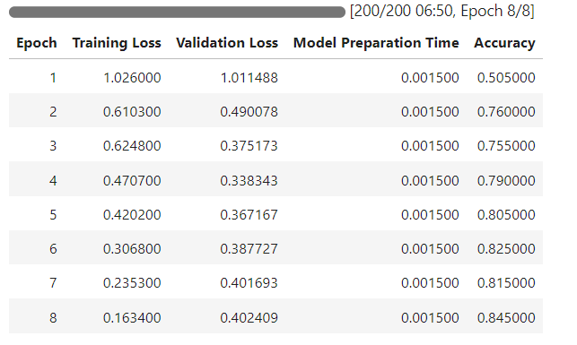
DistilBERT Training Progress Across Epochs
DistilBERT was trained over 8 epochs on clinical text to classify cancer types (lung, colon, thyroid).
Model showed rapid improvement from epoch 1 (accuracy = 0.51) to epoch 2 (accuracy = 0.76).
Peak accuracy reached: 0.8450 at epoch 8, with steadily decreasing training loss.
Validation loss fluctuated slightly after epoch 5, indicating potential minor overfitting.
Consistent model preparation time per epoch confirmed stable training behavior.

Slide 20
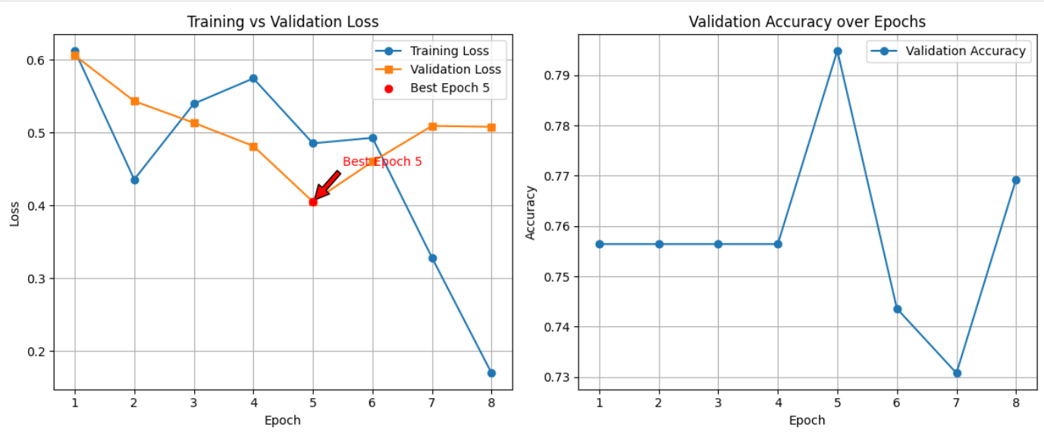
DistilBERT Model Performance Across Epochs
Left Chart: Training vs. Validation Loss • Sharp decline in training loss from epoch 1 to epoch 8 • Lowest validation loss achieved at epoch 5 (highlighted) • Slight increase in validation loss afterward indicates early overfitting
Right Chart: Validation Accuracy • Accuracy peaked at epoch 5 (≈0.795) • Performance dipped post-epoch 5 before recovering slightly at epoch 8 • Confirms epoch 5 as the optimal stopping point for generalization
Suggests effective learning with good convergence, though earlier stopping may improve generalization.

Slide 21
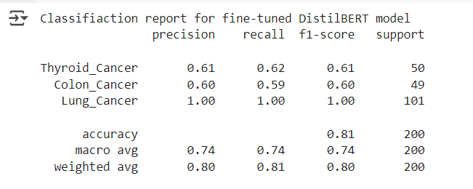
Classification Metrics for Cancer Type Prediction (DistilBERT)
Overall model accuracy: 81% on the test set of 200 samples.
Lung Cancer was classified perfectly with:
Precision = 1.00, Recall = 1.00, F1-score = 1.00
Performance was moderate for:
Thyroid Cancer: F1 = 0.61
Colon Cancer: F1 = 0.60
Macro average F1 = 0.74, showing balanced performance across classes.
High weighted average (F1 = 0.80) reflects good handling of class imbalance.

Slide 22
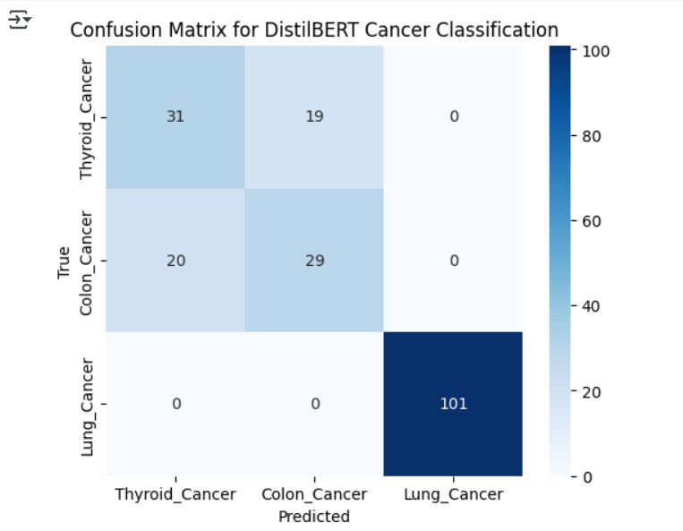
Confusion Matrix for DistilBERT Cancer Classification
Model achieved perfect classification of all Lung Cancer cases (101/101).
Thyroid and Colon Cancer were frequently misclassified as each other:
19 Thyroid samples predicted as Colon
20 Colon samples predicted as Thyroid
Suggests semantic overlap in descriptions of Thyroid and Colon cancer.
Indicates strong performance on the majority class (Lung Cancer) and room for improvement in distinguishing similar classes.
Confirms insights from classification report: high precision/recall for Lung, moderate for Thyroid, and Colon.

Slide 23
Discussion
4.1 Preprocessing Benefits
Text preparation greatly decreased noise and increased data clarity. Duplicate filtering improved model training by removing redundancy, while lemmatization and stopword elimination cleaned up the token space.

Slide 24
Discussion
Integrated a full biomedical NLP pipeline with preprocessing, NER, semantic IR, and cancer classification using transformer-based models.
NER Results:
BC5CDR achieved F1-scores > 0.96 for CHEMICAL and DISEASE entities.
Outperformed BIONLP13CG, confirming the importance of domain-specific models for clinical accuracy (Park et al., 2024; Navarro et al., 2023).
IR Findings:
BERT-based retrieval was most effective for treatment-related queries.
Poor performance on diagnosis-related queries suggests need for domain-tuned embeddings (Ahmad et al., 2023; Das et al., 2020).
Classification Insights:
DistilBERT reached 81% accuracy, with perfect prediction for Lung Cancer.
Misclassifications between Thyroid and Colon Cancer likely due to terminology overlap (Qasim et al., 2022; Diwakar & Raj, 2024).
Training Trends:
Best validation performance at epoch 5, final accuracy peaked at 84.5%.
Confirms transformer model stability and generalization (Guo, 2024).

Slide 25
Conclusion
Developed a complete biomedical NLP pipeline integrating preprocessing, NER, semantic information retrieval, and transformer-based classification.
BC5CDR outperformed BIONLP13CG in NER tasks, confirming the importance of domain-specific models for accurate clinical entity extraction.
Information retrieval using BERT worked best for treatment-related queries; diagnostic and symptom-based queries exposed limitations in semantic understanding.
Fine-tuned DistilBERT achieved 81% accuracy, with perfect classification for Lung Cancer, and strong generalization across test samples.
Minor misclassifications between Thyroid and Colon cancers reflect vocabulary overlap; training trends supported early stopping to prevent overfitting.
Results confirm the value of transformer-based NLP models in biomedical text analysis; future work should explore BioBERT, multitask learning, and larger datasets for broader clinical applicability.

Slide 26
References
Ahmad, P. N., Liu, Y., Khan, K., Jiang, T., & Burhan, U. (2023). Bir: Biomedical information retrieval system for cancer treatment in electronic health record using transformers. Sensors, 23(23), 9355.
Cohen, K. B., & Demner-Fushman, D. (2014). Biomedical natural language processing. J. Benjamins Publishing Company.
Das, D., Katyal, Y., Verma, J., Dubey, S., Singh, A., Agarwal, K., ... & Ranjan, R. (2020, July). Information retrieval and extraction on covid-19 clinical articles using graph community detection and bio-bert embeddings. In Proceedings of the 1st Workshop on NLP for COVID-19 at ACL 2020.
Diwakar, & Raj, D. (2024). DistilBERT-based Text Classification for Automated Diagnosis of Mental Health Conditions. In Microbial Data Intelligence and Computational Techniques for Sustainable Computing (pp. 93-106). Springer Nature Singapore.
Falgunipatel19. (2022). Medical text dataset -cancer doc classification. Kaggle. https://www.kaggle.com/datasets/falgunipatel19/biomedical-text-publication-classification.
Guo, Z. (2024). Automated Text Mining of Experimental Methodologies from Biomedical Literature. arXiv preprint arXiv:2404.13779.
Qasim, R., Bangyal, W. H., Alqarni, M. A., & Ali Almazroi, A. (2022). A fine‐tuned BERT‐based transfer learning approach for text classification. Journal of healthcare engineering, 2022(1), 3498123.
Navarro, D. F., Ijaz, K., Rezazadegan, D., Rahimi-Ardabili, H., Dras, M., Coiera, E., & Berkovsky, S. (2023). Clinical named entity recognition and relation extraction using natural language processing of medical free text: A systematic review. International Journal of Medical Informatics, 177, 105122.
Park, Y., Son, G., & Rho, M. (2024). Biomedical flat and nested named entity recognition: Methods, challenges, and advances. Applied Sciences-Basel, 14(20), 1-23.
Shortliffe, E. H., Cimino, J. J., & Chiang, M. F. (2021). Biomedical informatics: computer applications in health care and biomedicine. Springer.

Slide 27

Thank you

