Slide 1
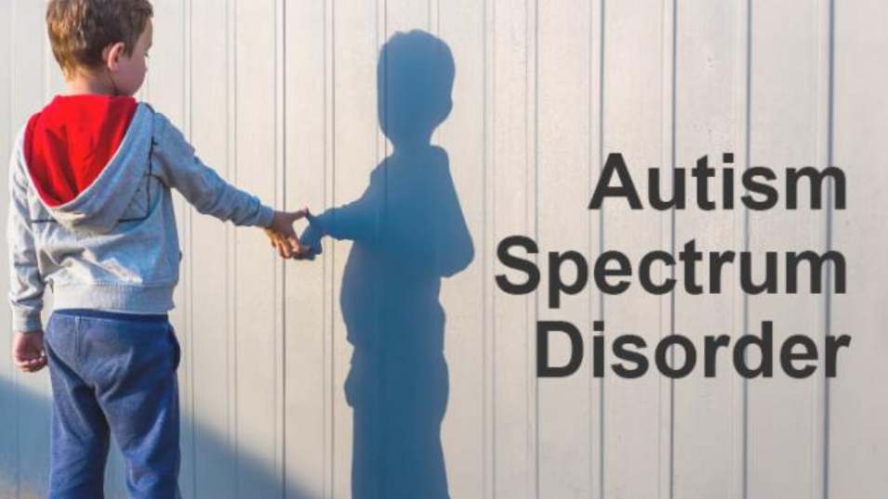
Autism Screening

Slide 2
Project Description
Autistic Spectrum Disorder (ASD) is a neurodevelopment condition associated with significant healthcare costs, and early diagnosis can significantly reduce these costs.
The increase in the number of ASD cases across the world reveals an urgent need for the development of effective screening methods and datasets related to behavior traits. Presently, very limited autism datasets associated with clinical or screening are available.
Hence, a new dataset is proposed that is related to autism screening for further analysis especially in determining influential autistic traits and improving the classification of ASD cases.
In this dataset, we record behavioral features plus individual characteristics that have proved to be effective in detecting the ASD cases from controls in behavior science.
The dataset used was from Kaggle, it includes 704 observations for adults and 1054 for toddlers, there was no missing values.

Slide 3
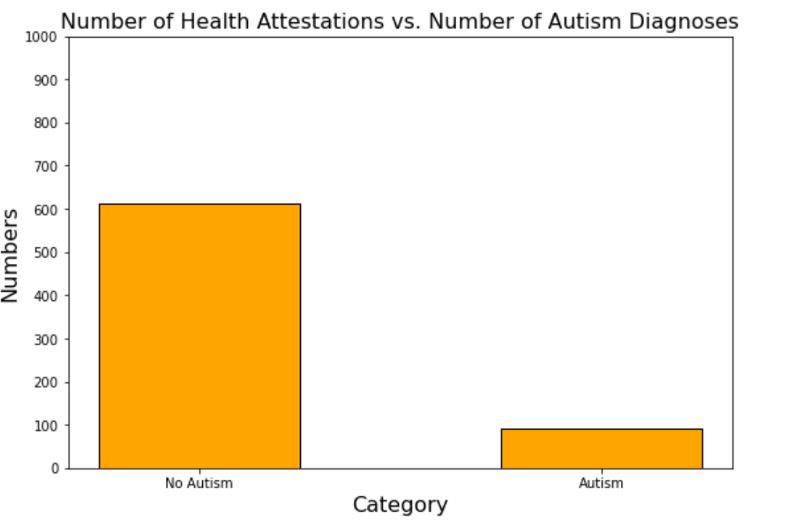
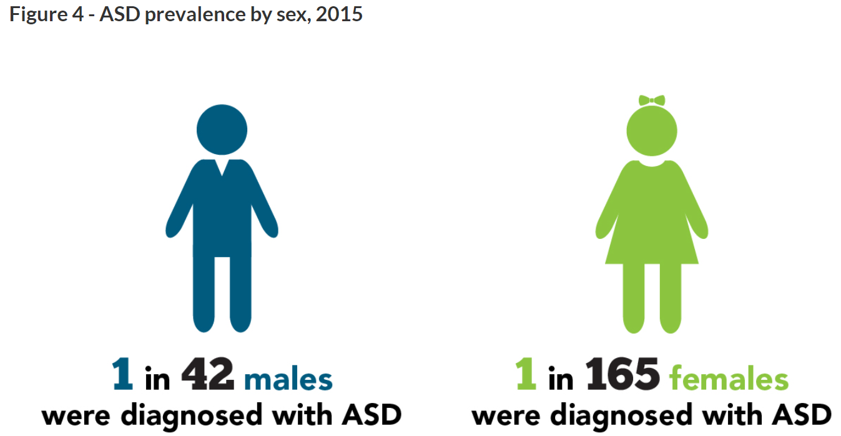
Counting how many people have been diagnosed with autism
According to the dataset, 613 patients don’t have autism, while 91 people apparently have it.
What is the Male/Female-Ratio among people who are diagnosed with autism?
Out of all people diagnosed with autism, there were 367 men and 337women.
A substantial amount of research shows a higher rate of autistic type of problems in males compared to females. The 4:1 male to female ratio is one of the most consistent findings in autism spectrum disorder (ASD).

Slide 4
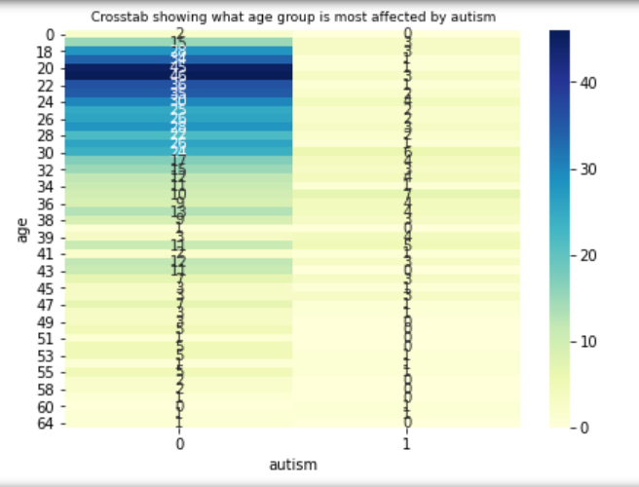
How many adults of what age were diagnosed with autism?
Apparently, most people appearing in these statistics are younger people. However, among those who were diagnosed with autism, most were middle aged (early 20s to mid 40s) with very few people younger or older than that.
We can see that in adults, as their age increases the number of autism cases decreases.

Slide 5
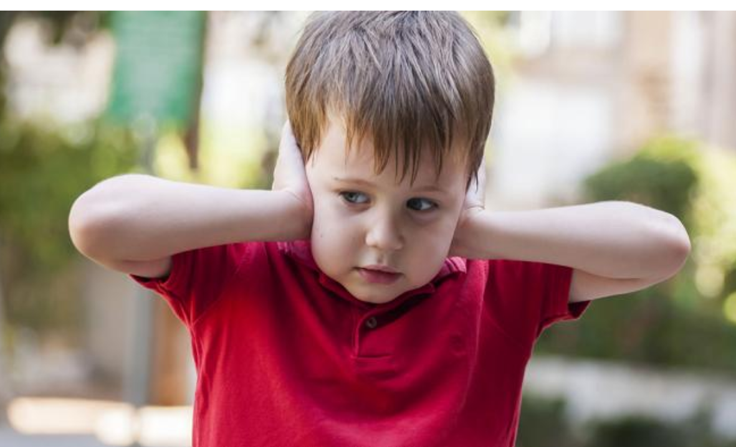
Predicting Early ASD Traits of Toddlers
Based on the checklist for Autism in Toddlers data provided, we will try to develop a simple prediction model for toddlers to predict the probability of showing ASD traits so that their parents can consider taking early steps.
So if parents provides toddler's age, gender, ethnicity, jaundice while birth and if any relatives have ASD traits, the model will try to predict if the toddler has ASD or not.

Slide 6
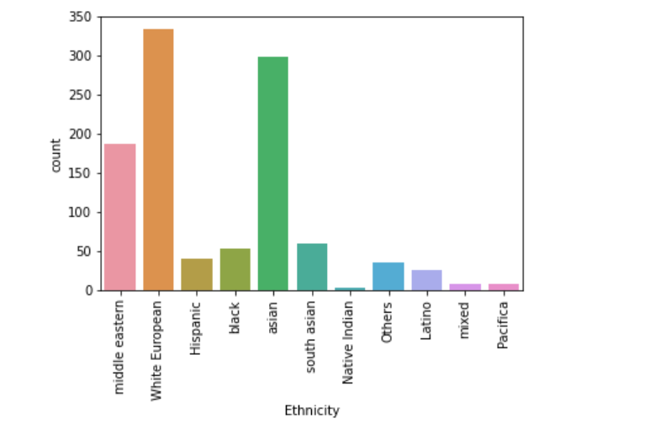
How many toddlers of which ethnicity were diagnosed with autism?
We can observe that White Europeans ethnicities have very high chance of being ASD positive. Asians and middle easterners follow next though with smaller ratios.

Slide 7
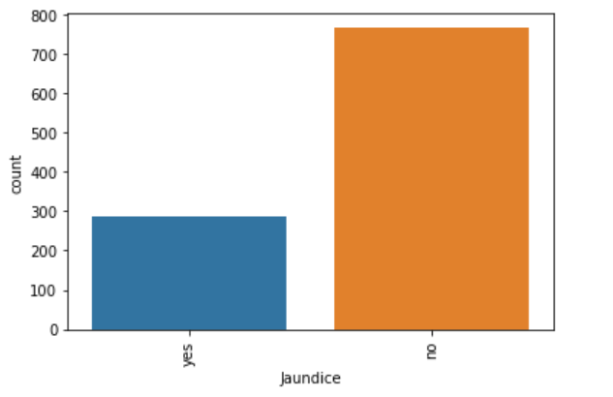
Is Jaundice related to autism?
The number of babies suffering from Jaundice is less than the number of babies not suffering from Jaundice, so Jaundice has a weak link to ASD.

Slide 8
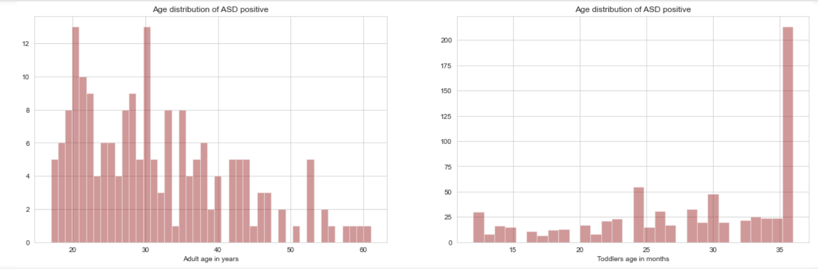
How many todlers of what age were diagnosed with autism?
We saw previously in adults, as the age increases the number of ASD cases decreases, whereas in toddlers as the age increases the number of cases increases.
For adults most of the ASD positive cases are around 20 or 30 years old, whereas for toddlers most of them are around 36 months old.

Slide 9
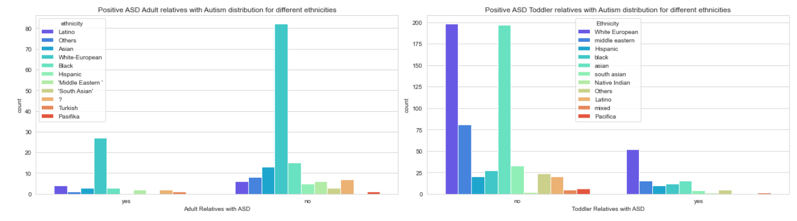
Visualizing the distribution of autism in families within different ethnicities
We can observe that both in Adults and Toddlers, White and Europeans ethnicities have a very high chance of being ASD positive if they have it in their genes. We can not conclude anything firmly, but we can stay confident that there is a genetic link for ASD positive as backed by studies.

