Slide 1
Lending Club Case Study
UPGRAD MLC65 BATCH
Payal Parhi
Praveen Kumar

Slide 2
In Lending club case study we perform following steps :
Environment setup
Load the data
Data Study
Data Cleaning
Data conversion & Derived columns
Data checking –
Missing Values
List Outliers
Handling missing values
Removing the outliers
EDA –
Univariate Analysis
Bivariate Analysis
Multivariate Analysis

Slide 3
DATA STUDY, CLEANING & MANIPULATION
In this case study first we understand the column attributes and their meta data
Initial number of columns – 111
No. of records – 39717
Then we have checked data types and no. of null values present
Dropped the Columns which have presence of high / all null values
Mths_since_last_major_derog
Annual_inc_joint
Dti_joint
Verification_status_joint
Tot_coll_amt & Etc.

Slide 4
DATA STUDY, CLEANING & MANIPULATION
Further, non-useful having columns also removed.
No. of columns remaining after data cleaning - 45
Following derivation/conversion/manipulation done on the data
Interest rate converted to numerical value
Term converted for numerical analysis
Derived columns for year made from the date column

Slide 5
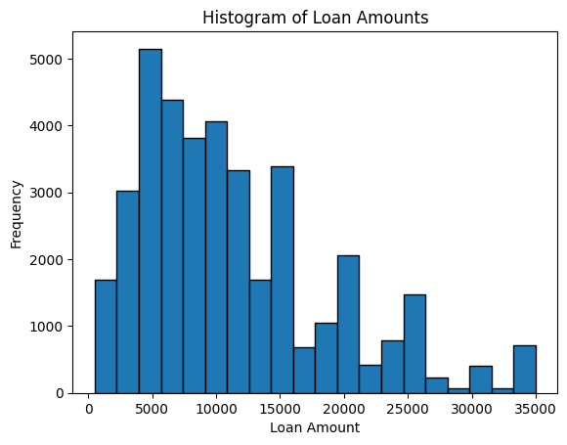
Histogram of Loan Amount
UNIVARIATE ANALYSIS
Insight :
The most common amount of loan taken is in the range from 5,000 to 10,000.

Slide 6
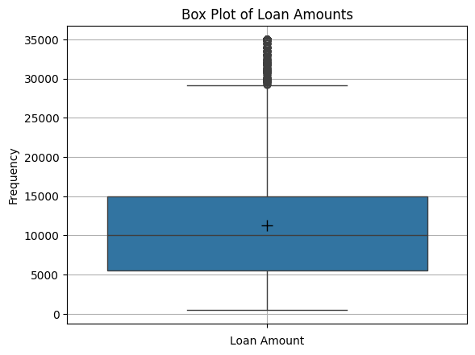
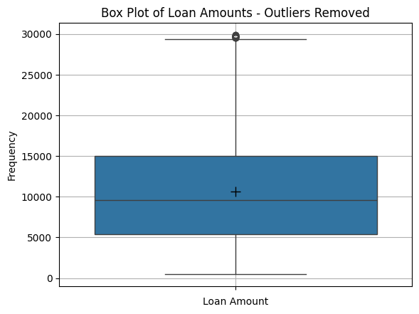
Box Plot of Loan Amount
With Outliers
Without outliers
Insights :
The above Box plot show that, the outliers starts from just below 30,000 and then continue upwards, so all the entries above 30,000 can be removed.
Here the loan amount varies from 0 to 30000 and 25% is more than 5000, 50% is less than 10000 and 75% is 15000

Slide 7
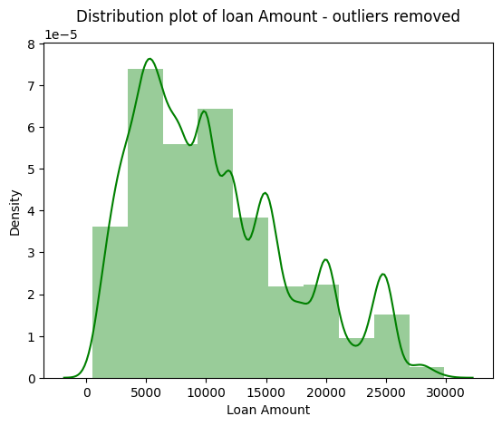
Distribution Plot of loan amount to customers - with outliers removed
Insight :
Here the loan amount varies from 0 to 30000 and 25% is more than 5000, 50% is less than 10000 and 75% is 15000

Slide 8
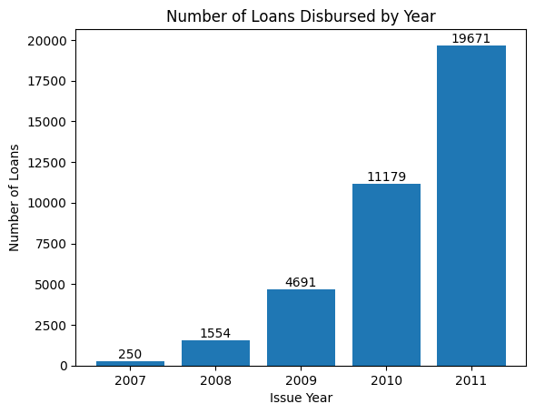
The number of loans disbursed year-wise
Insight :
It is clear that the number of loans disbursed increased yearly.

Slide 9
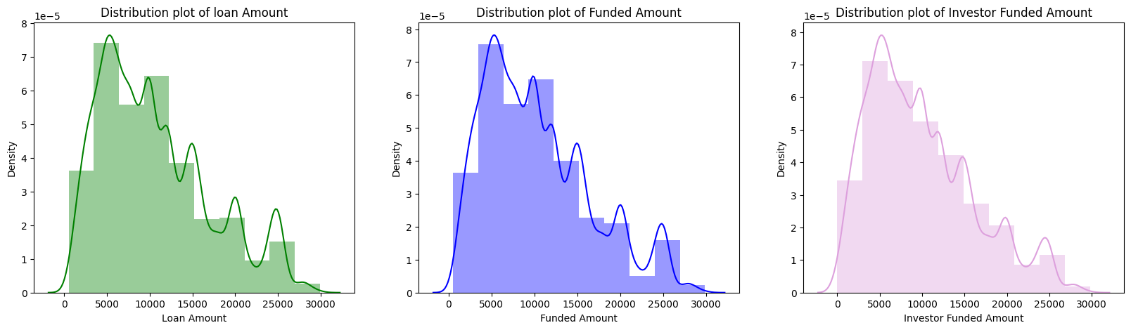
Distribution of Loan Amounts, Funded Amount and Investor Funded Amount using distribution plot
Insight :
Distribution of Loan Amounts, Funded Amount and Investor Funded Amount are looking similar as per above distribution plots.

Slide 10
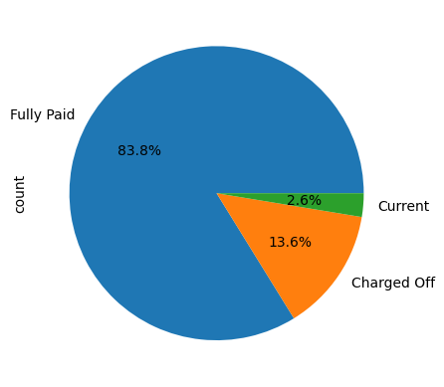
The Loan Status counts data in pie chart
Insights :
Around 13.6% of the customers have not been able to completely repay the loans and have been charged off by the lending club.
Majority of the customers (83.8%) have completely paid off the loan.
Around 2.6% of customers are currently re-paying the loan.

Slide 11
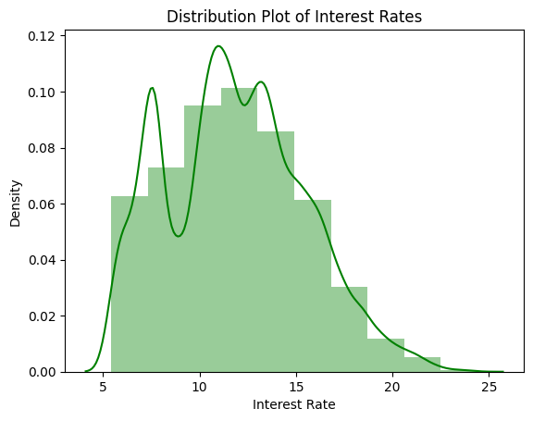
Distribution plot of interest rates
Insight :
Majority of the loans disbursed are having their interest rates in the range of 10% to 15%.

Slide 12
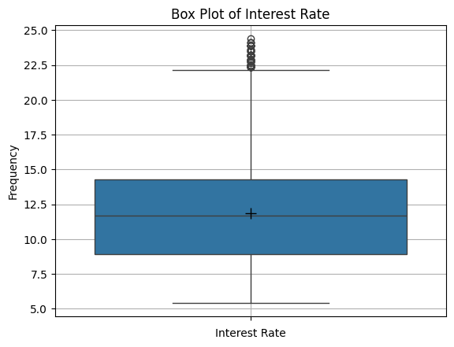
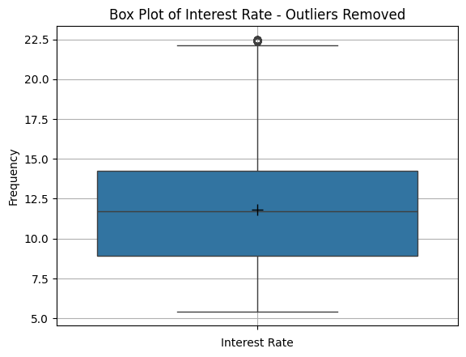
Box plot of interest rates
With Outliers
Without Outliers
Insight :
On the basis of the above box-plot it is clear that evident above the mark of 22.5% having certain outliers, so all the entries above 22.5% can be removed.

Slide 13
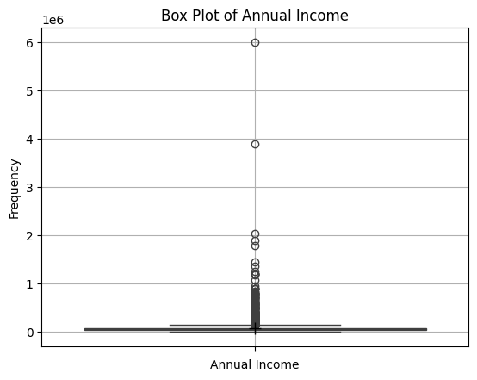
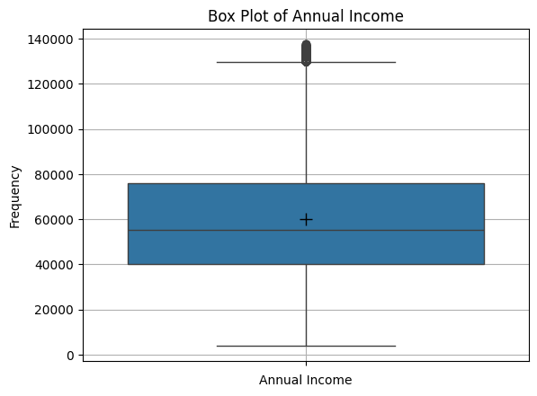
Box plot of Annual Income
With Outliers
Without Outliers
Removing the outliers from Annual Income by taking a threshold of 95 percentile.

Slide 14
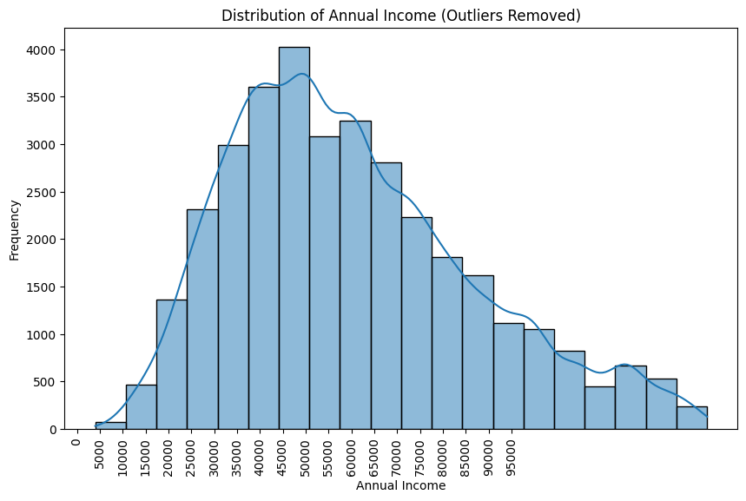
Histogram for Annual Income
Insight :
The above Histogram shows most of the Annual Income are in the range 30000-75000.

Slide 15
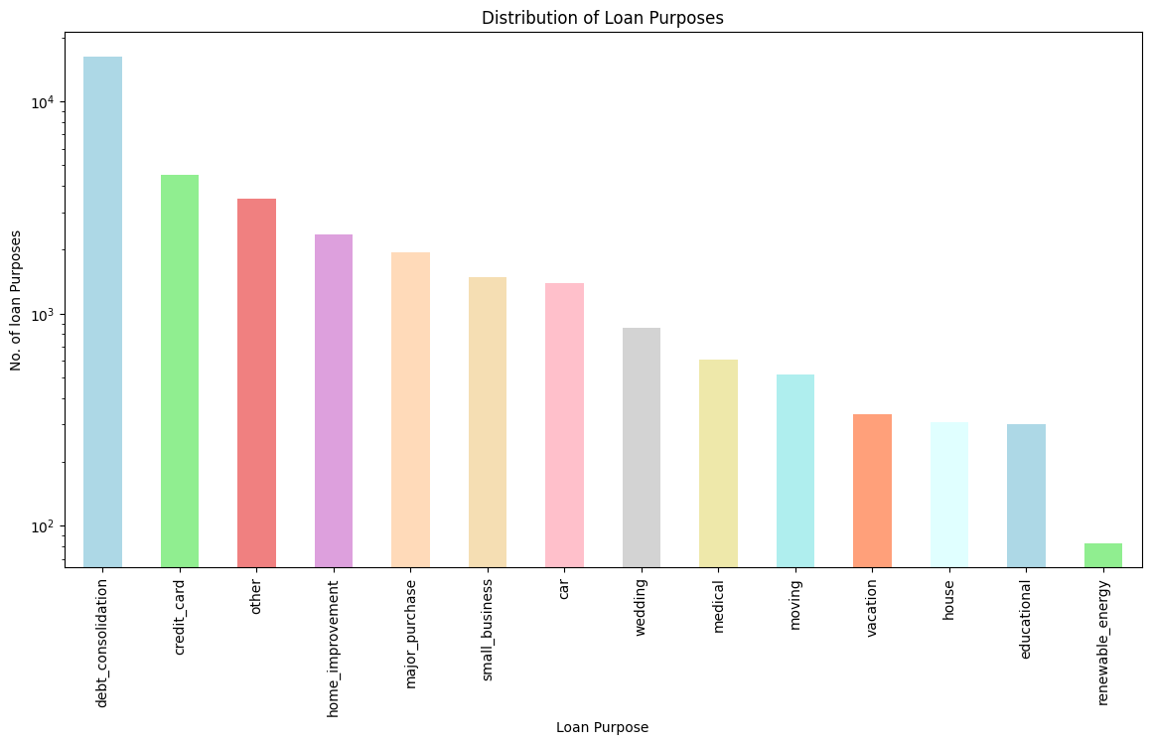
Bar chart to show the different loan purpose from the lending clubs
Insights :
The five major purposes of Loan applications are - 'debt_consolidation', 'credit_card', 'other', 'home_improvement' and 'major_purchase'.
The 'debt_consolidation' is the highest loan purpose.

Slide 16
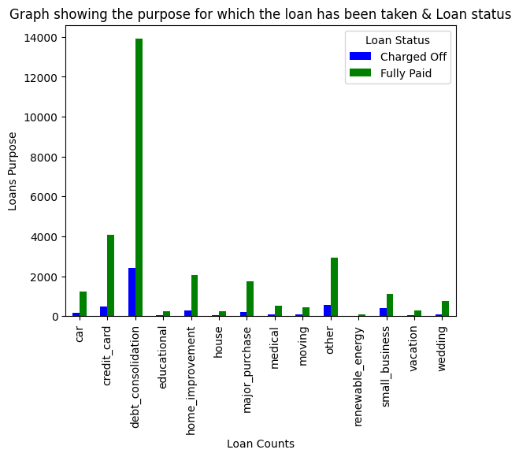
The grouped categorical bar chart of Purpose of loan and Loan Status
Insight :
The bar chart shows the loan taken for debt_consolidation having the highest fully paid loan status.

Slide 17
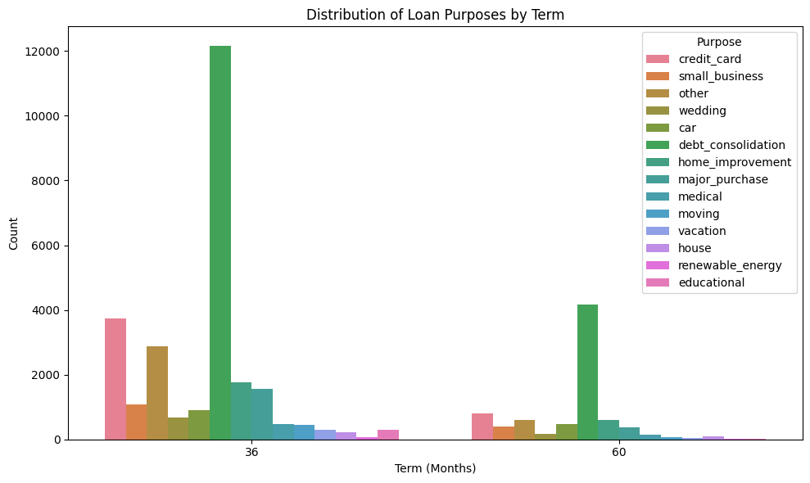
The bar chart between Term Months and Purpose
Insight :
From above bar chart, it is showing mostly loan generate in 36 months.

Slide 18
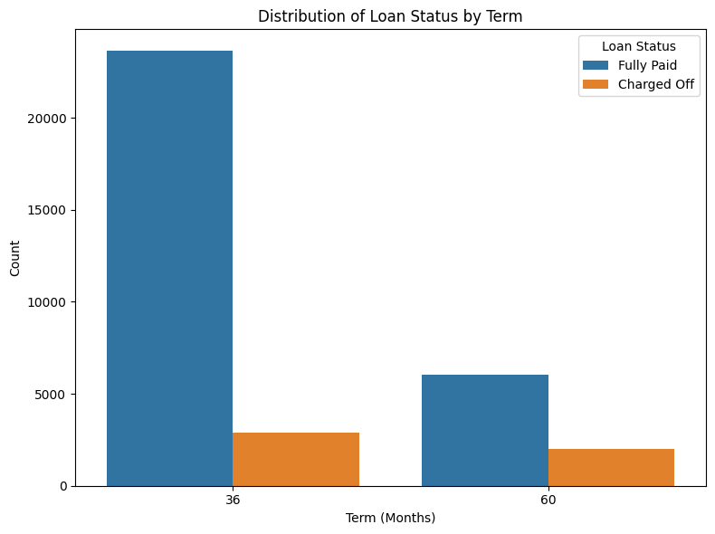
Bar chart between Term Months and Loan Status
Insights :
From above bar chart, it is showing that more customers who have not been able to completely repay the loans had taken the loan for 36 months than the customers who had taken the loan for 60 months.
More customers had taken the loan for 36 months and able to fully paid the loans.

Slide 19
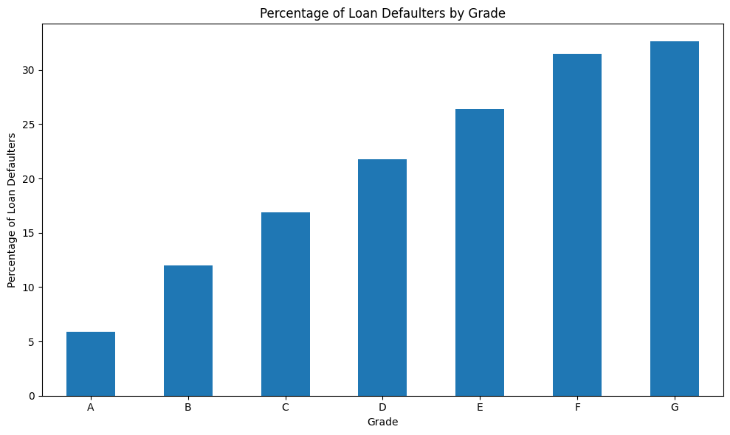
Bar chart to visualize the percentage of loan defaulters by grade
Insight :
The highest percentage of Defaulters are in Grade G group.

Slide 20
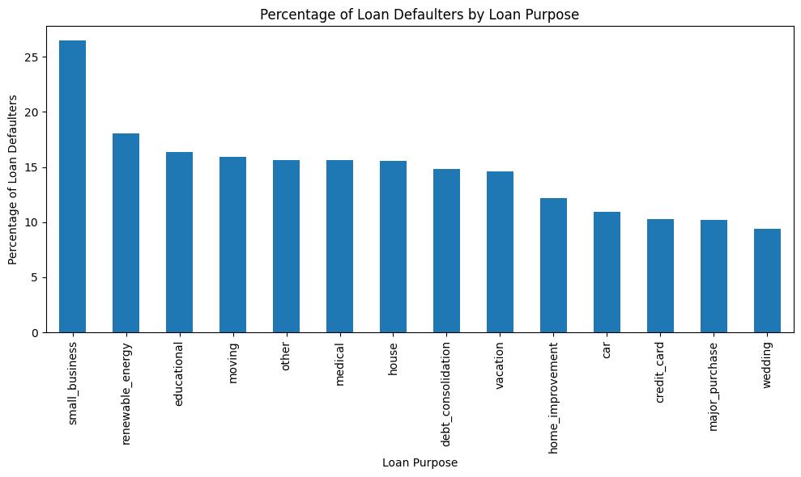
Bar chart to visualize the percentage of loan defaulters by Loan Purpose
Insight :
The percentage of risk of Defaulters is the largest in the 'small_business' Loan Purpose, followed by 'renewable_energy' , 'educational' and so on.

Slide 21
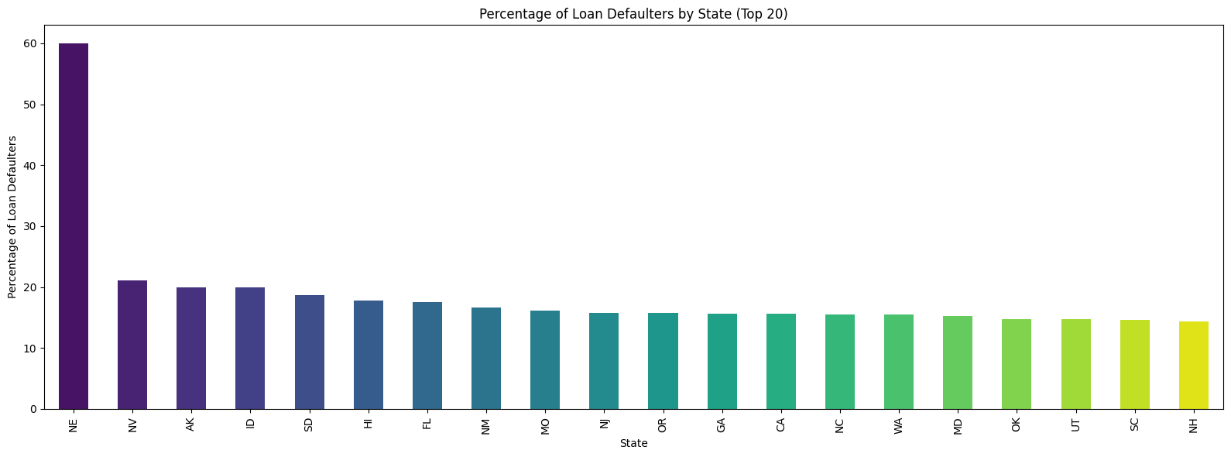
Bar chart to visualize the percentage of loan defaulters by address state
Insight :
The percentage of Defaulters is maximum from NE (State) which is nearly equal to 60%.
The percentage of Defaulters for other states are slightly varies.

Slide 22
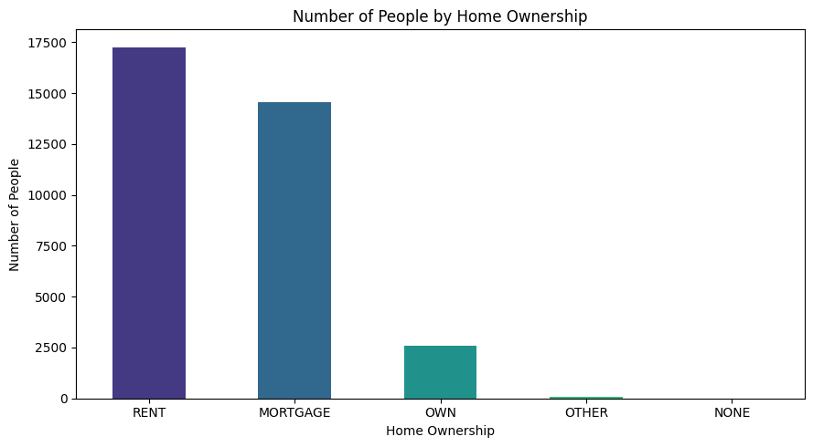
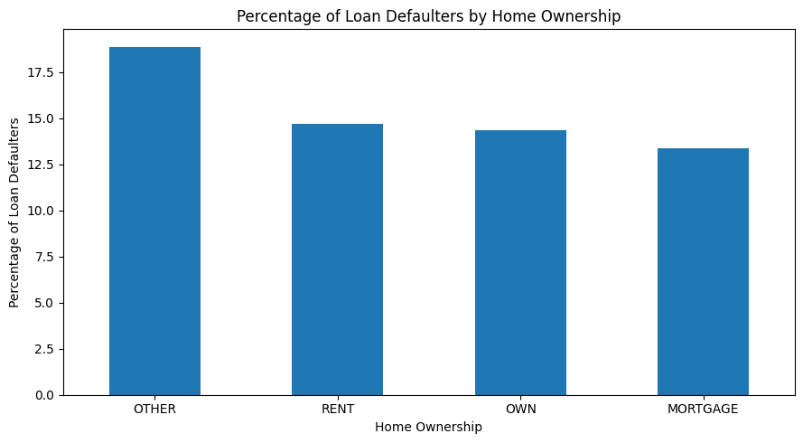
Bar chart to visualize the number of people by home ownership
Bar chart to visualize the percentage of loan defaulters by home ownership
Insights :
The highest number of people who have home ownership is in 'Rent'.
But percentage of defaulter under home ownership is 'Other' followed by 'Rent' and 'Own' and 'Mortgage'.

Slide 23
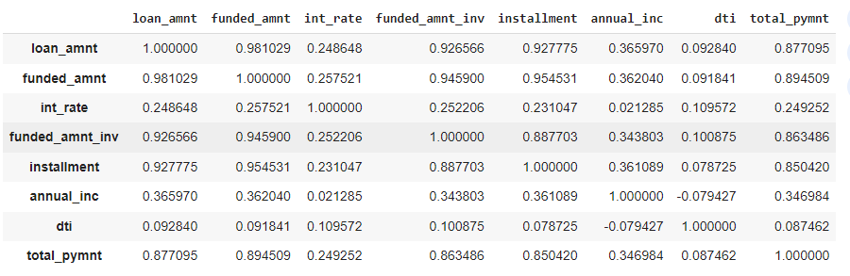
BIVARIATE ANALYSIS
Correlation Analysis of Bivariate Matrix
Insights :
From above correlation matrix, we found below insights -
Loan Amount, Investor Funded Amount and Funded Amount are Strongly Correlated.
Annual Income and Debt To Income Ratio (dti) are Negatively Correlated means when Annual Income increases then dti decreases and vice versa.
Annual Income and Funded Amount are Positively Correlated it means customers having high income gets high funded amount.
Loan Amount and Interest Rate are Positively Correlated.
Annual Income and Total Payment are Positively Correlated.

Slide 24
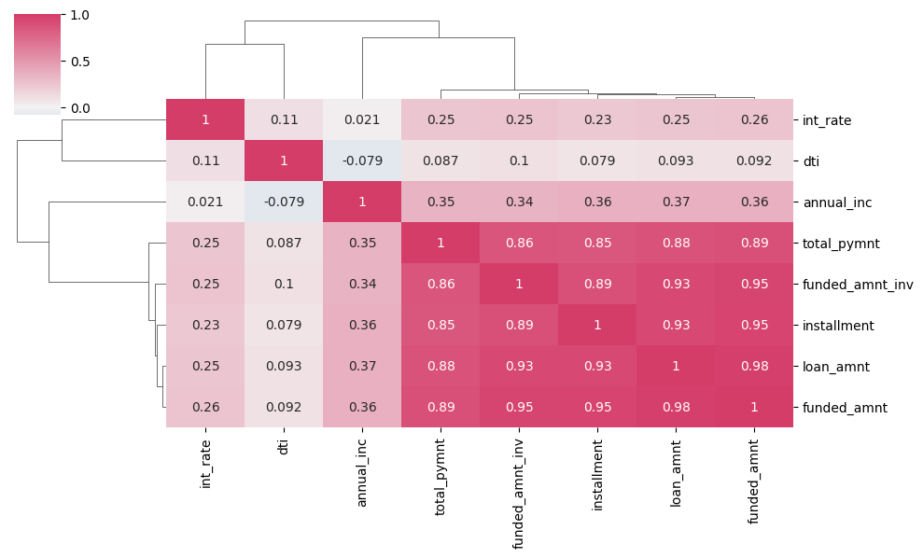
Heatmap to show correlation

Slide 25
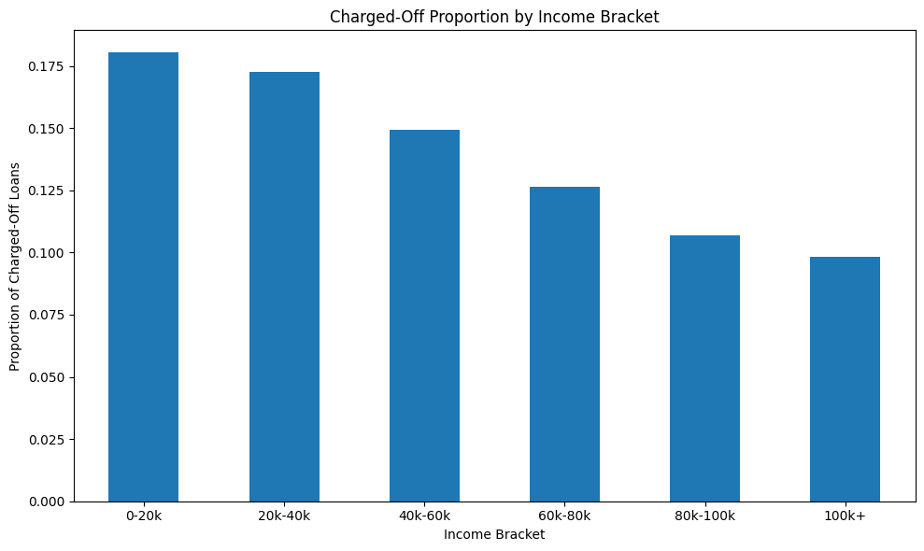
Bivariate Analysis on annual income on Charged Off Proportion in bar chart
Insights :
From the above bar chart we found that with increase in annual income charged off proportion got decreased and vice versa.
The customer having income range 100000+ has less chances of charged off.
The customer having income range 0 to 20000 has high chances of charged off.

Slide 26
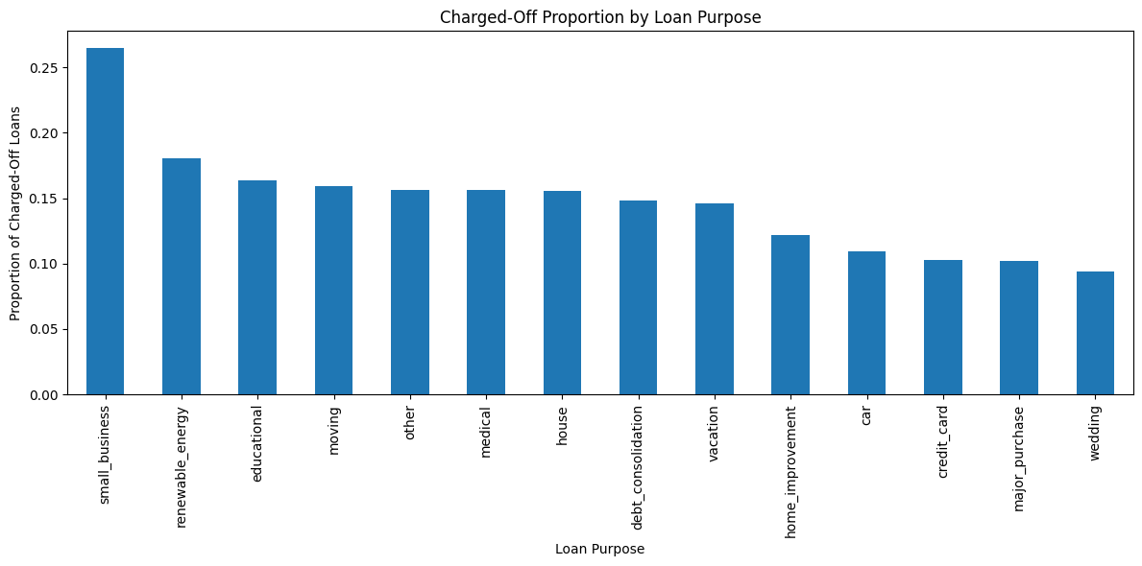
Bivariate Analysis for Purpose of Loan Vs Charged Off Proportion in bar chart
Insights :
Small Business customers have high chances of getting charged off.
Customer having Wedding purpose loan have low chances of getting charged off.

Slide 27
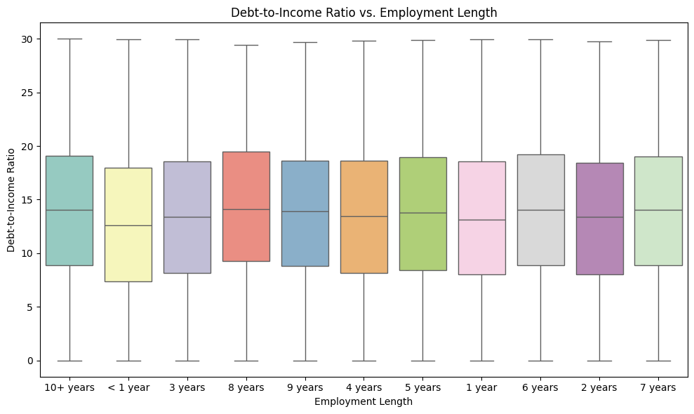
Bivariate Analysis of dti vs emp_length in box plot
Insight :
From above box plots we found that 6+ years of experienced employees having debt to income ratio (dti) in maximum range apart from that rest years of experienced employees are more or less in same range of dti.

Slide 28
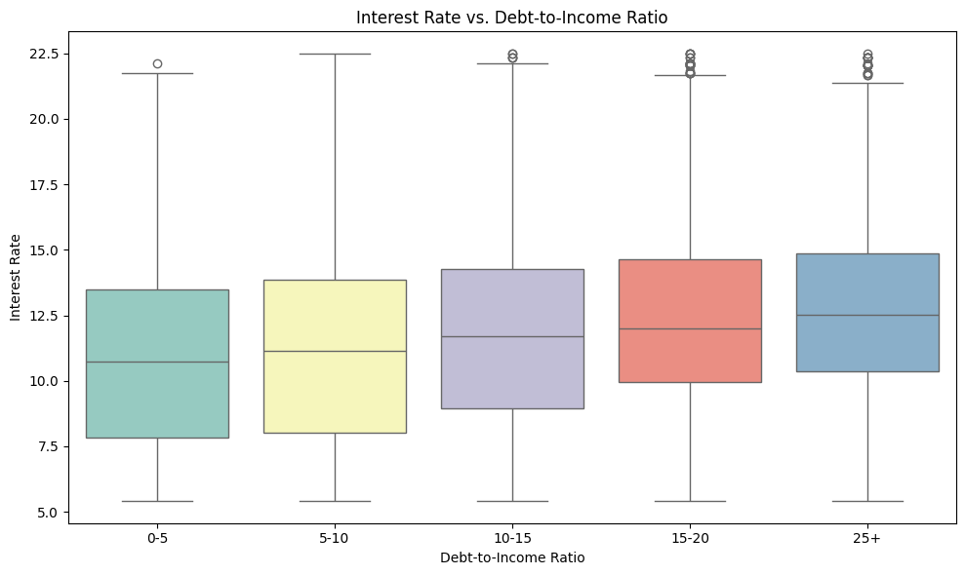
Bivariate Analysis of dti vs interest rate in box plot
Insights :
When dti is low then the interest rate is also low.
The above bar chart shows no significant variations. There is slightly increase in interest rate with increase in dti.

Slide 29
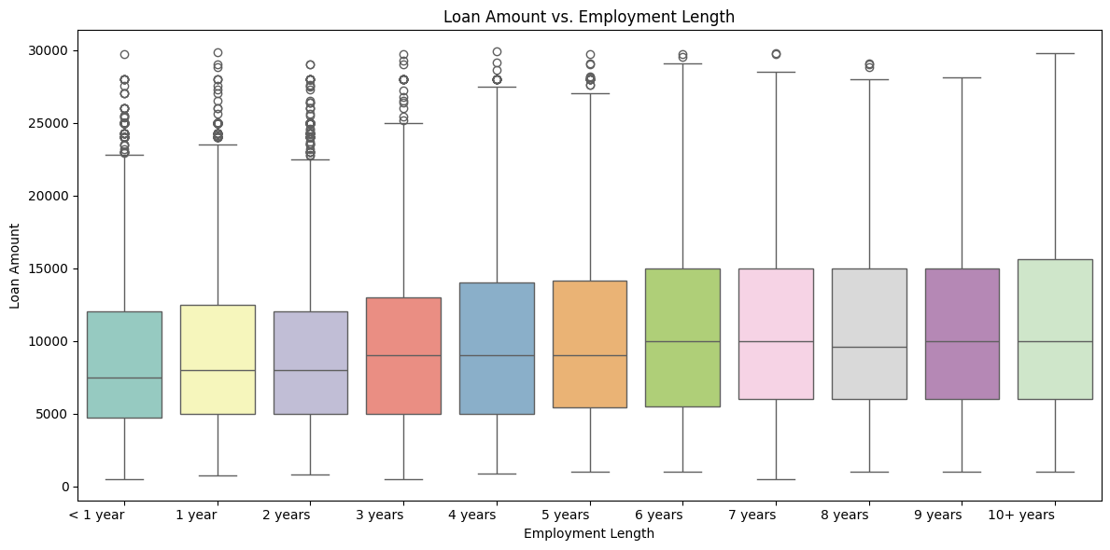
Bivariate Analysis of loan amount vs emp_length in box plot
Insight :
In above box plot it is showing that the employees experienced with 10+ years is taking more amount of loan and those who are less than 1 year is taken less amount of loan.

Slide 30
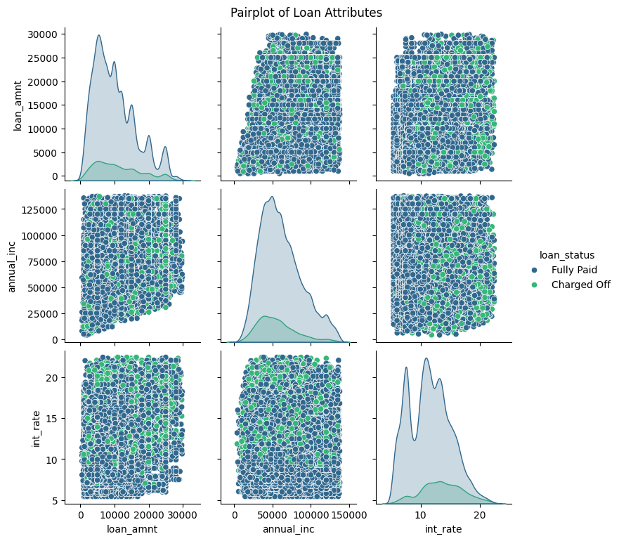
MULTIVARIATE ANALYSIS
Pairplot to visualize relationships between multiple variables
Insights :
There is an increase in number of charged off yearly.
When the charged off ratio is more then the interest rate is more.
There is an increase in interest rate with increase in loan amount

Slide 31
Conclusion -
The percentage of risk of Defaulters is the largest in the 'small_business' Loan Purpose.
The customer having income range 0 to 20000 has high chances of Defaulters.
The highest percentage of defaulter under home ownership is 'Other' and 'Rent’.
The customers belongs to NE state have high chance to be defaulter.
The Grade G group has highest percentage of Defaulters. So, Low grade is high chance to defaulters.

Slide 32
Thank You

