Slide 1


Sanjivani College of Engineering, Kopargaon-423603
Sanjivani Rural Education Society’s
(An Autonomous InstituteAffiliated to Savitribai Phule Pune University, Pune)
NAAC ‘A’Grade Accredited
Department of Information Technology
(UG program, NBAAccredited)
Academic Year 2026-27
Project Idea Presentation
“An Intelligent NLP System for Legal and Employment Document Risk Analysis with Multiplatform Delivery”
Team Member
Sushant More
Varun Pawar
Pratiksha Rahane
Payal Shinde
Project Idea Presentation

Slide 2

Content
Problem Statement / Idea Title
Abstract
Introduction
Objectives
Literature Survey
Methodology
Proposed system
Software tools/ Technologies to be used
Sustainable Development Goal(SDG) Achieved(Mention SDG achieved by project)
References
Project Idea Presentation

Slide 3
Problem Statement
Current Challenges
Legal documents are lengthy and difficult to understand.
Users often accept Terms & Conditions without reading them.
Employment contracts contain hidden clauses.
Important legal risks are overlooked.
Legal consultation is expensive and time-consuming.
Need
Develop an AI-powered system that simplifies legal documents into understandable insights while identifying potential risks.
Project Idea Presentation

Slide 4
Abstract
What is Legal-Ease Translator?
Legal-Ease Translator is an AI-driven NLP platform that analyses legal and employment documents and converts complex legal language into simple, user-friendly summaries.
The system automatically:
Extracts legal clauses
Detects risky terms
Identifies user-friendly clauses
Calculates trust/risk score
Generates recommendations
Delivers results through Web, Mobile, and Browser Extension
Project Idea Presentation

Slide 5
Introduction
Legal and employment documents such as Terms of Service (ToS), Privacy Policies, Employment Contracts, and Agreements are often written in complex legal language, making them difficult for users to understand. As a result, many people accept these documents without fully understanding the risks, obligations, or important clauses they contain.
An Intelligent NLP System for Legal and Employment Document Risk Analysis with Multiplatform Delivery is an AI-powered solution that uses Natural Language Processing (NLP) and Large Language Models (LLMs) to analyse legal documents, simplify complex legal text into plain language, identify potential risks, and provide intelligent recommendations.
The system extracts important clauses, classifies them into Red Flags (Risky Clauses) and Green Flags (Safe Clauses), calculates a Trust Score, and delivers the results through a Web Application, Mobile Application, and Browser Extension, enabling users to make informed decisions before accepting any legal or employment agreement.
Project Idea Presentation

Slide 6
Objectives
Aim
To build an intelligent NLP system that analyses legal and employment documents and provides understandable summaries with risk analysis.
Objectives
Simplify legal language
Detect hidden legal risks
Extract important clauses
Classify clauses
Generate Trust Score
Provide AI recommendations
Support multiple platforms
Project Idea Presentation

Slide 7
Literature Survey
Sr. No | Research Paper Name | Published Year | Author Names | What this research paper contains | Research Gap
1 | CUAD: An Expert-Annotated NLP Dataset for Legal Contract Review | 2025 | Dan Hendrycks et al. | Introduced the CUAD dataset with expert annotations for contract clause extraction and legal contract review using Transformer models. | Focuses mainly on contract clause extraction and review; does not provide risk scoring, plain-language explanations, or multiplatform deployment.
2 | Natural Language Processing in Legal Document Analysis: A Systematic Review | 2025 | J. M. Maseko et al. | Reviews NLP techniques for legal document summarization, information extraction, legal QA, and compliance verification. | Provides a survey of methods but does not propose an integrated system combining clause classification, trust scoring, and user recommendations.
3 | A Survey of Classification Tasks and Approaches for Legal Contract Analysis | 2026 | Multiple Authors | Reviews legal contract classification tasks, datasets, and approaches including traditional ML, deep learning, and LLMs. | Focuses on benchmarking rather than delivering simplified legal explanations, AI recommendations, or end-user applications
Project Idea Presentation

Slide 8
Methodology
Phase | Description | Key Research Foundation
Data Collection | Collect legal and employment documents (ToS, Privacy Policies, Employment Contracts) from public datasets and websites. | CUAD Dataset, ToS;DR Dataset, Public Legal Repositories.
Text Preprocessing | Extract, clean, tokenize, and normalize text for analysis. | NLP Techniques, spaCy, NLTK, OCR.
AI-Based Document Analysis | Analyse document semantics, extract clauses, and understand legal context using Large Language Models. | Transformer Models (BERT, Legal-BERT, Llama 3, Mistral)
Risk Detection & Classification | Identify Red Flags, Green Flags, hidden clauses, and classify legal risks. | Explainable AI (XAI), Risk Scoring Algorithm, LLM-based Summarization
Trust Score & Recommendations | Generate Trust Score, simplify legal language, and provide personalized recommendations. | RAG-enhanced multi-agent orchestration
Multiplatform Delivery | Display results through Web Application, Mobile Application, and Browser Extension | React.js, FastAPI, MongoDB, Chrome Extension API
Project Idea Presentation

Slide 9
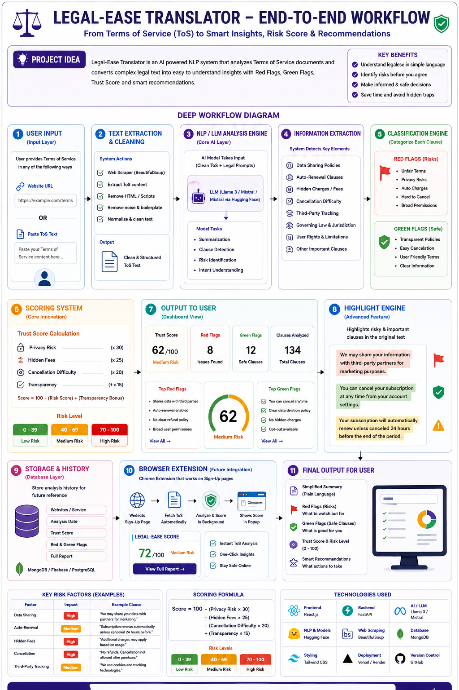
Proposed System
Project Idea Presentation

Slide 10
Software Tools / Technologies to be Used
Category | Technology
Frontend | React.js,HTML5,CSS3,Tailwind CSS
Backend | Python , FastAPI, Uvicorn
AI/NLP | Hugging Face , spaCy,NLTK,Llama3
ML | PyTorch,Scikit-learn
Database | MongoDB , Firebase
Document Processing | PyMuPDF, python-docx, BeautifulSoup
Browser Extension | Chrome Extension API
Version Control | Git, GitHub
Project Idea Presentation

Slide 11
Relevant SDG’s
SDG 9: Industry, Innovation and Infrastructure This project promotes innovation by leveraging Artificial Intelligence (AI) and Natural Language Processing (NLP) to automate legal and employment document analysis. It strengthens digital infrastructure by providing an intelligent platform that enhances document transparency, accessibility, and decision-making.
SDG 16: Peace, Justice and Strong Institution The system supports access to justice by simplifying complex legal language, improving transparency in contracts, and helping users identify unfair or risky clauses before accepting legal or employment agreements. This empowers individuals to make informed and legally aware decisions.
SDG 8: Decent Work and Economic Growth By analysing employment contracts and identifying unfair terms, hidden obligations, and employee rights, the system promotes fair employment practices, protects workers, and contributes to decent work opportunities.
Project Idea Presentation

Slide 12
References
Automated Vulnerability Detection in Source Code Using Deep Representation Learning, arXiv:2602.23121, Feb 2026.
LLM Agentic Workflow for Automated Vulnerability Detection and Remediation, IEEE Access, Jan 2025.
Enhancing Graph-Based Vulnerability Detection through Standardized Pipelines, IEEE Xplore, Dec 2024.
A Survey on Large Language Models in Software Security, MDPI, April 2026.
Vibe Coding Security: Risks and Best Practices, Hostinger/SimonRoses, April 2026.

Slide 13

Thank you
Project Idea Presentation

