Slide 1
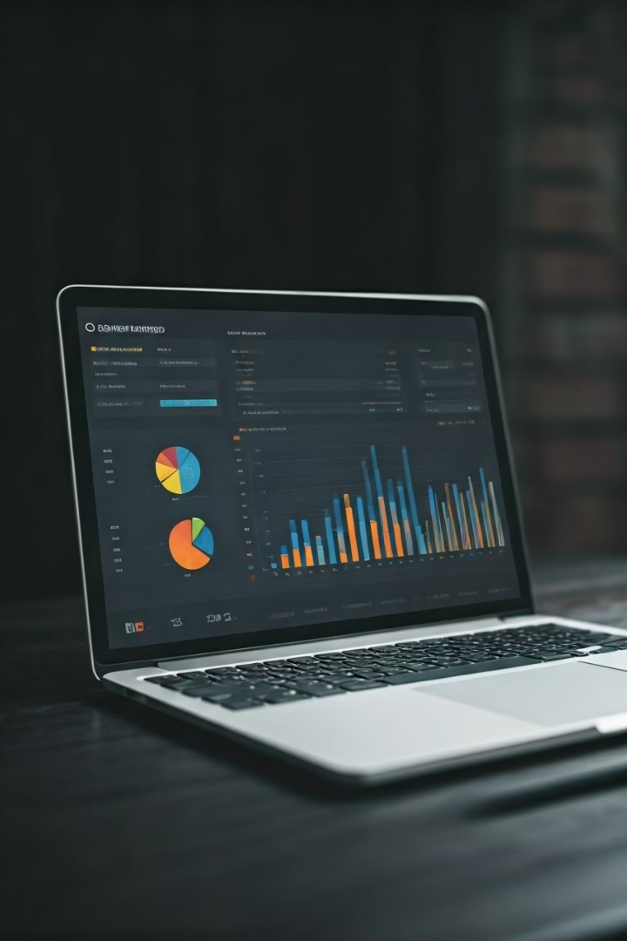

Campaign Performance Analysis
This analysis evaluates the effectiveness of marketing campaigns across different traffic sources, mediums, and creatives by calculating key performance metrics. We'll examine click-through performance, conversion efficiency, and revenue contribution to identify top-performing channels and opportunities for optimization.
Our analysis covers campaign dimensions, performance KPIs, top campaigns, channel efficiency, creative performance, keyword attribution, and temporal trends to provide a comprehensive view of marketing effectiveness.
by Payal Nagaonkar

Slide 2
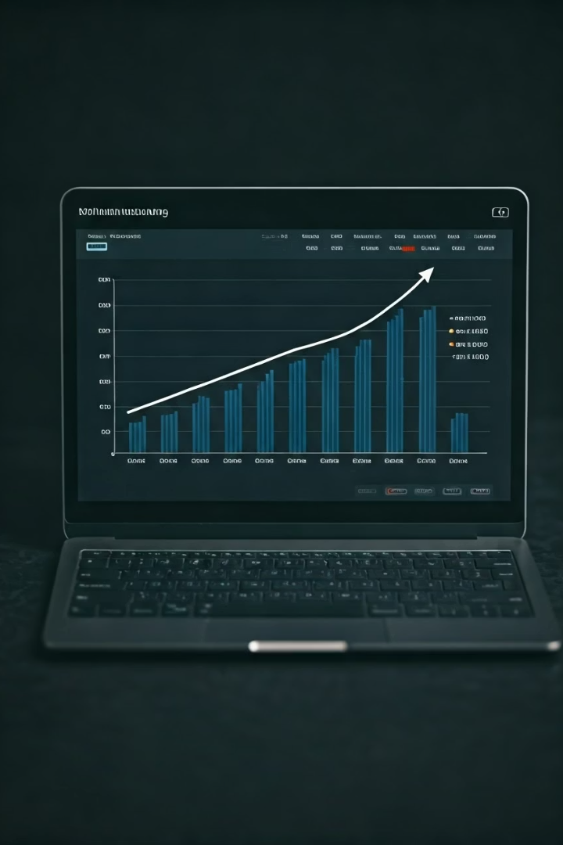




Key Performance Metrics
Traffic Volume
Clicks measure the total traffic volume driven by each campaign, providing insight into reach and engagement.
Goal Completions
Conversions indicate successful goal completions such as sales or signups, showing campaign effectiveness.
Monetary Impact
Revenue measures the direct financial impact of each campaign, helping assess ROI.
Efficiency Metrics
Conversion Rate (CVR), Revenue per Click (RPC), and Revenue per Conversion help evaluate campaign efficiency and profitability.

Slide 3
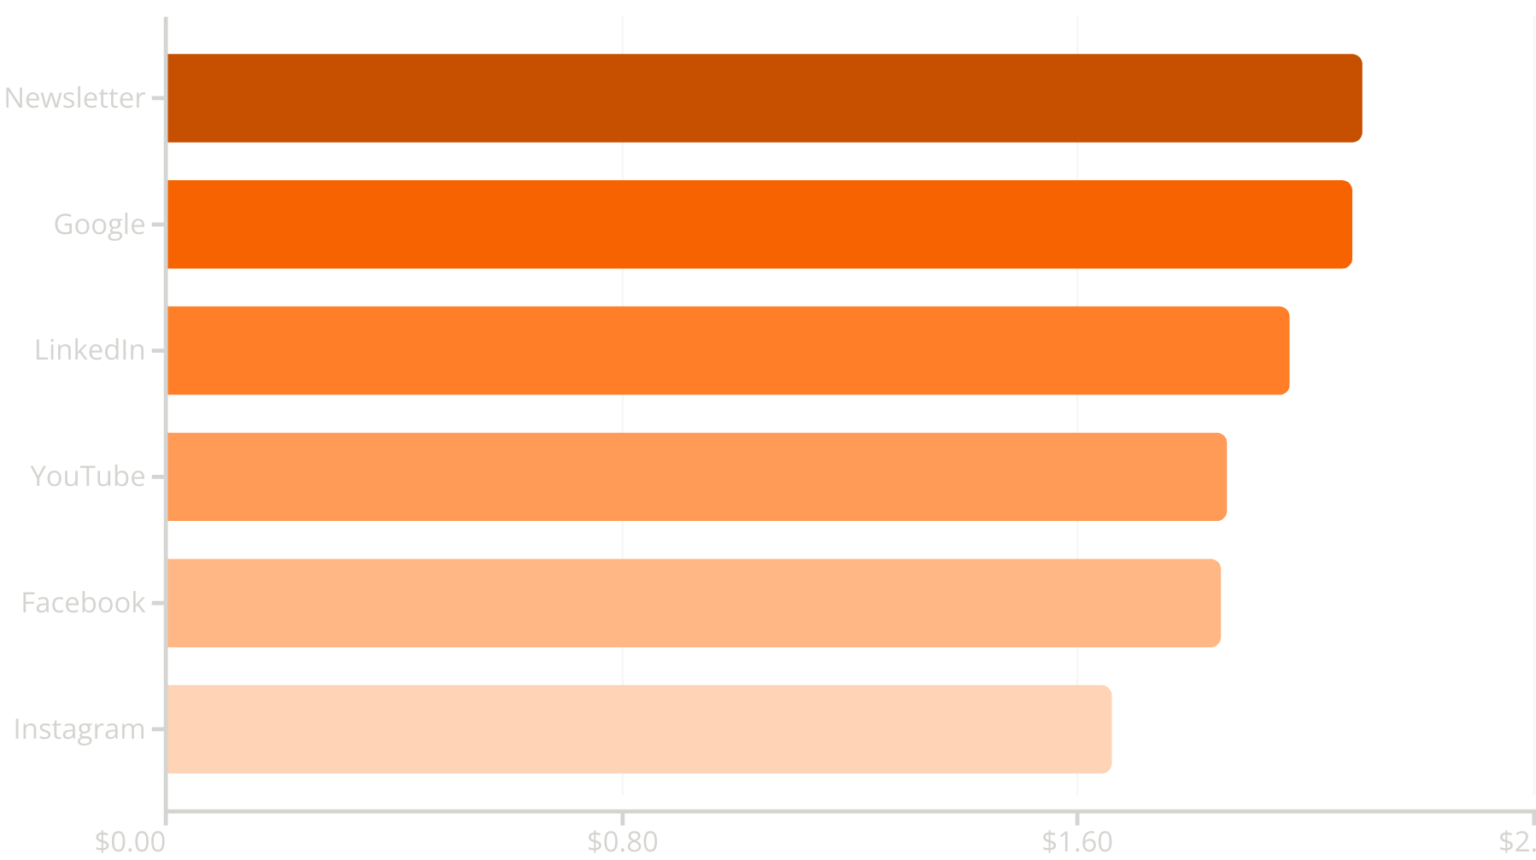
Top Performing Channels
The newsletter campaign generated the highest revenue per click ($2.10) and conversion rate (10.55%), indicating both high engagement and efficient conversion. Google delivered strong performance with $2.08 RPC and 10.20% CVR, making it a consistent high performer in both reach and monetization.
Instagram underperformed with lower RPC ($1.66) and CVR (9.46%), suggesting potential issues with creative targeting or intent alignment. This analysis indicates we should double down on newsletter campaigns and maintain investment in Google, while re-evaluating Instagram strategy.

Slide 4

Creative Performance Analysis
10.44%
10.18%
Video Ad CVR
Banner1 CVR
Highest conversion rate among all content types
Second highest performing creative format
9.56%
Carousel/Text CVR
Lower performing creative formats
Video ads delivered the highest conversion rate (10.44%) among all content types, slightly outperforming banner1 (10.18%) and clearly outperforming carousel ads and text links (both at 9.56%). Despite receiving 8,000 fewer clicks than banner1, video ads generated nearly as many conversions, indicating a more persuasive format.
This suggests we should prioritize video ad creatives for upcoming performance campaigns, particularly where cost per conversion is a key metric, while reducing reliance on carousel and text-only formats unless they support engagement at a lower cost.

Slide 5
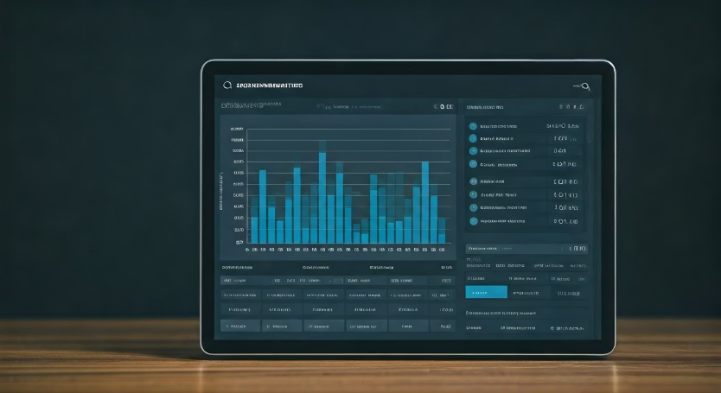
Keyword Performance
Keyword Insights
The keyword "discount" yielded the highest revenue per click ($0.57) among all terms, suggesting that value-oriented messaging drives stronger monetization. While "bags" generated the highest total revenue ($165K), its lower RPC ($0.49) indicates that volume was the key driver rather than conversion quality.
Keywords like "signup" and "shoes" were close in RPC ($0.51) and revenue ($141K-$143K), making them efficient mid-range performers. These could be strong candidates for further scaling with budget optimization.
Discount Keywords
Bags Campaign
Signup & Shoes
Expand and double down on discount-related keyword variants, as they deliver the strongest value per click.
Consider optimizing bags campaigns to improve efficiency by narrowing audiences or improving landing page alignment.
Continue investing in these terms and A/B test variations in ad copy or CTA to lift RPC further.

Slide 6








Quarterly Performance Trends
Q2 (Apr-Jun)
Q3 (Jul-Sep)
Highest conversion rate at 10.38%, despite second-lowest click volume
Steady performance with 9.74% CVR, led in volume with highest clicks and conversions
Q1 (Jan-Mar)
Q4 (Oct-Dec)
Delivered steady performance with 9.74% CVR
Surprisingly had lowest CVR (9.64%), despite expectations for holiday peak
Q2 showed the highest conversion rate, outperforming all other quarters despite having the second-lowest click volume. This suggests high-quality targeting or compelling mid-year campaigns. Q1 and Q3 delivered steady performance with similar CVRs, but Q3 led in volume.
Surprisingly, Q4, typically expected to peak due to Black Friday or holiday promotions, had the lowest CVR, indicating a potential disconnect between increased marketing pressure and user conversion behavior.

Slide 7



Source-Medium Performance
Google/CPC
Top performer with consistent high RPC across quarters ($3.14, $2.40, $2.63)
LinkedIn/Referral
Strong B2B channel with high value ($2.95, $2.51, $2.43)
Newsletter/CPC
Notable Q2 spike ($2.37, $2.97, $1.60)
Google/CPC emerged as the most reliable and profitable source-medium combination, delivering consistently high RPCs across Q1 to Q3. LinkedIn/Referral also performed well, suggesting strength in high-intent or B2B traffic.
Conversely, Facebook/Social and Instagram/CPC showed lower RPCs and signs of fatigue or saturation, particularly in Q3, warranting creative or audience adjustments. The Newsletter/CPC combination showed a significant spike in Q2 that warrants further investigation to identify replicable tactics.

Slide 8




Recommendations & Next Steps
Scale Google/CPC
Increase investment in Google/CPC campaigns which demonstrated best overall revenue performance with sustained ROI across all quarters.
Refresh Social Media Creatives
Update Facebook/Instagram creative assets to address Q3 decline that suggests user fatigue or poor conversion targeting.
Analyze Newsletter Q2 Strategy
Investigate the sudden RPC spike in Newsletter/CPC during Q2 to identify replicable high-impact tactics.
A/B Test LinkedIn Expansion
Develop tests for LinkedIn/Social and LinkedIn/Referral channels which show promise with steady efficiency.
These recommendations are based on comprehensive analysis of campaign performance data across multiple dimensions. By focusing on high-performing channels while optimizing underperforming ones, we can improve overall marketing efficiency and ROI.

