Slide 1
Analytics Engineer – Technical Assessment
Use Case : You are working for an online retail company that sells products on Amazon. Our
marketeers will have many questions about the performance of our sales on Amazon to
better understand the customer and take the appropriate actions. To better facilitate our
marketeers, you are asked to build a simple data warehouse using Kimball dimensional
modeling that will make it easy for marketeers to perform analysis on.

Slide 2
About the Use case
The use case is about data warehouse using the Kimball dimensional modeling technique for an online retail company selling products on Amazon.
Kimball dimensional modeling technique is a model, where the data warehouse is designed using star schema.
Few insights that are addressed are :
Which product styles and categories are the most popular in the city of Mumbai?
What are the sales trends across different seasons?

Slide 3
Approach followed-
Exploration of raw data :
Started by analyzing the provided raw data in Amazon Sale Report.csv.
Inspected the structure, identifying key columns for sales, products, customers, and dates.
Noted data issues like missing values and inconsistent formats.
Data cleaning.
Handling missing values.
Remove trailing commas: sed 's/,\+$//' /home/guptpay/Downloads/data.csv > /home/guptpay/Downloads/data_cleaned.csv

Slide 4
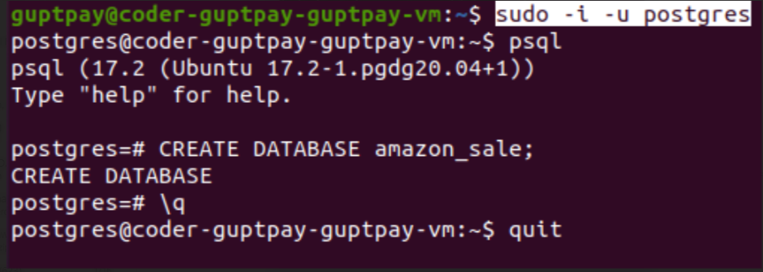
Setting up postgres and creating database and stage table

Slide 5
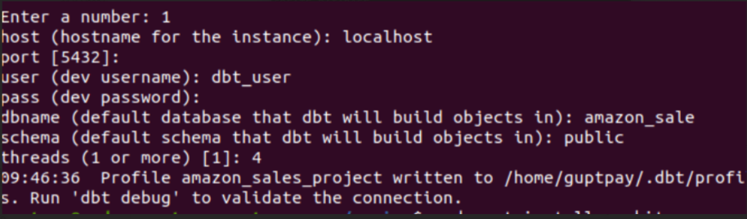
Setting Up DBT

Slide 6
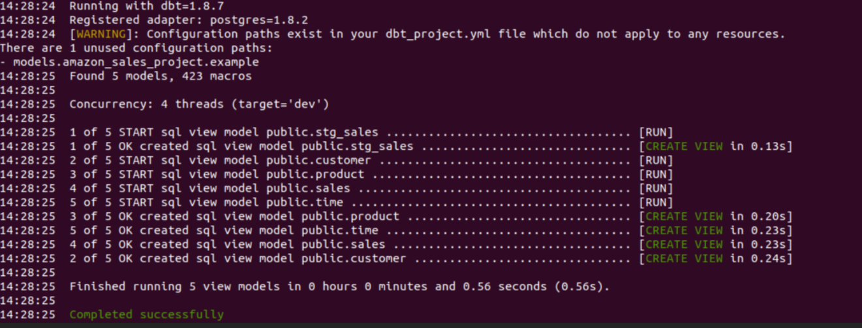
Kimball Dimension model
Kimball dimension model :
sales is fact table to store sales metrics (e.g., quantity, sales amount).
Dimension tables – product, customer , time

Slide 7
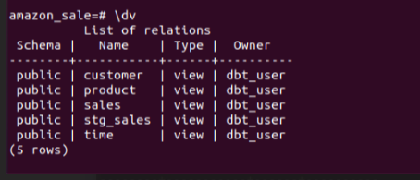
Once the models are executed using dbt run , views are created using dbt run.

Slide 8
DBT Implementation
Created a DBT project to automate and organize the transformation workflow.
Built staging models for raw data ingestion.
Developed dimension models to extract descriptive attributes.
Created the fact model to consolidate metrics and link dimensions.

Slide 9
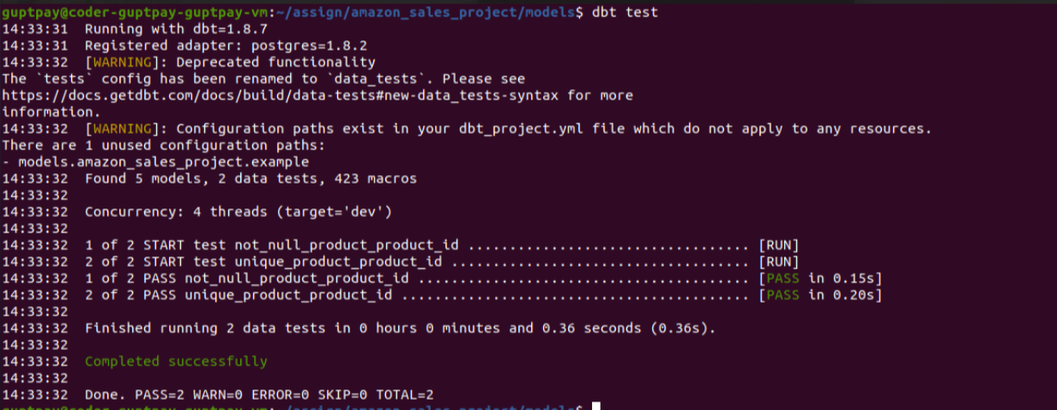
Data Quality Assurance:
Used DBT tests (schema.yml) to validate:
No null values in key fields like product_id, customer_id, and date_id.
Unique and consistent primary keys for dimensions.

Slide 10
BI Preparations
Visualizing insights such as :
Popular product styles and categories in Mumbai.
Sales trends across different seasons.

