Slide 1
IBM University Engagement Project Submission
“Exploring the Power of Agentic AI with IBM Cloud and Orchestrate”

Slide 2

Project Tile – Smart Study Generator Agent
Domain of Project – [Education]
Student Name | Recent Passport Photo | Email ID | Mobile number [WhatsApp]
Payal Kadam |  | payalpiukadam23@gmail.com | 8485851634
Recommended font style and size:
Font Style: Arial
Font Size (Heading): 28
Font Size (Content): 20

Slide 3
Problem Statement -
Problem Statement :
The Challenge
Students today have access to a vast amount of learning resources, including lecture notes, textbooks, research papers, YouTube tutorials, and online courses. However, this information is scattered across multiple platforms, making it difficult to organize, understand, and study effectively. Traditional learning tools provide static notes and lack personalized guidance, making exam preparation time-consuming and less efficient.
The Objective
Build an AI-powered Smart Study Generator Agent that personalizes and simplifies learning for students. The solution should:
Aggregate content from lecture notes, textbooks, research papers, and online resources into structured study material.
Allow students to upload PDFs, notes, images, or voice queries and generate summaries, flashcards, quizzes, and concept maps.
Create personalized study plans based on syllabus, learning progress, and exam schedules.
Recommend important topics by analyzing previous question papers and study patterns.
Provide a real-time dashboard to track study progress, identify weak areas, and forecast exam readiness.
Use IBM watsonx.ai, IBM Granite Models, IBM LangFlow/Orchestrate, and RAG to deliver accurate and intelligent learning assistance.

Slide 4
Proposed Solution -
Proposed Solution:
The proposed solution is an AI-powered Smart Study Generator Agent built using IBM watsonx.ai, IBM Granite Models, IBM LangFlow, IBM Cloud, and Retrieval-Augmented Generation (RAG). The system acts as an intelligent study assistant that helps students learn efficiently by organizing learning resources and providing personalized study guidance.
The solution combines class notes, textbooks, PDFs, research papers, and online learning materials into one platform. Using RAG, it retrieves relevant educational content and generates concise summaries, flashcards, concept explanations, and quizzes.
The system consists of four intelligent agents:
Knowledge Retrieval Agent – Retrieves information from notes, books, and uploaded documents using RAG.
Study Planner Agent – Creates personalized study schedules based on syllabus, exam dates, and learning progress.
Content Generator Agent – Generates summaries, flashcards, quizzes, and concept maps.
Performance Analysis Agent – Tracks learning progress, identifies weak topics, and recommends improvement strategies.
An interactive dashboard allows students to upload notes, ask questions, and monitor study progress in real time.

Slide 5
Technology Used
Langflow platform -For designing and orchestrating multi-agent workflows visually
IBM Granite model - for eg – ibm-granite-3-2-8b – For natural language understanding, reasoning, and personalization
IBM Cloud – It provides the infrastructure to build, deploy, and scale the Nutrition Agent efficiently. IBM Cloud enables a reliable, secure, and scalable environment for deploying the Nutrition Agent.
RAG– RAG to fetch real data first, then generate intelligent answers, making the Nutrition Agent more trustworthy and effective.
IBM Watsonx.ai - For model deployment, embeddings, and AI governance
Vector Database (FAISS/Chroma) – For RAG-based nutritional data retrieval

Slide 6
Orchestrate component Used -
1) Chat Input – Interface where users enter their queries, preferences, or meal details (text/voice/image).
2) IBM watsonx AI Agent - Processes user input using Granite models to generate personalized nutrition insights and recommendations.
3) Name of IBM Granite model - Granite-4.0-8B-Instruct → Fast, efficient for real-time diet recommendations
4) Chat output - Displays AI-generated study summaries, personalized learning recommendations, quizzes, flashcards, and answers to student queries.
5) File component - Stores and retrieves student notes, PDFs, textbooks, and study materials for RAG-based learning, summarization, and personalized study assistance.

Slide 7
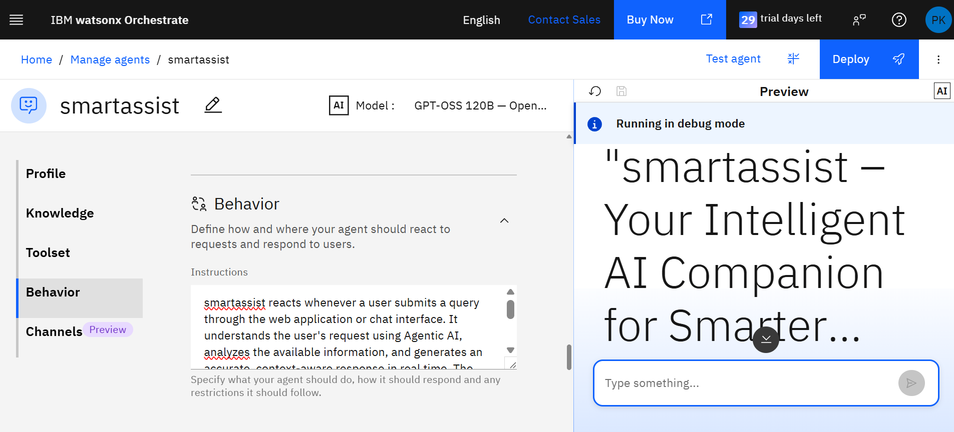
Agent Instructions Screenshot-

Slide 8
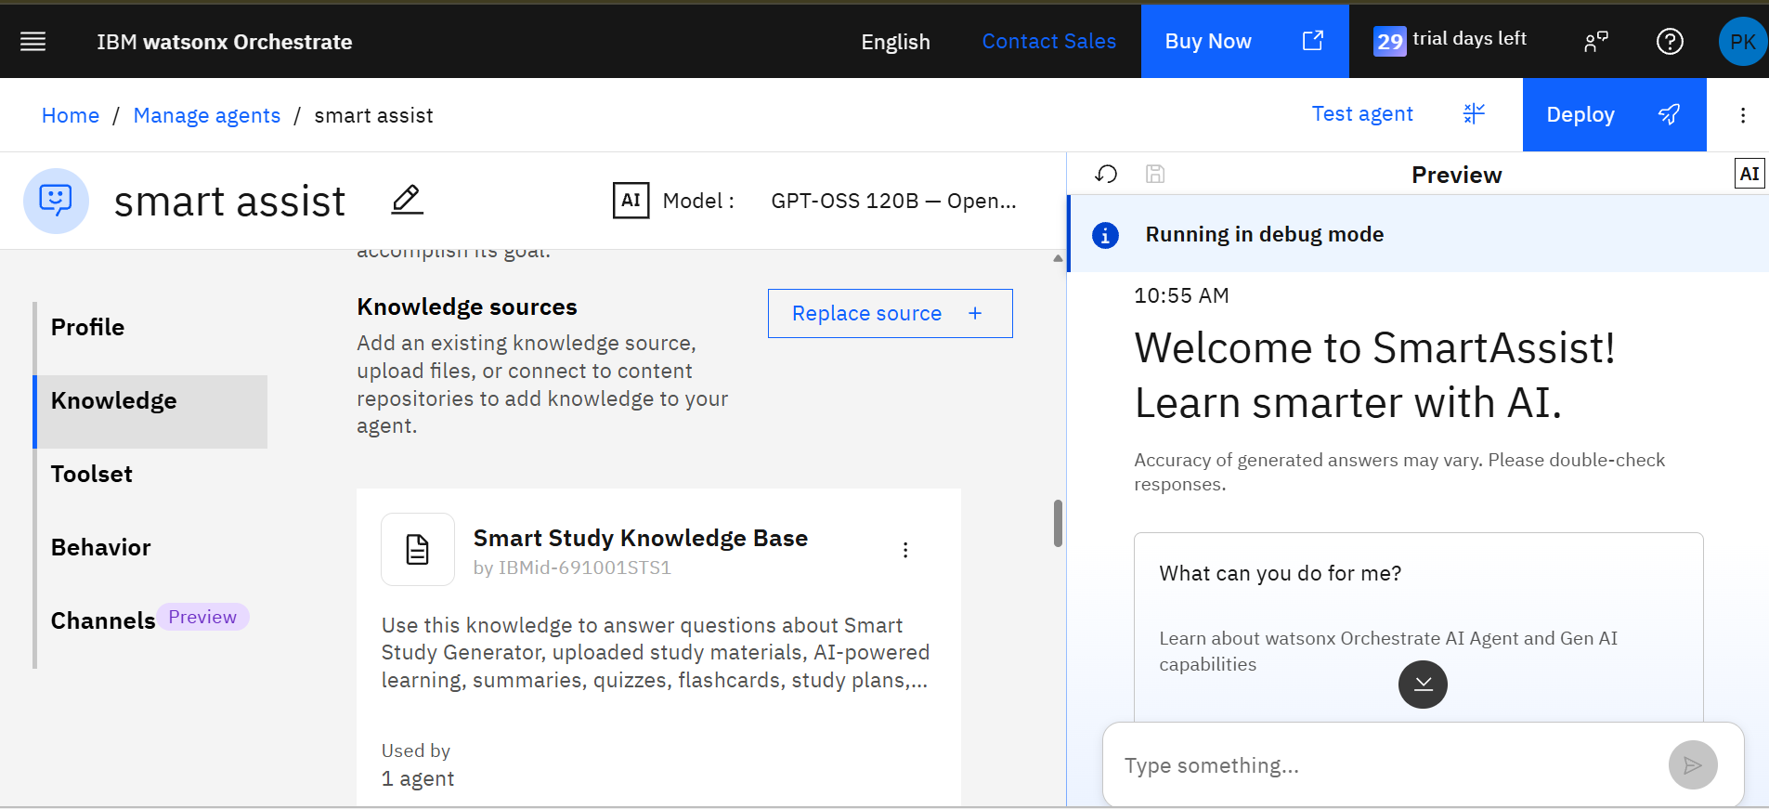
Document Uploaded Screenshot (If applicable)-

Slide 9
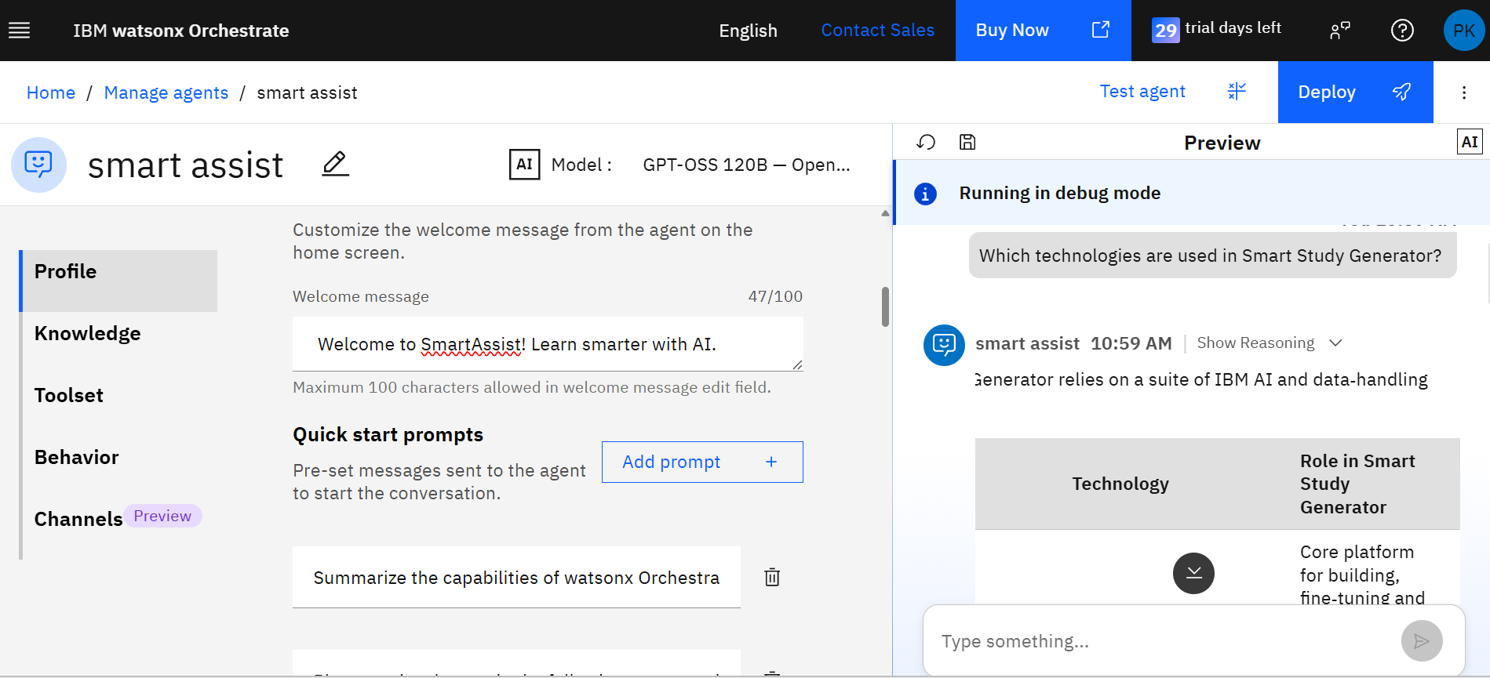
Prompt with output Screenshot:
-Use different slides for multiple screenshots

Slide 10
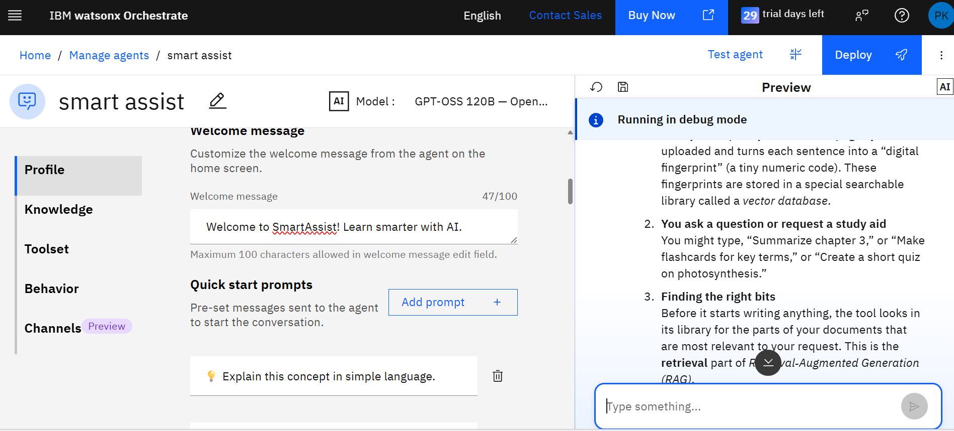
Other Applicable Screenshots:
- Put multiple screenshots for multiple prompts and outputs
All the content screenshots should be clearly visible

Slide 11
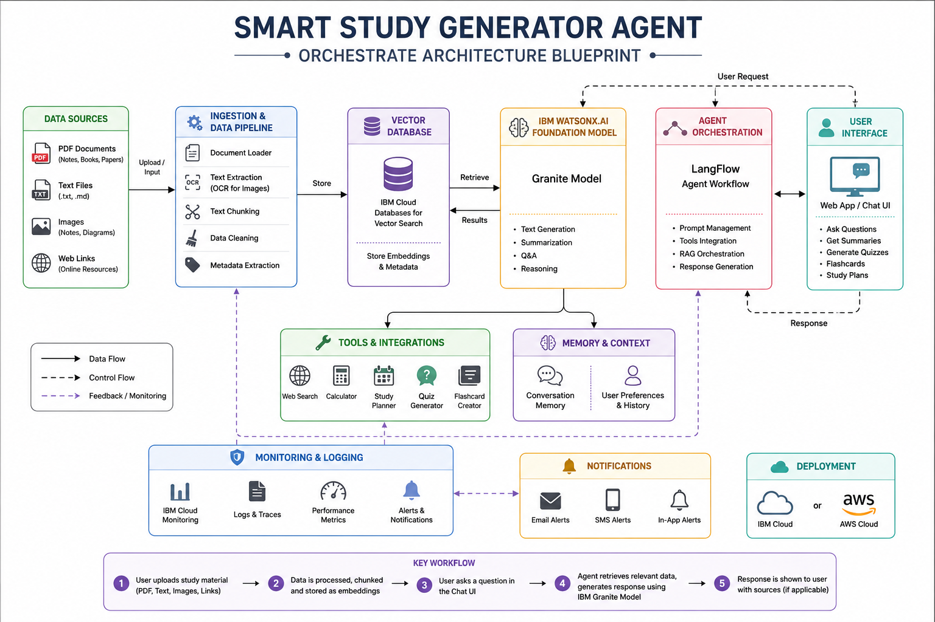
Orchestrate architecture blueprint

Slide 12

Role of Agentic AI in the solution
Role of Agentic AI
Agentic AI enables the Smart Study Generator to act as an intelligent and autonomous learning assistant. Instead of only answering questions, it understands the student's learning goals, retrieves relevant study materials, generates personalized summaries, quizzes, flashcards, and study plans, and continuously adapts its responses based on the user's needs.
By integrating IBM watsonx.ai, Granite Models, LangFlow, and RAG, multiple AI agents collaborate to retrieve knowledge, reason over educational content, and provide accurate, context-aware learning support. This makes studying more personalized, interactive, and efficient.
Retrieves relevant study material using RAG
. 🧠 Generates summaries, quizzes, and flashcards.
📅 Creates personalized study plans
. 🎯 Identifies important exam topics and weak areas.
💬 Provides intelligent, context-aware responses through natural language

Slide 13
Novelty and Uniqueness
The Smart Study Generator Agent goes beyond traditional study apps by using Agentic AI to provide intelligent, personalized, and adaptive learning support.
🤖 Agentic AI-Powered Learning – Multiple AI agents collaborate to generate study plans, summaries, quizzes, and flashcards.
📚 RAG-Based Knowledge Retrieval – Retrieves accurate information from uploaded notes, PDFs, textbooks, and research papers before generating responses.
🎯 Personalized Study Experience – Adapts recommendations based on the student's learning goals, syllabus, and progress.
📊 Smart Progress Tracking – Identifies weak areas and recommends topics for focused revision.
☁️ Built on IBM Technologies – Powered by IBM watsonx.ai, Granite Models, LangFlow, and IBM Cloud for secure and scalable AI assistance.
Unique Value:
Unlike traditional study tools, Smart Study Generator provides an AI-driven, personalized learning experience by combining intelligent agents with Retrieval-Augmented Generation (RAG) to help students learn more effectively.

Slide 14
Git Hub Link
Please create public github repository (Enable Add README button while creating repository) with format –
Please test and Paste the working Github URL –
Make sure you have Uploaded following three files into your github repository
1) app.json file , 2) yourproblemstatement.pdf file 3) your projectpresntation.pptx file 4)any other files
·
·
·

Slide 15
Future Scope
AI-Powered Adaptive Learning
The system will analyze each student's learning progress and automatically generate personalized study plans, adaptive quizzes, and targeted recommendations to improve academic performance.
LMS & Multi-Platform Integration The Smart Study Generator can be integrated with Google Classroom, Moodle, Microsoft Teams, and Canvas to provide seamless access to study materials, assignments, and progress tracking from a single platform.
·
·
·

Slide 16
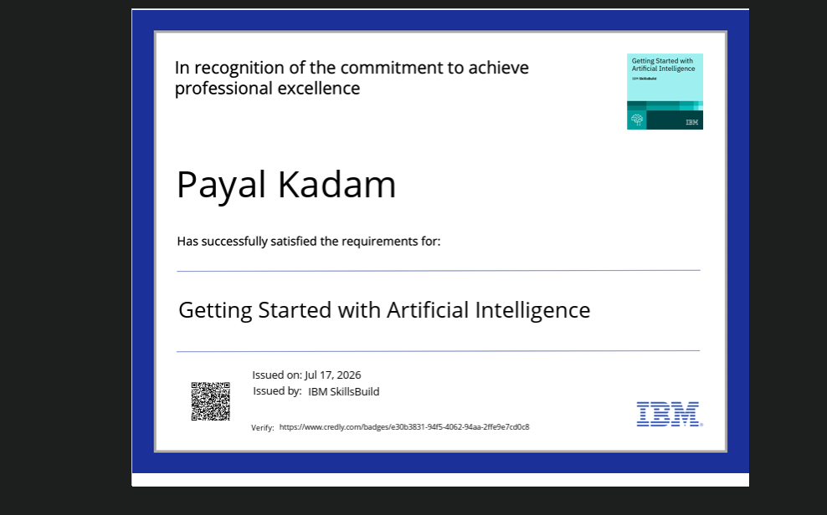
Certificates Earned:
Please add your credly certificate

Slide 17
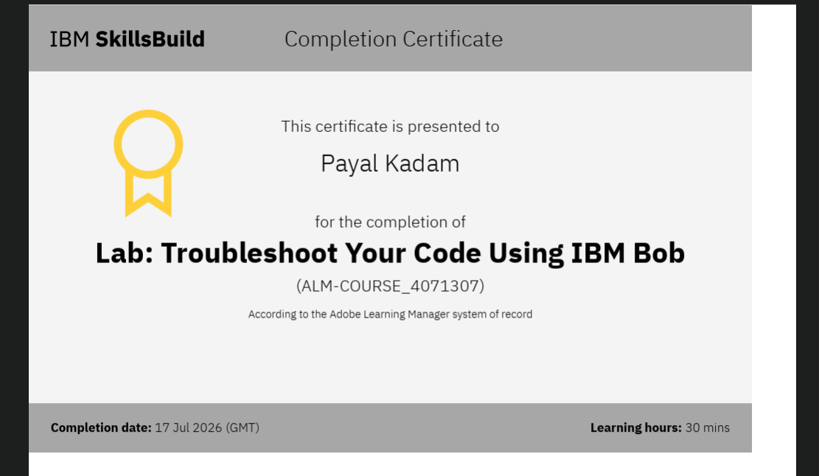
Certificates Earned:​
Add your IBM BOB Certificate

Slide 18


