Slide 1
Oasis Infobyte Internship Web Development and Designing Completed By- Payal Kadadhekar

Slide 2
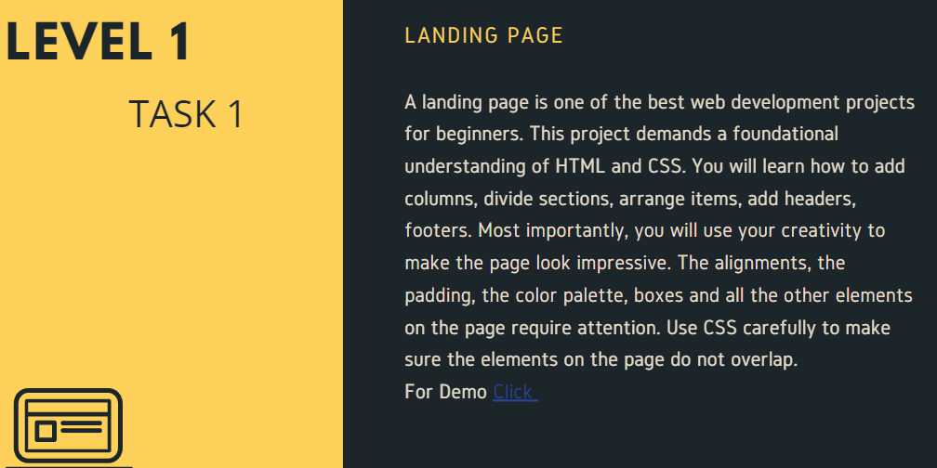

Slide 3
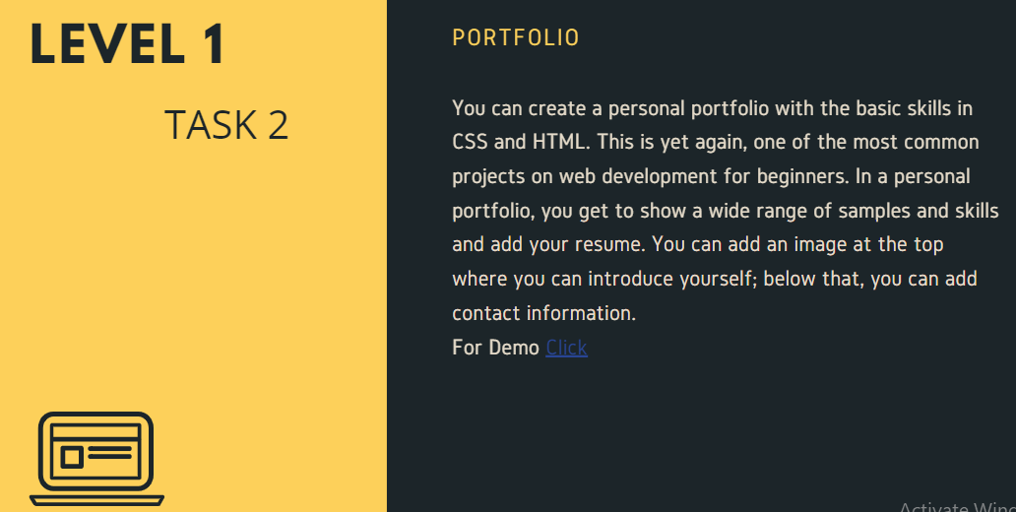

Slide 4
