Slide 1
Cloud Computing Data Processing IR&D
^{Oscar E. Ganteaume}
^{May 2018}

Slide 2
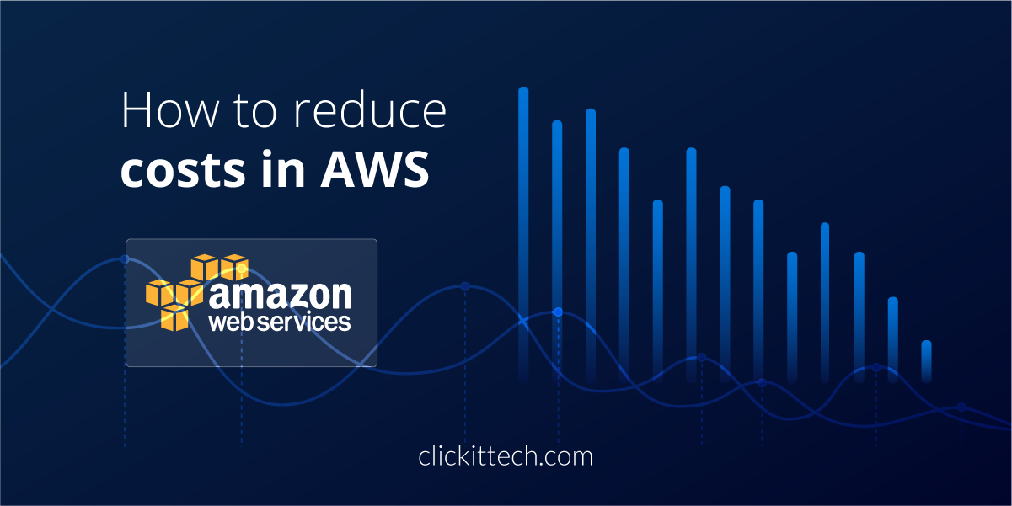
Bottom Line Up Front
LGS Innovation has developed, and has a patent pending on technology that will save up to 60% of the AWS compute costs within C2S, DI2E, and GovCloud.

Slide 3
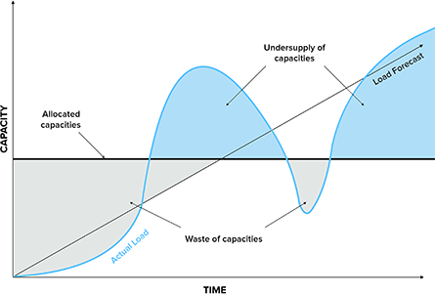
The Problem with AWS Costs
Amazon Web Services (AWS’ C2S) provides an excellent cloud infrastructure solution for government enterprises.
  The good news is that AWS is a pay-per-use service, provides universal access to state-of-the-art computing resources, and scales with the growing needs.
  The bad news – AWS mission costs have shown that they far exceed the costs of dedicated stovepipe system costs
    Routine Provisioning of instances for a worst case scenario
    The Elastic Compute cloud (EC2) is charged per usage time even if the EC2 instance is using less than destined capacity or sitting idle.
    Limited Mission Resource Visibility

Slide 4
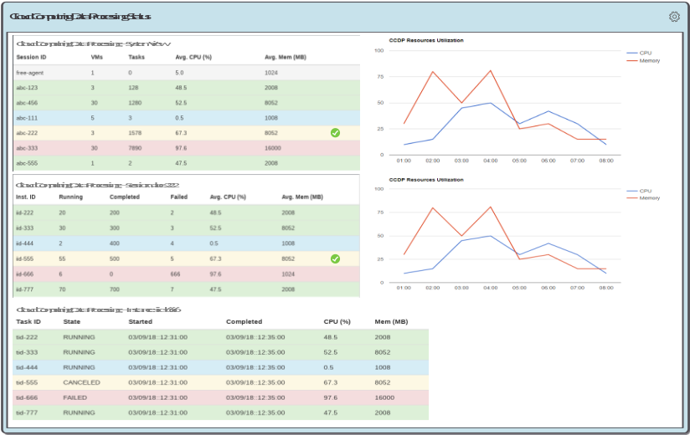
The LGS Solution
    Dynamically “Right-Sizing” resources & providing visibility in a Cloud agnostic environment
The CCDP Engine is responsible for orchestrating tasks as well as virtual machines.
The Auto Scaling engine analyzes performance metrics and determines when to start or stop virtual machines.
It uses its own algorithms and allows developers to create their own as well, to decide how the tasks need to be allocated (load balanced).
It also monitors the resources utilization such as memory, CPU, disk space, number of tasks running, (Visibility).

Slide 5
Cloud Computing Data Processing
Main Objectives
Provide a service to dynamically allocate Virtual Machines (VM) to a cluster based on resources utilization
Allows customer to add their own allocation algorithm through an application programming interface
Service is cloud provider agnostic and compatible with major cloud providers
Capable of running on two different modes:
  Conventional mode
  Serveless mode
Allows users to configure the system through a web-based Graphical User Interface (GUI)
Allows users to add, modify, remove custom tasks to generate processing threads through a web-based GUI
Allows user to start, stop, pause processing threads through a web-based GUI
Provides cluster status through a web-based dashboard monitoring application
Allows incorporation of external frameworks such as NiFi to interact with framework
Facilitates Big Data Processing by incorporating frameworks such as Hadoop and Spark

Slide 6
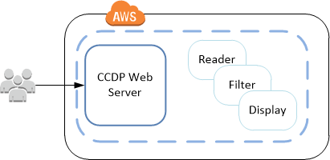
Cloud Computing Data Processing
Processing Modes: Conventional
  Users login into our Web Server running the framework
  Based on the tasks, the framework deploys EC2 Virtual Machines
  Once all the tasks have been initialized, the thread starts executing
  More EC2 instances are launched as needed
  Once a task finishes processing it notifies the chain of tasks ahead of it
  As the states of the tasks are changing the GUI provides feedback to the user
  All instances except the web server are terminated if they remain idle
  Using this approach we are responsible for making sure resources are available at all time

Slide 7
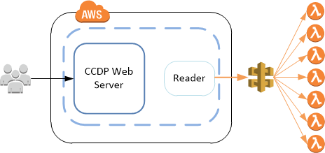
Cloud Computing Data Processing
Processing Modes: Serveless Computing
  Approach used for short lived tasks
  Users login into our Web Server running the framework
  Once all the tasks have been initialized, the thread starts executing
  Short lived tasks can be executed using AWS lambda functions
  Framework provides API to simplify lambda execution
  AWS is responsible to ensuring there are enough resources to honor all the lambda requests
  Tasks can be executed in parallel
  Cost analysis should be done to choose appropriate processing mode

Slide 8
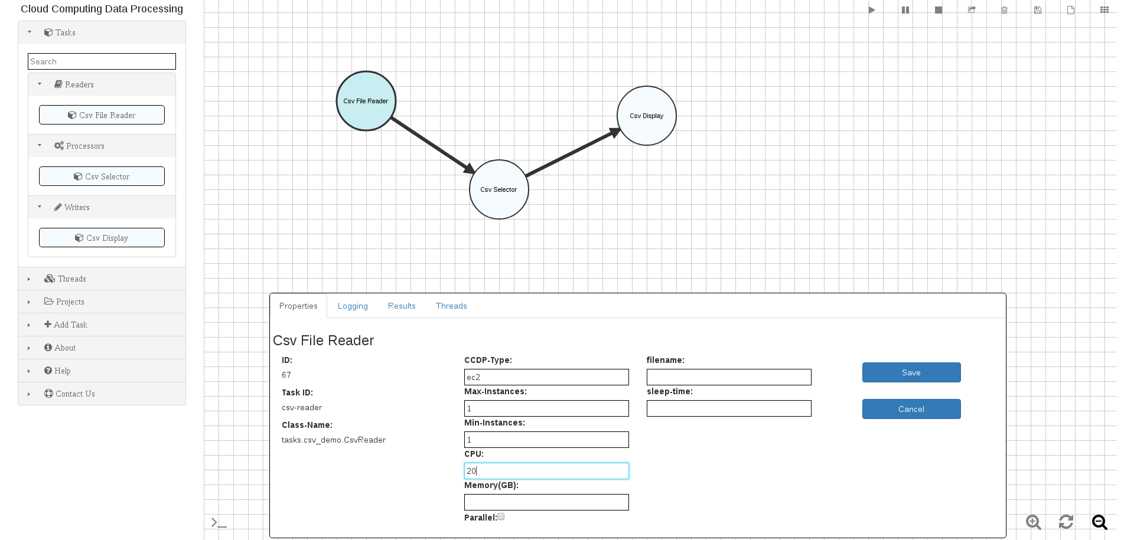
Cloud Computing Data Processing
Graphical User Interface

Slide 9
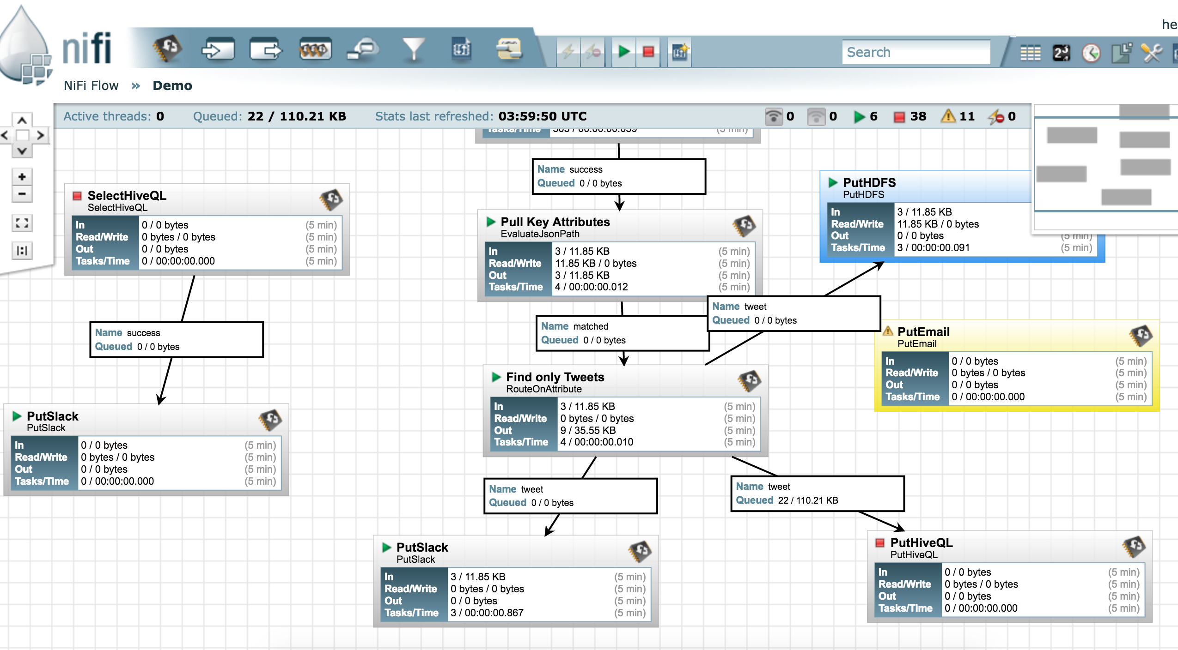
Cloud Computing Data Processing
NiFi Graphical User Interface

Slide 10
Cloud Computing Data Processing
Benefits
Could reduce operation costs significantly based on the actual processing resources needs by:
  Stopping resources that are not being used
  Provides running mode options allowing customers to choose best running mode
Simplifies the configuration and management of a cluster
  Removes the need to know how to use cloud provider’s resource management which could be very difficult and convoluted
Provides a more flexible resource allocation schemes through API
Simplifies integration with widely used processing frameworks
Simplifies custom processing needs through the framework’s API

Slide 11
Cloud Computing Data Processing
Actual Cost Comparison
Chauee Typical Usage Scenario
Service | Legacy Cost | 7H Cost
EC2 | $9,876.84 | $3,567.25
RDS | $0.00 | $556.32
Total Equiv. Monthly | $9,876.84 | $4,123.57
Sixty Users Eight Hours Shift Monthly Cost
Service | Legacy Cost | 7H Typical Cost | 7H Max Cost (*)
EC2 | $6,449.74 | $3,035.56 | $4,659.24
EBS | $515.29 | $403.37 | $403.37
RDS | $0.00 | $365.38 | $365.38
Total Monthly | $6,965.03 | $3,804.31 | $5,427.99
(*) Running all necessary instances 100% of the time due to support requirements

Slide 12

Cloud Computing Data Processing
Questions?
Oscar E. Ganteaume
Office: 703.665.7259
Cell: 703.655.3479
Oganteaume@LGSInnovations.com

