Slide 1

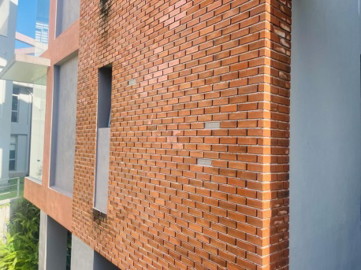
Occupational Health & Safety |BTC 3321|
(Group Activity 02)
Group No. 03
Selected Location.
Laboratory Complex
Group members
BST/20/110
BST/20/006
BST/20/009
BST/20/050
BST/20/059
BST/20/066
BST/20/089
BST/20/103

Slide 2
Introduction
Laboratory complexes pose various hazards that require careful management to ensure the safety of personnel and the environment. These hazards include chemical exposure, biological risks, physical dangers (such as radiation or electrical hazards), and potential for fires or explosions. Proper training, use of personal protective equipment, and adherence to safety protocols are essential to mitigate these risks effectively. Regular risk assessments and emergency response plans are crucial components of a comprehensive approach to laboratory safety.

Slide 3
Potential Consequences:
1.Accumulation of flowing water in the open drain system below the lab building. So, mosquitoes can breed.
2.Having several slippery floor areas in the lab building.
Ex: On the ground floor, there may be danger of slipping in slippery areas and sloping areas
3.Presence of hazardous chemicals
Ex: food lab, Agriculture lab, IBST lab, Chemistry lab, Latex testing lab, Microbiology lab
4. Presence of snakes and other animals breeding in densely planted bush type plants.
5. Electric wires have been pulled into the labs without following any safety measures.
Ex: 4th floor.

Slide 4
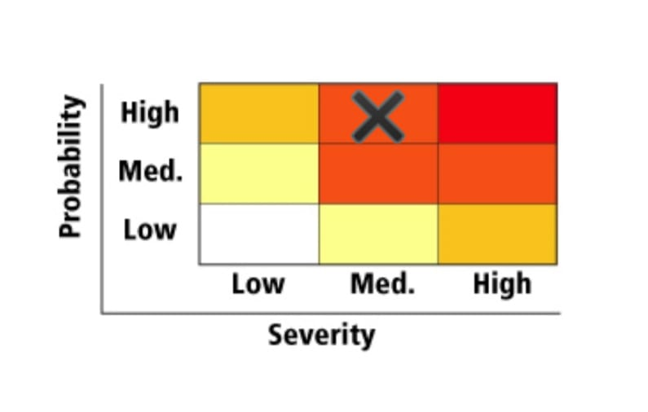
Justification on Probability & Severity
Accumulation of flowing water in the open drain system below the lab building. So, mosquitoes can breed.

Slide 5
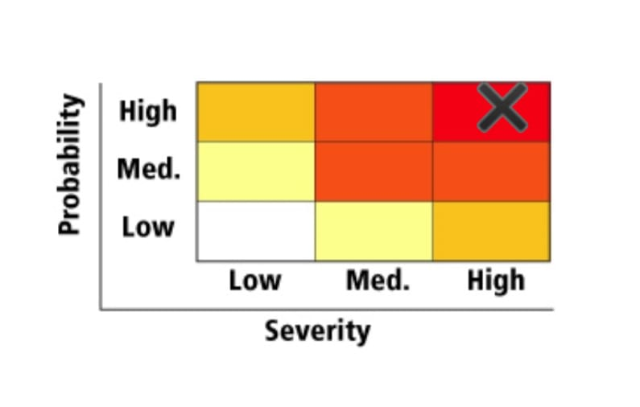
Justification on Probability & Severity
Having several slippery floor areas in the lab building. Ex: On the ground floor, there may be danger of slipping in slippery areas and sloping areas

Slide 6
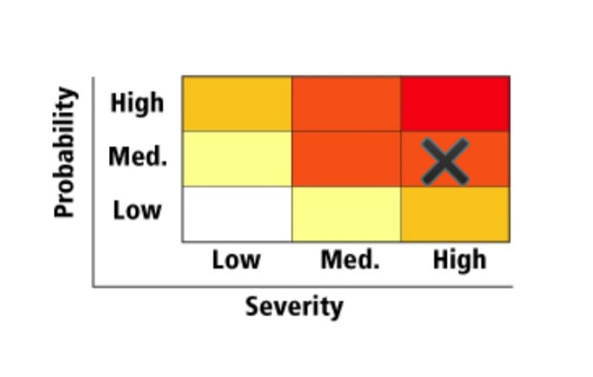
Justification on Probability & Severity
3. Presence of hazardous chemicals
Ex: Food lab, Agriculture lab, IBST lab, Chemistry lab, Latex testing lab, Microbiology lab

Slide 7
Justification on Probability & Severity
4. Presence of snakes and other animals breeding in densely planted bush type plants.

Slide 8

Justification on Probability & Severity
5. Electric wires have been pulled into the labs without following any safety measures.
Ex: 4th floor.

