Slide 1

Hazelcast for caching and distributed task scheduling
Kushtrim Hajrizi

Slide 2
What, Why, How?
What is Hazelcast?
Why would we use it? What other alternatives are there?
How to integrate it with Spring?

Slide 3
What is Hazelcast?
Hazelcast IMDG is an open-source distributed in-memory object store that supports many different data structures.
It is highly scalable and available. (Can scale up to hunderds of members and thousands of clients)
Can be used for caching, clustering, synchronization, processing, pub/sub messaging, as a dynamic configuration store etc…
Implemented in Java, but has clients for C++, .NET, Python, Go and Node.js.
Very easy integration with Hibernate (2nd level cache) and Spring.

Slide 4
What is Hazelcast? (Topologies)
There are 2 topologies in which Hazelcast clusters can be deployed.
Embedded, the data and Hazelcast services are attached with the application code (Preferred for applications that focus on high performance computing or have a very high number of tasks to execute).
Client/Server, the data and Hazelcast services are centralized in one or more server members, and are accessed by applications using a Hazelcast client (More predictable and reliable performance, easier for debugging problems, better scalability).

Slide 5
What is Hazelcast? (Distributed data structures)
Map
Queue
Set
List
Multimap
Topic
and many more

Slide 6
Why Hazelcast?
Queue and distribute tasks
Share information on the fly with different members of the same cluster
Dynamic configuration store
Share data structures
Caching
Session storage
Service discovery and registration
and more

Slide 7
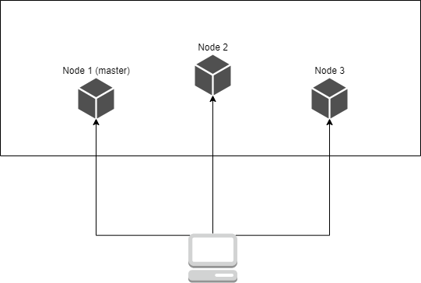
Why Hazelcast? (Scheduling without Hazelcast)

Slide 8
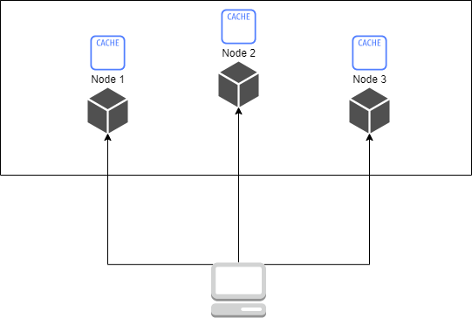
Why Hazelcast? (Caching without Hazelcast)

Slide 9
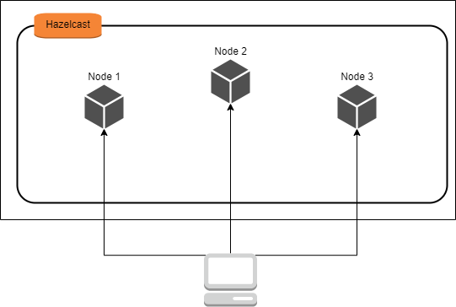
Why Hazelcast? (Caching and scheduling with Hazelcast)

Slide 10
Other alternatives?
Redis
Memcached
Infinispan
EhCache
Apache Ignite
Apache Geode

Slide 11
Hazelcast on MSU.
Used for caching and scheduling on MSU Notification Service.
Caching temporarily split payments notification data, and storing dead notifications for further monitoring and processing.
Scheduling notification retries for failed notifications.
Documentation https://confluence.local.payten.com.tr/pages/viewpage.action?pageId=92342713

Slide 12

How to integrate Hazelcast into Spring?

