Slide 1
N+1 problem in ORM
ORM – Object Relational Mapping
Abstracts repository layer
Maps relational data to objects – hence the name
Hides low level JDBC/SQL details
JPQL/Criteria API instead of SQL
Standardized in Java with JPA

Slide 2
Scenarios N+1
Scenario 1 - @ManyToOne reference (non-lazy)
Scenario 2 - @ManyToOne reference (lazy)
Scenario 3 - @OneToMany collection reference (lazy)

Slide 3
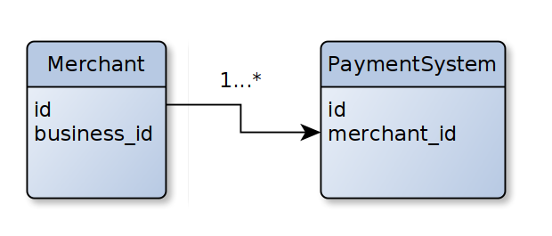
One-To-Many example

