Slide 1
Kushtrim Hajrizi 19/01/2022
SPA Authentication and Authorization Practices

Slide 2
Ways to achieve authentication and authorization in SPA
HTTP Basic Auth
HTTP Basic Auth + Tokens
HTTP Basic Auth + Cookie
OAuth2

Slide 3
HTTP Basic
Username and password, as Base64 encoded
Username and password stored in the front end, so if an attacker gets access to them, they have access to your data

Slide 4
HTTP Basic + Token
Use username and password to receive a token
Token should expire, otherwise if an attacker gets the token, he gets access to your data
If a token expires, we need a solution to get a new token

Slide 5
HTTP Basic + Token
Token can be stored in either on the application code, local storage, or session storage.
Application code: On refresh the session is lost
Session storage: Session storage gets cleared when the page session ends.
Local storage: Data has no expiration, cleared when deleted explicitly.

Slide 6
HTTP Basic + Cookie
Use username and password to login, and the server returns a cookie
Use the cookie to access the API
Same problems apply as in ‘HTTP Basic + Token’
Can use ‘HTTP only’ cookies to increase security

Slide 7
OAuth2 and OpenIDConnect
“OAuth 2.0, which stands for “Open Authorization”, is a standard designed to allow a website or application to access resources hosted by other web apps on behalf of a user.”
“OpenID Connect 1.0 is a simple identity layer on top of the OAuth 2.0 protocol. It allows Clients to verify the identity of the End-User based on the authentication performed by an Authorization Server, as well as to obtain basic profile information about the End-User in an interoperable and REST-like manner.”

Slide 8
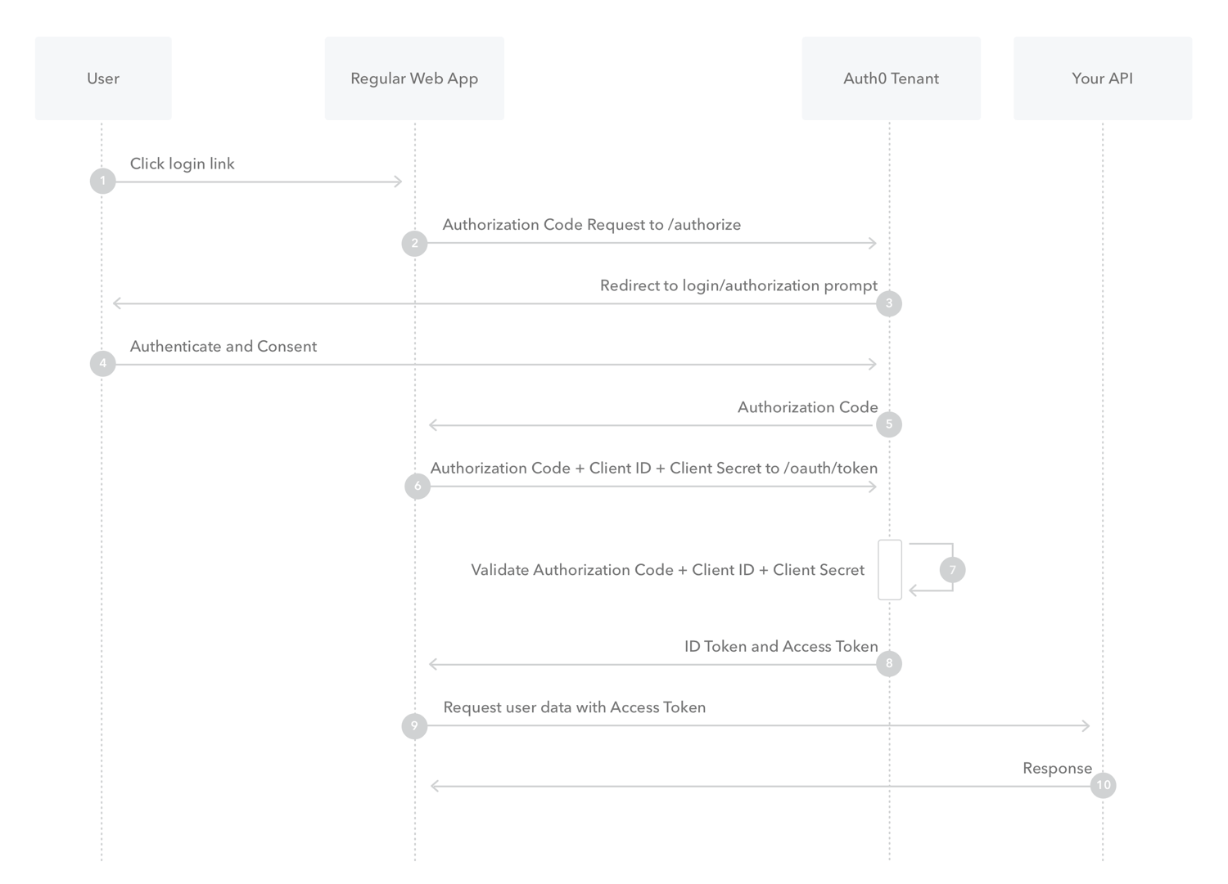

Slide 9
Problems that arise
Using cross site scripting, attackers can get access to the tokens if they’re stored in cookies (non ‘http only’), local storage, and session storage.
If the attacker gets access to the refresh token, the attacker will be able to generate new access tokens all the time

Slide 10
Some solutions
Refresh tokens, should be refreshed themselves. This can be achieved either with refresh tokens that are valid for one-time use, or with a job that refreshes the tokens on time basis.
Web Workers can be used as well, as a more safe place to store the tokens. Making only the access token available to the application.
Careful with usage of ‘eval’ and remote code execution.

Slide 11
Use a BFF (Backend-for-frontend)
Backend-for-frontends serve as a proxy, and also as a manager of the tokens on behalf of the SPA.
Tokens are handled in backend, with much better security properties than a browser.
Between backend and frontend, use cookies to track the state (if its stateless, we put the tokens in an encrypted format in the cookie)
BFF keeps token out of the browser, which significantly increases security. Session riding remains a realistic attack vector.

Slide 12
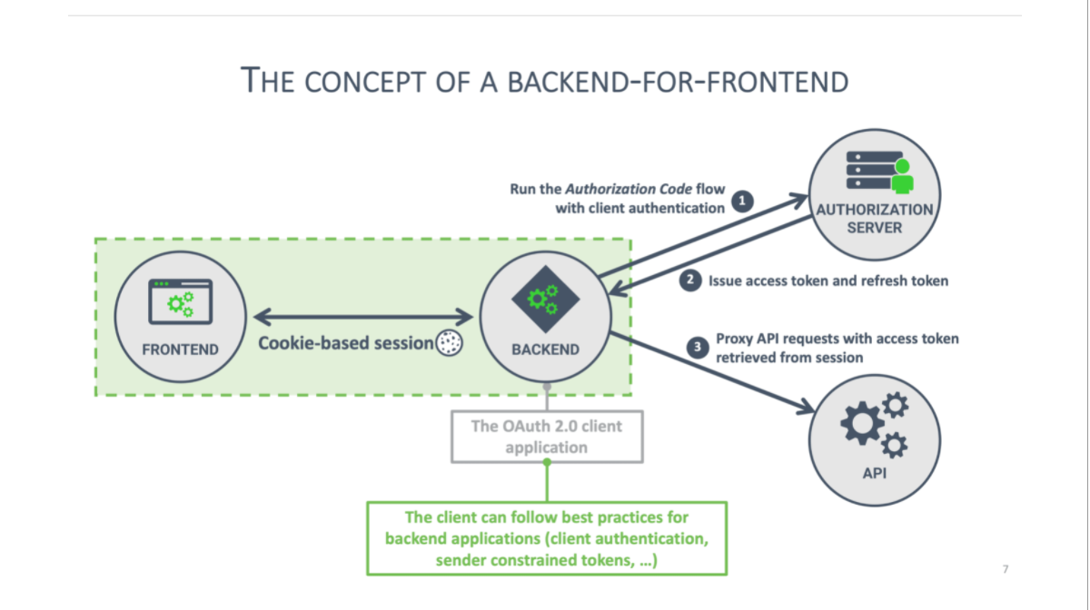
BFF Flow

Slide 13
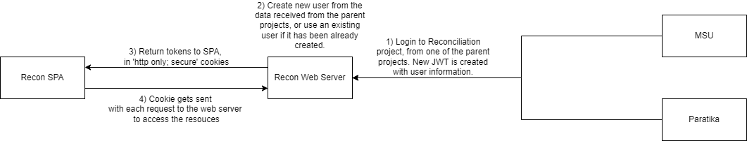
Reconciliation Project Flow

Slide 14
The most important point
Fixing XSS is top priority!

Slide 15
References
https://www.pingidentity.com/en/company/blog/posts/2021/refresh-token-rotation-spa.html
https://auth0.com/docs/get-started/authentication-and-authorization-flow/authorization-code-flow
https://openid.net/connect/
https://developers.google.com/identity/protocols/oauth2
https://developers.google.com/identity/protocols/oauth2/openid-connect

Slide 16
The End
Thank you!

