Slide 1
PROJECT
ATM SIMULATOR SYSTEM

Slide 2
REQUIREMENTS
Providing provision for balance check in account, withdraw money from account, deposit money in account, fast cash, mini statement of account activities, new account sign up, email alerts of account activities, transfer money from one account to another and change password.

Slide 3
DESIGN
In order to implement the features are required, a total of 14 frames are made.
Various buttons, combo boxes, panels, radio buttons etc also designed.
Some of the frames are shown in the next few slides.

Slide 4
SCREENSHOTS

Slide 5
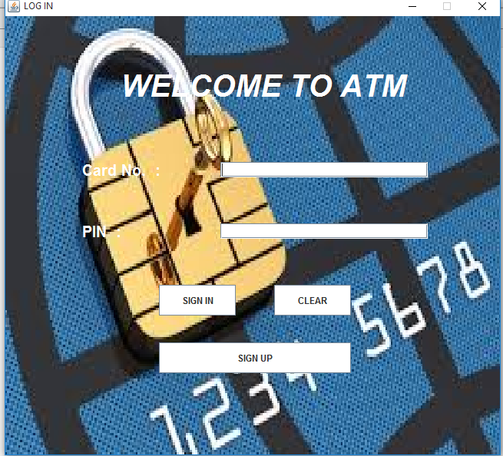
login

Slide 6
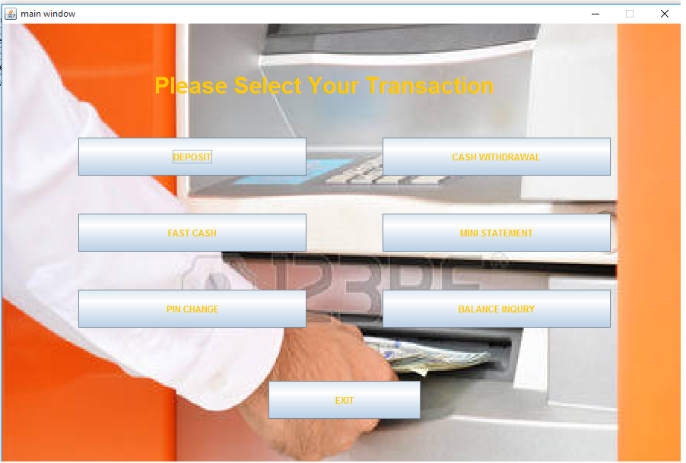
MAIN SCREEN

Slide 7
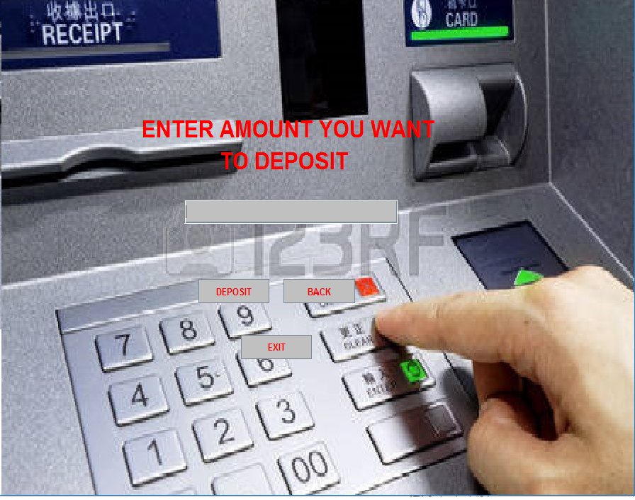
DEPOSIT
SCREEN

Slide 8
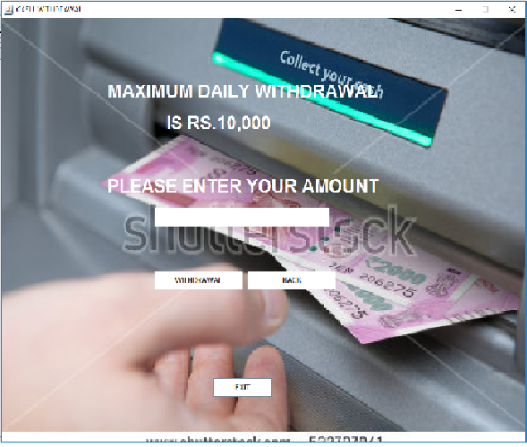
WITHDRAW
SCREEN

Slide 9
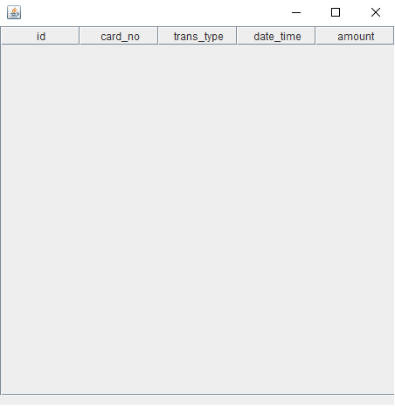
STATEMENT SCREEN

Slide 10
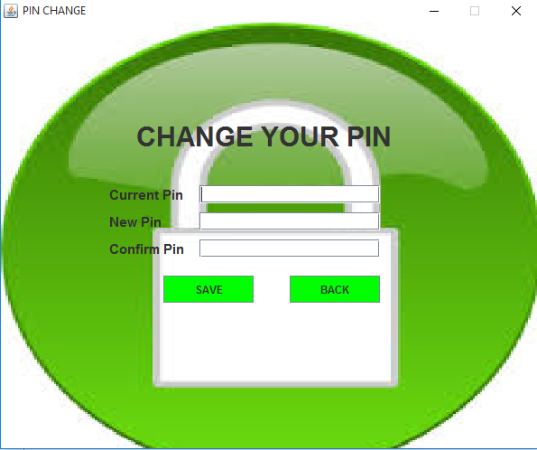
CHANGE PASSWORD

Slide 11
IMPLEMENTATION
As you just saw 7 frames have been made.
Basic controls such as textboxes, combo-boxes, buttons, password-field etc. are also added into the relevant panels.
All the required action listeners are defined.

Slide 12
TESTING
In the absence of advanced testing techniques, basic testing was performed.
For this purpose, a variety of records were entered and the software’s response was noticed.
Since the response was as expected, testing was taken to be successful.
Hence the project was completed.

Slide 13
THANK
YOU!!!
By Payush and Punit Kumar

