Slide 1
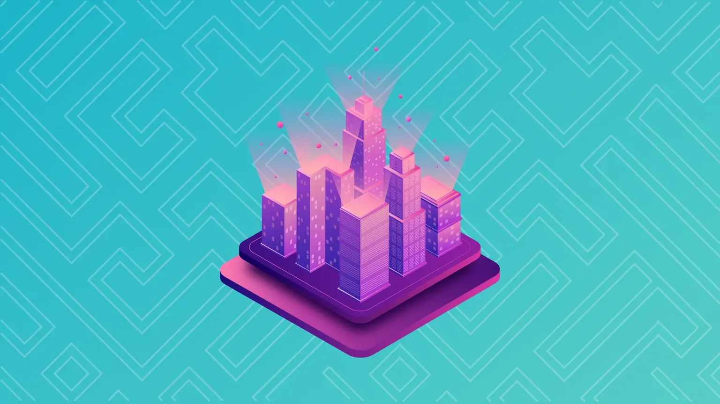
Meta Decentraland
Creators:
Paz Nahmias – 205560048
Ronen Saviz – 205688690
Teacher: Mr. Micha Barshap

Slide 2
No known bugs

Slide 3
Technologies
Express
Node.js
MongoDB
React
Ganache
Solidity
Metamask

Slide 4
Contracts
Token:
a contract that inherits from ERC20 of openzeppelin library, this contract creates 10000 PRC coins on deployment and stores them in the creators wallet. One token is worth 0.1 ether.
Contract functions:
getPrice() – returns the price of 1 token
buyTokens() – allows user to purchase tokens from the contract creator

Slide 5
Contracts
World:
a contract that inherits from ERC721 and Ownable of openzeppelin library, this contract defines a struct named Land which holds all our NTFs data, it uses the Token contract to transfer lands ownership by a fixed price determined in the Token contract.
Contract functions:
mint() – receives land data and checks if the sender is the contract owner and the land has not been minted. if this conditions are met, the contract will mint the land and set it to the lands mapping.
checkIfMinted() – receives a landId and checks if the land has been minted.
setLand() – after minting the land this function is called and set the land to the mapping.
getOwnerAddress() – receives a landId and returns the owner wallet address.

Slide 6
Contracts
Contract functions:
getWorldOwnerAddress() – returns contract owner wallet address.
getOwners() – returns an array of minted lands in the contract, this array holds all land data and owner address.
updateLandPrice() – receives a landId and a price and updates the new price if the sender is the owner and the price is positive.
transferLand() – receives a landId and a owner address, it checks if the sender is not the land owner. If this condition is met, the contract transfers tokens from the sender to the owner according to the land price and registers the new land owner in the mapping.

Slide 7
Install guide
Phase 1 – Ganache
Open Ganache and choose NEW WORKSPACE.
Enter a workspace name, press ADD PROJECT and choose truffle-config.js from the project directory.
Press SAVE WORKSPACE.
Phase 2 – Metamask
Open Metamask, go to settings -> Networks -> Add network.
On Network Name field, choose a name for the network.
On New RPC URL write http://127.0.0.1:7545.
On ChainID field write 1337.
Press SAVE.
Switch to our new defined network.

Slide 8
Install guide
Phase 3 – Import Ganache wallets to Metamask
Go to Ganache workspace and copy the MNEMONIC phrase.
In the Wallet Secret Recovery Phrase copy this phrase and choose a password for future logins.
Phase 4 – Contract compile and deploy
Open VSCode in the project directory.
Open a terminal.
Run npm run contract to install dependencies, compile and migrate contracts.
Phase 5 – Starting the project
Run npm run server to install server dependencies and start backend.
Open another terminal.
In the new terminal, run npm run client to install client dependencies and start frontend.

Slide 9
Use cases
Register and Login:
User enters landing page.
User fills information in form and registers/logins to website.
Server authenticates user and redirects to home page.
User can see world map and interacts with the contracts.
Guest use:
User click guest button on landing page.
Website redirects to home page but user can’t interacts with contracts and buy lands.
User can’t access wallet modal.

Slide 10
Use cases
PRC token purchase:
Login as a registered user.
Click wallet icon in the top navigation bar.
Choose an amount to purchase (1-1000).
Click buy PRC.
* A connected Metamask wallet is required.
Land mint:
Login as a registered user and connect the contract owner wallet.
Double click on a land.
Click mint.
* A connected Metamask wallet is required.

Slide 11
Use cases
Land purchase:
Login as a registered user.
Double click on a minted land.
Click buy.
* A connected Metamask wallet is required.
Update land data:
Login as a registered user.
Double click on a land u own.
Click edit.
Change desired fields (sale status, price, game).
Click confirm.
* If land data is updated the data will be written to the blockchain.

Slide 12
Enjoy!

