Slide 1
Sentiment Analysis of Airbnb Reviews to Inform Dynamic Pricing for Listings in Boston
Final Project
Zindua School
Kipkorir Pbartuiyot Biegon

Slide 2
Background
As of late 2023, Boston has approximately 5,500 active Airbnb listings, including both entire homes/apartments and private/shared rooms.
Airbnb guests depend on user reviews and listing details to gauge value, often willing to pay more for well-rated properties.
However, hosts don’t have clear guidance on which features, like location, amenities, or host responsiveness, affect guest satisfaction and pricing.

Slide 3
Problem Statement
Airbnb hosts in Boston struggle with setting the right prices, leading to either low occupancy due to high rates or lost revenue from underpricing.
Many listings lack visibility and fail to highlight unique features or proximity to local attractions, making them less competitive.
Hosts lack data-driven insights from guest reviews to understand what influences satisfaction and pricing, unlike hotels that benefit from brand reputation.

Slide 4
Dataset
The dataset used is from an insider website which provides datasets or short-stay rentals across major cities, which offers hosts to list their short-stay rental houses and also allows customers to leave reviews and ratings.
The following are characteristics of the data:
Listing Details: Title, property type (e.g., apartment, house), number of bedrooms/bathrooms, amenities (e.g., Wi-Fi, pool)
Pricing: Nightly rate, discounts, service fees
Location: County, city, or specific coordinates
Reviews: Ratings, number of reviews, guest comments
Host Information: Name, response rate, super-host status
Availability: Booked/unbooked dates.

Slide 5
Dataset Structure
1. Reviews Data : 63415 reviews on 4488 unique listings
2. Listings Data : 3585 listings with 95 attributes

Slide 6
Methodology
Data preprocessing and cleaning.
Sentiment analysis using NLP techniques.
Pricing model development using regression techniques.
Model validation and interpretation.
Deployment as a pricing tool for hosts.

Slide 7
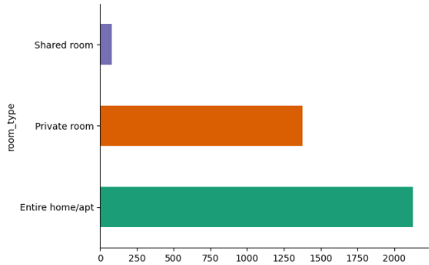
Exploratory Data Analysis

Slide 8
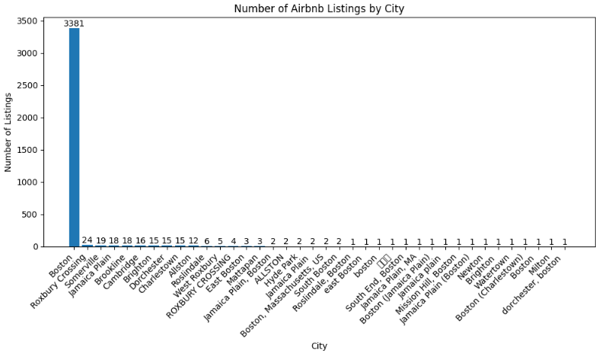
Number of Airbnb Listings by City

Slide 9
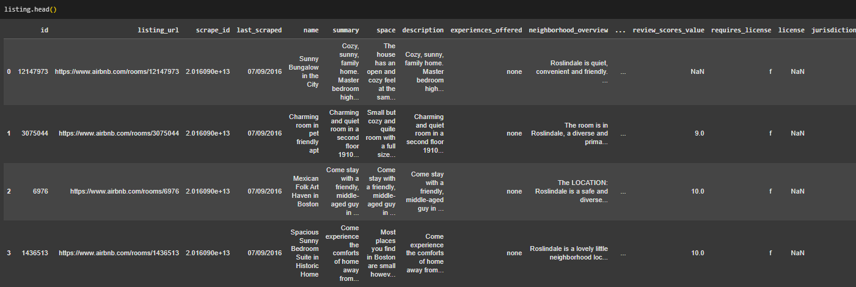
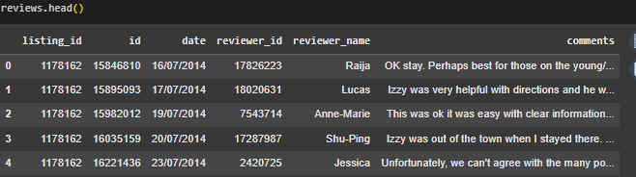
Sentiment Analysis on Reviews

Slide 10
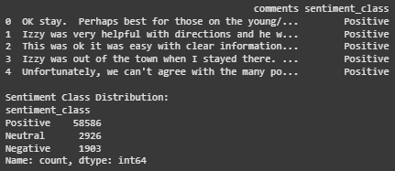
Classify reviews into positive or negative sentiments

Slide 11
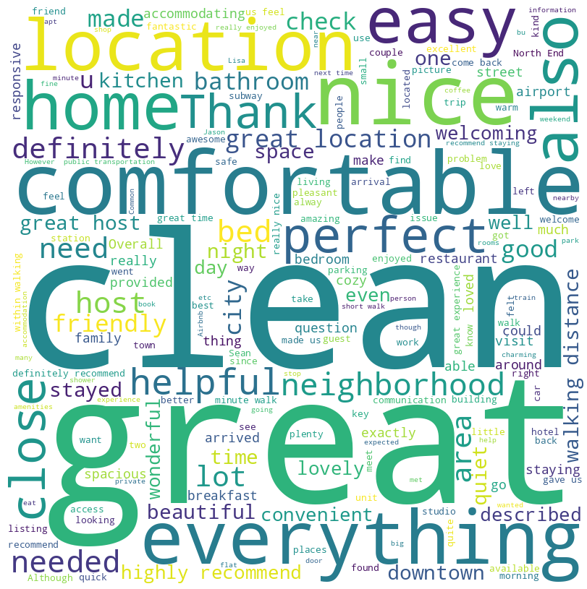
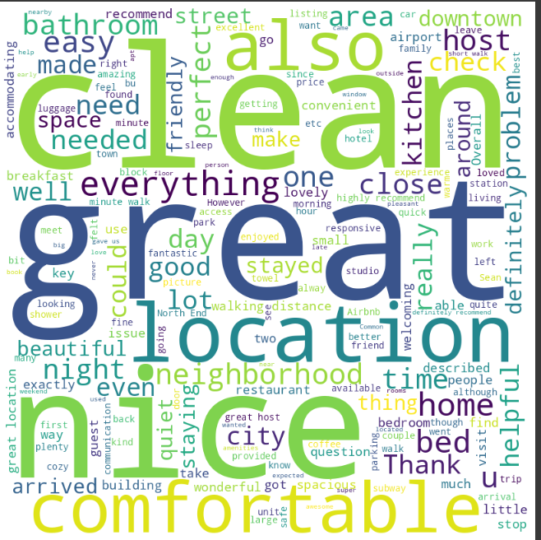
Customer Reviews: Word Cloud
Positive Reviews
Negative Reviews

Slide 12
Factors Behind Ratings

Slide 13
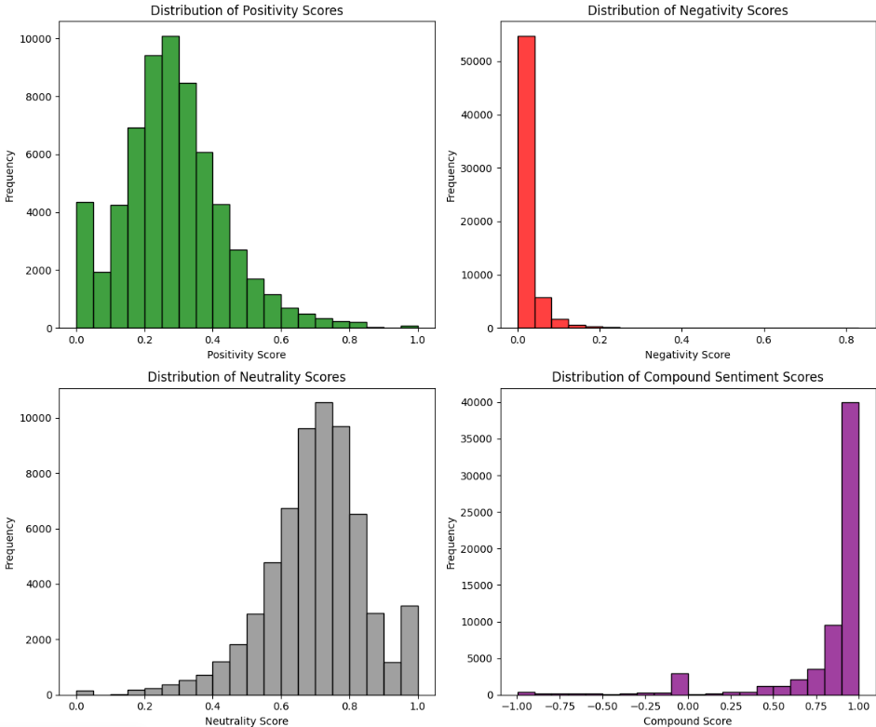
Comments Distribution

Slide 14
Thank You

