Slide 1
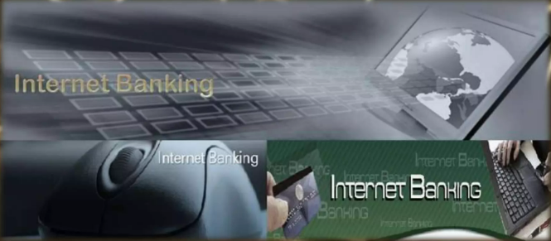
INTERNET BANKING SYSTEM
SUBMITTED BY TEAM 6

Slide 2
Content
1. Introduction to internet banking
What is internet banking
Development of e-commerce
2. Specific available features of internet banking
Uses of internet banking
Electronic information transfer system
Fully electronic transactional system

Slide 3
3. Features available in internet banking
Automated teller machine(ATM)
Different services provided under e-commerce
Services provided by SBI
4. Overall benefits of internet banking
Advantages of e-banking
Benefits from small to medium business
Benefits to customers
5. Disadvantages of internet banking
6. Security risks

Slide 4
7. Persecutions
Persecution for bank
Persecution for customer
8. Diagram requirements
Use case diagram
Entity relationship diagram

Slide 5
What is internet banking?
A system allowing individuals to perform banking activities at home, via the internet.
The automated delivery of new and traditional banking products and services directly to customers through electronic, interactive communication channels.
Some online banks are traditional banks which also offer online banking, while others are online only and have no physical presence

Slide 6
Development of e-banking
The concept of Internet banking has been simultaneously evolving with the development of the world wide web.
Programmers working on banking data bases came up with ideas for online banking transactions, some time during the1980’s.
The online shopping promoted the use of credit cards through Internet.
The first online banking service in United States was introduced, in October 1994.

Slide 7
Uses of internet banking
There is no interaction between the customer and bank's application system.
No identification of the customer is done.
In this system, there is no possibility of any unauthorized person2B62022 www.fotoserch.comgetting into production systems of the bank through internet.

Slide 8
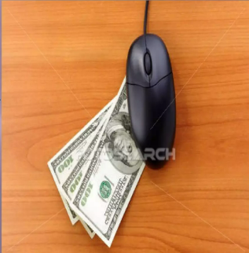
Electronic Information Transfer System
The system provides customer- specific information in the form of account balances , transaction details, and statement of accounts .
The information is still largely of the 'read only format. Identification and authentication of the customer is through password .
The information is fetched from the bank’s application system either in batch mode or off-line.

Slide 9
Fully Electronic Transactional System
Fully Electronic Transactional System -This system allows bi-directional capabilities .
Transactions can be submitted by the customer for online update .
This system requires high degree of security and control. In this environment, web server and application systems are linked over secure infrastructure .
It comprises technology covering computerization , networking and security, inter-bank payment gateway and legal infrastructure.

Slide 10
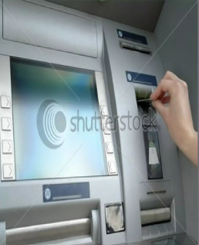
Automated Teller Machine(ATM)
ATM is designed to perform the most important function of bank.
It is operated by plastic card with its special features.
The plastic card is replacing cheque, personal attendance of the customer, banking hours restrictions and paper based verification.

Slide 11
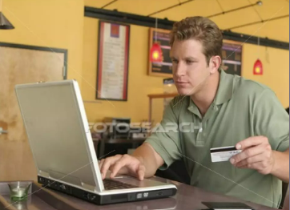
Different services provided under e-banking
ONLINE BILL PAYMENT
SHOPPING
TICKET B0OKING
PRE PAID MOBILE RECHARGE
INVESTMENT SERVICES
ONLINE APPLICATION

Slide 12
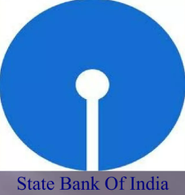
Service Provided By SBI
Self-account funds transfer across India .
Third party transfers in the same branch.
New account opening.
New Cheque-book request.
Railway tickets booking.
Utility bill payments. LIC and other insurance premium payments .

Slide 13
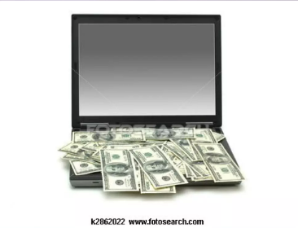
Advantages of E-banking
Benefits for Banks .
Benefits for Small to Medium Businesses .
Benefits for Customers.
No identification of the customer is done.

Slide 14
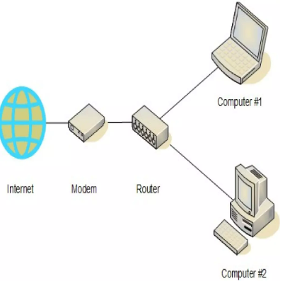
Benefits for Small to Medium Businesses
To run its operations more effectively.
Lower cost than traditional financial management mechanisms.
Increasing the customer satisfaction .
Providing a personalized relationship with customers.

Slide 15
Benefits for Customers
Convenience 24 hours a day, seven days a week .
Cost Reducing transfer fees .
Speed Faster circulation of assets.
Competitiveness - Fostering competition in financial market.
Communicate easily.
Abolishing the uses of paper.

Slide 16
Disadvantages OF E-banking
A need for customer skill to deal with computers and browsers.
Many people who are not comfortable with computers and the Internet, often find it difficult to use internet banking.
For beginners, internet banking is really time consuming.
In many instances, a simple mistake, like clicking a wrong button, may create a big problem.

Slide 17

Security Risk
Increasing number of fraudulent bank websites.
For Eg. A suspicious bank FRAUD website : www.sbionline.com Original bank website www.onlinesbi.com.
Fake emails purporting to be sent from banks.
Email send from Fraudulent bank Verify the personal information Guide customer enter the fraud link Disclosing their ATM card numbers and their passwords

Slide 18
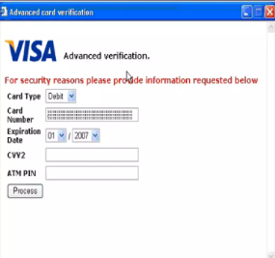
Persecutions For Bank
Should provide specific guidance to their customers.
Should take the adequate measures to ward off any problems related to the security of internet banking.
Online banking tutorials should be provided to help familiarize people with internet banking.

Slide 19
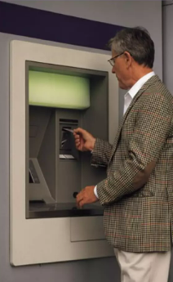
Persecutions For Customers
Should not disclose their customer IDs(eg, account numbers) or passwords to anyone else.
Periodically change their passwords.
Should promptly log out from the service.
Should regularly check their account balances and statements to identify unusual transactions.

Slide 20
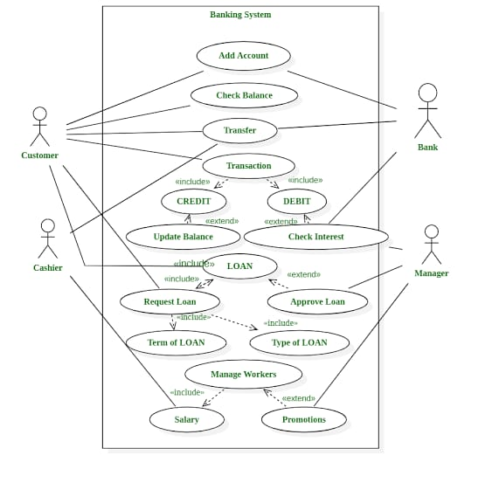
Use case diagram for internet banking system:

Slide 21
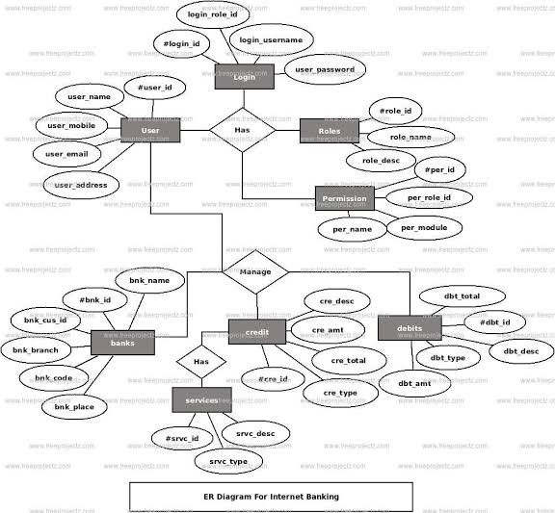
Entity relationship diagram for internet banking system:

Slide 22
THANK YOU
BY TEAM 6

