Slide 1
Groep2
Thom Overhand, Paul de Keijzer, Timo van Werkhoven, Stef Gelderblom, Marcel Bostelaar

Slide 2
Personal contributions
Timo: Database, navigation bar, wishlist
Stef: Login, registration, database, flowchart, logout, api, git-wizard
Thom: Css, html, flask, login, registration
Paul: Wishlist, database, searching, html+css, jquery
Marcel: Scrum master, architectual diagrams, presentations, searching items

Slide 3
The prototype
Searching for items
Logging in and registering
User wishlists

Slide 4
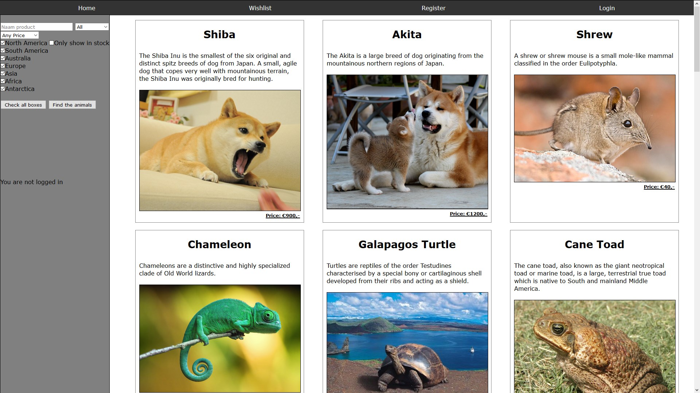
Screenshots
Homepage

Slide 5
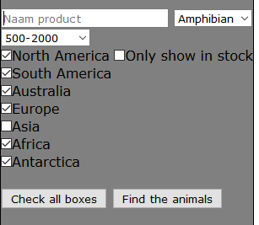
Searching

Slide 6
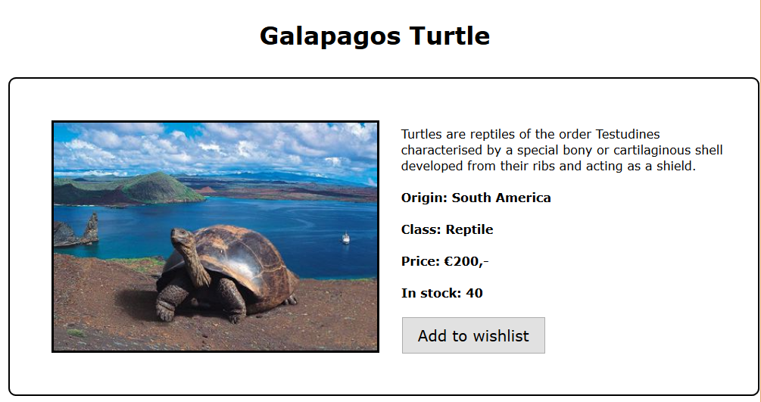
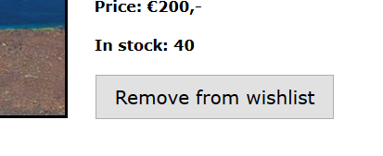
Product page

Slide 7
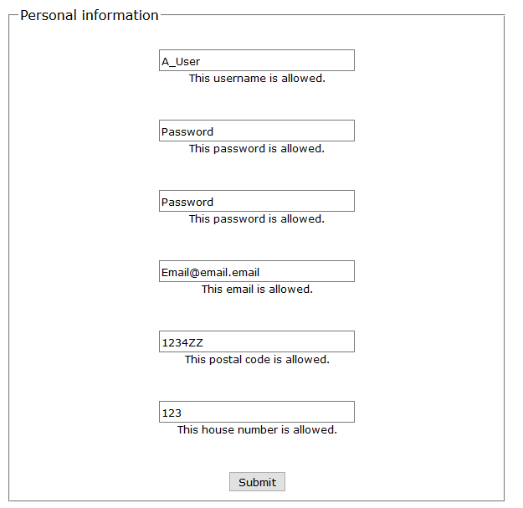
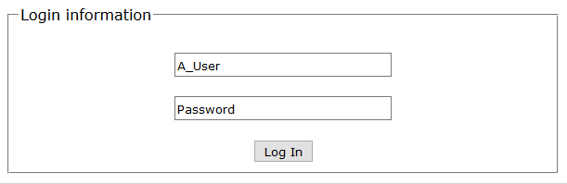
Registration and login

Slide 8
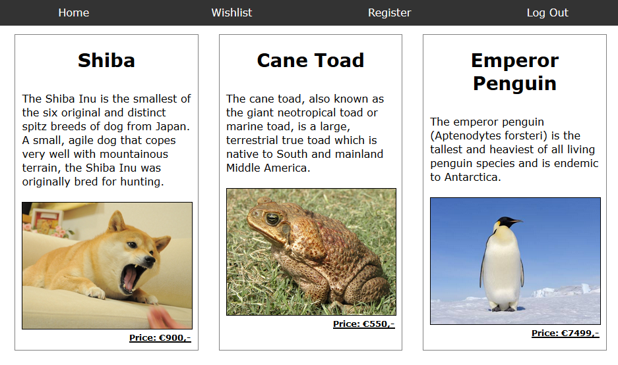
Wishlist

