Slide 1
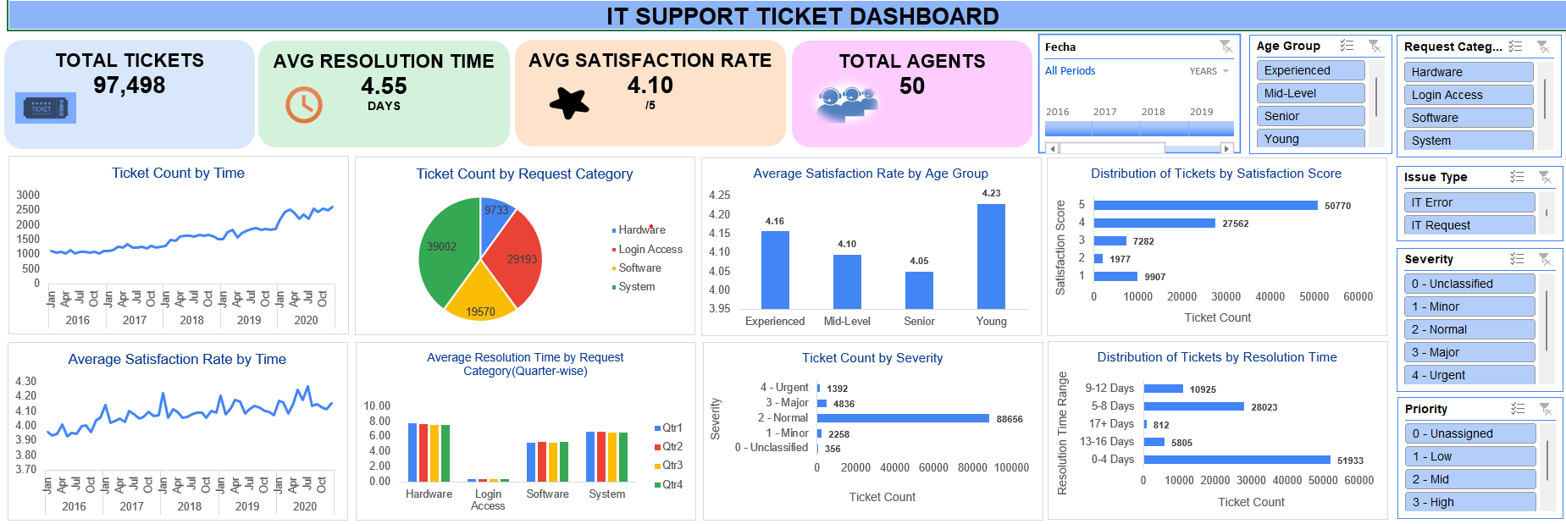
IT Support Ticket Analysis Performance Analysis of IT Support Operations Using Ticket Data
Presented By: Pratiksha Sanjay Bhadang
Institute: Newton School
Date: 05 July 2026

Slide 2
Agenda
1. Problem Statement
2. Project Objective
3. Data Overview
4. Key Metrics Overview
5. Data Analysis & Insights
6. Dashboard Overview
7. Recommendations
8. Conclusion

Slide 3

Problem Statement
IT support teams handle a large number of service requests and technical issues every day. Managing tickets efficiently is essential to ensure quick issue resolution and maintain high user satisfaction.
This analysis helps identify:
High ticket volume categories.
Delays in issue resolution.
Difficulty in prioritizing urgent issues.
Maintaining customer satisfaction.
Goal:
Identify problem areas and improve IT support efficiency.

Slide 4

Project Objective
Understand ticket patterns/trend.
Evaluate support team performance.
Identify cause of delay.
Measure customer satisfaction.
Suggest improvement.

Slide 5

Data Overview
Metric | Value
Total Tickets | 97489
Total Agents | 50
Total Columns | 12
Ticket Information:
1. IT Ticket
2. Fecha
3. Employee ID
4. Agent ID
Issue Details:
5.Request Category
6. Issue Type
7. Severity
8. Priority
Performance Metrics:
9. Resolution Time
10. Satisfaction Rate
11. Severity Score
Agent Details:
12. Age Name
The dataset contains IT support ticket records, including ticket details, issue categories, resolution time, and customer satisfaction metrics.

Slide 6




Key Metric Overview
TOTAL TICKETS
97,498
AVG RESOLUTION TIME
4.55
DAYS
AVG SATISFACTION RATE
4.10
/5
TOTAL AGENTS
50
Insights:
High ticket volume handled efficiently.
Resolution time is moderate.
Customer satisfaction is good.

Slide 7
Data Analysis & Insights
Tickets By Request Category:
Insights-
System category has highest ticket volume.
Software and Login Access follow.
Hardware has lowest ticket volume.

Slide 8
Data Analysis & Insights
2. Tickets By Issue Type:
IT Request: 73,220
IT Error: 24,278
Insights-
IT Requests dominate support workload.
Errors are lower compared to requests.

Slide 9
Data Analysis & Insights
3. Tickets By Severity:
Insights-
Normal severity dominates with 88,656 tickets.
Urgent tickets are minimal.
Most issues are routine operational requests.

Slide 10
Data Analysis & Insights
4. Tickets By Priority:
Insights-
High priority tickets form a major portion.
Low and mid priority also significant.
Unassigned tickets require monitoring.

Slide 11
Data Analysis & Insights
5. Resolution Time By Severity:
Insights-
Normal severity takes longest (4.66 days).
Urgent issues resolved fastest (2 days).
Critical issues are handled efficiently.

Slide 12
Data Analysis & Insights
6. Satisfaction Rate By Severity:
Insights-
Satisfaction remains stable across severity levels.
Ratings are consistently around 4.1.
Overall customer experience is positive.

Slide 13
Data Analysis & Insights
7. Age Group Analysis:
Insights-
Senior users generate most tickets.
Young users generate fewer tickets.
Ticket behavior varies by age group.

Slide 14
Data Analysis & Insights
8. Resolution Time By Request Category:
Insights-
Hardware requests take longest (7.63 days).
System issues also take longer.
Login access resolved fastest (0.31 days).

Slide 15
Dashboard Overview

Slide 16
Recommendations
Increase staff during peak hours: High ticket volume during busy periods can delay issue resolution. Adding more support staff can reduce workload and improve response time.
Improve hardware support service: Hardware-related tickets take longer to resolve. Improving hardware support processes can help reduce delays.
Automate common login issues: Many login/access issues are repetitive. Automation can solve these quickly and reduce manual effort.
Resolve system issues faster: System-related tickets are the highest in volume. Faster resolution can improve overall support efficiency.
Monitor unassigned tickets regularly: Unassigned tickets may lead to delays. Regular monitoring ensures all tickets are addressed on time.

Slide 17
Conclusion
The IT support team handles a high volume of tickets effectively while maintaining good customer satisfaction.
However, system and hardware-related issues require focused improvement to reduce resolution time and improve efficiency.
Data-driven decision making can further enhance support performance.

Slide 18
Thank You !

